Slide 1


presented by
BREAKING THE CYCLE OF POVERTY IN THE DALLAS COMMUNITY
Aeron Brown – Matthew Cocco – Jan Laenge - Hieu Nguyen – Alexandra Trevino

Slide 3
Did you know?
Dallas has the
3rd highest
poverty rate
2 out of 5 kids grow up poor in Dallas
2 out of 3 non-college youth thought they would attend higher education
Between 2000 and 2012 the number of poor people rose 41%

Slide 4
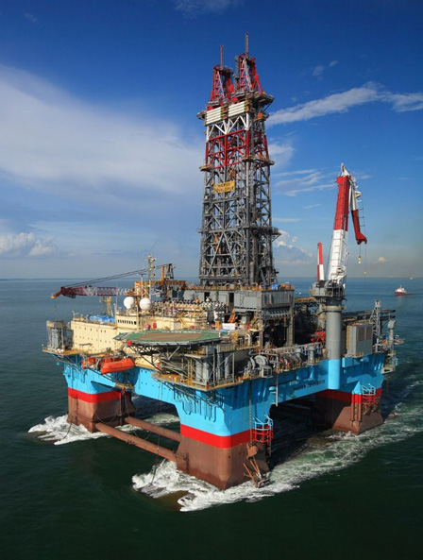

We are
#2 on Fortune 500
Primary in Oil and Gas
Sustainability,
locally focused

Slide 5
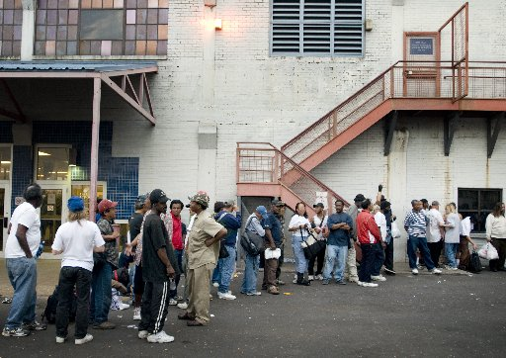
Poverty.
Cyclical
Causes and effects
Day Resource Center

Slide 6
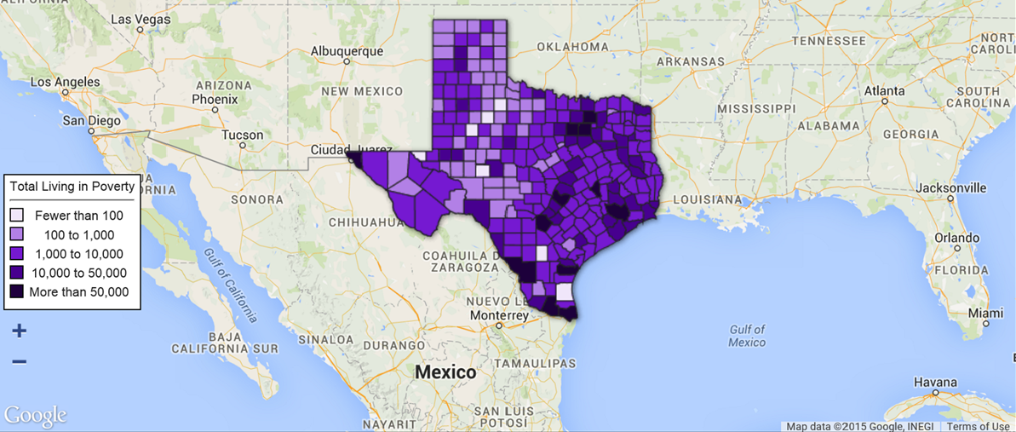

Slide 7
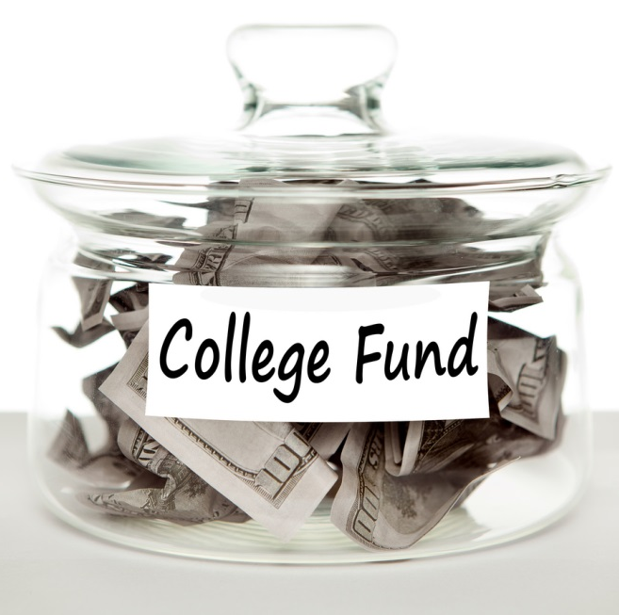
Education.
High barriers to entry
Exorbitant costs
Rapid price increases
Lifts people out of poverty

Slide 8
Scholarship.
2-year college degree or trade school
For individuals below poverty line
Life-changing potential

Slide 9

Endowment.
$250 MM initial endowment
Sends 1500 to college
and vocational-tech,
every year

Slide 10
Who’s eligible?
High school grads / GED-holders
No entry GPA requirements
Must meet income specifications

Slide 11
Applications.
Paper and electronic submission
As many applicants as possible,
accepted – pending board review
live demo of electronic application at http://mxdev.3owl.com/getfunded

Slide 12
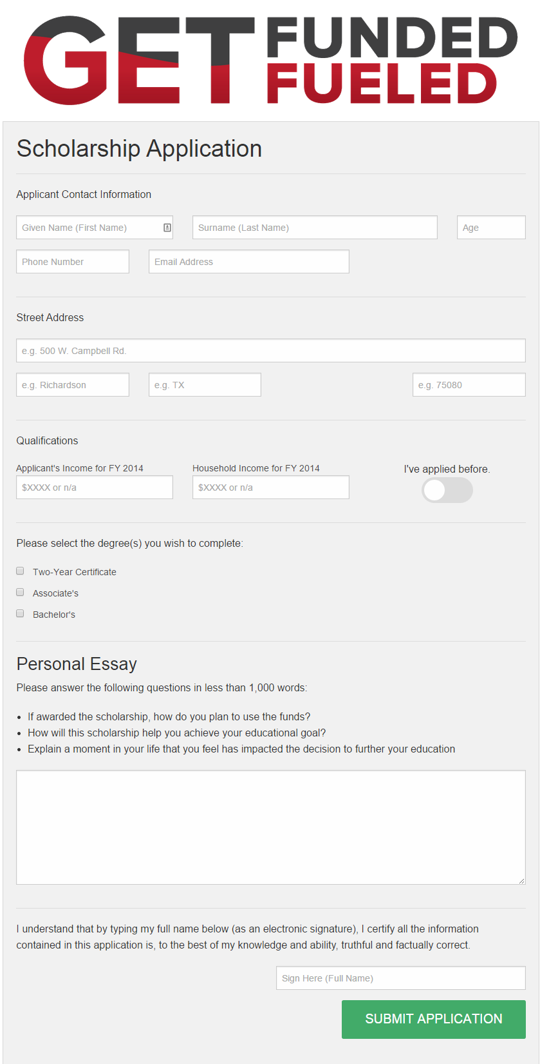

Slide 13
Goals.
85% new graduates per year
$30MM value added to local economy
Networking to facilitate employment

Slide 14
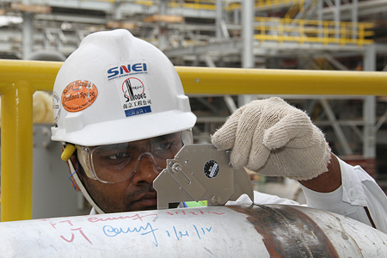
Case Study: Welding
$708 per Semester
Welding Inspector
Cert: $1,065
Median salary: $67,222 (DFW: $57,398)
  …can grow to $100,000

Slide 15
Benefits.
Growing workforce in the DFW area.
Reducing entitlement usage.
Satisfying the Chamber’s #2 Goal

Slide 16
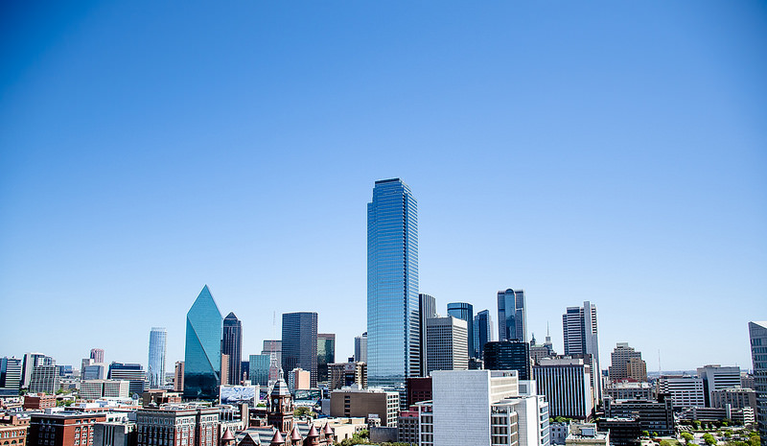
We need your help.
Network
Knowledge
Committee

Slide 17
presented by
BREAKING THE CYCLE OF POVERTY IN THE DALLAS COMMUNITY
Aeron Brown – Matthew Cocco – Jan Laenge - Hieu Nguyen – Alexandra Trevino

