Slide 1
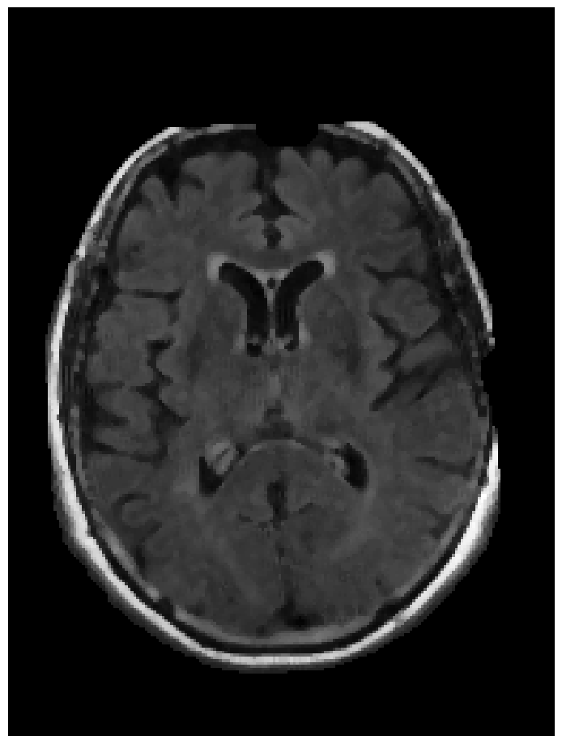
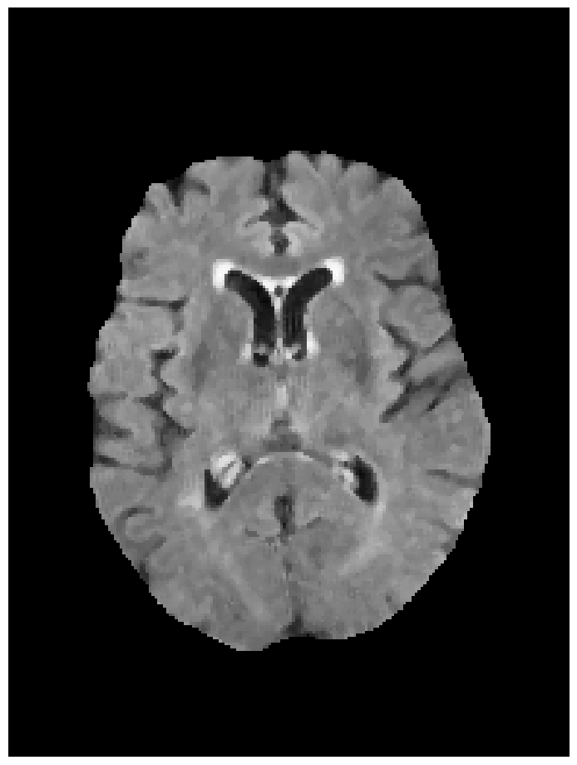
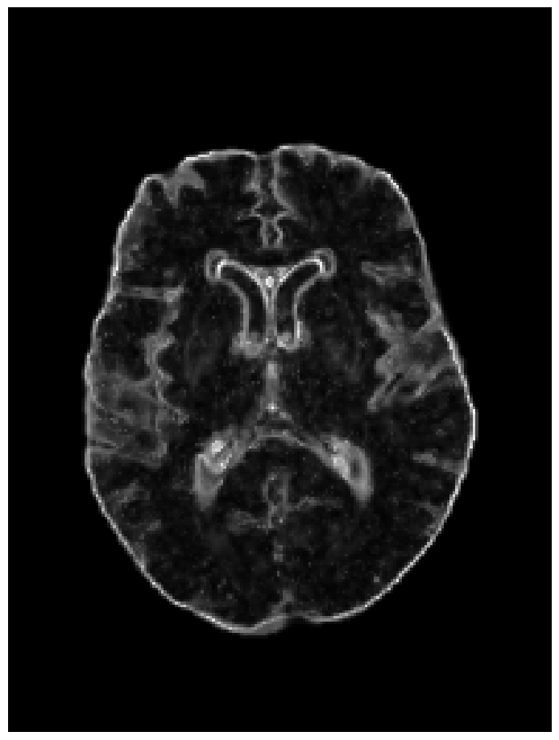
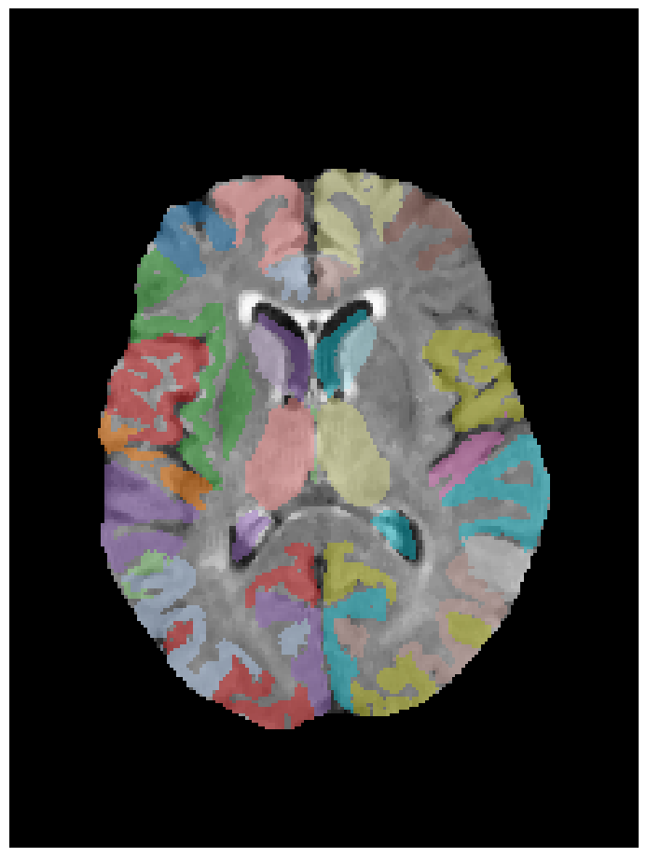
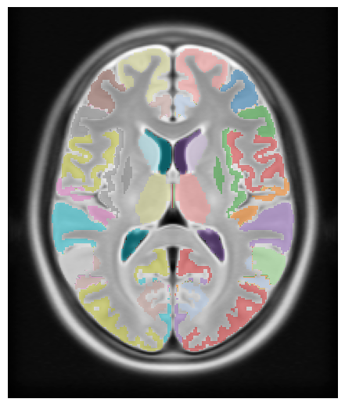
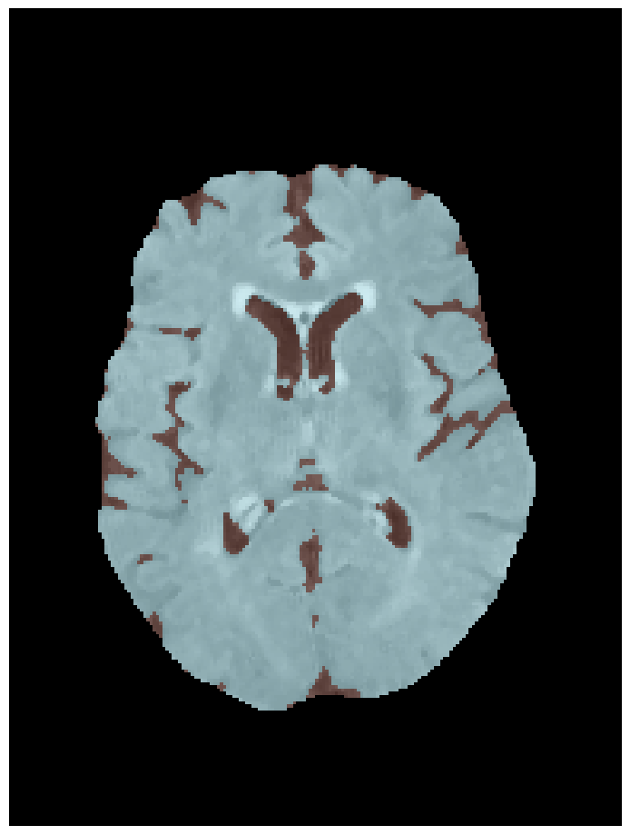
Skull strip CNN
MAD calculation
Standardized FLAIR
Skullstripped FLAIR
MAD texturemap
Registration
CerebrA “False FLAIR” + labels + CerebrA CSF
FLAIR-based labels
CSF segmentation

Slide 2
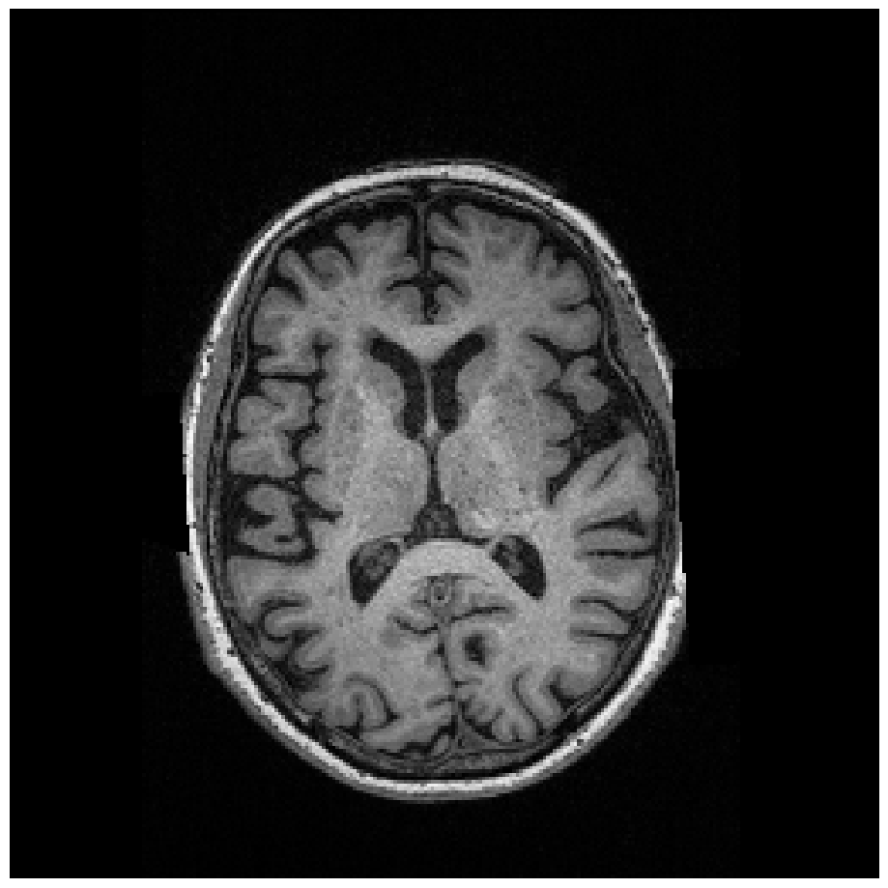
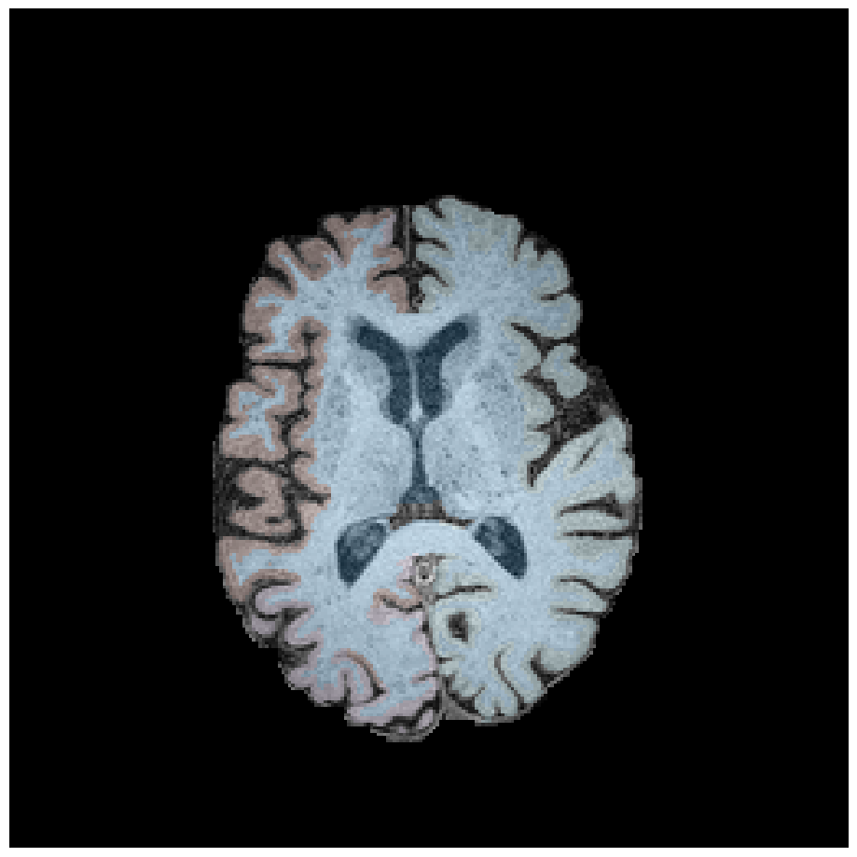
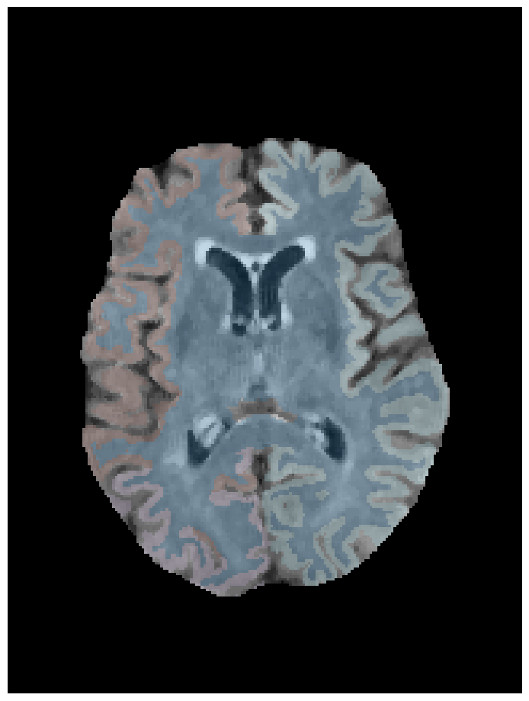
FastSurfer
Registration
Raw T1
Skullstripped T1+T1 labels
T1-based FLAIR labels
Skullstripped FLAIR (from FLAIR pipeline)

