Slide 1
Mt. Zion Marketing Ministry
Notes:
This overview is to provide you with general information about the Marketing Ministry and the services we can provide.

Slide 2
MINISTRY PURPOSE
To promote church activities with creativity while keeping the church vision and mission statement as our center of focus.
Creating products that will excite and peak the interest of the target audience.
Working closely with Special Events and other ministries as needed to be prepared to market church events.

Slide 3
AREAS OF MARKETING
Media
Website
Flyers
Newsletter
Notes:
These are the areas that we be working. With some notice we can also assist with other things as needed (presentations, invitations, etc.)

Slide 4




RADIO
Notes:
Depending on the event and the audience, we can use the local gospel and secular stations to get our event publicized. All stations offer a community event section on their website and they will occasionally highlight certain events on the air free of charge.

Slide 5

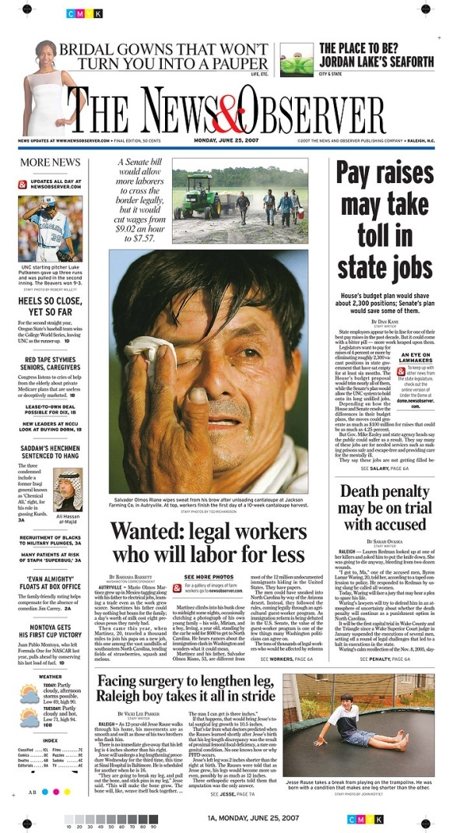



NEWSPAPER
Notes:
These are the five newspapers that we have identified as an avenue for getting information out on events that would be open to the community.

Slide 6

WEBSITE
Notes:
Marketing will work with the IT Ministry to assist them in keeping the website current.

Slide 7
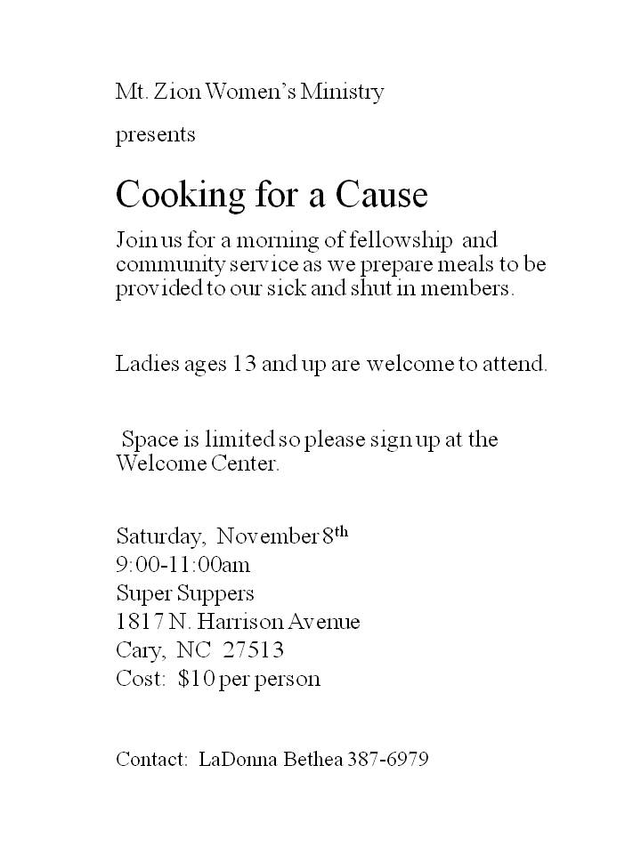

FLYERS
Notes:
The pictures in this page show the difference in the normal flyer and one that the Marketing Ministry was allowed to spruce up. None of the content was changed. The only thing that was done was making the flyer more appealing to the eye.

Slide 8
NEWSLETTER
SECTIONS
  Pastor’s Corner
  First Lady’s Section
  Special Achievements
  Business Directory
  Ministry Highlight
  New member Spotlight
  Children’s/Youth Page
  Upcoming Events/Community News
  List of Ministries
  Meet the Staff
  Recipe Corner
  Blessed Events
Notes:
Newsletter sections. Every Newsletter will not necessarily contain every section. It will be based on submissions received.

Slide 9
GUIDELINES FOR SUBMISSIONS
Flyers
  Two weeks prior to deadline for announcement submission.
Radio and newspaper
  Thirty days prior to event date
Newsletter
  Announcement will be made each quarter for the upcoming deadline.
  Will fall approximately two months prior to the church family meeting (i.e. the April 27th newsletter will have a submission cutoff of March 8th.
  This allows us a month to work on the content to submit to the Elders, and then a month for their suggestions/edits and getting the final version ready for the website.
Notes:
All projects will go through Elder Bullock for final approval before being posted online, radio or in newspapers. We will use the list of approved events for the year as a guideline to know what is ok to begin working on when we receive the requests.

Slide 10
CONTACTING THE MINISTRY
In our event to streamline the submission process, all requests should be made to the ministry through the link on the church website or to marketing@mtzionmb.org
Request received from Ministry
Marketing does work
Send to Elder for final approval
Approved product returned to ministry
Notes:
The version that will be returned to them will be in read only format.

