Slide 1


Slide 2
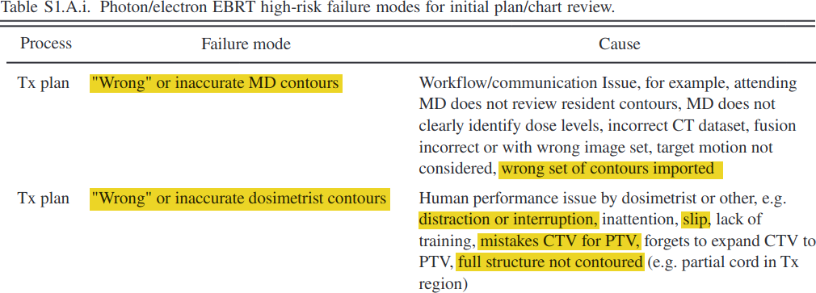
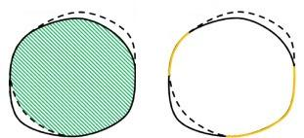
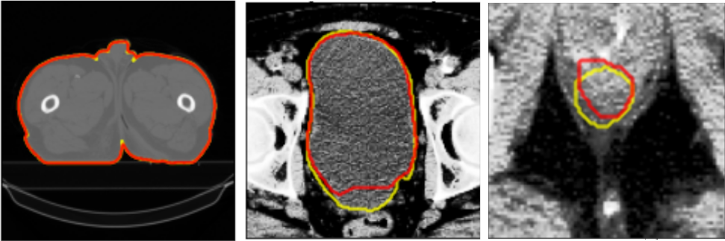
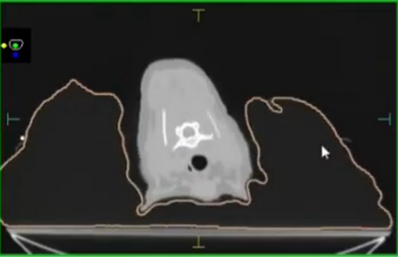
Volumetric
Dice
Surface
Dice
Ford et al. TG-275. Med Phys 2020;47:6 (Redrawn)
Vaassen et al. Phys Img Rad Onc. 2020;13:1-6 (Redrawn)
Patient
Bladder
Rectum
Truth
Model
Prostate QA model: Average contour representations
Canine vacuum bag model: Clinical case on Monaco TPS

