Slide 1
Two steps forward? Making accessibility easier.
Matthew Deeprose
Senior Learning Designer
University of Southampton
Notes:
Hi everyone, I’m Matthew Deeprose from the University of Southampton.

Slide 2
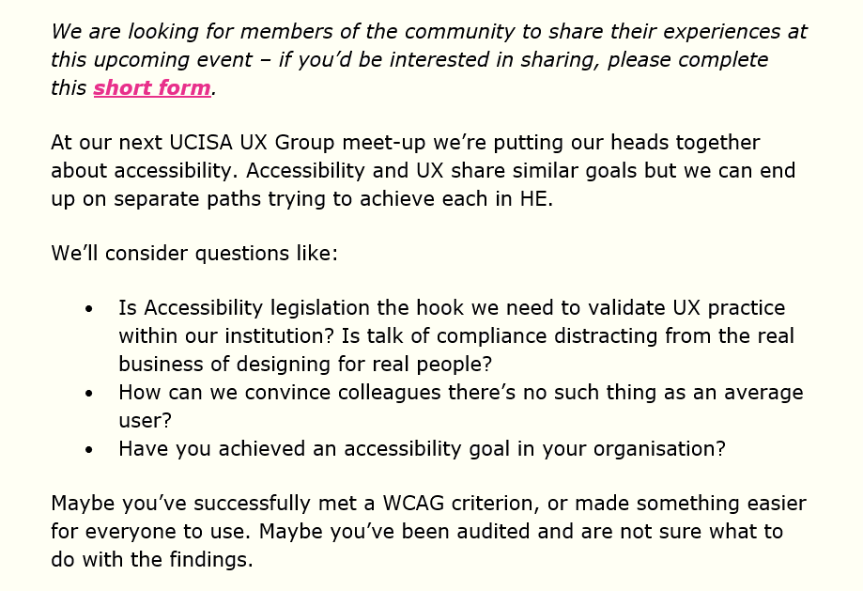
Introduction
Notes:
I expect most of you received this email from the UCISA-UX team about this meeting.
I noticed this question “maybe you’ve made something easier for everyone to use”, so…

Slide 3


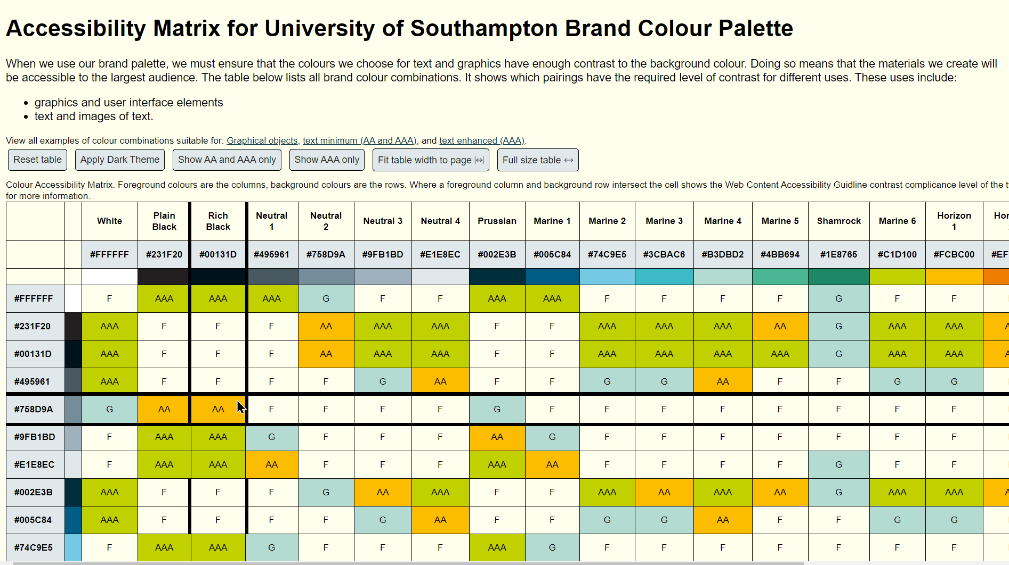
Two topics, five minutes
Brand colour contrast made easy
Accessibility inspector for everyone
Notes:
I’m going to share two topics in the next five minutes, making accessible use of a brand colour scheme easier, and removing friction from the accessibility check process in Office.

Slide 4
Brand colour contrast made easy
Notes:
Starting with “Brand colour contrast made easy”

Slide 5
What’s the most persistent accessibility issue?
* WebAIM Million 2022
Notes:
I’m assuming most of you will know about all about colour contrast and accessibility, but just in case…
[progress]
In the WebAIM survey of a million web pages, the most persistent accessibility issue
was low contrast text. What do we mean by that?

Slide 6
Colour Contrast?
Hard to read
Hard to read
Hard to read
1.64:1
1.84:1
1.19:1
Hard to read?
Hard to read?
Hard to read?
2.71:1
4:1
2.96:1
Easy to read
Easy to read
Easy to read
21:1
15.27:1
7.58:1
Notes:
Here I’m sharing nine boxes in rows of three. Each box has a different coloured background and white or black text.
[progress]
The top row is harder to read because the colour of the text has LOW contrast to the background colour.
[progress]
The bottom row is easier to read. The text colour has higher contrast with the background colour.
[progress]
What about this middle row? Some might find it easy to read, some may disagree? How do we know how much contrast is sufficient?
The web content accessibility guidelines, which I’ll shorten to WCAG, provide a calculation for assessing colour contrast. The result is a ratio, the higher the number the better.
[progress]
I’ve revealed the contrast ratios for these boxes. The top row are all low numbers below 2:1 those would all fail. The bottom row are all high numbers, all are over 7:1 and would pass because they go beyond the minimum level of contrast.
The middle row are all 4 to one or lower. Those would all FAIL the minimum contrast ratio for the presentation of text.

Slide 7
Contrast in WCAG
3:1
7:1
(not to scale)
Minimum for Text
AA
AAA
Minimum for Graphical Objects / UI
4.5:1
Enhanced level for Text
1.4.11 Non-text Contrast (Level AA)
1.4.3 Contrast (Minimum) (Level AA)
1.4.6 Contrast (Enhanced) (Level AAA):
2.4.11 Focus Appearance (Minimum)
2.4.12 Focus Appearance (Enhanced)
Notes:
The web content accessibility guidelines state that a contrast ratio of 3:1 is the minimum level of contrast for graphical objects like icons.
[progress]
A contrast level of 4.5:1 is the minimum for text
[progress]
7:1 and higher is the minimum for text when we want to reach the AAA level of accessibility.
For someone new to accessibility, this can seem a bit intimidating, if someone just wants to use our brand colour palette, how can they make accessible choices easily?

Slide 8
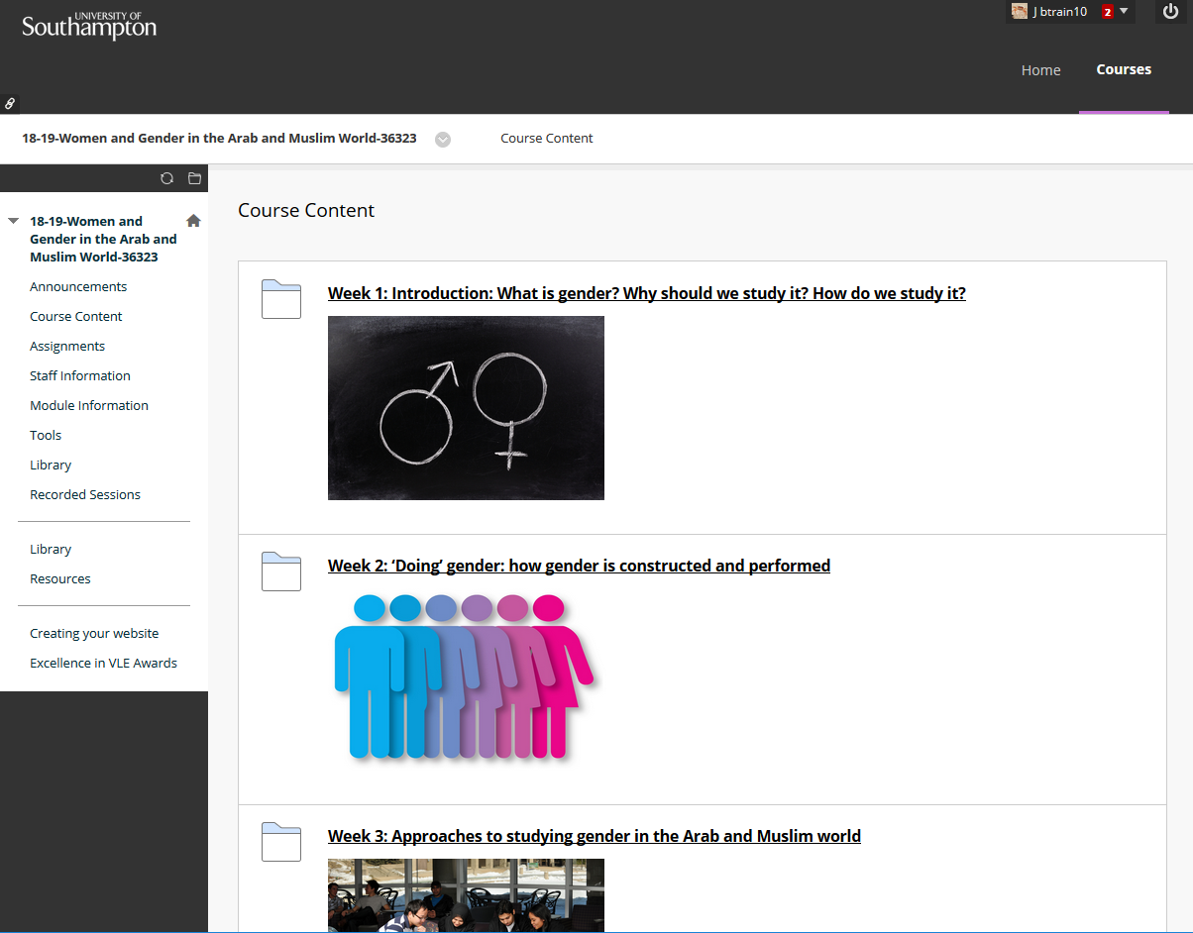
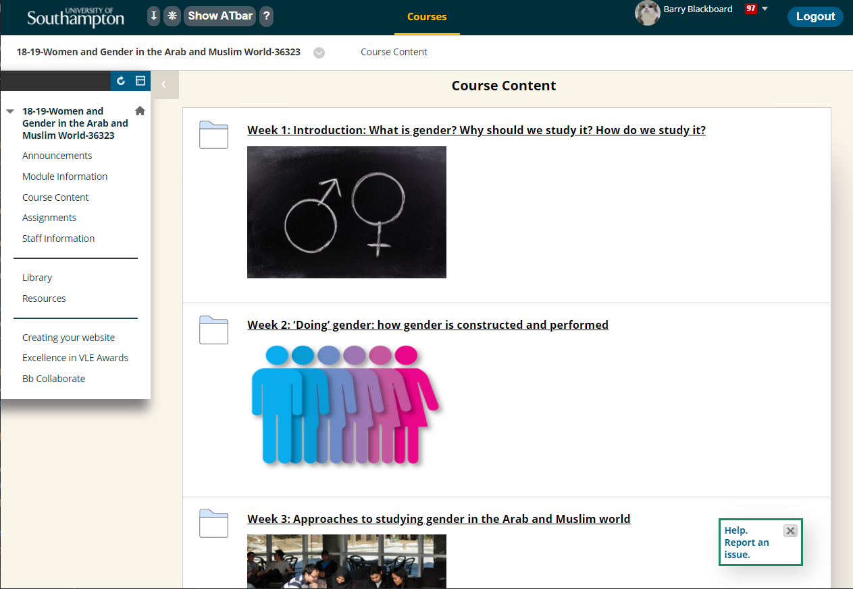
Updating our VLE theme
Notes:
That’s a question I was asking myself in spring 2019 when I was updating our institutional virtual learning environment blackboard
[progress]
to use our corporate brand colour scheme. In almost 2000 lines of CSS I had about 300 colour statements. That included things like focus indicators, hover states and so on.

Slide 9
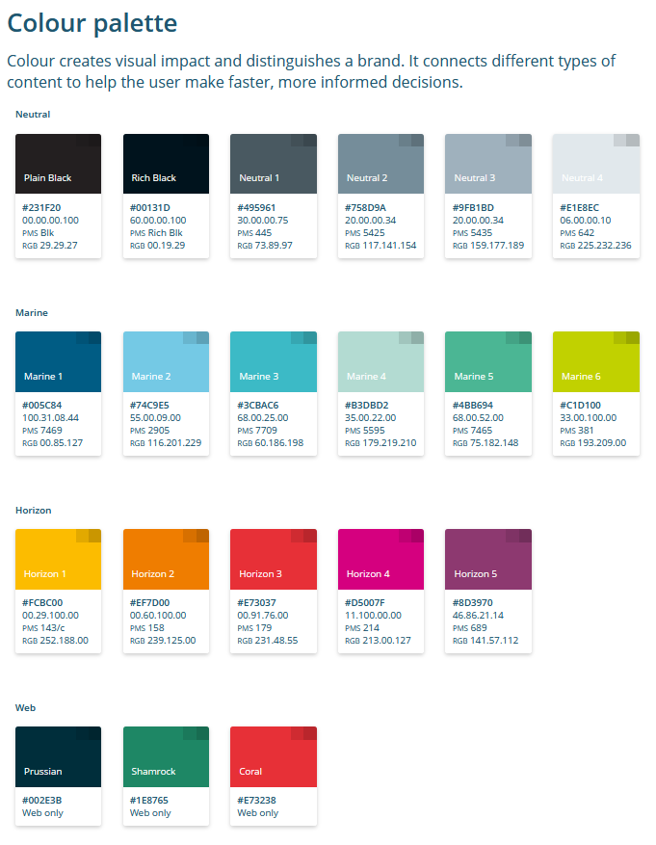
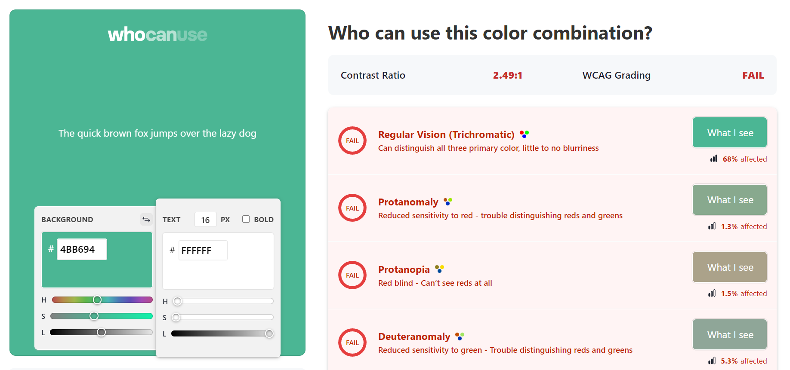
The manual process
whocanuse.com
Notes:
I was regularly going between our brand palette
[progress]
and a contrast checker. My favourite is who can use.com.

Slide 10
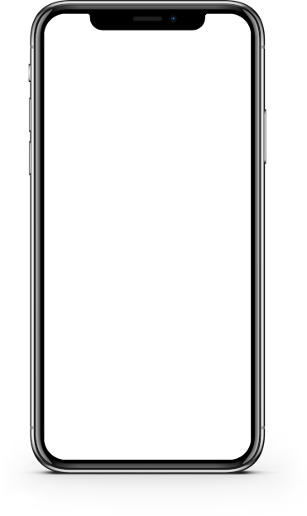
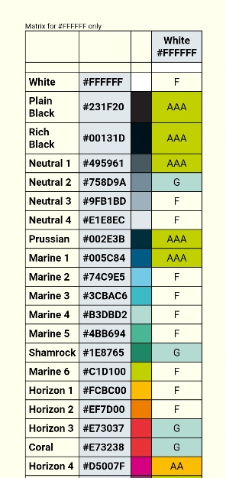
Creating a look up table
Notes:
So after the umpteenth colour contrast check, I wrote a script which took all of the 441 colour combinations of our brand and checked them for contrast. Initially the result was a spreadsheet, but I developed it further into a responsive web page. This meant I had a look up table to check colours easily

Slide 11
Example
Notes:
To zoom in and give you a clear understanding. The same colours are in the same order for both the horizontal and vertical axes. Where two colours meet the table shows F, if it fails all contrast criteria. G means it can only be used for graphical objects, AA means that as well as graphical objects it can be used for text, but only at the minimum AA level, and AAA means it can be used for text at the enhanced level, as well as for graphical objects.

Slide 12
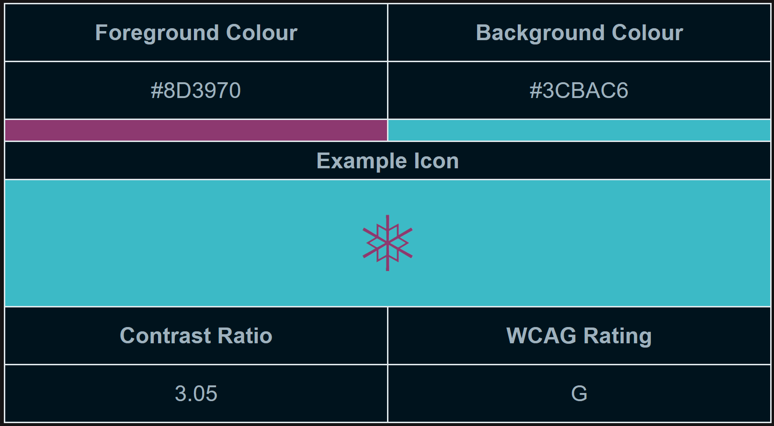
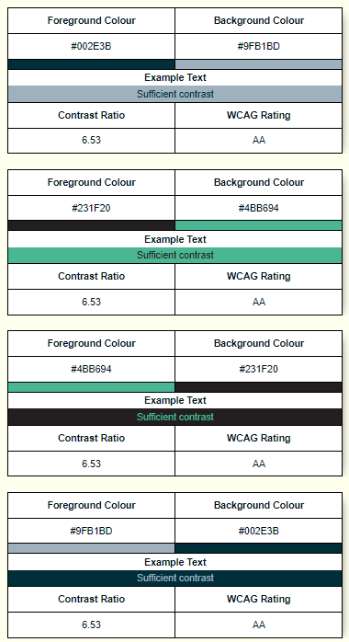
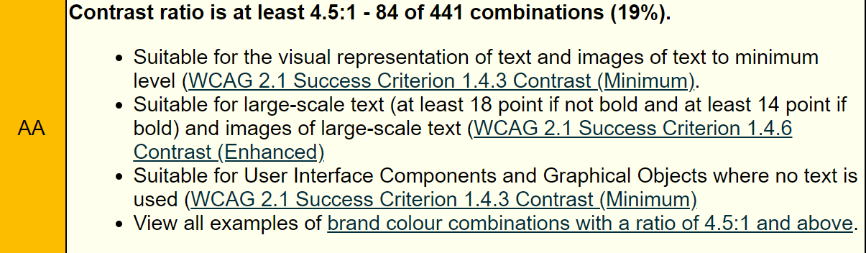
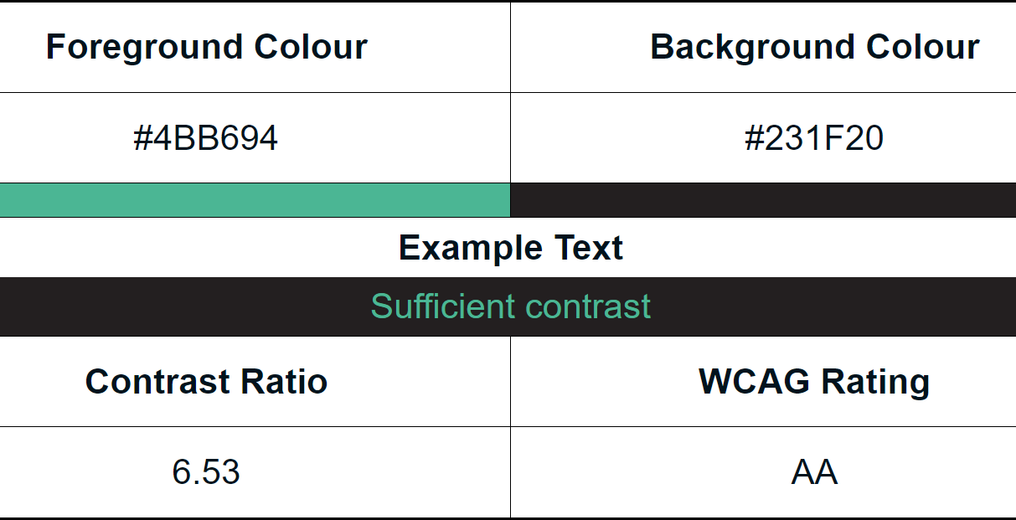
Developments based on user-feedback
Notes:
I shared with colleagues who started using it and giving feedback. One shared that it was all well and good to know what combinations you could use, but it would be nice to browse through the accessible combinations and see how they look. So I developed the script further to produce examples of every “on-brand” accessible colour combination.
[progess]
Here’s a larger example so you can see it has the colour details, contrast ratio and an example of how it looks. One example shows a graphic icon, the other shows text. These screenshots also show that I implemented both dark and light themes.
[progress]
I also added a little bit of info like how many combinations from our brand palette were accessible when used together. For example only 19% of colour combinations of our brand can be used for text. Obviously our palette was not designed with accessibility in mind.

Slide 13
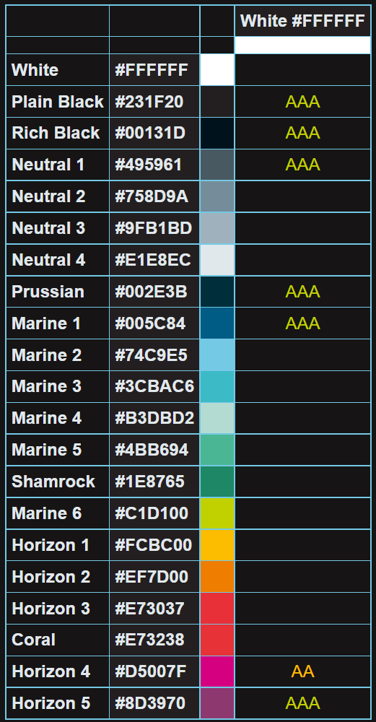
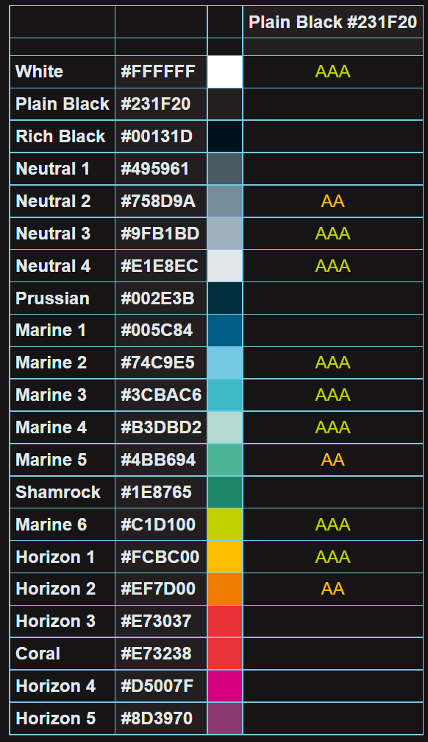
Insights
Sufficient contrast with a white background:
7 brand colours.
Sufficient contrast with a black background:
11 brand colours.
Notes:
It helped me find some insights.
Only 7 colours in our brand have sufficient contrast with white, and two are different shades of black!
Whereas with black I can use 11 other colours, and they are much more fun colours like orange, green, yellow and cyan, compared with the dark blue and magenta I can use with white.

Slide 14
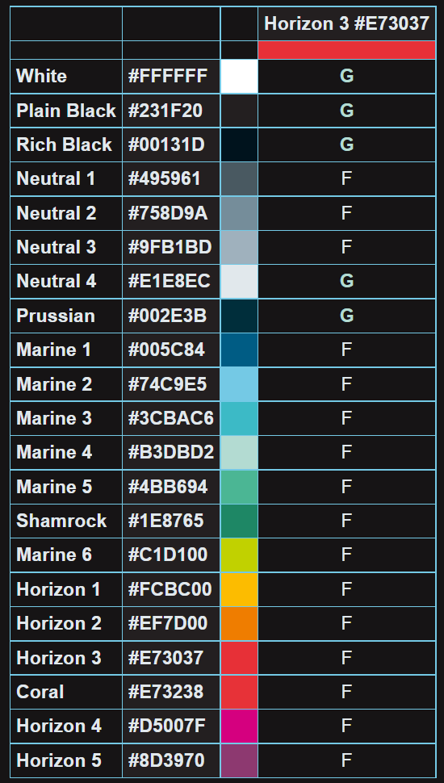
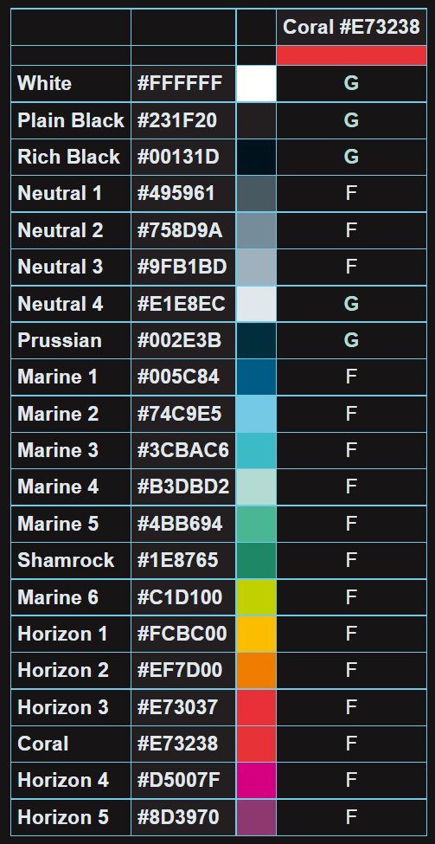
Insights 2
Notes:
It also highlighted that two colours in our brand cannot be used for text whatsoever! Only graphical objects.

Slide 15

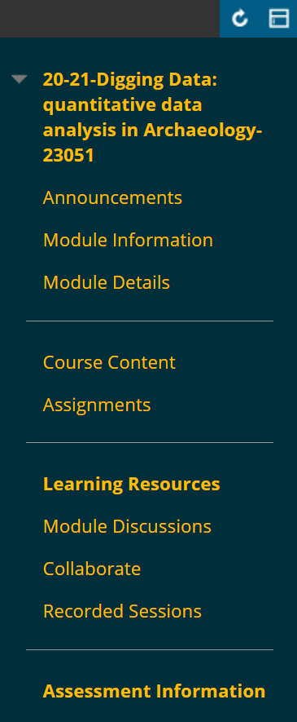
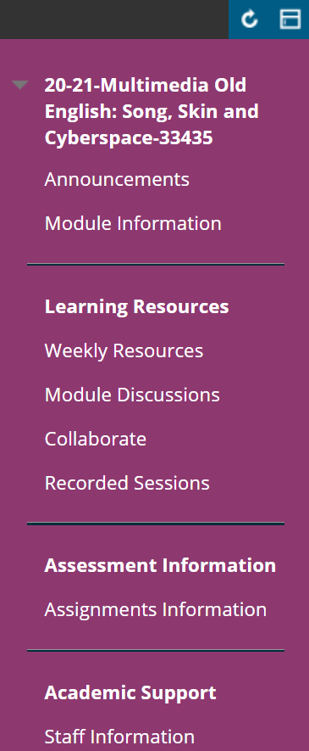
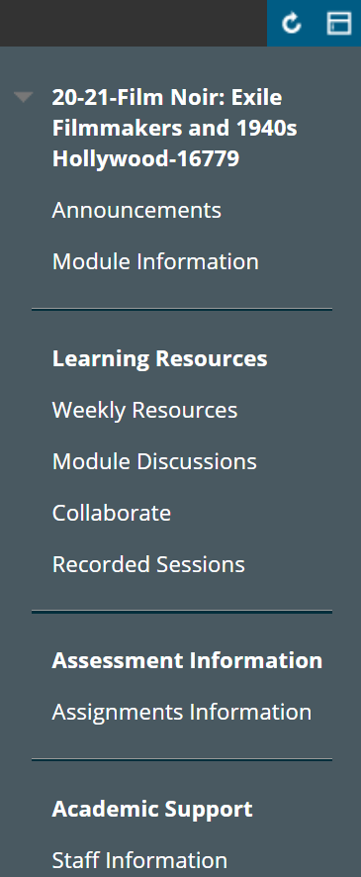
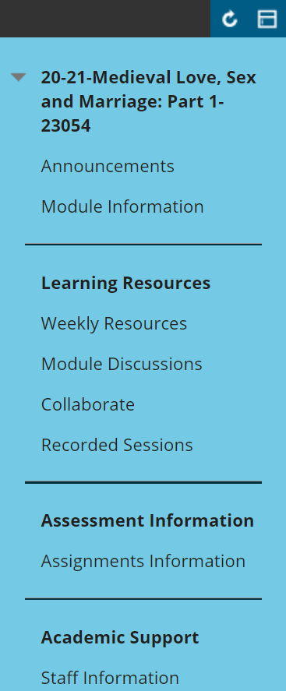
Real world usage
Email warning
Request from Humanities faculty to have course templates with consistent, accessible colour schemes across each subject area.
Archaeology
English
Film
History
Notes:
While I’ve had good feedback from colleagues I can’t point at much real world usage,
[progress]
one examples I can share are we had a security warning on our emails it looked like this and it received negative feedback. The team asked me for some assistance and
[progress]
Chose a colour combination from the look up table that was both on brand and accessible.
[progress]
Another example is our Humanities faculty wanted consistent Blackboard menus across their schools. They used the look up table to choose colours that were both on brand and accessible.

Slide 16
Want a matrix for your colour palette?
Let me know:
The HTML colour codes of your brand, in the order in which you would like them to appear.
Remember to include white.
If you have ‘names’ for your colours include them, use comma separation.
Email them to Matt: md4@soton.ac.uk
We’ll send you the files within a week or so.
Example:
#FFFFFF, white
#FAFF7F, medicine yellow
#FF5154, art pink
#91A6FF, science blue
Notes:
Since I wrote a script to do this…
the hard work is done,
I can put your brand colours into it and produce the files and send them to you if you are interested. I’ll share this info in the chat in a bit.

Slide 17
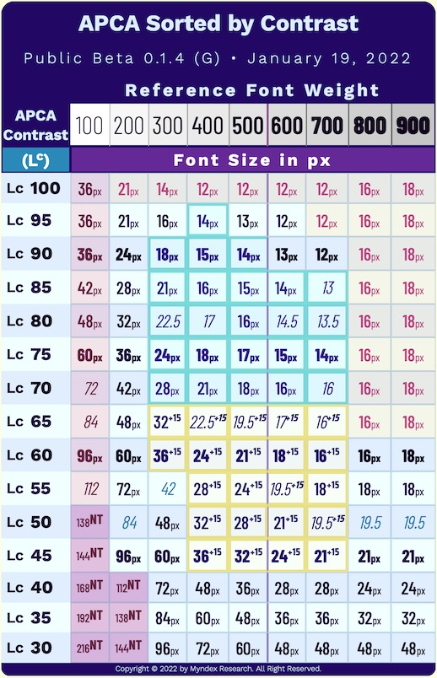
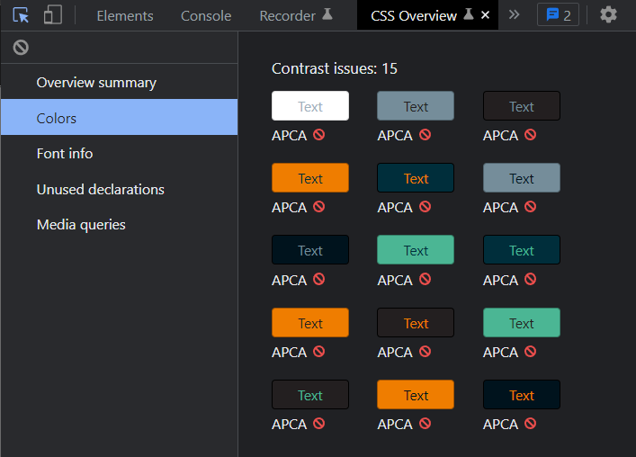
Potential future developments
Notes:
If you’re an accessibility geek like me you’ll know that WCAG 3 will use the Accessible Perceptual Contrast Algorightm. When an API is available I plan to use that to build an APCA version,
[progress]
but you can use the CSS Overview in Chrome Dev Tools with the my table to do a quick APCA check already. That reduced the number of combinations we can use for text by a further 15.

Slide 18
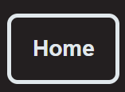
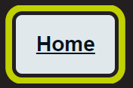

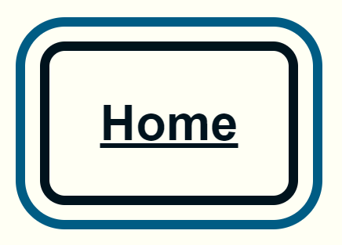
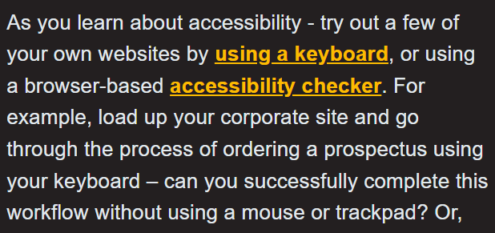
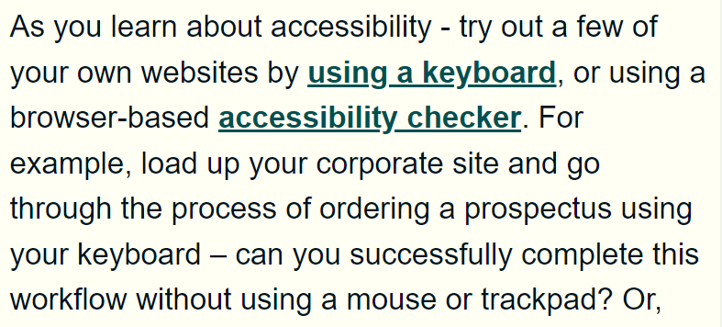
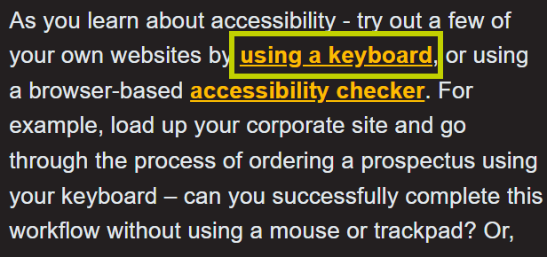
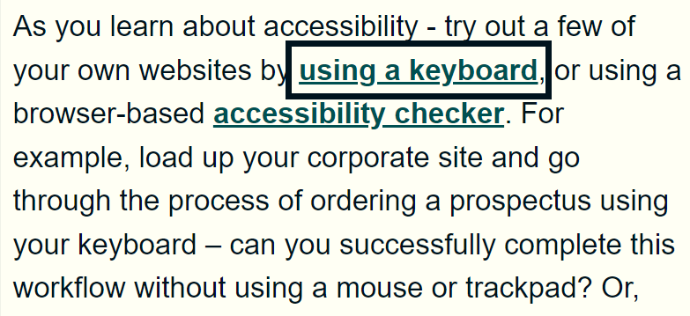
Idea: Style your own component library
Notes:
I would also like to develop it further to build a simple web page with a few components on it and show all the different colour combinations you could use for not only for text, but also for UI components and focus indicators. This is just an idea. I’m not sure when I would have the time to do it.

Slide 19
Accessibility inspector for everyone!
Notes:
The other topic is making the accessibility inspector more visible in Office for everyone.

Slide 20
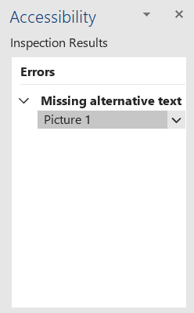

Accessibility inspector?
Notes:
The accessibility inspector in office alerts you to accessibility issues whilst you work.

Slide 21
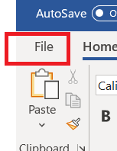
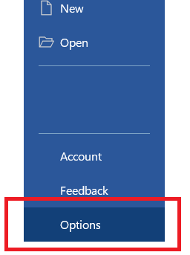
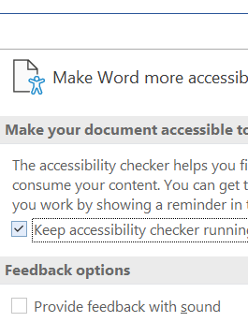
Reduce friction by removing these steps
Notes:
But there’s some friction. You have to follow three steps to turn it on. File > Options > Ease of Access -> Keep accessibility checker running while I work.
Often see when people share their screens during meeting that they do not have this setting turned on. Even people giving presentations about equality, diversity and inclusion.

Slide 22

Work in progress
Microsoft enterprise Disability Answer Desk eDAD@microsoft.com confirmed possible via Group Policy.
Raised request to desktop team.
Ticket currently in queue, hope to be ready in September.
Communicate to user community.
Success?
Notes:
I asked the Microsoft enterprise Disability Answer Desk if we could set this on by default on machines managed by the University. They said yes you can do this using “group policy”.
I raised this then as a request to our desktop team who now have it in their queue, I’m hoping it will have been implemented by September.
We’ll then be doing some comms with our user-community and hopefully this change that reduces the friction of setting up this option
[progress]
will inspire more people to turn that cross in the accessibility inspector into a tick.

Slide 23


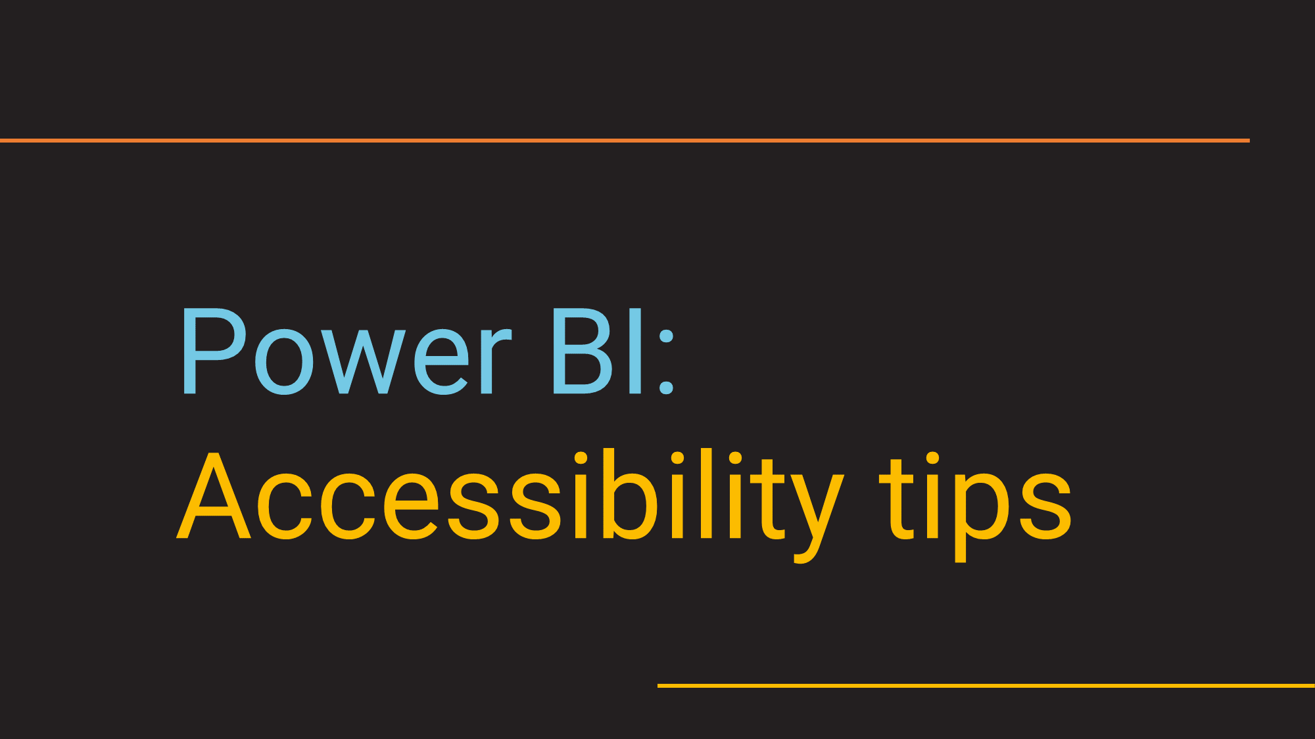
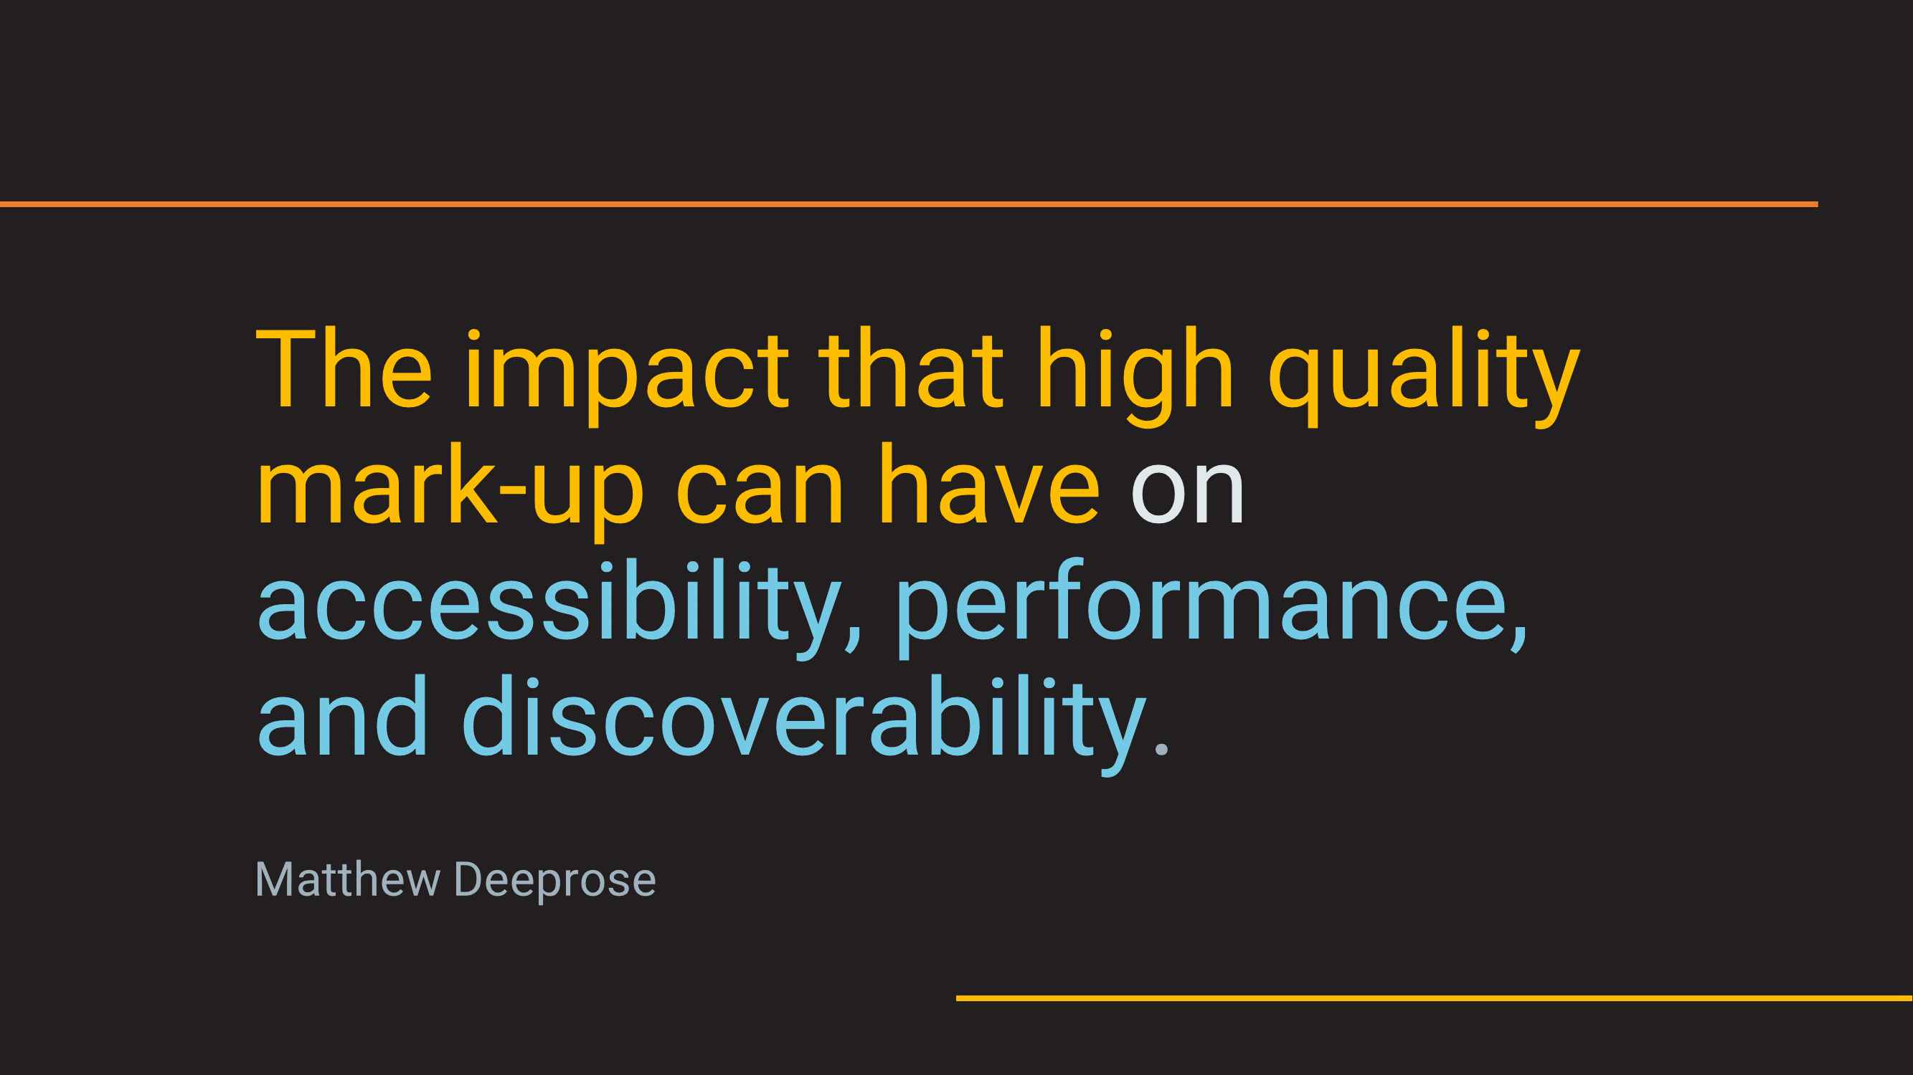
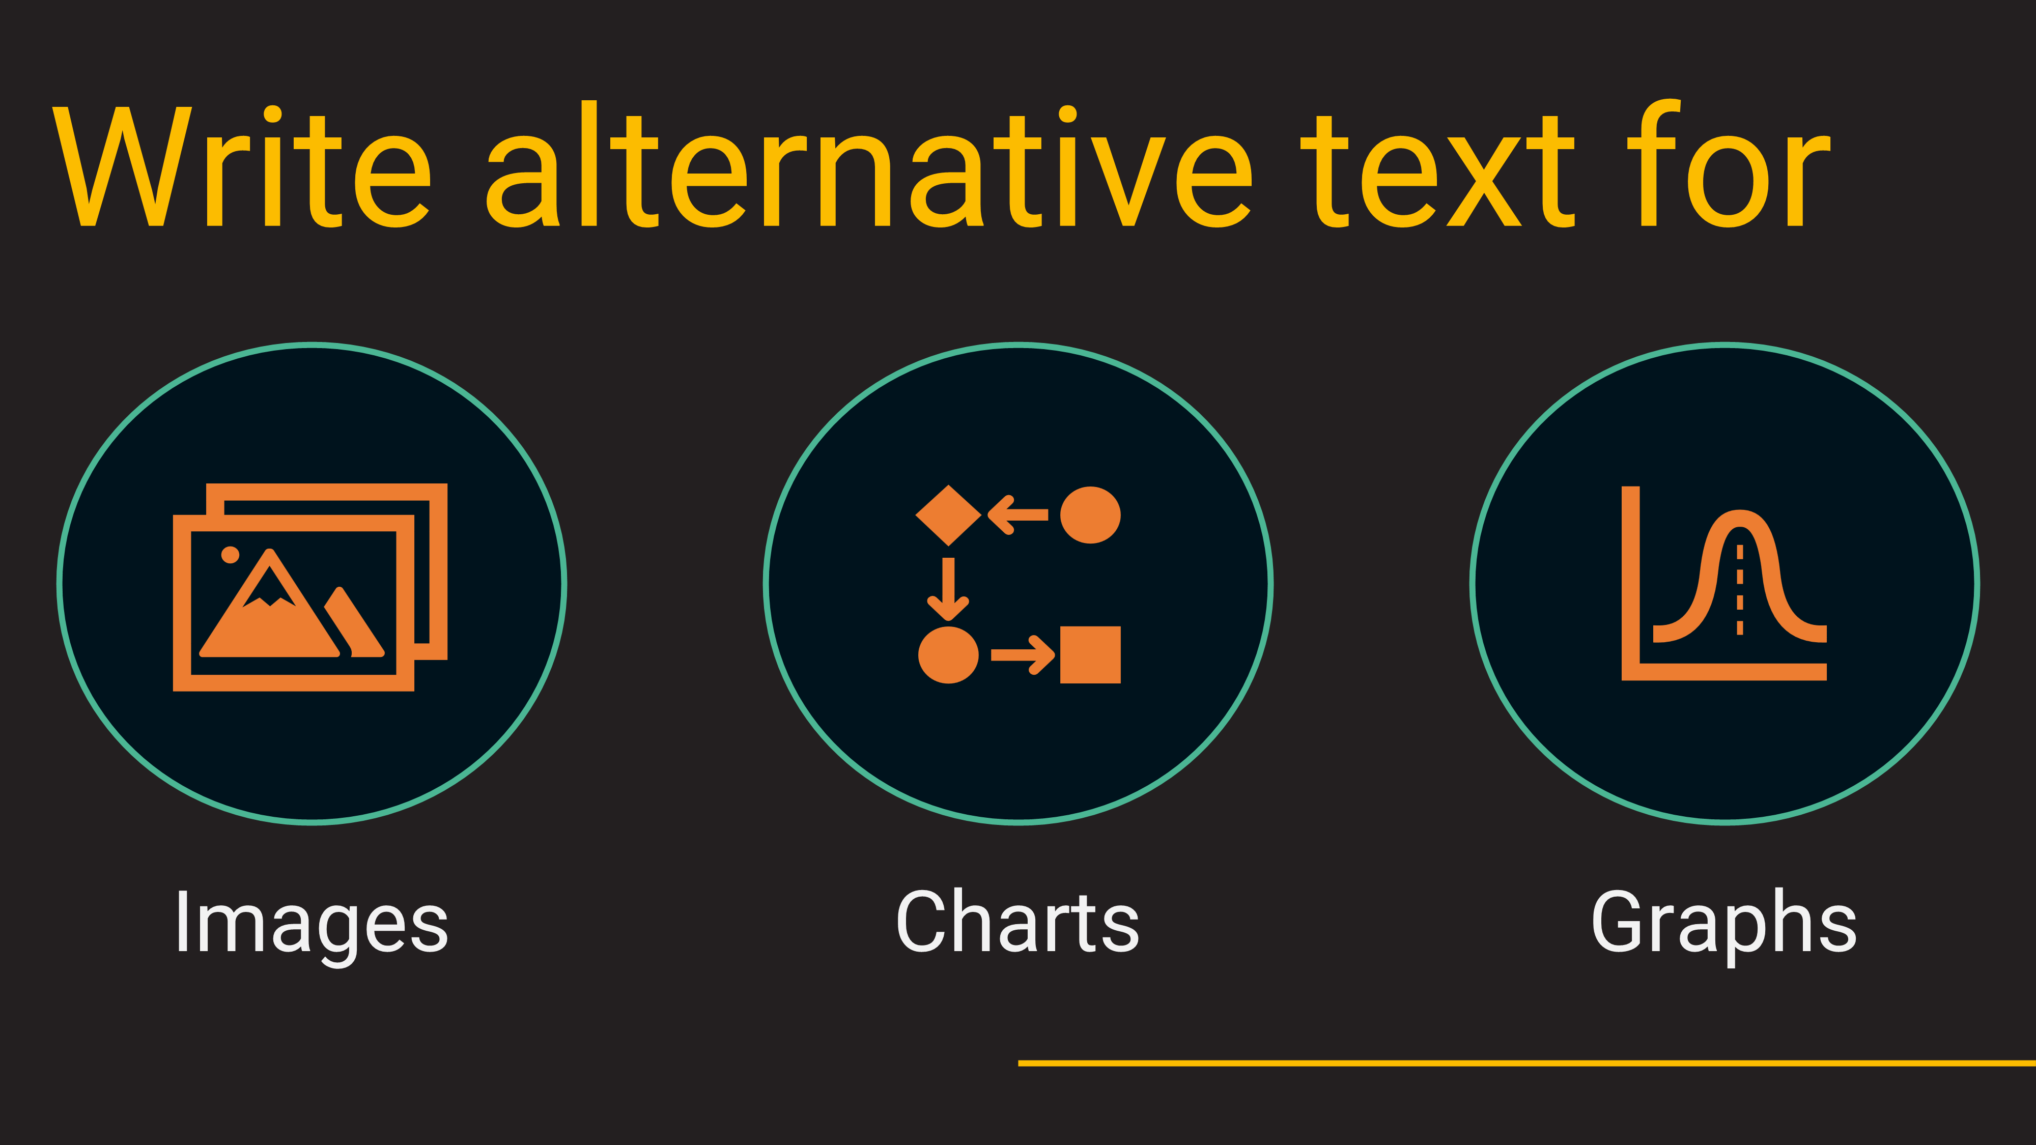
Thanks!
https://matthewdeeprose.github.io
Notes:
Thanks for listening!
[Progress]
If you’re interested in other blog posts, presentations, and accessibility projects I’ve shared take a look at my website. Recently I’ve covered writing alternative text for charts and graphs, how to implement accessibility within a Higher Education IT department, creating accessible PowerBI reports, and aspects of web development like ARIA roles, light and dark modes and so on.
[Progress]
https://matthewdeeprose.github.io/two-steps.html

