Slide 1
CS186 Discussion 7
(Transactions, Concurrency Control, Lock Granularity)
Matthew Deng

Slide 2
Transactions

Slide 3
Transactions
DBMS abstract view of program or activity
Sequence of reads and writes
All actions must commit or abort entirely
Has ACID properties

Slide 4
ACID
Atomicity
All or none
Consistency
Stay consistent
Isolation
Isolated from other transactions
Durability
Commit effects persist

Slide 5
Atomicity and Durability
Transactions are committed or aborted
Committed transactions are permanent

Slide 6
Consistency
A transaction will bring one consistent state to another
Transactions must satisfy integrity constraints

Slide 7
Isolation (Concurrency)
Actions of different transactions do not interfere
Each transaction executes as if ran by itself

Slide 8
Serializability
Serial schedule
Transactions are run one at a time, with no intervention
Equivalence
Same transactions with same actions
Leave DB in same state
Serializable
Equivalent to a serial schedule

Slide 9
Conflict Serializability
Conflict
Same object
Different transactions
At least one is a write
Conflict Equivalent
Same transactions with same actions
Conflicts are in the same order
Conflict Serializable
Conflict equivalent to a serial schedule
{conflict serializable schedules} ⊆ {serializable schedules}

Slide 10
Dependency Graph
(Precendence Graph)
Node
Transaction
Directed edge
O_{i} of T_{i} conflicts with O_{j} of T_{j}, and O_{i} appears earlier than O_{j}
(T_{i}, T_{j}) if T_{j} depends on T_{i}
Schedule is conflict serializable if and only if
its dependency graph is acyclic.

Slide 11
Transactions Worksheet #2

Slide 12
Transaction Exercises
Consider the following schedules:
Draw the dependency graph (precedence graph) for the schedule.
T1 |  | R(A) | W(A) | R(B)
T2 |  |  |  |  | W(B) | R(C) | W(C) | W(A)
T3 | R(C) |  |  |  |  |  |  |  | W(D)

Slide 13
Transaction Exercises
Consider the following schedules:
Draw the dependency graph (precedence graph) for the schedule.
T3 -> T2 [(R(C), W(C)];
T1 -> T2 [R(A), W(A) and W(A),W(A) and R(B),W(B)]
T1 |  | R(A) | W(A) | R(B)
T2 |  |  |  |  | W(B) | R(C) | W(C) | W(A)
T3 | R(C) |  |  |  |  |  |  |  | W(D)

Slide 14
Transaction Exercises
Consider the following schedules:
(b) Is the schedule conflict serializable? If so, what are all the (conflict) equivalent serial schedules? If not, why not?
T1 |  | R(A) | W(A) | R(B)
T2 |  |  |  |  | W(B) | R(C) | W(C) | W(A)
T3 | R(C) |  |  |  |  |  |  |  | W(D)

Slide 15
Transaction Exercises
Consider the following schedules:
(b) Is the schedule conflict serializable? If so, what are all the (conflict) equivalent serial schedules? If not, why not?
Yes. Serial schedules: T3, T1, T2; T1, T3, T2.
T1 |  | R(A) | W(A) | R(B)
T2 |  |  |  |  | W(B) | R(C) | W(C) | W(A)
T3 | R(C) |  |  |  |  |  |  |  | W(D)

Slide 16
Transaction Exercises
Consider the following schedules:
(c) Draw the dependency graph (precedence graph) for the schedule.
T1 | R(A) |  | R(B) |  |  |  | W(A)
T2 |  | R(A) |  | R(B) |  |  |  | W(B)
T3 |  |  |  |  | R(A)
T4 |  |  |  |  |  | R(B)

Slide 17
Transaction Exercises
Consider the following schedules:
(c) Draw the dependency graph (precedence graph) for the schedule.
T3 -> T1 [R(A), W(A)];
T2 -> T1 [R(A), W(A)];
T1 -> T2 [R(B), W(B)];
T4 -> T2 [R(B), W(B)]
T1 | R(A) |  | R(B) |  |  |  | W(A)
T2 |  | R(A) |  | R(B) |  |  |  | W(B)
T3 |  |  |  |  | R(A)
T4 |  |  |  |  |  | R(B)

Slide 18
Transaction Exercises
Consider the following schedules:
(d) Is the schedule conflict serializable? If so, what are all the (conflict) equivalent serial schedules? If not, why not?
T1 | R(A) |  | R(B) |  |  |  | W(A)
T2 |  | R(A) |  | R(B) |  |  |  | W(B)
T3 |  |  |  |  | R(A)
T4 |  |  |  |  |  | R(B)

Slide 19
Transaction Exercises
Consider the following schedules:
(d) Is the schedule conflict serializable? If so, what are all the (conflict) equivalent serial schedules? If not, why not?
No. Why not: cycle in the precedence graph (T1 must precede T2, T2 must precede T1)
T1 | R(A) |  | R(B) |  |  |  | W(A)
T2 |  | R(A) |  | R(B) |  |  |  | W(B)
T3 |  |  |  |  | R(A)
T4 |  |  |  |  |  | R(B)

Slide 20
Concurrency Control

Slide 21
Locks
S (shared lock) for reading
X (exclusive lock) for writing
Lock Compatibility Matrix
 | S | X
S | √ | –
X | – | –

Slide 22
Two-Phase Locking (2PL)
Transaction cannot get new locks after releasing any locks
Most common scheme for enforcing conflict serializability
Guarantees conflict serializability
Does not prevent cascading aborts
acquisition phase
release phase
# locks held
time

Slide 23
Strict 2PL
Transaction releases all locks when it commits or aborts
Guarantees conflict serializability
prevents cascading aborts
acquisition phase
# locks held
release all locks at end of xact
time

Slide 24
Deadlock Detection
Waits-For Graph
Node
Transaction
Directed edge
O_{i} of T_{i} conflicts with O_{j} of T_{j}, and O_{j} appears earlier than O_{i}
(T_{i}, T_{j}) if T_{i} waits for T_{j}

Slide 25
Concurrency Control Worksheet #3, 4

Slide 26
Concurrency Control Exercises
(a) What will be printed in the following execution (B=3, F=300)?

Slide 27
Concurrency Control Exercises
(a) What will be printed in the following execution (B=3, F=300)?
3030

Slide 28
Concurrency Control Exercises
(b) Does the execution use 2PL or Strict 2PL?

Slide 29
Concurrency Control Exercises
(b) Does the execution use 2PL or Strict 2PL?
Neither, because transaction 2 unlocks F before locking B. In 2PL, a transaction cannot get any new locks after another lock has been released.

Slide 30
Concurrency Control Exercises
(c) How would you change the above execution to use 2PL? How would you change it to use Strict 2PL? Does the output change?

Slide 31
Concurrency Control Exercises
(c) How would you change the above execution to use 2PL? How would you change it to use Strict 2PL? Does the output change?
There are many ways to get 2PL/Strict 2PL schedules, but here is one:
2PL: You could move T2’s Unlock(F) to any point after it’s Lock_S(B)
Strict 2PL: You would have to move T1’s Unlock(B) and T2’s Unlock(F) to the end of execution; In both of these cases, the output will not change.

Slide 32
Concurrency Control Exercises
Consider the following schedule. Draw a “waits-for” graph and state whether or not there is a possibility of deadlock. Assume that no locks are released within the timeframe we are looking.
T1 | S(A) | S(D) |  | S(B)
T2 |  |  | X(B) |  |  |  | X(C)
T3 |  |  |  |  | S(D) | S(C) |  |  | X(A)
T4 |  |  |  |  |  |  |  | X(B)

Slide 33
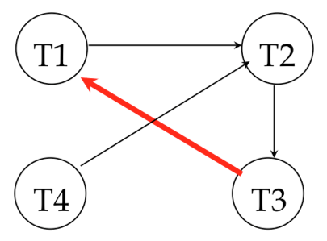
Concurrency Control Exercises
Consider the following schedule. Draw a “waits-for” graph and state whether or not there is a possibility of deadlock. Assume that no locks are released within the timeframe we are looking.
Yes, deadlock is possible since there is a cycle in the waits-for graph.
T1 | S(A) | S(D) |  | S(B)
T2 |  |  | X(B) |  |  |  | X(C)
T3 |  |  |  |  | S(D) | S(C) |  |  | X(A)
T4 |  |  |  |  |  |  |  | X(B)

Slide 34
Lock Granularity

Slide 35
Lock Granularity
Select amount to lock
Used with 2PL to
guarantee serializability
Steps:
Start at root
Get locks top-down
Release locks bottom-up
Database
contains
Tables
contains
Pages
contains
Tuples

Slide 36
Intent Locks
S: shared lock for reading
X: exclusive lock for writing (and reading)
IS: intent to get S lock(s) at finer granularity
IX: intent to get X lock(s) at finer granularity
SIX: shared lock with intent to get X lock(s) at finer granularity

Slide 37
Lock Compatibility Matrix
 | S | X
S | √ | –
X | – | –

Slide 38
Lock Compatibility Matrix
 | IS | IX | SIX | S | X
IS
IX
SIX
S |  |  |  | √ | –
X |  |  |  | – | –

Slide 39
Lock Compatibility Matrix
 | IS | IX | SIX | S | X
IS | √ | √ | √ | √ | –
IX | √ | √ | – | – | –
SIX | √ | – | – | – | –
S | √ | – | – | √ | –
X | – | – | – | – | –

Slide 40
Lock Granularity Worksheet #1

Slide 41
Lock Granularity Exercises
Suppose a transaction, T1, wants to scan a table R and update a few of its tuples. What kind of locks should T1 have on R, its pages, and the tuples that are updated?

Slide 42
Lock Granularity Exercises
Suppose a transaction, T1, wants to scan a table R and update a few of its tuples. What kind of locks should T1 have on R, its pages, and the tuples that are updated?
SIX lock on R
IX lock on pages
X lock on updated tuples

Slide 43
Lock Granularity Exercises
Is an S lock compatible with an IX lock? Explain why or why not. Make your description as simple as possible.

Slide 44
Lock Granularity Exercises
Is an S lock compatible with an IX lock? Explain why or why not. Make your description as simple as possible.
Suppose T1 wants an S lock on an object, O, and T2 wants an IX lock on the same object O. An S lock implies that T1 will read the entire object (all of its sub-objects). An IX lock implies that T2 will write some of the sub- objects of the object. This means that there is some sub- object of O that T1 will read and T2 will write. This is not valid, so the S and IX locks must be incompatible.

Slide 45
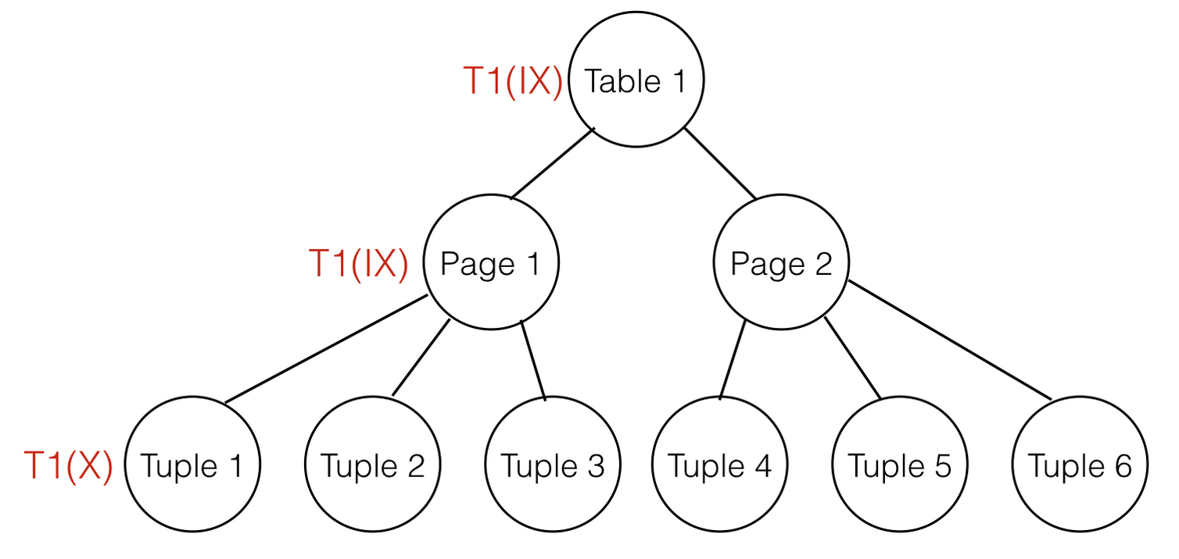
Lock Granularity Exercises
Given that transaction T1 has an IX lock on table 1, an IX lock on page 1, and an X lock on tuple 1, which locks could be granted to transaction T2 for tuple 2?

Slide 46
Lock Granularity Exercises
Given that transaction T1 has an IX lock on table 1, an IX lock on page 1, and an X lock on tuple 1, which locks could be granted to transaction T2 for tuple 2?
X, S

Slide 47
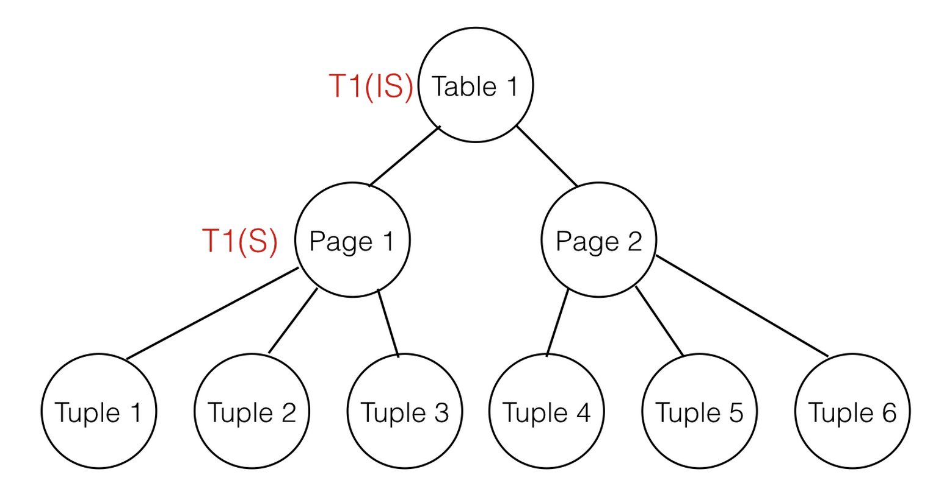
Lock Granularity Exercises
Given that T1 has an IS lock on table 1 and an S lock on page 1, what locks could be granted to T2 for page 1?

Slide 48
Lock Granularity Exercises
Given that T1 has an IS lock on table 1 and an S lock on page 1, what locks could be granted to T2 for page 1?
S, IS

