Slide 1
CS186 Discussion 4
(Record Formats, File Organization, Indexes, B+ Trees)
Matthew Deng

Slide 2
Record Formats

Slide 3
Record Formats: Fixed Length
use this when you can!
F1
F2
F3
F4
L1
L2
L3
L4
Base address (B)
Address = B+L1+L2

Slide 4
Record Formats: Variable Length
F1 F2 F3 F4
symbols can cause problems
$
$
$
$
1. Fields Delimited by Special Symbols
F1 F2 F3 F4
2. Array of Field Offsets

Slide 5
Page Formats: Fixed Length
record id = <page id, slot number>
free space in unpacked spread out
Slot 1
Slot 1
Slot 2
Slot 2
. . .
Free
Space
. . .
Slot N
Slot N
Slot M
N
1
. . .
0
1
1
M
number
of records
M ... 3 2 1
number
of slots
PACKED
UNPACKED, BITMAP

Slide 6
Page Formats: Variable Length
Rid = (i,N)
can move records without changing rid
Page i
Rid = (i,2)
Rid = (i,1)
20
16
24
N
Pointer
to start
of free
space
N . . . 2 1
# slots
SLOT DIRECTORY

Slide 7
Worksheet: Record Formats

Slide 8
Record Formats Exercises
1. What’s the tradeoff between fixed length fields and variable length fields?

Slide 9
Record Formats Exercises
1. What’s the tradeoff between fixed length fields and variable length fields?
fixed length has less bookkeeping overhead, but can be memory-inefficient

Slide 10
Record Formats Exercises
2. What is fragmentation?

Slide 11
Record Formats Exercises
2. What is fragmentation?
when free memory is divided into small chunks

Slide 12
Record Formats Exercises
What does slotted page header contain?

Slide 13
Record Formats Exercises
3. What does slotted page header contain?
number of record entries
end of free space in the block
location and size of each record

Slide 14
File Organization

Slide 15
File Organization
 | Heap File | Sorted File
Scan All
Equality Search
Range Search
Insertion
Deletion

Slide 16
File Organization
 | Heap File | Sorted File
Scan All | B | B
Equality Search | .5B | log₂(B)
Range Search | B | log₂(B) + num_matches
Insertion | 2 | log₂(B) + 2 * .5B
Deletion | .5B + 1 | log₂(B) + 2 * .5B

Slide 17
Worksheet: File Organization

Slide 18
File Organization Exercises
What should we consider when optimizing our file organization?

Slide 19
File Organization Exercises
What should we consider when optimizing our file organization?
How often we need to update records
How fast the worst case search/scan is

Slide 20
File Organization Exercises
2. When should we use heap files? Sorted files?

Slide 21
File Organization Exercises
2. When should we use heap files? Sorted files?
How often we need to update records
How fast the worst case search/scan is

Slide 22
Indexes

Slide 23
Indexes
Index – Disk-based data structure for fast lookup by value
Data entry: k*
<k, {items}>
Hash Indexes
Equality search
Tree Indexes
Equality search
Range search

Slide 24
Alternatives
There are three alternatives for storing data entries in index:
actual data
there can only be one alternative 1 index per table
key and record ID
<k, rid>
key and list of record IDs
<k, [rids]>

Slide 25
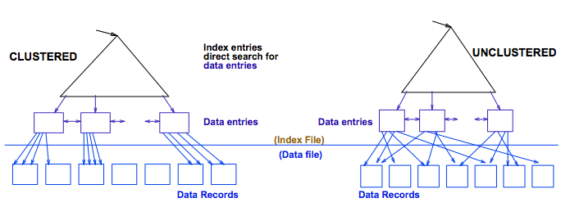
Clustering
Clustered Index:
index data entries are stored in (approximate) order by value of search key in data records
A file can be clustered on at most one search key
Alternative 1 is always clustered
Heap file usually packed to 2/3 capacity

Slide 26
File Organization
 | Heap File | Sorted File
Scan All
Equality Search
Range Search
Insertion
Deletion

Slide 27
File Organization
 | Heap File | Sorted File
Scan All | B | B
Equality Search | .5B | log₂(B)
Range Search | B | log₂(B) + num_matches
Insertion | 2 | log₂(B) + 2 * .5B
Deletion | .5B + 1 | log₂(B) + 2 * .5B

Slide 28
File Organization
 | Heap File | Sorted File | Clustered File
Scan All | B | B
Equality Search | .5B | log₂(B)
Range Search | B | log₂(B) + num_matches
Insertion | 2 | log₂(B) + 2 * .5B
Deletion | .5B + 1 | log₂(B) + 2 * .5B

Slide 29
File Organization
 | Heap File | Sorted File | Clustered File
Scan All | B | B | 1.5B
Equality Search | .5B | log₂(B) | log_{F}(1.5B) + 1
Range Search | B | log₂(B) + num_matches | log_{F}(1.5B) + num_matches
Insertion | 2 | log₂(B) + 2 * .5B | log_{F}(1.5B) + 2
Deletion | .5B + 1 | log₂(B) + 2 * .5B | log_{F}(1.5B) + 2

Slide 30
Worksheet: Indexes

Slide 31
Indexes Exercises
What are indexes and why do we have them?

Slide 32
Indexes Exercises
What are indexes and why do we have them?
to find records faster over a variety of workloads

Slide 33
Indexes Exercises
2. What are clustered indexes?

Slide 34
Indexes Exercises
2. What are clustered indexes?
the index whose search key specifies the sequential order of the file

Slide 35
Indexes Exercises
What is a unclustered index and how is it different from a clustered index?

Slide 36
Indexes Exercises
What is a unclustered index and how is it different from a clustered index?
the table file is not ordered by the unclustered index field, so range queries on a unclustered index are a lot worse than those on a clustered index

Slide 37
Indexes Exercises
4. How is data stored in a index? Describe the three alternatives.

Slide 38
Indexes Exercises
4. How is data stored in a index? Describe the three alternatives.
(A1) By value: entire row in leaf
(A2) By reference: (key, rid) pairs, with each key occuring once
(A3) By reference: (key, [rid]) pairs -- difference from A2 is that all rids with the same key are in one index entry

Slide 39
Indexes Exercises
5. What’s the difference between multiple indexes and a multi-column index?

Slide 40
Indexes Exercises
5. What’s the difference between multiple indexes and a multi-column index?
Multiple indexes are constructed on different columns individually, while a multi-column index is constructed on a concatenation of columns.

Slide 41
Indexes Exercises
6. What if you want two clustering indices on separate columns?

Slide 42
Indexes Exercises
6. What if you want two clustering indices on separate columns?
Either:
create a multi-column index (must do lexicographic search; can’t search on second column alone)
or
duplicate the table and have two clustering indices
(must duplicate writes -- less efficient).

Slide 43
Indexes Exercises
What is data locality and why do we care?

Slide 44
Indexes Exercises
7. What is data locality and why do we care?
Spatial locality: good for finding data in shorter time (less movement)
Cache locality: good for I/O

Slide 45
Indexes Exercises
What disadvantages are there to using indexes?

Slide 46
Indexes Exercises
What disadvantages are there to using indexes?
Maintenance cost
clustered indexes force us to maintain a sorted file

Slide 47
Tree-Structured Indexes

Slide 48
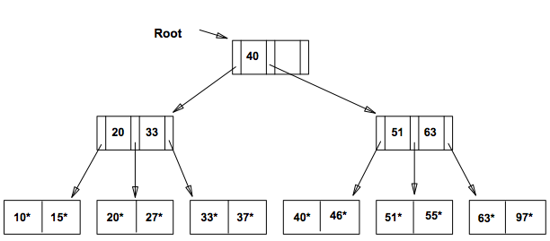
ISAM
Indexed Sequential Access Method
Static data structure
No longer used

Slide 49
ISAM Insertion
find leaf node L
if L not full:
insert data entry
else:
if overflow page not full:
insert data entry
else:
create overflow page
insert data entry

Slide 50
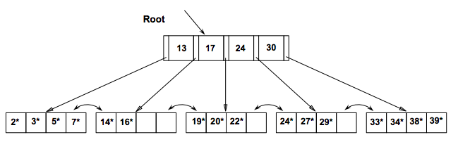
B+ Trees
Dynamic data structure
Most popularly used index
Height balanced
Terminology:
Order d: every node has between d and 2d entries
Fanout F: branches from a node (max: 2d + 1, average: 2/3 * 2d)
Number of leaf pages N

Slide 51
B+ Tree Insertion
find leaf node L
if L not full:
insert data entry
else: // 2d+1 in L
split L into L and L2 // d in L, d+1 in L2
copy up middle key to parent P
while P past capacity: // 2d+1 in L
split P into P and P2 // d in P, d in P2
push up middle key to parent P

Slide 52
Worksheet: B+ Trees

Slide 53
B+ Trees Exercises
What is the difference between an ISAM and B+ Tree Index?

Slide 54
B+ Trees Exercises
1. What is the difference between an ISAM and B+ Tree Index?
ISAM Tree: Static structure
Consists of root, primary leaf pages, overflow pages.
Long overflow chains can develop.
B+ Tree: Dynamic structure.
Height balanced.
Usually preferable to ISAM.
Order d: Each node contains d≤m≤2d entries (except for the root!)
Height: Length of longest path from the root to a leaf node
Fanout of a node: The number of pointers out of the node

Slide 55
B+ Trees Exercises
What seems to be the tradeoff between index designs?

Slide 56
B+ Trees Exercises
What seems to be the tradeoff between index designs?
static vs. dynamic maintenance
impact on data lookup and data insertion at runtime
impact on storage requirements

Slide 57
B+ Trees Exercises
Why do you think B+ trees are so popular?

Slide 58
B+ Trees Exercises
Why do you think B+ trees are so popular?
Adaptive to writes and balanced

Slide 59
B+ Trees Exercises
4. In the insert algorithm for a B+tree, what happens when the inserted leaf doesn’t have enough space?

Slide 60
B+ Trees Exercises
4. In the insert algorithm for a B+tree, what happens when the inserted leaf doesn’t have enough space?
must split L (into L and a new node L2)
then redistribute entries evenly
copy up middle key
insert index entry pointing to L2 into parent of L
This can happen recursively!

Slide 61
B+ Trees Exercises
True/False
Leaves can have different distance from root.
Every non-leaf, non-root node has at least floor(d / 2) children.
Leaf nodes cannot be full.

Slide 62
B+ Trees Exercises
True/False
Leaves can have different distance from root. F
Every non-leaf, non-root node has at least floor(d / 2) children.
Leaf nodes cannot be full.

Slide 63
B+ Trees Exercises
True/False
Leaves can have different distance from root. F
Every non-leaf, non-root node has at least floor(d / 2) children. T
Leaf nodes cannot be full.

Slide 64
B+ Trees Exercises
True/False
Leaves can have different distance from root. F
Every non-leaf, non-root node has at least floor(d / 2) children. T
Leaf nodes cannot be full. F

Slide 65
B+ Trees Exercises
6. Can you think of a better way to load data with a B+ tree than inserting one by one?

Slide 66
B+ Trees Exercises
6. Can you think of a better way to load data with a B+ tree than inserting one by one?
Sort the data entries, then build the tree up layer by layer.
Really good for concurrency and space utilization.
(read about bulk inserts if you want to learn more)

Slide 67
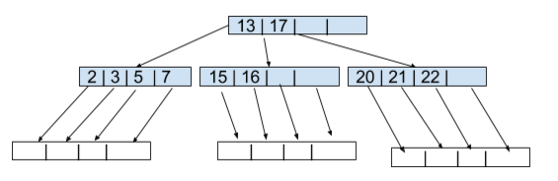
B+ Trees Exercises
7. Draw the tree after we insert the key 9.

Slide 68
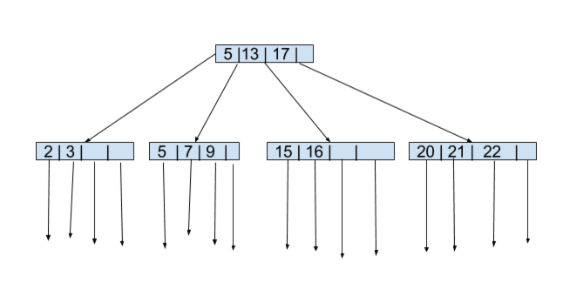
B+ Trees Exercises
7. Draw the tree after we insert the key 9.

