Slide 1
CS186 Discussion 11
(ER Diagrams, Functional Dependencies)
Matthew Deng

Slide 2
ER Diagrams

Slide 3
ER Diagrams
Conceptual design of relations
Entities
Relationships
Attributes

Slide 4
Entities
Entity: a real world object described by a set of attributes
Entity set: a collection of similar entities
E.g. all employees
Entities in entity set have same attributes
Has a key attribute
Each attribute has a domain
name
ssn
lot
Employee

Slide 5
Relationships
Relationship: association among two or more entities
Can have own attributes
Relationship set: collection of similar relationships
since
name
dname
ssn
lot
did
budget
Employee
Works_In
Department

Slide 6
Constraints
Key constraint: entity participates at most once
Key, non-key
Represented by
Participation constraint: entity participates at least once
Total, partial
Represented by
since
name
dname
ssn
lot
did
budget
Employee
Works_In
Department

Slide 7
Constraints
Key constraint: entity participates at most once
Key, non-key
Represented by
Participation constraint: entity participates at least once
Total, partial
Represented by
 | Partial Participation | Total Participation
Non-Key | 0 or more | 1 or more
Key | 0 or 1 | 1

Slide 8
Ternary Relations
3 entities connected to a relationship instead of 2

Slide 9
Weak Entity
An entity that only makes sense in the context of another entity (its parent)
Has a partial key (dashed underline)
E.g. there can be two songs with the same name
Key is (Artists.artist_id, Songs.song_name)

Slide 10
ER Diagram Exercises

Slide 11
ER Diagrams Exercises
Assume that a player can play in more than one team (Yes, our league has different rules!) and that a team needs at least one player. Draw an ER diagram for our database.

Slide 12
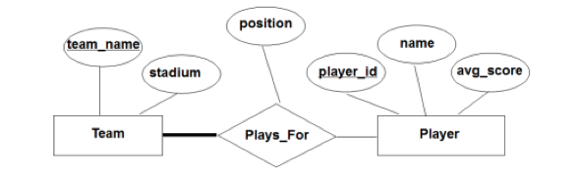
ER Diagrams Exercises
Assume that a player can play in more than one team (Yes, our league has different rules!) and that a team needs at least one player. Draw an ER diagram for our database.

Slide 13
ER Diagrams Exercises
Now let’s say we want to also track who is the captain of every team. How will the ER diagram change from the previous case? Note: Every team needs exactly one captain!

Slide 14
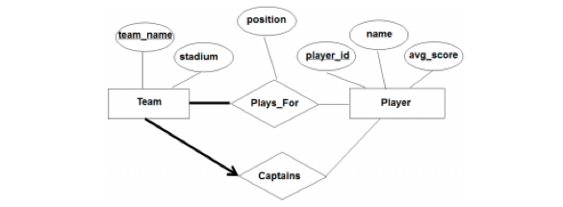
ER Diagrams Exercises
Now let’s say we want to also track who is the captain of every team. How will the ER diagram change from the previous case? Note: Every team needs exactly one captain!

Slide 15
ER Diagrams Exercises
Are there any weak-entity relationships in either of our ER diagrams?

Slide 16

ER Diagrams Exercises
Are there any weak-entity relationships in either of our ER diagrams?
No. A weak entity can be identified uniquely only by considering the primary key of another (owner) entity. Consider the following example:
A team can have many coaches, but each coach exactly coaches one team. Coach is a weak-entity set and can be identified by its partial key “name”.

Slide 17
Functional Dependencies

Slide 18
Functional Dependencies
Used to identify redundancy in schemas and suggest refinement
X → Y
X determines Y
K → {all attributes of R}
K is a superkey of R

Slide 19
Armstrong’s Axioms
Reflexivity: If X ⊇ Y, then X  Y
Augmentation: If X  Y, then XZ  YZ for any Z
XZ  YZ does not mean X  Y
Transitivity: If X  Y and Y  Z, then X  Z
Union: If X  Y and X  Z, then X  YZ
Decomposition: If X  YZ, then X  Y and X  Z

Slide 20
Closures
X+: set of all FDs implied by X, including trivial dependencies
X+ := X
while not done:
for UV in F:
if U in X+:
add V to X+

Slide 21
Boyce-Codd Normal Form (BCNF)
R is in BCNF if the only non-trivial FDs over R are key constraints
R with FDs F is in BCNF if
for all X  A in F+:
A ⊆ X (called a trivial FD), or
X is a superkey for R

Slide 22
BCNF Decomposition
For R, if X  A violates BCNF, decompose R into R – A and XA

Slide 23
Functional Dependencies Exercises

Slide 24
Functional Dependencies Exercises
1. Flight schema
Flights(Flight_no, Date, fRom, To, Plane_id), ForeignKey(Plane_id)
Planes(Plane_id, tYpe)
Seat(Seat_no, Plane_id, Legroom), ForeignKey(Plane_id)
Find the set of functional dependencies.

Slide 25
Functional Dependencies Exercises
1. Flight schema
Flights(Flight_no, Date, fRom, To, Plane_id), ForeignKey(Plane_id)
Planes(Plane_id, tYpe)
Seat(Seat_no, Plane_id, Legroom), ForeignKey(Plane_id)
Find the set of functional dependencies.
FD → RTP
P → Y
SP → L

Slide 26
Functional Dependencies Exercises
2. Now consider the attribute set R = ABCDE and the FD set F = {AB → C, A → D, D → E, AC → B}. Compute the closure for the following attributes.
A:
AB:
B:
D:

Slide 27
Functional Dependencies Exercises
2. Now consider the attribute set R = ABCDE and the FD set F = {AB → C, A → D, D → E, AC → B}. Compute the closure for the following attributes.
A: {A, D, E}
AB: {A, B, C, D, E}
B: {B}
D: {D, E}

Slide 28
Functional Dependencies Exercises
3. Decompose R = ABCDEFG into BCNF, given the functional dependency set:
F = {AB → CD, C → EF, G → A, G → F, CE → F}

Slide 29
Functional Dependencies Exercises
3. Decompose R = ABCDEFG into BCNF, given the functional dependency set:
F = {AB → CD, C → EF, G → A, G → F, CE → F}
AB→CD => decompose ABCDEFG into ABCD, ABEFG
G→A => decompose ABEFG into AG, BEFG
G→F => decompose BEFG into FG, BEG
Final relations: ABCD, AG, FG, BEG.

Slide 30
Functional Dependencies Exercises
4. Does the above decomposition preserve dependencies? F = {AB → CD, C → EF, G → A, G → F, CE → F}
Final relations: ABCD, AG, FG, BEG

Slide 31
Functional Dependencies Exercises
4. Does the above decomposition preserve dependencies? F = {AB → CD, C → EF, G → A, G → F, CE → F}
Final relations: ABCD, AG, FG, BEG
No, C → EF and CE → F are not represented in the closure of the union of each subrelation’s dependencies

