Slide 1
CS186 Discussion 09
(Distributed Data, Data Science)
Matthew Deng

Slide 2
Distributed Data

Slide 3
Partitioned Data
Data is partitioned across nodes
One copy of each record

Slide 4
2-Phase Commit
Phase 1:PREPARE
Coordinator: Prepare
Participatnt: Yes/No
Phase 2: COMMIT/ABORT
Coordinator: Commit/abort
Participant: Ack

Slide 5
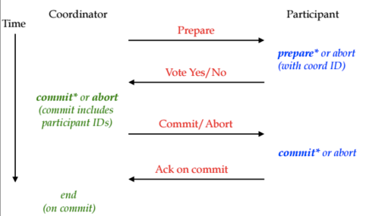
2-Phase Commit

Slide 6
Replicated Data
Increases availability
Reduces latency
Load balancing

Slide 7
Single-Master vs. Multi-Master
Single-Master
Every data item has one master node
Multi-Master
Anyone can write a data item

Slide 8
Quorums
Replicate each item on N nodes
Write to W nodes
Read from R nodes
W+R > N

Slide 9
NoSQL
Key/Value Stores/ “Document” Stores
Replicated Data
Multi-master

Slide 10
Eventual Consistency
Safety
Nothing bad ever happens
Liveness
A good thing eventually happens

Slide 11
Monotonic Code
Sets grow bigger
UNION
Counters go up
MAX
Booleans go from false to true
OR

Slide 12
2PC + ARIES Worksheet

Slide 13
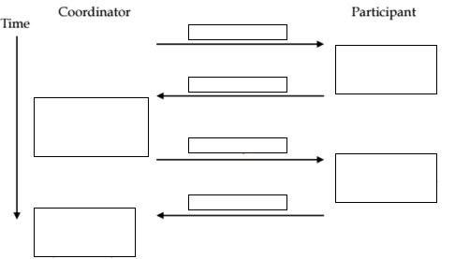
2PC + ARIES Exercises

Slide 14
2PC + ARIES Exercises

Slide 15
2PC + ARIES Exercises
In a distributed commit protocol, what new log record types are needed to support Two-Phase Commit with ARIES?

Slide 16
2PC + ARIES Exercises
In a distributed commit protocol, what new log record types are needed to support Two-Phase Commit with ARIES?
PREPARE

Slide 17
2PC + ARIES Exercises
What happens when the Coordinator crashes before all participants ACK and after logging COMMIT?

Slide 18
2PC + ARIES Exercises
What happens when the Coordinator crashes before all participants ACK and after logging COMMIT?
Coordinator will restart
Coordinator will check the last entry in its log - “COMMIT”
Coordinator must periodically resend— because there may be other link or site failures in the system — a commit or abort message to each subordinate until we receive an ack.
After we have received acks from all subordinates, we write an end log record for .

Slide 19
Eventual Consistency Worksheet

Slide 20
Eventual Consistency Exercises
You are designing a version of GitHub where file updates are stored in a geo-distributed NoSQL store, that is eventually consistent. Why might we choose NoSQL over a RDBMS for our application?

Slide 21
Eventual Consistency Exercises
You are designing a version of GitHub where file updates are stored in a geo-distributed NoSQL store, that is eventually consistent. Why might we choose NoSQL over a RDBMS for our application?
NoSQL allows for faster writer latency since updates are only ACKed by one node
Highly available since it is horizontal scaling
Con: consistency requirements need to be added at the application layer

Slide 22
Eventual Consistency Exercises
Say Alice and Bob are project partners. Alice makes a commit on top of the skeleton code on her computer and pushes her changes. Bob does the same from his computer. What do you think should happen when Alice/Bob/their TA pulls their code?

Slide 23
Eventual Consistency Exercises
Say Alice and Bob are project partners. Alice makes a commit on top of the skeleton code on her computer and pushes her changes. Bob does the same from his computer. What do you think should happen when Alice/Bob/their TA pulls their code?
You could use a “last writer wins” (or first writer) → pulling may overwrite your commit history
When the distributed nodes are gossiping updates, they could merge together the code (using gits merging algorithm). This means pulling could retrieve code with merge conflicts from the server.
You could do 2PC at the application layer on each push, to give replica consistency guarantees.

Slide 24
Data Science

Slide 25
OTLP & OLAP
Online Transaction Processing
Online Analytics Processing

Slide 26
Data Warehouse
Extract
Collect data from multiple sources
Transform (Clean)
Data validation and filtering
Schema manipulation
Data normalization
Load
Bulk load

Slide 27
Data Lake
Like data warehouse, but without ETL
Save in raw form
Beware of data swamp
Dirty data

Slide 28
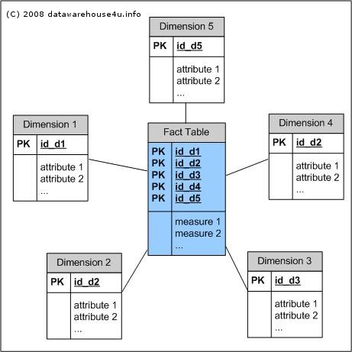
Multidimensional Data
Multidimensional cube of data
StarSchema

Slide 29
Cross Tabulation
Aggregate data across pair of dimensions
GROUP BY
Pivot Tables
Cube Operator
X | Y | Value
 | Y1 | Y2 | Total
X1
X2
X3
Total

Slide 30
OLAP Queries
Slicing
Select a value for 1 dimension
Dicing
Select a range of values for multiple dimensions
Rollup
Aggregate along 1 dimension
Drill-Down
De-aggregate along 1 dimension

Slide 31
Data Science / Queries Worksheet

Slide 32
Data Science / Queries Exercises
Create a star schema for this data (be sure to include all fields). You may need to introduce new fields.

Slide 33
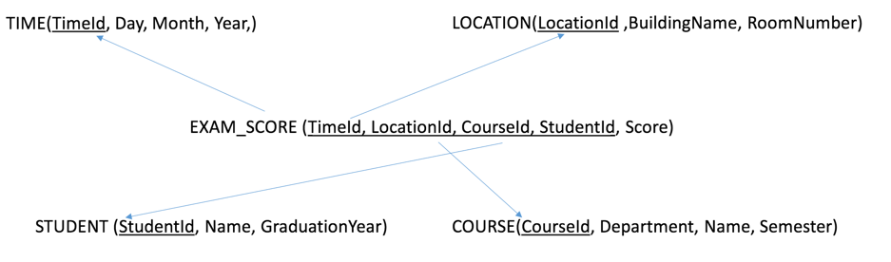
Data Science / Queries Exercises
Create a star schema for this data (be sure to include all fields). You may need to introduce new fields.

Slide 34
Data Science / Queries Exercises
2a. Fill in our pivot table where the dimensions are Make and Year, and our aggregation is MEAN().
 | Ferrari | Tesla | Total
2014
2015
Total

Slide 35
Data Science / Queries Exercises
2a. Fill in our pivot table where the dimensions are Make and Year, and our aggregation is MEAN().
 | Ferrari | Tesla | Total
2014 | 50 | - | 50
2015 | 85 | 80 | 82.5
Total | 67.5 | 80 | 71.67

Slide 36
Data Science / Queries Exercises
2b. How many rows are in the output of this query?
SELECT Make, Year, Color, SUM(Sales) FROM Sales GROUP BY Make, Year, Color WITH CUBE;

Slide 37
Data Science / Queries Exercises
2b. How many rows are in the output of this query?
SELECT Make, Year, Color, SUM(Sales) FROM Sales GROUP BY Make, Year, Color WITH CUBE;
(Ferrari, Tesla, *) x (2014, 2015, *) x (Red, *)
3 * 3 * 2 = 18 rows

Slide 38
Data Science / Queries Exercises
2b. Fill in the rows:
Make | Year | Color | SUM(Sales)
Ferrari | * | Red
Tesla | * | *
* | * | *

Slide 39
Data Science / Queries Exercises
2b. Fill in the rows:
Make | Year | Color | SUM(Sales)
Ferrari | * | Red | 135
Tesla | * | * | 80
* | * | * | 215

Slide 40
Data Science / Queries Exercises
2c. Suppose we “drill down” (deaggregate) on Year, by quarter. How many rows are in the output ?

Slide 41
Data Science / Queries Exercises
2c. Suppose we “drill down” (deaggregate) on Year, by quarter. How many rows are in the output ?
3 rows * 4 quarters per row = 12

Slide 42
Data Science / Queries Exercises
2d. If we sold equal numbers of Teslas each quarter, what does the drill down by year look like for Tesla?
Make | Year | Color | Quarter | Sales
Tesla | 2015 | Red

Slide 43
Data Science / Queries Exercises
2d. If we sold equal numbers of Teslas each quarter, what does the drill down by year look like for Tesla?
Make | Year | Color | Quarter | Sales
Tesla | 2015 | Red | Q1 | 20
Tesla | 2015 | Red | Q2 | 20
Tesla | 2015 | Red | Q3 | 20
Tesla | 2015 | Red | Q4 | 20

