Slide 1
CS186 Discussion 5
(Indexes, Tree-Structured Indexes)
Matthew Deng

Slide 2
Indexes

Slide 3
Indexes
Index – Disk-based data structure for fast lookup by value
Data entry: k*
<k, {items}>
Hash Indexes
Equality search
Tree Indexes
Equality search
Range search

Slide 4
Alternatives
There are three alternatives for storing data entries in index:
actual data
there can only be one alternative 1 index per table
key and record ID
<k, rid>
key and list of record IDs
<k, [rids]>

Slide 5
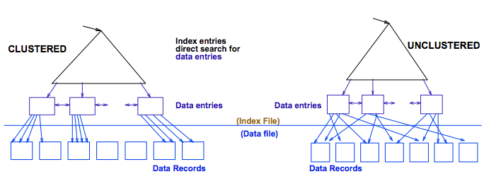
Clustering
Clustered Index:
index data entries are stored in (approximate) order by value of search key in data records
A file can be clustered on at most one search key
Alternative 1 is always clustered
Heap file usually packed to 2/3 capacity

Slide 6
File Organization
 | Heap File | Sorted File
Scan All
Equality Search
Range Search
Insertion
Deletion

Slide 7
File Organization
 | Heap File | Sorted File
Scan All | B | B
Equality Search | .5B | log₂(B)
Range Search | B | log₂(B) + num_matches
Insertion | 2 | log₂(B) + 2 * .5B
Deletion | .5B + 1 | log₂(B) + 2 * .5B

Slide 8
File Organization
 | Heap File | Sorted File | Clustered File
Scan All | B | B
Equality Search | .5B | log₂(B)
Range Search | B | log₂(B) + num_matches
Insertion | 2 | log₂(B) + 2 * .5B
Deletion | .5B + 1 | log₂(B) + 2 * .5B

Slide 9
File Organization
 | Heap File | Sorted File | Clustered File
Scan All | B | B | 1.5B
Equality Search | .5B | log₂(B) | log_{F}(1.5B) + 1
Range Search | B | log₂(B) + num_matches | log_{F}(1.5B) + num_matches
Insertion | 2 | log₂(B) + 2 * .5B | log_{F}(1.5B) + 2
Deletion | .5B + 1 | log₂(B) + 2 * .5B | log_{F}(1.5B) + 2

Slide 10
Indexing Worksheet

Slide 11
Indexing Exercises: Basics
What are indexes and why do we have them?

Slide 12
Indexing Exercises: Basics
What are indexes and why do we have them?
An index is a data structure that organizes data records on disk to optimize certain kinds of retrieval operations. An index allows us to efficiently retrieve all records that satisfy search conditions on the search key fields of the index.

Slide 13
Indexing Exercises: Basics
Compare the two main types of indexes.

Slide 14
Indexing Exercises: Basics
Compare the two main types of indexes.
Hash based index: Cannot do range queries.
Slightly faster on equality search.
Tree based index:
Unclustered: Fast equality search, insertion, deletion.
Clustered: Fast search, insertion, deletion, scan,
range search. Needs space.

Slide 15
Indexing Exercises: Basics
What are important factors in determining whether or not you should add an index to add to a table?

Slide 16
Indexing Exercises: Basics
What are important factors in determining whether or not you should add an index to add to a table?
Should know which field to cluster on
(calculate based on typical queries run)
Decide if you even want to cluster
(high maintenance cost)

Slide 17
Indexing Exercises: Alternatives
What are ‘alternatives’?

Slide 18
Indexing Exercises: Alternatives
What are ‘alternatives’?
Alternatives are the different ways of storing a data entry.
Data entry - an index file representation of record.
Three alternatives:
1. Actual data record (with key value k)
2. <k, rid of matching data record>
3. <k, list of rids of matching data records>

Slide 19
Indexing Exercises: Alternatives
Say we have the following records. Use the boxes to show examples of each data entry alternative, assuming we build an index on age.
Clowns (Name text, SID int, Experience int, Age int)
RID: 022 - Casey | 134234 | 2 | 35
RID: 051 - Merk | 955551 | 2 | 35
RID: 101 - Test | 045671 | 11 | 15
Alternative 1 | Alternative 2 | Alternative 3

Slide 20
Indexing Exercises: Alternatives
Say we have the following records. Use the boxes to show examples of each data entry alternative, assuming we build an index on age.
Clowns (Name text, SID int, Experience int, Age int)
RID: 022 - Casey | 134234 | 2 | 35
RID: 051 - Merk | 955551 | 2 | 35
RID: 101 - Test | 045671 | 11 | 15
Alternative 1 | Alternative 2 | Alternative 3
Casey | 134234 | 2 | 35 Merk | 955551 | 2 | 35 Test | 045671 | 11 | 15 (RID is implicit) | <key, RID> <35, 022> <35, 051> <15, 101> | <key, [RID list]> <35, [022, 051]> <15, [101]>

Slide 21
Indexing Exercises: Clustering
What are clustered indexes?

Slide 22
Indexing Exercises: Clustering
What are clustered indexes?
When a (data) file is organized so that the ordering of data records is the same as or close to the ordering of data entries in some index, we say that the index is clustered

Slide 23
Indexing Exercises: Clustering
How do they relate to data entry alternatives?

Slide 24
Indexing Exercises: Clustering
How do they relate to data entry alternatives?
An index that uses Alternative (1) is clustered, by definition. An index that uses Alternative (2) or (3) can be a clustered index only if the data records are sorted on the search key field.

Slide 25
Indexing Exercises: Clustering
True or False? Given the table Students(sid char(20), gpa float, age integer), a clustered tree based index on gpa will increase the performance of the following query: SELECT * FROM Students where age > 20 AND gpa > 3.5;

Slide 26
Indexing Exercises: Clustering
True or False? Given the table Students(sid char(20), gpa float, age integer), a clustered tree based index on gpa will increase the performance of the following query: SELECT * FROM Students where age > 20 AND gpa > 3.5;
True

Slide 27
Tree-Structured Indexes

Slide 28
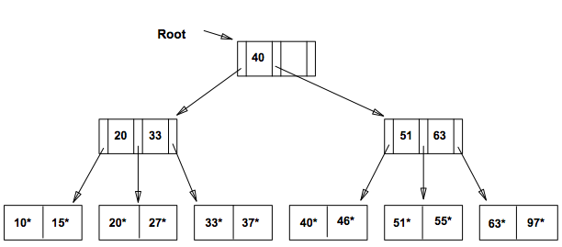
ISAM
Indexed Sequential Access Method
Static data structure
No longer used

Slide 29
ISAM Insertion
find leaf node L
if L not full:
insert data entry
else:
if overflow page not full:
insert data entry
else:
create overflow page
insert data entry

Slide 30
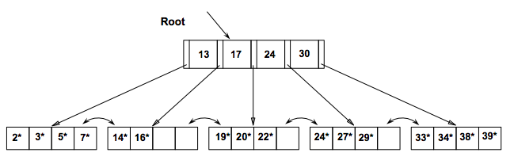
B+ Trees
Dynamic data structure
Most popularly used index
Height balanced
Terminology:
Order d: every node has between d and 2d entries
Fanout F: branches from a node (max: 2d + 1, average: 2/3 * 2d)
Number of leaf pages N

Slide 31
B+ Tree Insertion
find leaf node L
if L not full:
insert data entry
else: // 2d+1 in L
split L into L and L2 // d in L, d+1 in L2
copy up middle key to parent P
while P past capacity: // 2d+1 in L
split P into P and P2 // d in P, d in P2
push up middle key to parent P

Slide 32
Tree-Structured Indices Worksheet

Slide 33
Tree-Structured Indices Exercises
What is the difference between an ISAM and B+ Tree Index?

Slide 34
Tree-Structured Indices Exercises
What is the difference between an ISAM and B+ Tree Index?
ISAM Tree: Static structure. Consists of root, primary leaf pages and overflow pages. Long overflow chains can develop.
B+ Tree: Dynamic structure. Height balanced. Usually preferable to ISAM.
Order d: Each node contains entries
Height: Length of Path from the root to a leaf node
Fanout: The number of pointers out of the node

Slide 35
Tree-Structured Indices Exercises
We are using a B+ tree with alternative 1 (actual data records in leaf pages) to store one billion records. Each records is 200 bytes, each disk page has 16kB (16,384 Bytes) and will always be at most 67% full.
a. Approximately many leaf pages are required?

Slide 36
Tree-Structured Indices Exercises
We are using a B+ tree with alternative 1 (actual data records in leaf pages) to store one billion records. Each records is 200 bytes, each disk page has 16kB (16,384 Bytes) and will always be at most 67% full.
a. Approximately many leaf pages are required?
16384 * 0.67 / 200 = ~54 Entries per page.
10^9 / 54 = ~18.5 * 10^6 pages.

Slide 37
Tree-Structured Indices Exercises
We are using a B+ tree with alternative 1 (actual data records in leaf pages) to store one billion records. Each records is 200 bytes, each disk page has 16kB (16,384 Bytes) and will always be at most 67% full.
b. Assume each index entry takes 32 bytes. What is approximately the maximum fanout of the index?

Slide 38
Tree-Structured Indices Exercises
We are using a B+ tree with alternative 1 (actual data records in leaf pages) to store one billion records. Each records is 200 bytes, each disk page has 16kB (16,384 Bytes) and will always be at most 67% full.
b. Assume each index entry takes 32 bytes. What is approximately the maximum fanout of the index?
16384 * 0.67 / (32) = ~343

Slide 39
Tree-Structured Indices Exercises
We are using a B+ tree with alternative 1 (actual data records in leaf pages) to store one billion records. Each records is 200 bytes, each disk page has 16kB (16,384 Bytes) and will always be at most 67% full.
c. What is the height (# levels of non-leaf nodes) of the tree How many I/O operations are required to insert a new record (assuming there is enough space in the leaf page)?

Slide 40
Tree-Structured Indices Exercises
We are using a B+ tree with alternative 1 (actual data records in leaf pages) to store one billion records. Each records is 200 bytes, each disk page has 16kB (16,384 Bytes) and will always be at most 67% full.
c. What is the height (# levels of non-leaf nodes) of the tree How many I/O operations are required to insert a new record (assuming there is enough space in the leaf page)?
Height = log₃₄₃(18.5 * 10^6) = ~3.
3 non-leaf reads + 1 leaf read + 1 write = 5 I/O’s.

Slide 41
Tree-Structured Indices Exercises
We are using a B+ tree with alternative 1 (actual data records in leaf pages) to store one billion records. Each records is 200 bytes, each disk page has 16kB (16,384 Bytes) and will always be at most 67% full.
d. How many pages are required to store the non-leaf nodes?

Slide 42
Tree-Structured Indices Exercises
We are using a B+ tree with alternative 1 (actual data records in leaf pages) to store one billion records. Each records is 200 bytes, each disk page has 16kB (16,384 Bytes) and will always be at most 67% full.
d. How many pages are required to store the non-leaf nodes?
1 + 343 + 343^2 = 117993

Slide 43
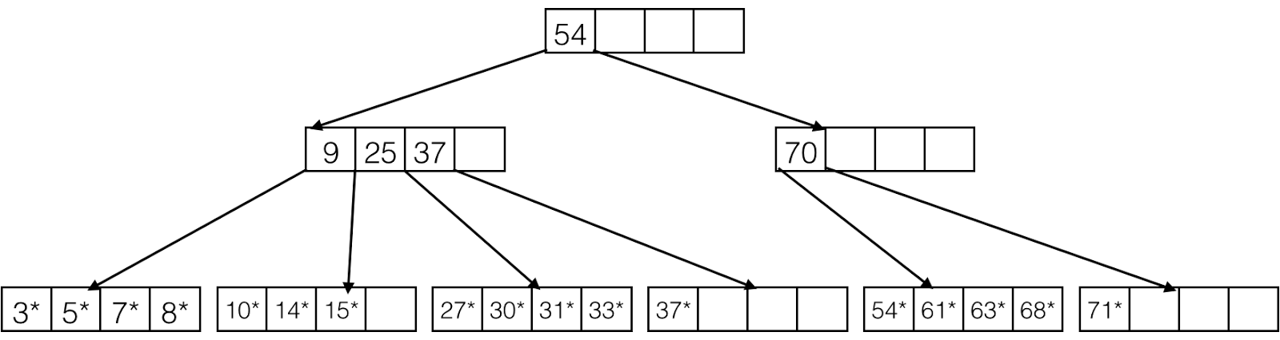
B+ Trees Exercises
Consider the B+ Tree below and insert the following in order: 17, 18, 29

Slide 44
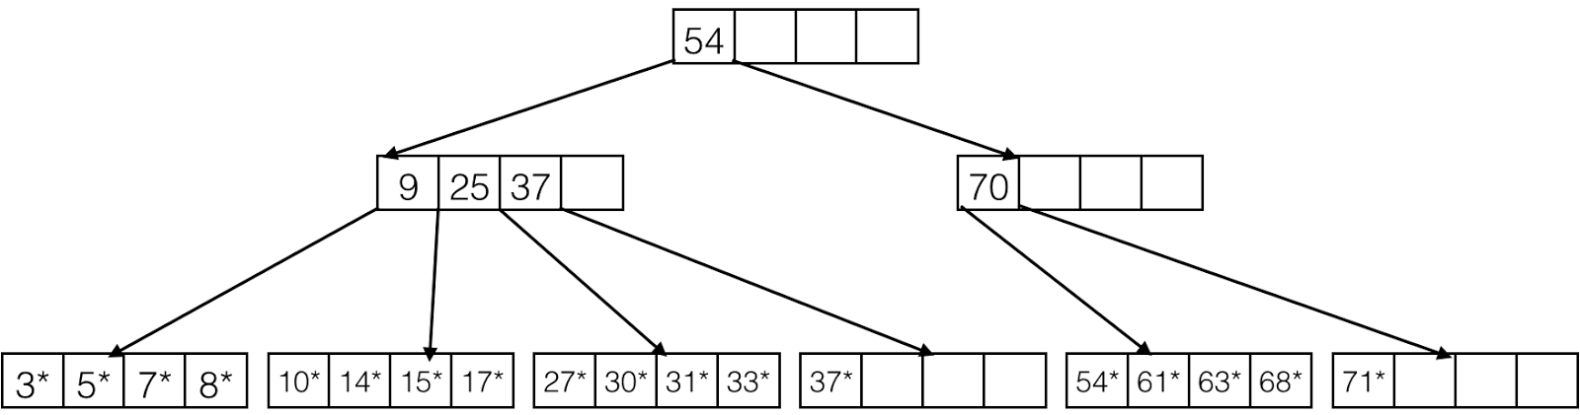
B+ Trees Exercises
Consider the B+ Tree below and insert the following in order: 17, 18, 29

Slide 45
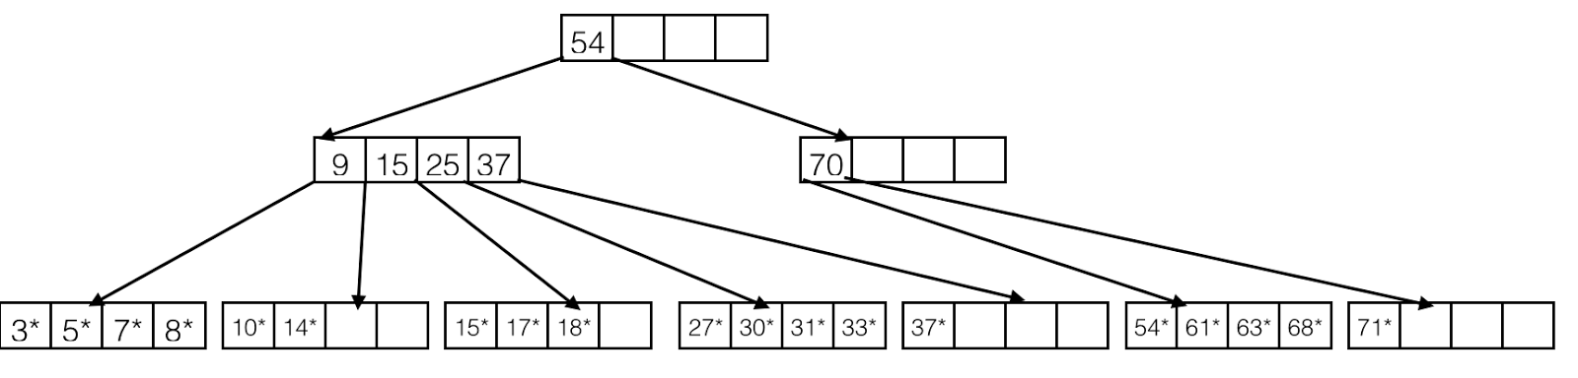
B+ Trees Exercises
Consider the B+ Tree below and insert the following in order: 17, 18, 29

Slide 46
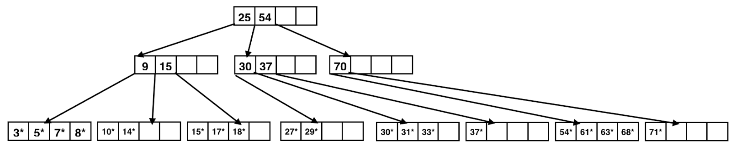
B+ Trees Exercises
Consider the B+ Tree below and insert the following in order: 17, 18, 29

Slide 47
Counting IOs Exercises
Assume that there are 2 million users in your database. Page size is 16kB. Each user entry is 2kB in size. You are performing range queries based on a user's age. Answer the following questions:
You have decided to create a clustered B+ Tree on the age field. The tree has a fanout of 200 and a height of 3. Assume that you are on average returning 50,000 users per query. On average, how many I/O’s are performed by such a query?

Slide 48
Counting IOs Exercises
Assume that there are 2 million users in your database. Page size is 16kB. Each user entry is 2kB in size. You are performing range queries based on a user's age. Answer the following questions:
You have decided to create a clustered B+ Tree on the age field. The tree has a fanout of 200 and a height of 3. Assume that you are on average returning 50,000 users per query. On average, how many I/O’s are performed by such a query?
3 + (50,000 * 2 / 16) = 6,253

Slide 49
Counting IOs Exercises
b. Assume your B+ tree is unclustered. In the worst case, how many I/O's do you need now? Assume that you are still returning 50,000 users per query on average, and that an index entry is 3 times smaller than a user entry.

Slide 50
Counting IOs Exercises
b. Assume your B+ tree is unclustered. In the worst case, how many I/O's do you need now? Assume that you are still returning 50,000 users per query on average, and that an index entry is 3 times smaller than a user entry.
3 I/Os to descend non-leaf index pages
ceil(50,000 * 2/3 / 16) = 2084 I/Os to read leaf index pages
50,000 I/Os to read unordered data pages
So 3 + 2084 + 50,000 = 52,087 I/Os.

