Slide 1
CS186 Discussion 9
(Lock Granularity, Multiversion Concurrency Control, 2PC)
Matthew Deng

Slide 2
Lock Granularity

Slide 3
Lock Granularity
Select amount to lock
Used with 2PL to
guarantee serializability
Steps:
Start at root
Get locks top-down
Release locks bottom-up
Database
contains
Tables
contains
Pages
contains
Tuples

Slide 4
Intent Locks
S: shared lock for reading
X: exclusive lock for writing (and reading)
IS: intent to get S lock(s) at finer granularity
IX: intent to get X lock(s) at finer granularity
SIX: shared lock with intent to get X lock(s) at finer granularity

Slide 5
Lock Compatibility Matrix
 | S | X
S | √ | –
X | – | –

Slide 6
Lock Compatibility Matrix
 | IS | IX | SIX | S | X
IS
IX
SIX
S |  |  |  | √ | –
X |  |  |  | – | –

Slide 7
Lock Compatibility Matrix
 | IS | IX | SIX | S | X
IS | √ | √ | √ | √ | –
IX | √ | √ | – | – | –
SIX | √ | – | – | – | –
S | √ | – | – | √ | –
X | – | – | – | – | –

Slide 8
Lock Granularity Exercises

Slide 9
Lock Granularity Exercises
Suppose a transaction, T1, wants to scan a table R and update a few of its tuples. What kind of locks should T1 have on R, its pages, and the tuples that are updated?

Slide 10
Lock Granularity Exercises
Suppose a transaction, T1, wants to scan a table R and update a few of its tuples. What kind of locks should T1 have on R, its pages, and the tuples that are updated?
SIX lock on R
IX lock on pages
X lock on updated tuples

Slide 11
Lock Granularity Exercises
Is an S lock compatible with an IX lock? Explain why or why not. Make your description as simple as possible.

Slide 12
Lock Granularity Exercises
Is an S lock compatible with an IX lock? Explain why or why not. Make your description as simple as possible.
Suppose T1 wants an S lock on an object, O, and T2 wants an IX lock on the same object O. An S lock implies that T1 will read the entire object (all of its sub-objects). An IX lock implies that T2 will write some of the sub- objects of the object. This means that there is some sub- object of O that T1 will read and T2 will write. This is not valid, so the S and IX locks must be incompatible.

Slide 13
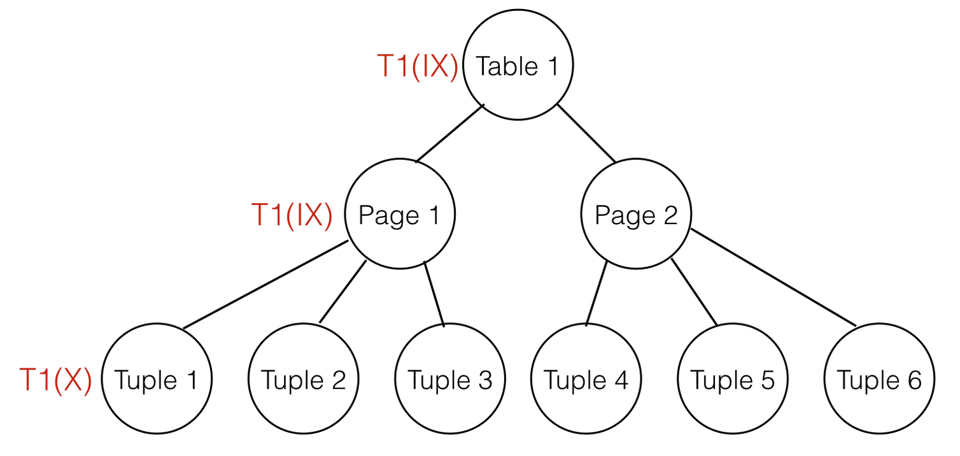
Lock Granularity Exercises
Given that transaction T1 has an IX lock on table 1, an IX lock on page 1, and an X lock on tuple 1, which locks could be granted to transaction T2 for tuple 2?

Slide 14
Lock Granularity Exercises
Given that transaction T1 has an IX lock on table 1, an IX lock on page 1, and an X lock on tuple 1, which locks could be granted to transaction T2 for tuple 2?
X, S

Slide 15
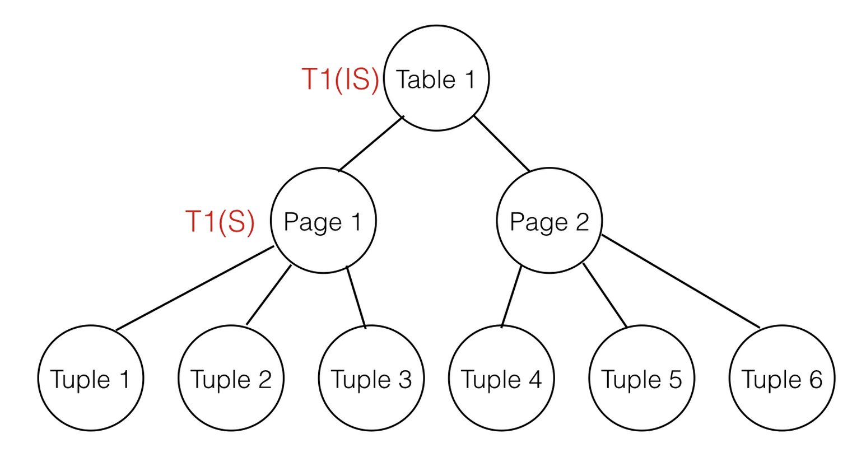
Lock Granularity Exercises
Given that T1 has an IS lock on table 1 and an S lock on page 1, what locks could be granted to T2 for page 1?

Slide 16
Lock Granularity Exercises
Given that T1 has an IS lock on table 1 and an S lock on page 1, what locks could be granted to T2 for page 1?
S, IS

Slide 17
Multiversion Concurrency Control

Slide 18
Multiversion Concurrency Control
Timestamp Ordered Multiversion Concurrency Control
Alternative to 2PL

Slide 19
Multiversion Concurrency Control
For each object, keep track of its “timeline”
Reads: {R-ts}
Versions: {<W-ts, value>}
Read_{ts}(x):
Read value of version with with highest W-ts < ts
Add ts to Reads
Write_{ts}(x, v):
If lowest R-ts > ts comes before lowest W-ts > ts:
abort
Else:
add <ts, v> to Versions

Slide 20
Multiversion Concurrency Control Exercises

Slide 21
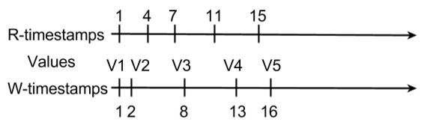
MVCC Exercises
For the given timeline of timestamps for a value X, fill out the rest of the timeline for the following reads and writes: R(X)@17, W(X)@18, W(X)@14, W(X)@12, R(X)@20, R(X)@19, R(X)@23, W(X)@26, W(X)@24

Slide 22
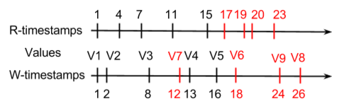
MVCC Exercises
For the given timeline of timestamps for a value X, fill out the rest of the timeline for the following reads and writes: R(X)@17, W(X)@18, W(X)@14, W(X)@12, R(X)@20, R(X)@19, R(X)@23, W(X)@26, W(X)@24

Slide 23
Two Phase Commit

Slide 24
Two Phase Commit
Distributed database concurrency control
Phase 1 (voting phase):
Coordinator asks participants
Participants vote yes or no
Phase 2 (commit phase):
If all participants voted yes, commit
Else, abort

Slide 25
Two Phase Commit Exercises

Slide 26
Two Phase Commit Exercises
What ACID properties does TPC ensure? How does TPC ensure these properties?

Slide 27
Two Phase Commit Exercises
What ACID properties does TPC ensure? How does TPC ensure these properties?
TPC ensures atomicity and durability by ensuring that a write happens across ALL replicas or NONE of them.

Slide 28
Two Phase Commit Exercises
What command does the MASTER need to issue in order to persist the changes of a transaction? What needs to happen in order for this command to be issued?

Slide 29
Two Phase Commit Exercises
What command does the MASTER need to issue in order to persist the changes of a transaction? What needs to happen in order for this command to be issued?
Must issue a GLOBAL-COMMIT. This can only happen when all of the slaves have voted to commit.

Slide 30
Two Phase Commit Exercises
Preview: What role does logging play in TPC?

Slide 31
Two Phase Commit Exercises
Preview: What role does logging play in TPC?
Failure handling

