Slide 1
Breast Cancer
Diagnosis and Prognosis
Final Project Presentation
Kendra Castellanos, Kwasi Mensah, Alyssa Moylan, & Matt Smith
September 23, 2022

Slide 2
Introduction – Scope/Context
For this project we explored the Wisconsin Diagnostic and Prognostic Breast Cancer data sets (UCI, 2007).
The diagnostic data set contains 569 records of 32 attributes (18,208 data points) and the prognostic data set contains 198 records of 34 attributes (6,732 data points) (UCI, 2007).
All analyses in this project were conducted with the R language in RStudio

Slide 3
Introduction – High Level Background
These data sets were first used by faculty from the University of Wisconsin (General Surgery and Computer Science departments) (UCI, 2007).
The diagnostic data set was first used in a study to analyze images of cancer cells in both benign and malignant cases (Street, Wolberg, & Mangasarian, 1993).
For the prognostic data set, the same researchers took the features from the diagnostic set, along with two traditional variables used to predict recurrence/nonrecurrence, and analyzed the relationships (Street, Mangasarian, & Wolberg, 1995).

Slide 4
Business Questions
Using the data sets described above, our team set out to answer the following questions:
Which variables are the most determinant of a benign or malignant breast cancer case (in Wisconsin).
What factors most/least affect a Recur/Non-Recur prognosis?
Who is at the most risk for occurrence?
Can we develop a model that accurately predicts a benign/malignant diagnosis or a recur/non-recur prognosis?

Slide 5

Data Acquisition, Cleaning and Transformation
`tidyverse` package (v1.3.2, Wickham et al., 2019)
Initial data variables (column headers) were not named; used data dictionary provided with column positions to rename the columns.
  See Appendix C and D in group 4 project paper for compete data dictionary.
Created two base data frames to work with:
  `df_wdbc` - cleaned data for diagnosis set
  `df_wpbc` - cleaned data for prognosis set

Slide 6
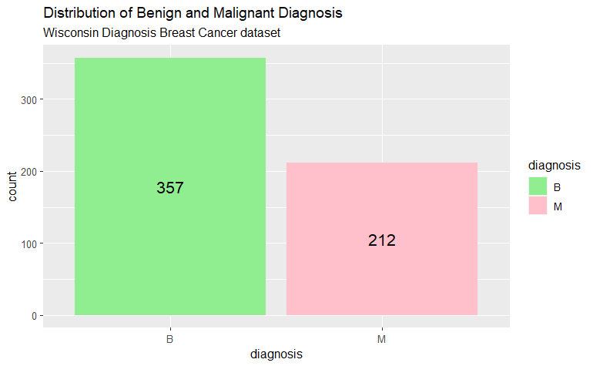
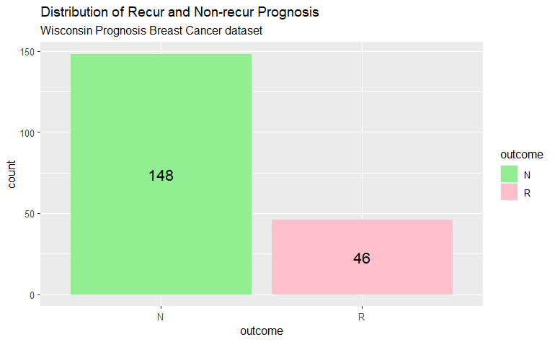
Demographic Statistics
Data did not have traditional demographic characteristics (gender, age, etc.)

Slide 7
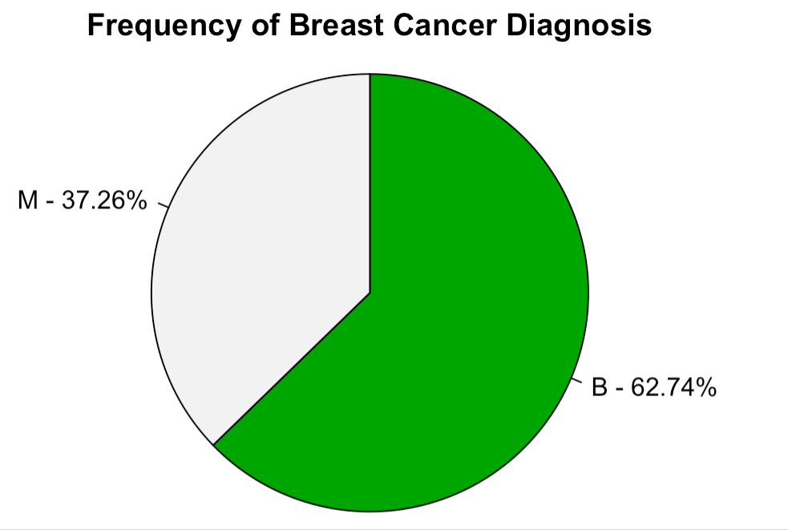
Demographic Statistics (cont.)
Most of the records in the diagnostics data set were of a benign diagnosis

Slide 8
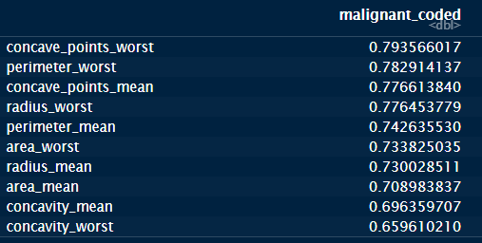
Initial Findings: Pre-Modeling
The following variables/factors were found to have the highest positive correlation with a malignant diagnosis.

Slide 9
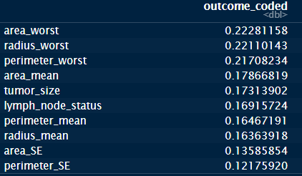
Initial Findings: Pre-Modeling (cont.)
These were the highest positive correlations with a cancer recurrence.

Slide 10
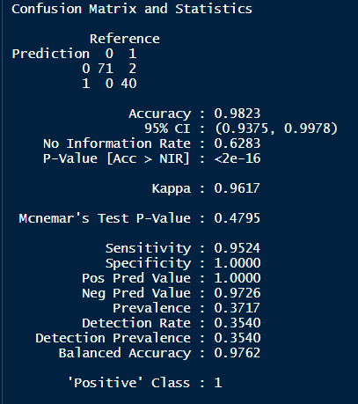
Modeling – Support Vector Machine
We chose a Support Vector Machine (SVM) to start as our first attempt at modeling these two datasets.
For the diagnosis data set, the SVM model created had a balanced accuracy of approximately 97%, with two false negatives (a benign prediction for malignant diagnosis), and a model significance of p < .001.
Scaling the independent variables in both datasets produced the same exact results as shown above, not providing any additional accuracy.

Slide 11
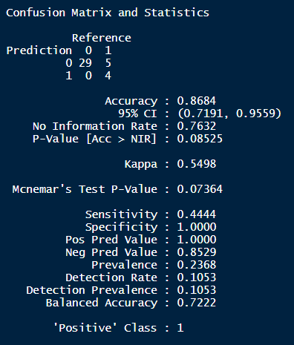
Modeling – Support Vector Machine (cont.)
The prognosis data set was not as accurate with a balanced accuracy of approximately 72%, and a model significance of p > 0.05 (~0.08).
Scaling the independent variables in both datasets produced the same exact results as shown above, not providing any additional accuracy.

Slide 12
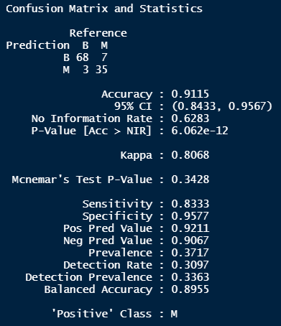
Modeling – Decision Tree Classifier
Accuracy
To see if we could improve our accuracy, we looked at creating a decision tree model for both datasets.
Again, for the diagnosis data set, the Decision Tree Classifier model created a relatively accurate model with a balanced accuracy of approximately 90%, with seven false negatives (a benign prediction for malignant diagnosis) and three false positives (a malignant prediction for a benign diagnosis), and a model significance of p < .001.
Scaling the independent variables in both datasets produced the same exact results as shown above, not providing any additional accuracy.

Slide 13
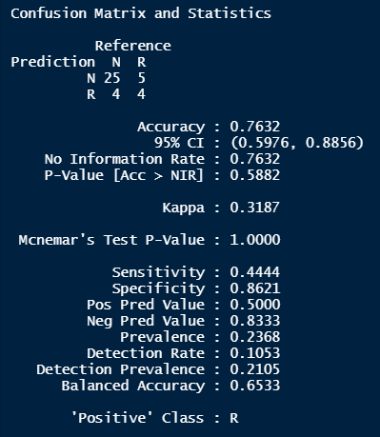
Modeling – Decision Tree Classifier
Accuracy (cont.)
The prognosis data set, again, was not as accurate with a balanced accuracy of approximately 65%, and a model significance of p > 0.1 (~0.6).
Scaling the independent variables in both datasets produced the same exact results as shown above, not providing any additional accuracy.

Slide 14
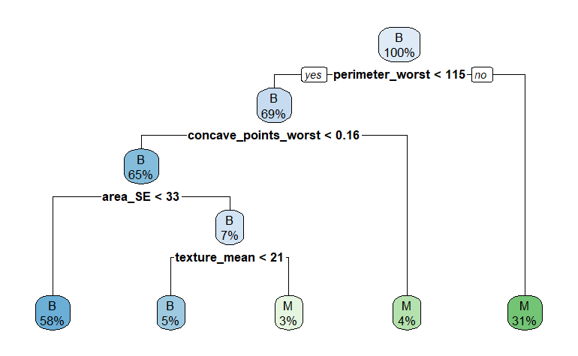
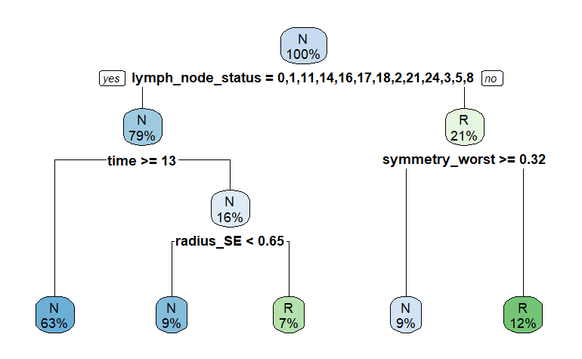
Modeling – Decision Tree Classifier
Visualizing the Models
Decision Tree Classifier plot - Diagnostic
Decision Tree Classifier plot – Prognostic

Slide 15
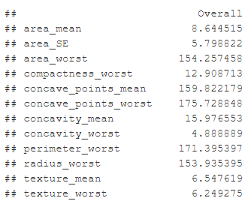
Interpterion of Results – SVM Model
From the SVM model on the diagnostic data set, we can say for certain that an accurate model (98.23%) can be produced in order to predict breast cancer in patients (at least with the data provided); answering business question #4.
However, the same cannot be said for the prognostic data provided, which also did not produce a statistically significant model (p > 0.05).
  We believe that this is possibly due to an initial cancer diagnosis being easier to recognize, but not easily predicted to return in the patient or not. It is also possible that the independent variables chosen for the prognosis dataset were not statistically significant or relevant to the prediction of a cancer recurrence.
Further investigation and data gathering may be required (related to business question #2).
  Based on this, we cannot determine the answer for our business question #3 at this time.

Slide 16
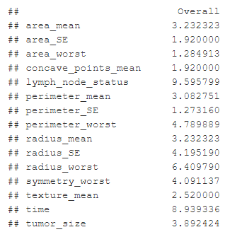
Interpterion of Results – Decision Tree Model
The Decision Tree Classifier model created for both datasets yielded the same results as the SVM
  Higher accuracies in the diagnosis data model versus the prognosis data model.
Exploring this method of modeling also provided insight into the most important factors influencing a malignant/benign cancer diagnosis (see Figure 20 and 21).
  This insight can help us answer business question #3 and shows us the factors that must be watched closely when monitoring the status of a cancer patient.

Slide 17
Questions?

Slide 18
References
Street, W. N., Wolberg, W. H., & Mangasarian, O. L. (1993). Biomedical image processing and biomedical visualization. doi:10.1117/12.148698
Street, W. N., Mangasarian, O. L., & Wolberg, W. H. (1995). An Inductive Learning Approach to Prognostic Prediction. Machine Learning Proceedings 1995, 522–530. doi:10.1016/b978-1-55860-377-6.50071-2
UCI (2007). UCI machine learning repository: Breast cancer wisconsin (Diagnostic) dataset. Retrieved from https://archive.ics.uci.edu/ml/datasets/Breast+Cancer+Wisconsin+%28Diagnostic%29.
UCI (2007). UCI machine learning repository: Breast cancer wisconsin (Prognostic) dataset. Retrieved from https://archive.ics.uci.edu/ml/datasets/Breast+Cancer+Wisconsin+%28Prognostic%29.
Wickham, H., Averick, M., Bryan, J., Chang, W., McGowan, L., François, R., Grolemund, G., Hayes, A., Henry, L., Hester, J., Kuhn, M., Pedersen, T., Miller, E., Bache, S., Müller, K., Ooms, J., Robinson, D., Seidel, D., Spinu, V., … Yutani, H. (2019). Welcome to the tidyverse. Journal of Open Source Software, 4(43), 1686.

