Slide 1

ECON 002: Principles of Macroeconomics
Lecture 4: GDP and Stable Prices

Slide 2

GDP: the market value of all final goods and services produced for a marketplace during a period of time, within a country’s borders
“Within a Country’s Borders”
GDP: Production within the geographical border of a country.
Can also be a City, State, Continent or Planet!
Gross National Product (GNP): Production by citizens of a country, no matter where they are

Slide 3

Measuring GDP
Most common way to measure GDP is the Expenditure Approach
Bureau of Economic Analysis (www.bea.gov) National Income and Product Accounts (NIPA) table
Four General Categories
Consumptions of goods and services (C): purchases by the households
Private investment of goods and services (I): purchases by firms/businesses
Government goods and services (G): purchase by governments
Net Exports (NX) = Exports (X) – Imports (M): net purchases by foreigners
Exports (X): Goods sold by home country, money comes from abroad
Imports (M): Goods bought by home country, money goes abroad
GDP defined as Y = C + I + G + NX

Slide 4

Y = C + I + G + NX
Consumption (C)
Consumption (67%): a final good or service purchased by a household
Goods (21%): a tangible item that consumers gain ownership over when purchasing
Durable Goods (9.5%): Motor Vehicles, Furniture, Recreation Goods
Non-Durable Goods (14.9%): Food, Clothing, Gasoline
Services (47%): an intangible good that we purchase but do not gain ownership of: health care, airline tickets, financial services, etc.

Slide 5

Incorporating Housing
Are homes a durable good?
New homes are considered an investment Household buying a home ~ Firm purchasing a plant
Households do not take their home when they move
Rental Housing: counted as a service
Imputed Rent: the cost to you if you rented your home
If your home would rent for $1,000/month = $12,000/year, count $12,000 in “imputed rent” as a service
Housing Services make up 12% of the total GDP!

Slide 6

Y = C + I + G + NX
Investment (I)
Investment (18%): goods and services purchased by firms
Nonresidential Investment (13.9%): Capital machinery and plants
Tractor, Assembly Line Part, Computer, Software, Desk, Building/Plant
Residential Investment (4.0%): New home construction
Change in Private Inventories (~0%)

Slide 7

Change in Private Inventories
Campus Bookstore in 2024
$10,000 worth of hoodies made and up for sale!
GDP in 2024 increases by $10,000
Sell $8,000 worth of hoodies
Consumption in 2024 increases by???
$2,000 worth of hoodies unsold at the end of the year
Added to inventory/stock room/etc.
Increase inventory in 2024 = increase investment in 2024
﻿
Campus Bookstore in 2025
Remaining $2,000 in hoodies sold!
Consumption in 2025 increases by $2,000
Where did the hoodies come from?
Inventory/stock room/etc. (not produced)
Decrease in inventory of $2,000
Change in Inventory = -$2,000
Investment decreases by $2,000 in 2025
Total Change in 2025 GDP? $0
Consumption = +$2,000, Investment = -$2,000﻿

Slide 8

Y = C + I + G + NX
Government Purchases (G)
Government Purchases (17.2%): Goods and services that the government buys
Federal Spending (6.5%): bought by the Federal Government
National Defense (3.7%)
What else?
State and Local Spending (10.7%): bought by local governments
Does not include transfer payments such as Social Security, Unemployment Benefits, Welfare. Why?

Slide 9

Y = C + I + G + NX
Net Exports (NX)
Net Exports (NX) = Exports (X) minus Imports (M) = X – M
Exports (X) : Goods and services purchased BY foreign entities
Imports (M) : Goods and services bought FROM foreign entities
Exports are 10.8% of GDP
Imports are 13.2% of GDP
Net Exports are 10.8% - 13.2% = -2.4% of GDP

Slide 10
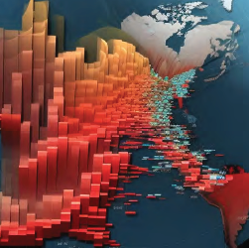
Y = C + I + G + NX
US Nominal GDP in 2025 Q3
C = 21.11 Trillion
I = 5.42 Trillion
G = 5.32 Trillion
X = 3.36 Trillion
M = 4.12 Trillion
Y = 21.11 + 5.42 + 5.32 + (3.36 – 4.12) =
31.095 Trillion

Slide 11
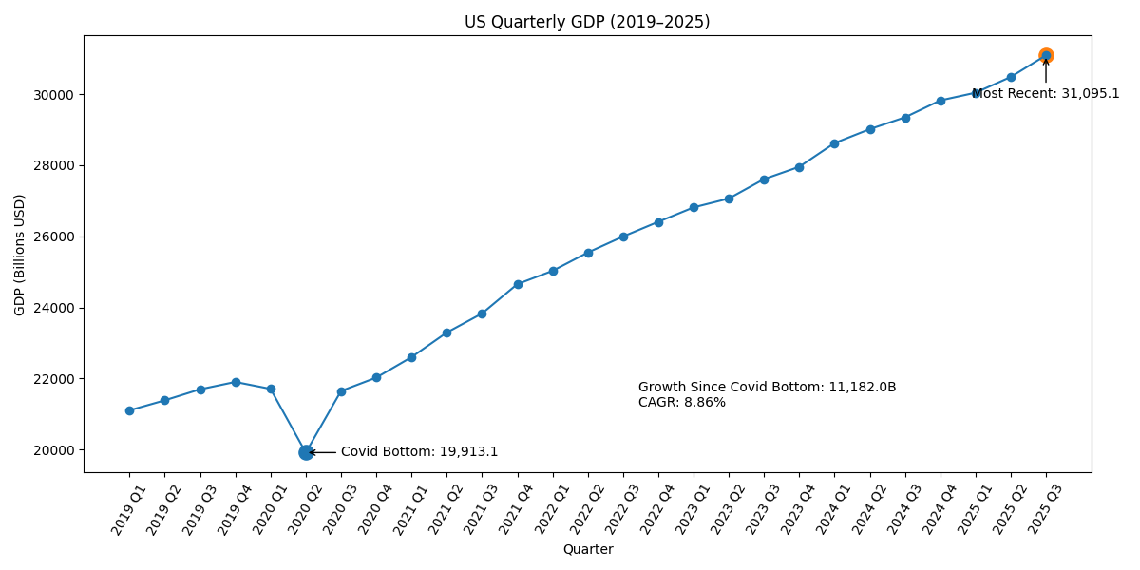
Total US GDP
Year | Q1 | Q2 | Q3 | Q4
2019 | 21,104.1 | 21,384.8 | 21,694.3 | 21,902.4
2020 | 21,706.5 | 19,913.1 | 21,647.6 | 22,024.5
2021 | 22,600.2 | 23,292.4 | 23,829.0 | 24,654.6
2022 | 25,029.1 | 25,544.3 | 25,994.6 | 26,408.4
2023 | 26,813.6 | 27,063.0 | 27,610.1 | 27,957.0
2024 | 28,624.1 | 29,016.7 | 29,349.9 | 29,825.2
2025 | 30,042.1 | 30,485.7 | 31,095.1

Slide 12
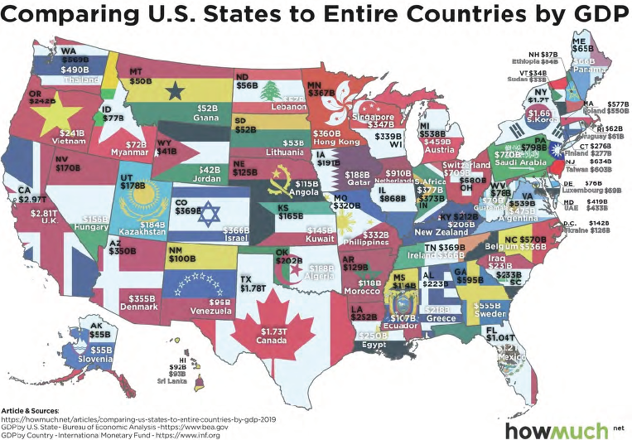
State GDP by Country

Slide 13

Alternative Measures of GDP
Remember Best Buy:
Step 1: Raw materials are gathered, sold to parts manufacturer for $50 Step 2: Parts are created by manufacturer and sold to Dell for $150 Step 3: Dell assembles the computer and sells to Best Buy for $350 Step 4: Best Buy sells computer to you for $400
We only add the final $400 sale to GDP (do not double count!)
Each stage of the production process adds value to the final product
Step 1: $50 in raw materials sold to parts manufacturer ($50 in value) Step 2: $50 in raw materials sold becomes $150 worth of parts ($100 in value-added) Step 3: $150 in parts assembled and sold for $350 ($200 in value-added) Step 4: $350 computer sold for $400 at central location ($50 in added-value)
Each step adds value to the product = “Profit” of the firm
Value-Added GDP = 50 + 100 + 200 + 50 = $400
Value-Added GDP = Firm Profit

Slide 14
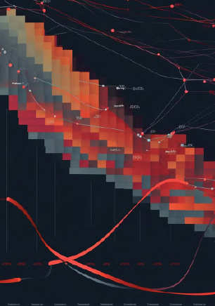
Alternative Measures of GDP
Best Buy made $50. Who gets that $50?
Labor = Income
Rent = Landlord Income
Interest Payment = Bank/Lender = Income
Owner = Income
Factor Payments GDP = Household Income!
GDP = Y =
Total Production (Expenditure Approach)
Firm Profit (Value-Added Approach)
Household Income (Factor Payments Approach)

Slide 15
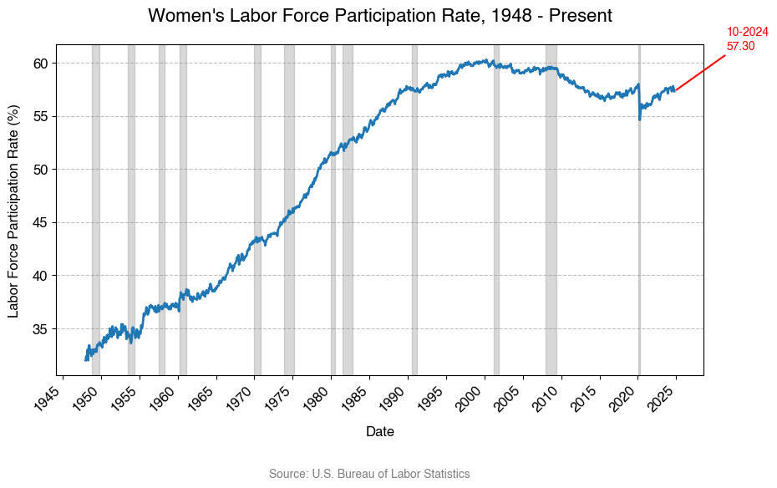
Shortcomings of GDP
Household Activities: GDP ignores vital household activities like childcare and home maintenance
Illegal Sales and Work: GDP does not capture illegal sales and work in the black market or underground economy.
Changing Labor Force Dynamics: GDP overlooks gig economy and changes in the characteristics of workers and jobs

Slide 16
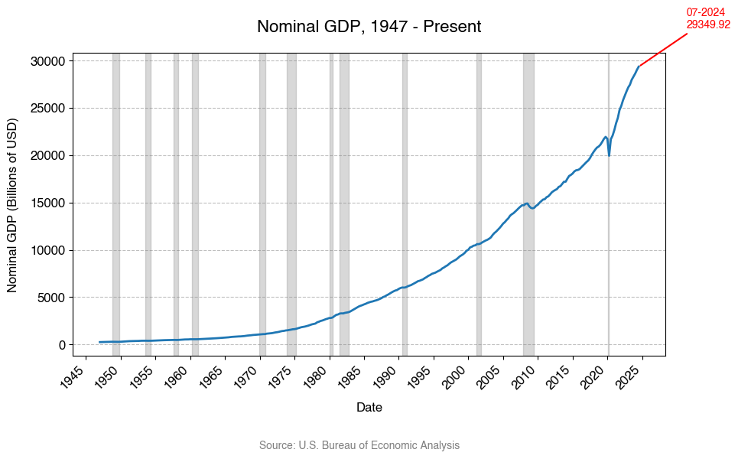
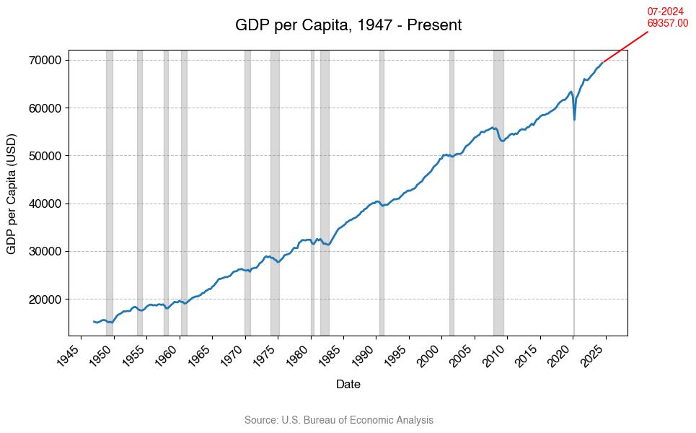
GDP and Well Being?
GDP/Capita, Inequality, Health, Gross National Happiness (GNH)

Slide 17
Calculating GDP
Simple UCSB Economy
 | 2009
Product | Quantity | Price
Food
Housing
Movies

Slide 18
Calculating GDP
Simple UCSB Economy
 | 2009 |  | 2016
Product | Quantity | Price | Quantity | Price
Food
Housing
Movies

Slide 19
Calculating GDP
Simple UCSB Economy
 | 2009 |  | 2016
Product | Quantity | Price | Quantity | Price
Food | 1000 | 1 | 1500 | 2
Housing | 100 | 100 | 150 | 150
Movies | 500 | 5 | 1000 | 10

Slide 20
Calculating GDP
Nominal GDP: Value of final goods and services evaluated at current year prices
Total dollars exchanged
Real GDP: Value of final goods and services evaluated at base year prices
Value of dollars exchanged if prices did not change from the prices in an arbitrary (base) year
GDP Deflator: Measure of how much nominal GDP changes are driven by price changes

Slide 21
Using the Deflator to Calculate Price Increases
How much did prices increase between 2009 and 2017?
How much did real GDP increase between 2009 and 2017?

Slide 22
Real GDP vs Nominal GDP with a single good
Movie | World Gross (Nominal) | Movie
1. Avatar (2009) | $2,923,706,026
2. Avengers: Endgame (2019) | $2,799,439,100
3. Avatar: The Way of Water (2022) | $2,320,250,281
4. Titanic (1997) | $2,264,743,305
5. Star Wars: The Force Awakens (2015) | $2,071,310,218
6. Avengers: Infinity War (2018) | $2,052,415,039
7. Spider-Man: No Way Home (2021) | $1,921,847,111
8. Jurassic World (2015) | $1,671,537,444
9. The Lion King (2019) | $1,663,075,401
10. The Avengers (2012) | $1,520,538,536

Slide 23
Real GDP vs Nominal GDP with a single good
Movie | Worldwide Gross (Nominal) |  | Movie | Ticket Sales
1. Avatar (2009) | $2,923,706,026 |  | 1. Gone w/the Wind (1939) | 202,044,600
2. Avengers: Endgame (2019) | $2,799,439,100 |  | 2. Star Wars (1977) | 178,119,600
3. Avatar: The Way of Water (2022) | $2,320,250,281 |  | 3. Sound of Music (1965) | 142,415,400
4. Titanic (1997) | $2,264,743,305 |  | 4. ET (1982) | 141,854,300
5. Star Wars: The Force Awakens (2015) | $2,071,310,218 |  | 5. Titanic (1997) | 135,474,500
6. Avengers: Infinity War (2018) | $2,052,415,039 |  | 6. The Ten Commandments (1956) | 131,000,000
7. Spider-Man: No Way Home (2021) | $1,921,847,111 |  | 7. Jaws (1975) | 128,078,800
8. Jurassic World (2015) | $1,671,537,444 |  | 8. Doctor Zhivago (1965) | 124,135,500
9. The Lion King (2019) | $1,663,075,401 |  | 9. Exorcist (1973) | 110,599,200
10. The Avengers (2012) | $1,520,538,536 |  | 10. Snow White and the 7 Dwarfs (1937) | 109,000,000

Slide 24

Stable Prices
Goal 2: Stable Prices
Inflation = Prices are rising
Deflation = Prices are falling
How much do consumers care about all prices?
What is the ideal level of inflation/deflation?

Slide 25

Federal Reserve’s “Stable Prices”
Why is the inflation target not higher?
Today —————————————6 Months———————————1 Year
Invest, Prepare —————————Produce—————————Sell at Expected Price
As prices rise, workers expect cost-of-living adjustments/wage increases
Example: Inflation is 25% away than expectations.
If inflation expectations are 2%, inflation range is 1.5% to 2.5%
If inflation expectations are 50%, inflation ranges from 37.5% to 62.5%
At 37.5% inflation, firms don’t sell at high enough prices to pay input costs.﻿
﻿At 62.5% inflation, workers don’t get raises to match the increasing prices of goods.

Slide 26

Federal Reserve’s “Stable Prices”
Why is the inflation target not lower?
Deflation:
1. Consumer Response: When the prices of goods and services are expected to decrease, consumers delay purchases.
Less spending = Less production = Lower GDP = Unemployment
2. Debt Burden:
Situation: $50,000 loan today, have to payback in 25 years $50,000 in 25 years is equivalent to $30,477 today at 2% inflation. Wages, prices, etc. rise, so the debt burden ($50,000) is less costly over time.
If prices are falling and interest rates don’t adjust, debt burden is growing! Deflation-still owe $50,000, but wage, prices, etc. have decreased! At 2% deflation for 25 years, $50,000 today is equivalent to $82,000 in 25 years!
3. Wage Adjustments
Real Wage Growth = Nominal Wage Growth –Inflation Rate
Easier to decrease real wage than nominal wage

Slide 27

Consumer Price Index
GDP Deflator Growth: measure of inflation
Do the prices of ALL goods and services matter to consumers?

Slide 28

Consumer Price Index
How do we calculate an “average price” for all goods purchased by consumers?
STEP 1: What do consumers purchase?
Determine basket of goods:

Slide 29

Consumer Price Index
How do we calculate an “average price” for all goods purchased by consumers?
STEP 2: How heavy is each good in the basket?
Determine the weight of goods and services in the basket:

Slide 30

Consumer Price Index
How do we calculate an “average price” for all goods purchased by consumers?
STEP 3: Calculate the weighted cost of a basket
Similar to GDP, calculate the cost of the average good bought by a household

Slide 31

Consumer Price Index
Calculate Base Year (BY) Basket Cost: BY Prices x BY Q
Calculate Current Year (CY) Basket Cost: CY Prices x BY Q
CPI = Ratio of Basket Costs
Inflation = CPI Growth Rate

Slide 32
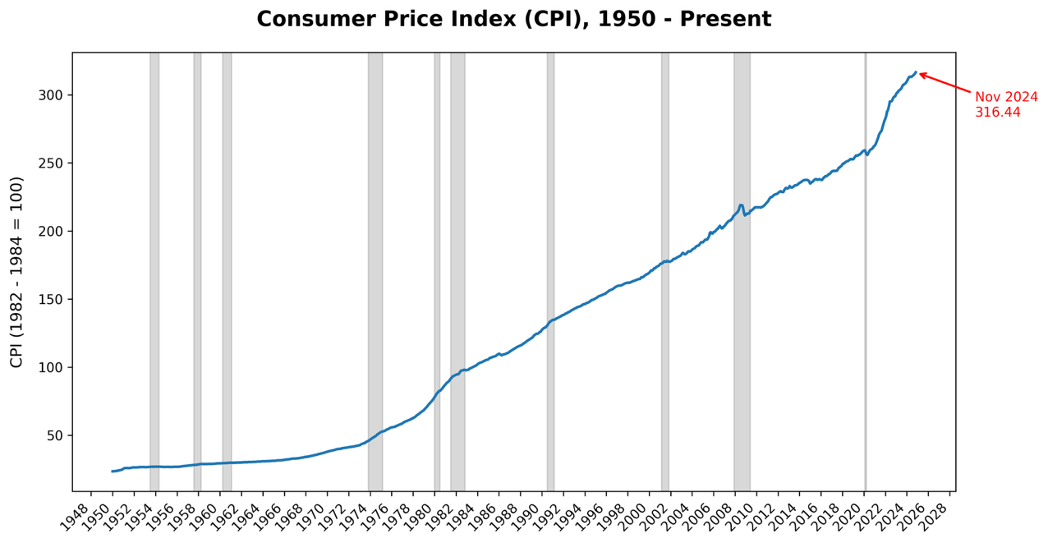
Consumer Price Index
Base Year: 1982-1984 Average Weights/Prices, CPI = 100
Today (November, 2024), CPI =316.44
1950 CPI = 24

Slide 33

Is the CPI an accurate measure of inflation?
Some Potential Problems with CPI
Substitution, quality, and new products can distort inflation measurements.
Consumers may change buying habits and price hikes may not always correlate with improved quality.
CPI doesn't cover new products or cheap stores/websites.
Economists believe it overestimates inflation by 0.5-1%.

