Slide 1

Econ 2 Principles of Macroeconomics
Lecture 15: Monetary Policy, Aggregate Demand/Aggregate Supply

Slide 2

Fractional Reserve Banking
Bank: a firm that specializes in brokering between savers and borrowers, allowing borrowers to go to one firm instead of 1000s
Banks are only required to keep a fraction of their deposits on hand as reserves
Lends out the rest
Creates new money in the form of a deposit in the borrower's account
Deposit effectively increases the overall money supply
Governments regulate banks and provide deposit insurance to protect depositors' funds.

Slide 3
Monetary Policy
Buying and selling Treasuries changes the money supply → bond price → interest rate
Target the Federal Funds Rate: the interest rates banks charge other banks for loans
determines flexibility in the banking system since banks can loan out more than they borrow
other important interest rates tend to follow the Federal Funds rate

Slide 4
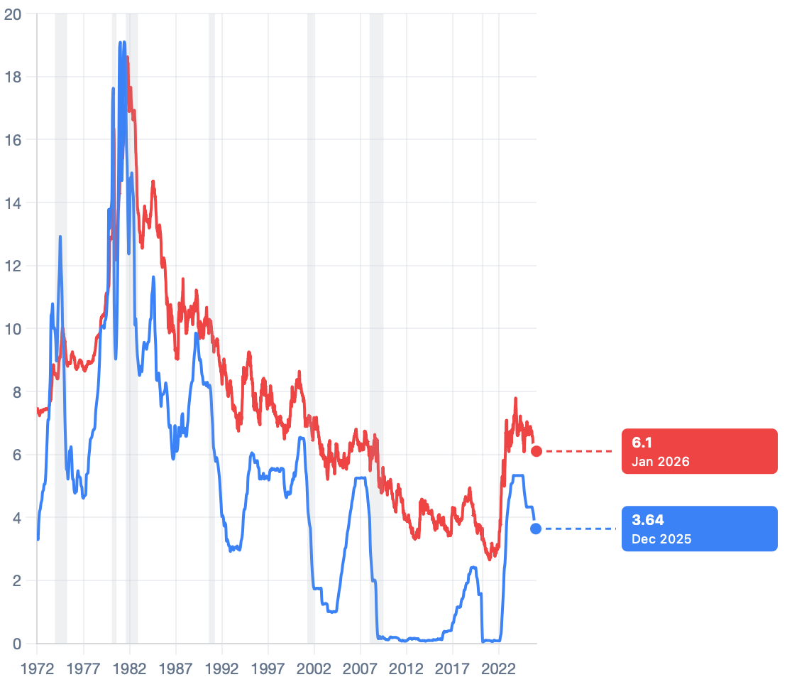
Federal Funds Rate vs 30 Year Mort. Rate

Slide 5
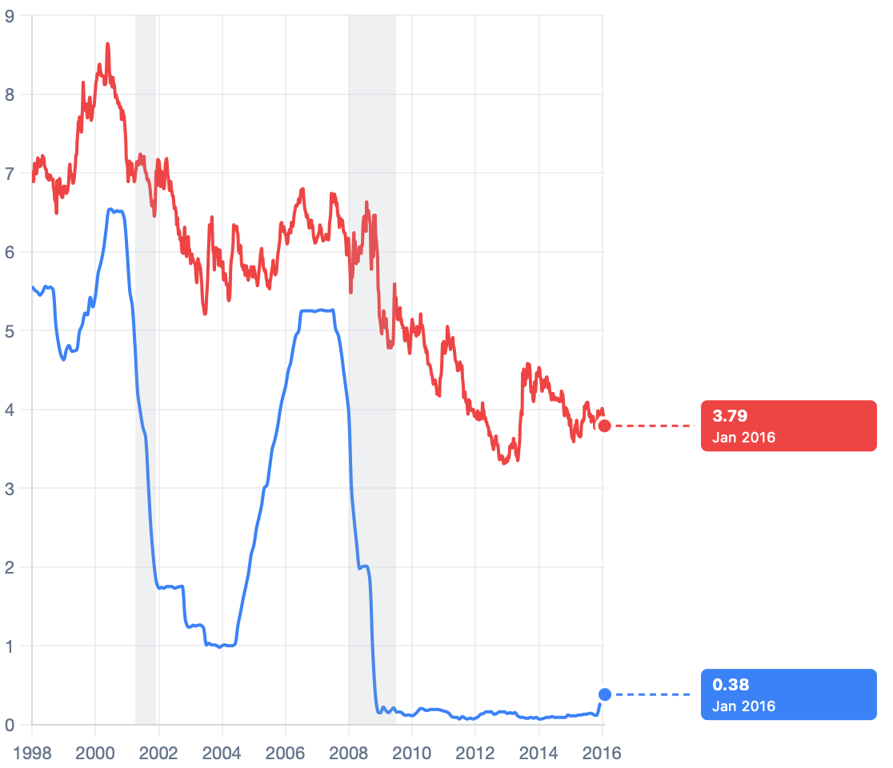
Federal Funds Rate vs 30 Year Mortgage Rate, 97-16

Slide 6
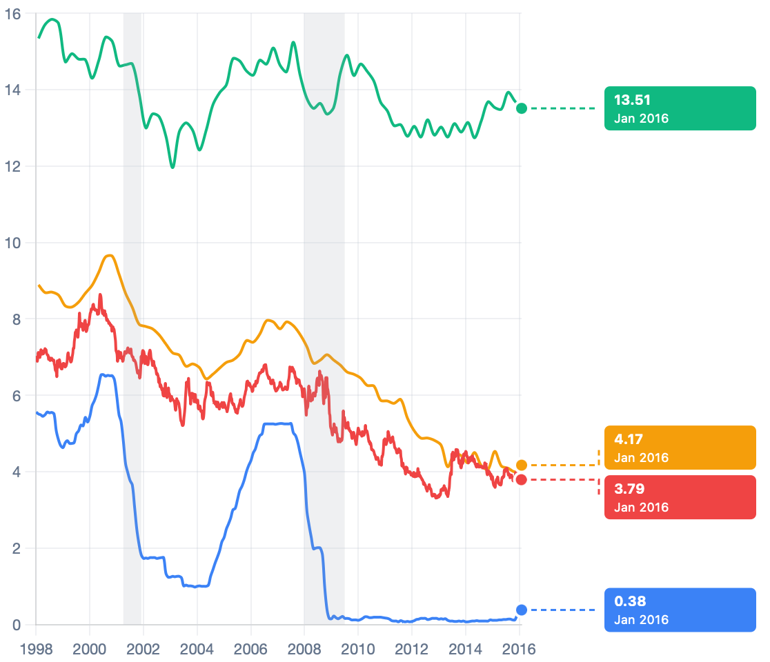
Federal Funds Rate vs Interest Rates

Slide 7

Demand for Money
Connect Monetary Policy to Interest Rates through the market for money
Demand for Money: Why hold on to money (M1 Money)?

Slide 8

Demand for Money
Wealth Box:
Money Other Assets

Slide 9

Demand for Money
Benefit of holding wealth in the form of money :
Cost of holding wealth in the form of money:
Price of money vs. Return on illiquid assets?

Slide 10

Demand for Money
Interest Rate = r
Demand for Money:

Slide 11
Demand for Money

Slide 12
Demand for Money
Point A:
r = 5%
Money Other Assets
1 trillion

Slide 13
Demand for Money
Point A to Point B:
r = 5% r = 4%
Money = Other 2.0 trillion Assets

Slide 14
Demand for Money
What shifts the demand for money?

Slide 15
Demand for Money
Point A: r = 5%
P = 100
Money = Other Assets
1 trillion

Slide 16
Demand for Money
Point A to Point D:
P = 100 P = 120
Money = Other 2.5 trillion Assets

Slide 17
Demand for Money
What shifts the demand for money?

Slide 18
Demand for Money
Point A: r = 5%, P=100
Y = 2
Money = Other Assets
2 trillion

Slide 19
Demand for Money
Point A to Point F: r = 5%, P=100
Y = 1
Money = Other Assets
0.5 trillion

Slide 20
Supply of Money
Set by the Central Bank/Federal Reserve
Same supply of money at all interest rates

Slide 21
Money Market Equilibrium

Slide 22

Changing the Interest Rate
Federal Reserve buys/sells bonds
Changes the interest rate
1-Year Bond with a value of $100
Buyer purchases bond today, gets $100 in 1 year
Price of bond today is less than $100
Interest Rate = (Return on the bond/Price of bond) x 100
Bond Price Change→ Return on bond Change→ r* Change

Slide 23
Carrying out Monetary Policy
How does the Fed enact monetary policy?
Example: r₁ = 5%, Fed wants to decrease r₂ = 4%

Slide 24
Carrying out Monetary Policy
How does the Fed enact monetary policy?
Example: r₁ = 5%, Fed wants to increase r₃ = 6%

Slide 25

Why is the interest rate so important?
What changes when r decreases?
1.
2.
3.

Slide 26
Monetary Policy in Action
Example 1: Y₁ = 8,000, r₁ = 6% and M₁ = 1 trillion
Y = 10,000 (full employment GDP)

Slide 27
Monetary Policy in Action
Example 1: Y₃ = 12,000, r₃ = 2% and M₃ = 4 trillion
Y = 10,000 (full employment GDP)

Slide 28
Effects of Inflation
Example: Y = 10,000 (full employment GDP), r₁ = 5%, M₁ = 1 trillion, CPI₁ = 100

