Slide 1

Econ 2 Principles of Macroeconomics
Lecture 16: Aggregate Demand/Aggregate Supply

Slide 2
Demand for Money
What shifts the demand for money?

Slide 3
Supply of Money
Set by the Central Bank/Federal Reserve
Same supply of money at all interest rates

Slide 4
Money Market Equilibrium

Slide 5

Changing the Interest Rate
Federal Reserve buys/sells bonds
Changes the interest rate
1-Year Bond with a value of $100
Buyer purchases bond today, gets $100 in 1 year
Price of bond today is less than $100
Interest Rate = (Return on the bond/Price of bond) x 100
Bond Price Change→ Return on bond Change→ r* Change

Slide 6
Carrying out Monetary Policy
How does the Fed enact monetary policy?
Example: r₁ = 5%, Fed wants to decrease r₂ = 4%

Slide 7
Carrying out Monetary Policy
How does the Fed enact monetary policy?
Example: r₁ = 5%, Fed wants to increase r₃ = 6%

Slide 8

Why is the interest rate so important?
What changes when r decreases?
1.
2.
3.

Slide 9
Monetary Policy in Action
Example 1: Y₁ = 8,000, r₁ = 6% and M₁ = 1 trillion
Y = 10,000 (full employment GDP)

Slide 10
Monetary Policy in Action
Example 1: Y₃ = 12,000, r₃ = 2% and M₃ = 4 trillion
Y = 10,000 (full employment GDP)

Slide 11
Effects of Inflation
Example: Y = 10,000 (full employment GDP), r₁ = 5%, M₁ = 1 trillion, CPI₁ = 100

Slide 12
Aggregate Demand Curve
How are prices and levels of Y=AE related?
Aggregate Demand Curve: “Equilibrium Level of Spending at Every Price Level” Curve As general level of prices rise, equilibrium level of spending (Y*=AE*) decreases
Moving along the aggregate demand curve?

Slide 13
Aggregate Demand Curve
Shifts in the AD Curve

Slide 14
Aggregate Supply Curve
Aggregate Supply: The amount that firms are willing and able to produce at various price levels
In the short-run: -firms respond to the costs of production -production costs are determined by level of Y in short-run -as Y increases, new (less productive) workers are hired -additional Y costs more than previous Y

Slide 15
Aggregate Supply Curve
Movement Along vs. Shifts in Supply
What shifts AS?
Anything that changes the amount firms are willing to produce that is not the price
Examples:

Slide 16
Complete Macroeconomic Equilibrium

Slide 17
Entire Macroeconomy
Money Supply = 1 trillion Interest Rate = 5% Price Level = 100 Y=Y-bar = 10,000

Slide 18
Shocks to the Macroeconomy
Connect model to real-world data
During the Great Recession, is there evidence that:
housing prices fell
output and CPI decreased
government spending increased
tax revenue decreased
interest rates decreased (money supply increased)

Slide 19
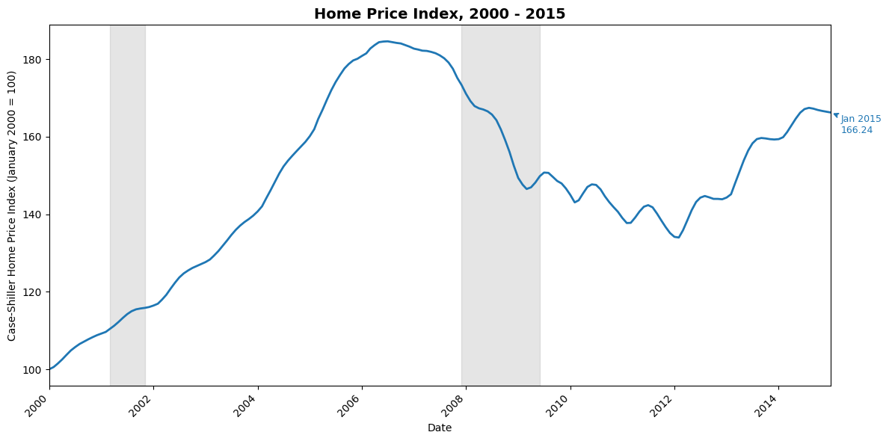
Housing Prices

Slide 20
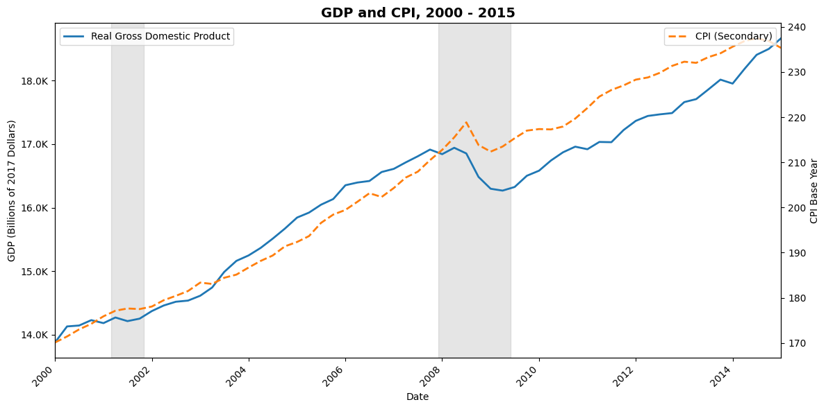
GDP/CPI

Slide 21
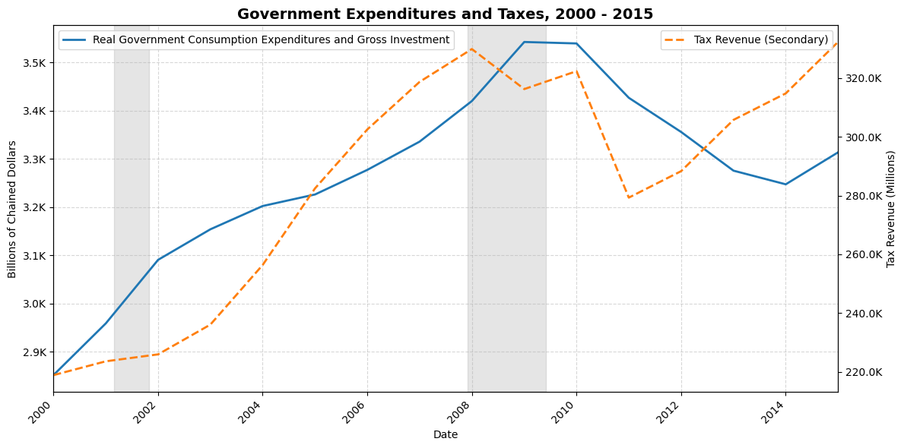
Taxes and Government Expenditures

Slide 22
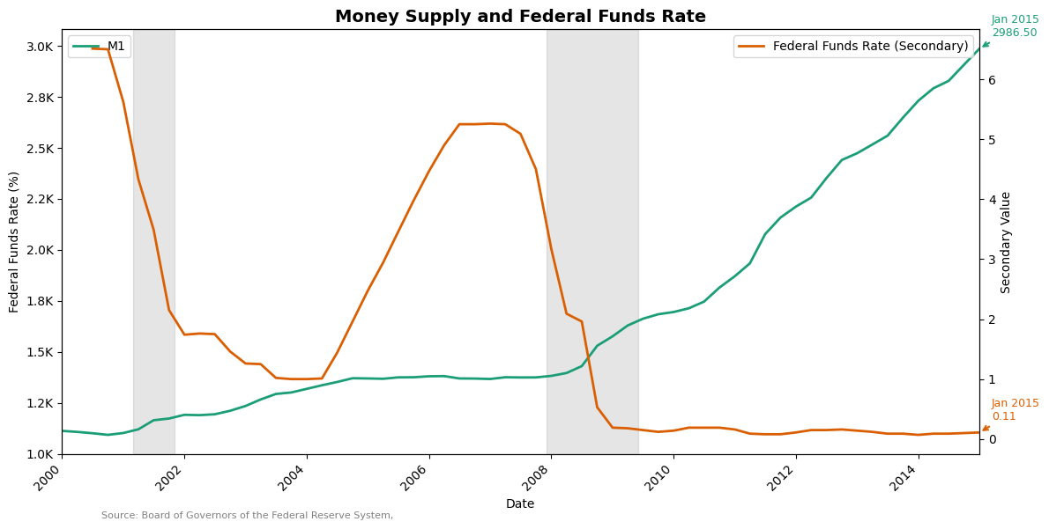
Interest Rate and Money Supply

Slide 23
Shocks to the Macroeconomy
Start at Full-Employment output
Housing Market Crash-how does P* and Y* change?

Slide 24
Shocks to the Macroeconomy
Start at Full-Employment output
Housing Market Crash-how does P* and Y* change?
How should the government or Fed respond?

Slide 25
Demand Shocks to the Macroeconomy
Demand Shock:
Counter-Cyclical Policy:

Slide 26
The Federal Reserve During COVID
Emergency Rate Cut I on March 3rd, 2020
Fed Funds Rate: 1.0 to 1.25%
Emergency Rate Cut II on March 15th, 2020
Fed Funds Rate: 0 to 0.25%
Only unconventional tools remain
Buying mortgage-backed securities
Lower reserve requirements for banks
All meant to increase AC, I^{P}

Slide 27
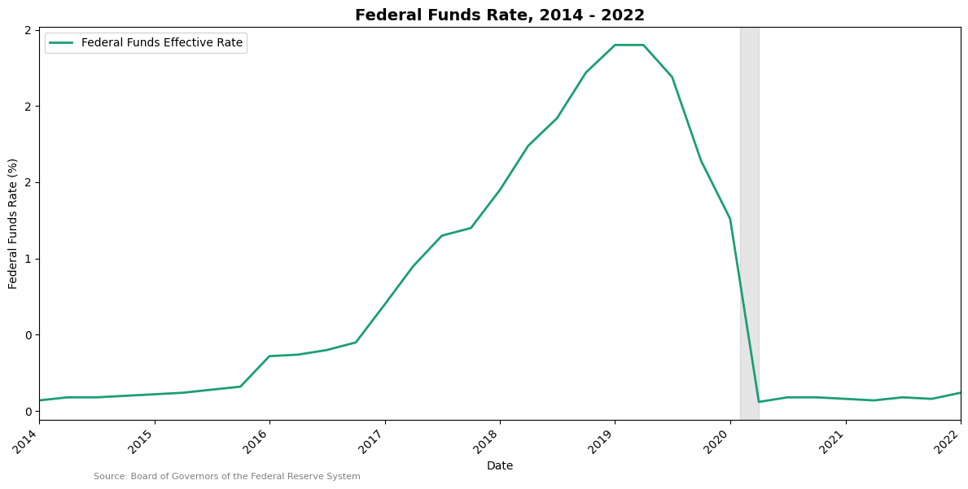
Federal Funds Rate, 2014-2022
Pandemic

Slide 28
Supply Shocks
Supply Shock: Change in AS that moves economy away from full-employment equilibrium
How do we know if a recession is caused by a supply shock instead of demand shock?

Slide 29
Supply Shock
How should the government respond to a recession driven by a decrease in AS?
Option 1: Fight unemployment, bring economy back to Y-bar

Slide 30
Supply Shock
How should the government respond to a recession driven by a decrease in AS?
Option 2: Fight rising prices, bring prices back to P*

Slide 31
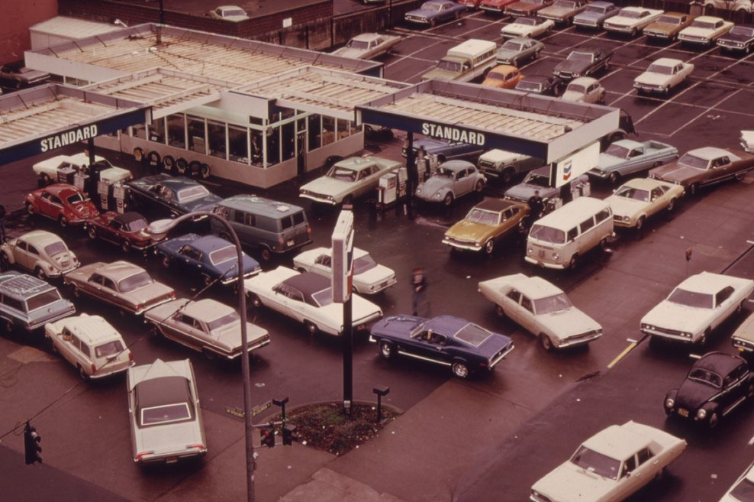
Historical Supply Shocks
OPEC Oil Embargo in the early 1970s
Microeconomic Consequences: Gasoline shortage

Slide 32
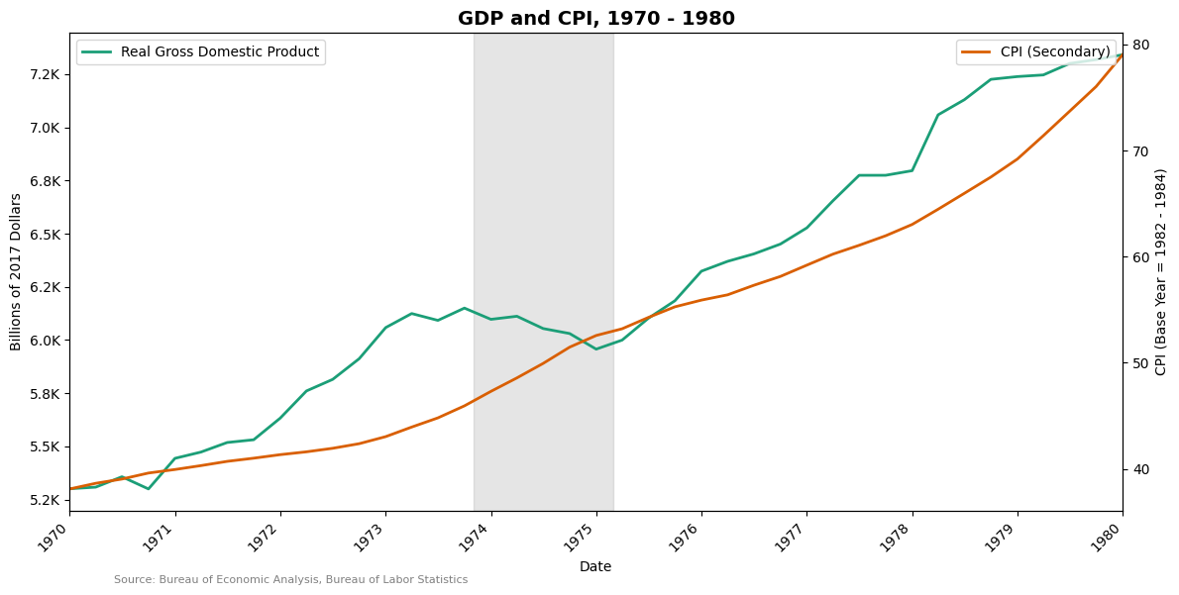
Historical Supply Shocks
Did prices rise as output fell?

Slide 33
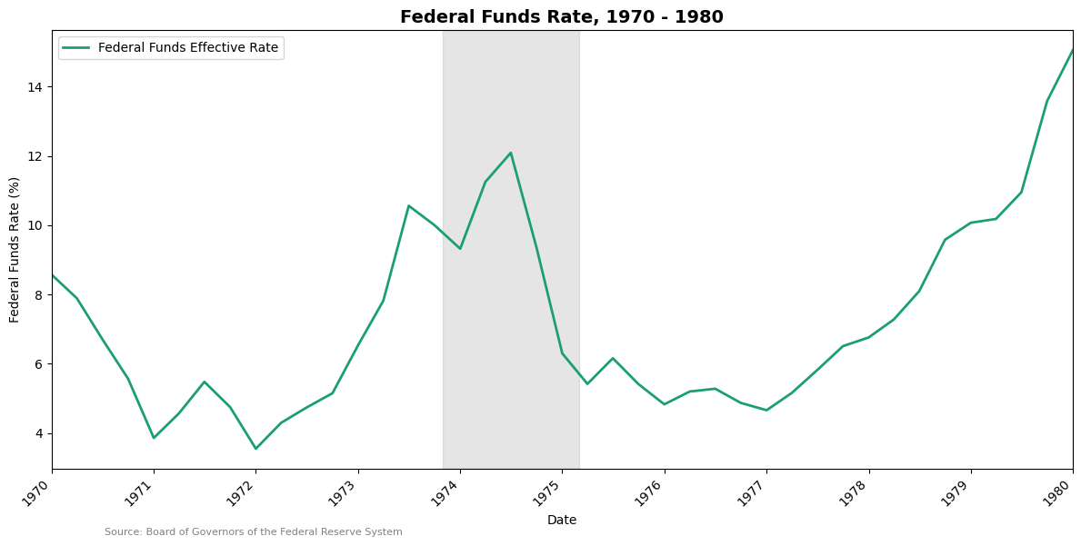
Historical Supply Shocks
How did the Federal Reserve respond?

