Slide 1



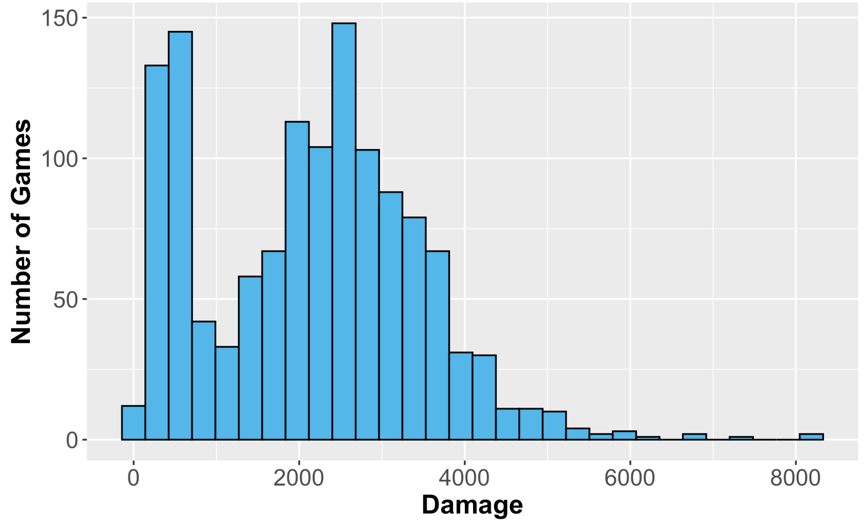
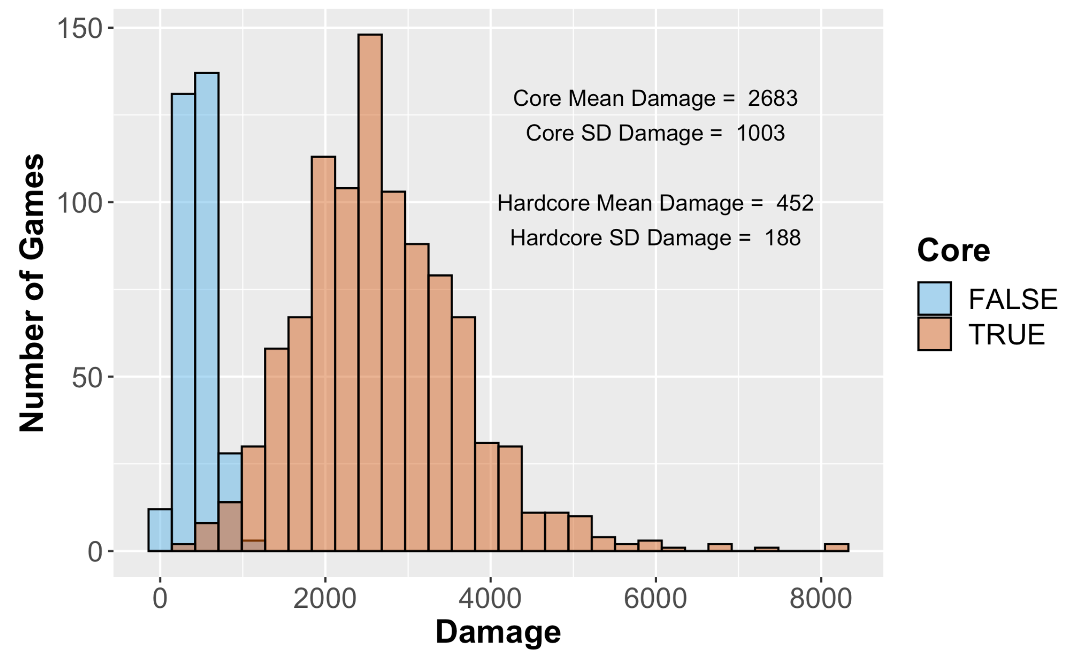
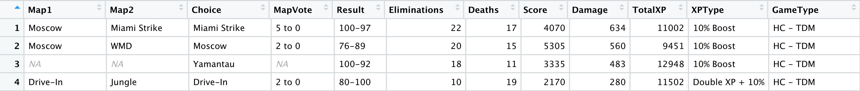
Developing Data Science Skills Using Call of Duty® Data
Matt Slifko (mds6457@psu.edu), The Pennsylvania State University
1. Introduction
3. Resources
5. EDA Example
The GAISE report provides many useful recommendations for educators. The 2016 report added 2 new emphases for the “Teach statistical thinking” recommendation:
teach statistics as an investigative process of problem-solving and decision-making
give students experience with multivariable thinking
For educators, there is always demand for interesting data sets and examples that can promote learning.
The GOAL of this work is to share 1) resources and 2) experiences for using data from the Call of Duty franchise for developing data science skills.
You may obtain the following resources:
Data dictionary
5 datasets
Examples with code
by visiting:
https://github.com/matthewdslifko/CallOfDutyProject
Background: “Damage” represents the amount of damage issued by the player on the opposing team’s players, weapons, and vehicles.
Task: Explore the distribution of Damage.
Bimodal Distribution – What other variables might affect the distribution?
Fig 2:
Distribution
of damage
variable.
4. Experiences
Where have I used this data?
University-level courses with 7 to 40 students
Introductory R/Data Science courses (No prerequisites)
Introductory Statistical Learning (R and Intro Stat perquisites)
How have I used this data?
For practice applying data wrangling, data visualization, and modeling concepts
To motivate challenges of real datasets
Types of activities:
mini-projects and final projects
take-home exam
class demonstrations
Suggestions:
Limit use to a college classroom because of mature content of game
Have students work in groups initially to help those unfamiliar with such games
Provide ample background information so that lack of familiarity with game is not a problem
Leverage student knowledge of the game
Additional background: Some values in the “GameType” variable include an “HC” designation. Unlike Core games, players begin with less health and health does not regenerate in Hardcore (HC) games.
Updated Task: Explore the distribution of Damage using this information.
2. Data Collection
The data were collected by the presenter while playing Call of Duty: Black Ops Cold War.
The primary data describe a player’s performance in an online multiplayer match. Each observation represents a unique match and contains pre and post game data as shown in Fig 1. All observations correspond to the same player.
There are 2 gameplay datasets:
one is ”easy” to use
one is more challenging (typos, increased NA’s) to illustrate realities of data analysis
Secondary data include 3 additional datasets containing information about Maps, Weapons, and Game Modes.
Fig 3: Distribution
of damage variable based on Core
This example provides an opportunity to discuss:
Data visualization and process of exploration
Complementary roles of visualization and summary statistics
Annotating plot with text
String processing and new variable creation (to create Core variable)
Multivariable thinking
Fig 1: Preview of gameplay datasets. 12 of 25 variables shown.
Take a handout or visit the GitHub page for more examples

