Slide 1
Developing Data Science Skills Using Call of Duty® Data
Matt Slifko
Department of Statistics
The Pennsylvania State University
Notes:
I want to talk about how I have used VG data from COD to help students develop DS skills

Slide 2
Motivation and Goals
Interest in data, data science, and statistics is high
GAISE Report¹ provides many useful recommendations for educators, for example:
Teach statistics as an investigative process of problem-solving and decision-making
Give students experience with multivariable thinking
For teachers, there is always demand for interesting new data sets and examples
Goals of this work:
Share resources
Share experiences
1 GAISE College Report: https://www.amstat.org/docs/default-source/amstat-documents/gaisecollege_full.pdf
Notes:
Interest is high, affects classrooms. As I teach these ideas I turn to resources like the gaise report. To execute, we look for interesting new data and examples

Slide 3
Background
Call of Duty® is popular video game franchise that began in 2003 and has sold over 400M units worldwide as of 2021
Guinness Book of World Records identified the franchise as the the best-selling first-person shooter series of all time² in 2021
Other sources identify the franchise among the most popular of all time along with Mario, Pokémon, and Tetris. ³⁻⁵
Our data focuses on a player’s performance in an online multiplayer match
2 Guinness Book of World Records: https://www.guinnessworldrecords.com/world-records/87955-best-selling-first-person-shooter-fps-videogame-series
3 https://history-computer.com/discover-the-most-profitable-video-game-franchises-ever-made/
4 https://apptrigger.com/2023/01/16/highest-grossing-video-game-franchises/
5 https://www.titlemax.com/discovery-center/lifestyle/the-top-50-highest-grossing-video-game-franchises/
Notes:
Do not spend much time talking about popularity of game to keep it short.

Slide 4
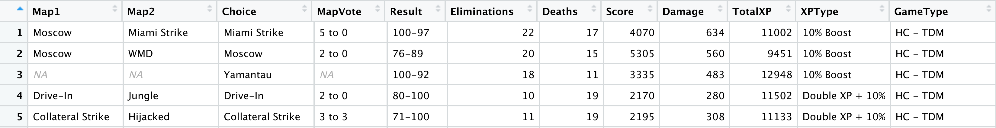
Data Sets Shared
Gameplay Data: collect data from pregame lobby (map vote) and match results. 12 of the 25 variables include:
Along with a data dictionary, we will provide the following data sets:
2 gameplay datasets (one semi-clean and one messy)
Maps dataset
Weapons dataset
Game modes dataset
Please visit: https://github.com/matthewdslifko/CallOfDutyProject
Notes:
No need to talk about map vote or to read datasets to audience

Slide 5
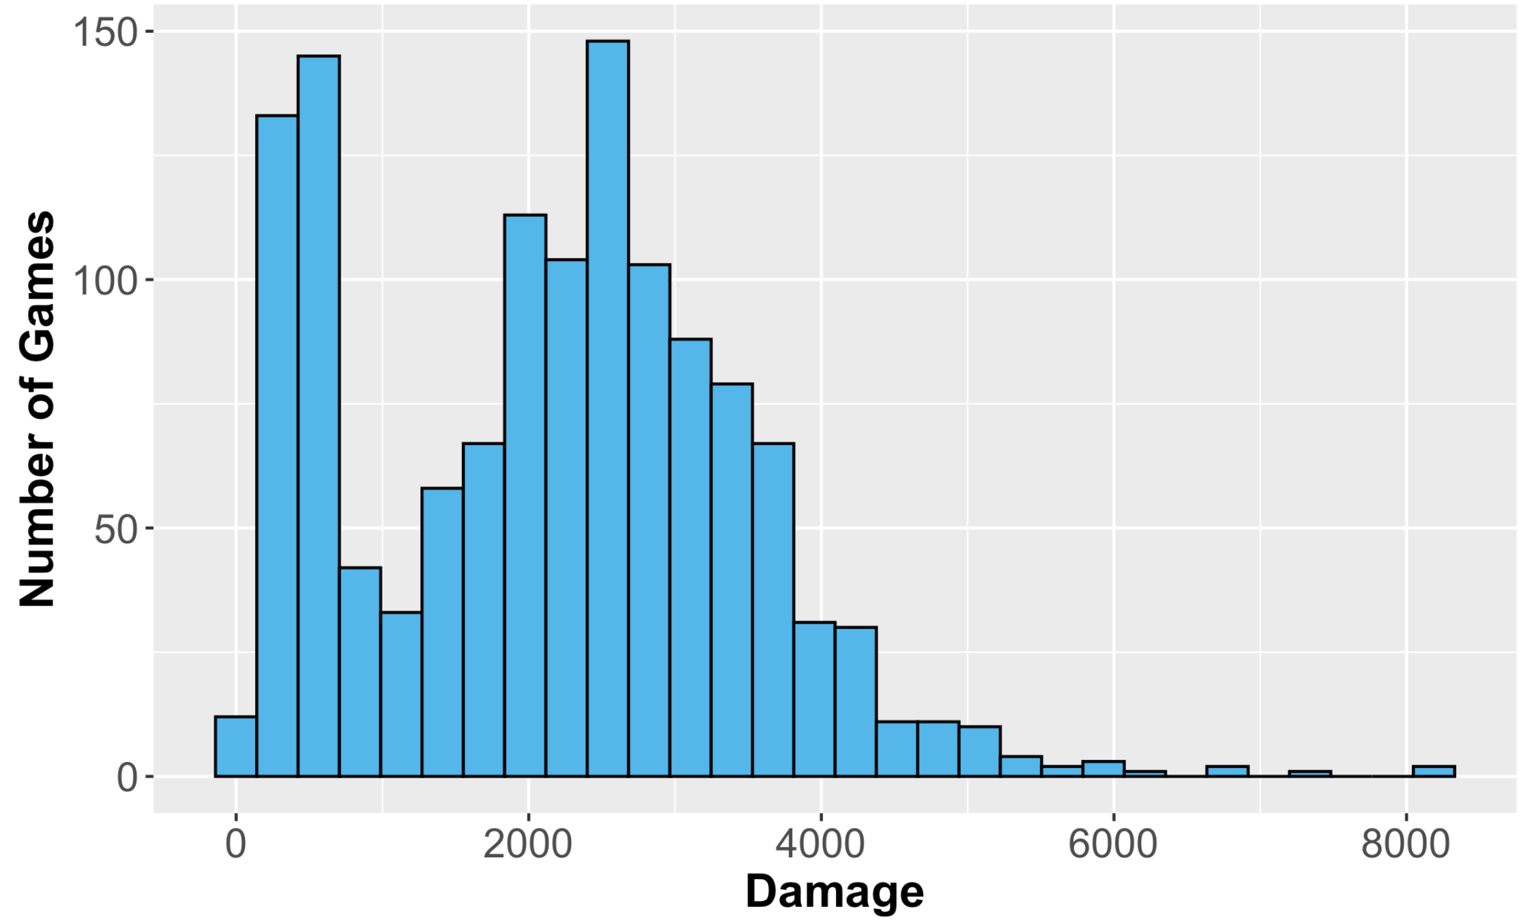
Example – Exploratory Data Analysis 1
Background: “Damage” represents the amount of damage issued by the player on the opposing team’s players, weapons, vehicles
Task: Explore the distribution of Damage.
Notes:
Avoid reading background to them.

Slide 6
Example – Exploratory Data Analysis 2
Background: “Damage” represents the amount of damage issued by the player on the opposing team’s players, weapons, vehicles
Task: Explore the distribution of Damage.
Bimodal Distribution – What other variables might affect the distribution?

Slide 7
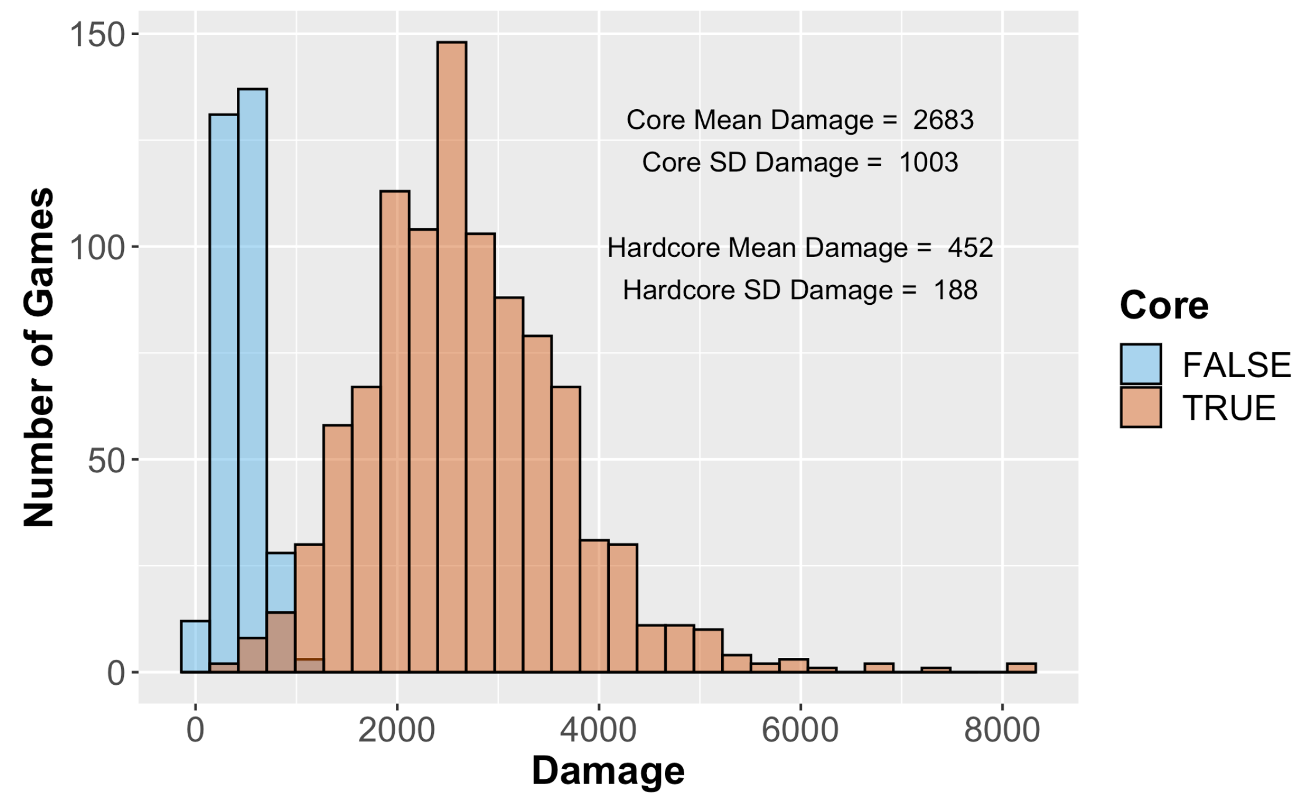
Example – Exploratory Data Analysis 3
Background: Some values in the “GameType” variable include the “HC” designation. Unlike Core games, in HardCore games, players begin with less health and health does not regenerate
Task: Explore the distribution of Damage using this information.
Notes:
Avoid reading background.

Slide 8
Thank you!
Come to the poster session to hear about my experiences using this data, see many more examples, and to discuss!!!
If you are interested in the data, please visit: https://github.com/matthewdslifko/CallOfDutyProject
Plan to update after SDSS and USCOTS
Thanks for your time!
Contact Information:
Name: Matt Slifko
Email: mds6457@psu.edu

