Slide 1

craig-o-mation

Slide 2
Description
Get Craigslist products delivered within an hour
Much easier and more convenient than Craigslist
Automated payments, delivery, etc.

Slide 3



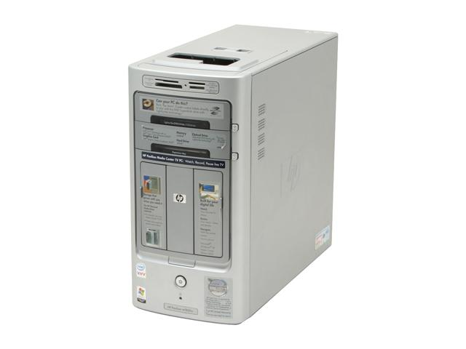






Architecture
client
Python proxy
craigslist
Go Backend
Datastore
App Engine

