Slide 1
Fargo Health Group
Cardiovascular Examinations for Disability at Abbeville Health Center

Slide 2
Background
Disability Compensation Benefits
Quality Assessment Office (QAO) reported total compensation reached $2.25 million in 2013.
34 Health Centers (HC) in Fargo Health Group support 34 Local Offices (LO) requests for disability examination.
HC has 30 days to complete examination starting on receipt of request from LO or Fargo will be charged $200 per day beyond 30 days by Regional Office of Health Oversight (ROHO).

Slide 3
Disability Examination Process
Patient will submit request for disability compensation to LO.
LO may self adjudicate the claim in other words accept the claim with no further examination.
LO more frequently will make a request from HC for an examination.
If HC cannot complete examination due to staffing, then LOC will submit request for examination to out-of-network provider.

Slide 4
Business Problem
HC unable to meet demand for disability examinations
Due to staffing HC will sometimes immediately reject LO request causing reroute to other HC or out-of-network Outpatient Clinic (OC).
OC costs on Average $1250 more than In Network.
OC has no incentive to meet 30 day deadline thus increasing likelihood of fines from ROHO.

Slide 5
Cost to Business
Financial Cost: ROHO fines $300 day for each day past 30 days.
Patient Cost: Health and Well Being of patients put at risk by delay of examination.
Reputational Cost: Not meeting examination demand causes negative sentiment toward entire Fargo Health Group.

Slide 6
Scope of Current Study
Limit to one Health Center: Abbeville, Louisiana
Limit to one type of Examination: Cardiovascular

Slide 7
Data Cleaning
Extensive use of Excel to combine dataset.

Slide 8
Data Imputation

Slide 9
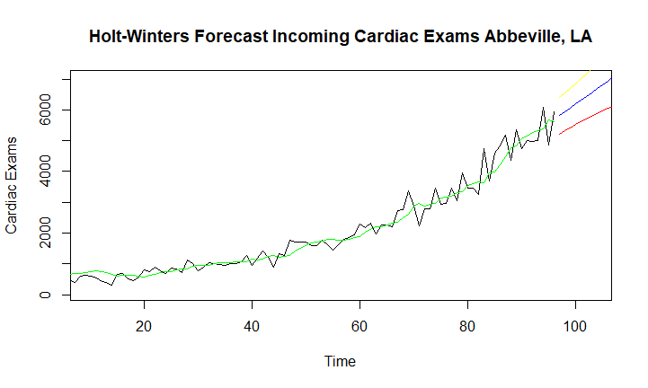
Time Series Model 1: Holt Winters

Slide 10

Time Series Model 2: ARIMA

Slide 11
Model Comparison

Slide 12
Recommendations

Slide 13
Data Governance
Quality Assessment Office (QAO)
Disability Examination Data
Examination data was de-identified.
Data provided was limited to examination type, date, and provider.

Slide 14
Ethical Implications
Context: What was the original purpose of the data collection? How close is the new use to its original purpose?
Consent: Was informed consent necessary from affected patients before data collection? If so, did they provide informed consent prior to data collection? Did they have an opportunity to decline?
Reasonability: Is the depth and breadth of the dataset reasonable for the forecast?
Fairness: Will the results be equitable for all parties (patients, Fargo Health, public health agencies, Fargo Health employees, etc.) when your forecasting model is deployed?

Slide 15
Ethical Implications
Ownership: Who owns the dataset, analysis, and insights gleaned from data analysis? Is there a moral obligation for Fargo Health to act based on the forecasting model?
Accountability: Who is accountable for mistakes and unintended consequences in data collection and analysis? Can the affected parties check the results that affect them?

Slide 16
Future Work
Expand to other Fargo Health Centers.
Analyze Utilization of other Exam Types like Audiology and Dental.

