Slide 1
Fargo Health Group
Cardiovascular Examinations for Disability at Abbeville Health Center

Slide 2
Background on Disability Compensation Benefits
Quality Assessment Office (QAO) reported total compensation reached $2.25 million in 2013.
34 Local Offices (LO) administer disability claims.
34 Health Centers (HC) in Fargo Health Group support disability examinations.

Slide 3
Disability Examination Process
Patient will submit request for disability compensation to LO.
LO may self adjudicate the claim in other words accept the claim with no further examination.
LO more frequently will make a request from HC for an examination.
HC has 30 days to complete examination starting on receipt of request from LO or Fargo will be charged $200 per day beyond 30 days by Regional Office of Health Oversight (ROHO).
If HC cannot complete examination due to staffing, then LO will submit request for examination to out-of-network provider.

Slide 4
Business Problem
HC unable to meet demand for disability examinations
Due to staffing HC will sometimes immediately reject LO request causing reroute to other HC or out-of-network Outpatient Clinic (OC).
Adds risk to not meet 30 days deadline
OC costs on Average $1250 more than In Network.
OC has no incentive to meet 30 day deadline thus increasing likelihood of fines from ROHO.

Slide 5
Cost to Business
Financial Cost: ROHO fines $300 day for each day past 30 days. Plus additional cost of sending exams to out-of-network providers.
Patient Cost: Health and Well Being of patients put at risk by delay of examination.
Reputational Cost: Not meeting examination demand and delaying processing of disability benefits causes negative sentiment toward entire Fargo Health Group.
Reputation in Health Care is important!

Slide 6
Scope and Intent of Current Study
Limit to one Health Center: Abbeville, Louisiana
Limit to one type of Examination: Cardiovascular
Study intent is to forecast next twelve months of cardiac examinations.
The intent is to model future demand for cardiac exams.
Fargo Health Group can then staff HC adequately to meet demand.

Slide 7
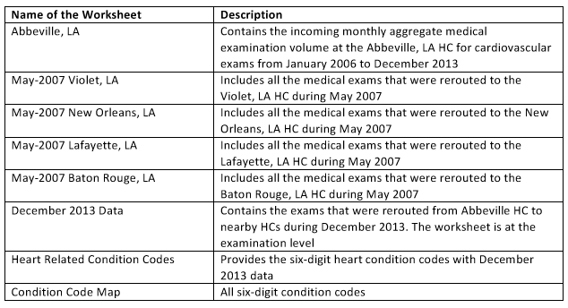
Dataset

Slide 8
Data Cleaning
Used dataset that was provided in Excel and combined to get fuller picture of incoming exams for Abbeville.
Filled in missing values for May 2007 by combining tabs “May-2007 Violet, LA”, “May-2007 New Orleans, LA”, “May-2007 Lafayette, LA”, and “May-2007 Baton Rouge, LA”, and filtering down to Abbeville Cardiac exams.
It was some amount of work to decide whether an exam was cardiac related.
These tabs also included completed information for May, June, July 2013
December 2013 all exams were rerouted from Abbeville. The total exams was found by parsing out Routing SSYID. First four characters indicate Abbeville. Last four characters could be used to identify cardiac related exams.

Slide 9
Data Cleaning

Slide 10
Data Cleaning
December 2009 to February 2010 was completely missing data. Fargo Health Administration though reported 5129 request during this span. Data was spread across the three months.
October 2008 showed an unusually high number of exams due to reroutes from New Orleans during hurricane.
This value was removed as an outlier to be imputed later.
Several months had either non-numeric values, or impossible numeric values. These values were set to blank to be imputed.

Slide 11
Data Imputation
Imputation is the process of replacing missing values with substituted values.
Exponential Weighted Moving Average was used to impute missing values.

Slide 12
Data Imputation

Slide 13
Timeseries

Slide 14
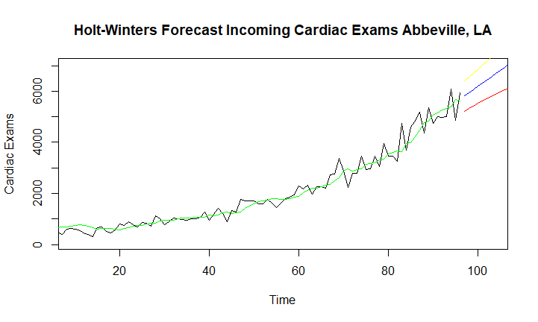
Time Series Model 1: Holt Winters

Slide 15

Time Series Model 2: ARIMA

Slide 16
Model Comparison

Slide 17
Model Comparison
Based on the mean absolute error (MAE), the ARIMA model would be a better candidate since it has a lower MAE. It fits the existing data better.

Slide 18
Model Predictions

Slide 19
Recommendations
Use the middle values of ARIMA model forecast as prediction of Cardiac Examination Demand at Abbeville.

Slide 20
Ethical Implications
It is unknown whether patients consented to be counted.
The data is sufficiently de-identified that it would be difficult to trace back to an individual.
Using the results of the forecast should positively impact Fargo Health Groups bottom line.
Help patients to have their disability claims resolved in a timely fashion.
Abbeville should have a chance to review the data, findings, and make suggestions and corrections if needed.

Slide 21
Future Work
Expand to other Fargo Health Centers.
Analyze Utilization of other Exam Types like Audiology and Dental.

