Slide 1

Streetlight Maintenance Priority Queue
Matthew Endo

Slide 2

What is a Priority Queue?
4 9 5 6 2 8 7 3 1

Slide 3

The Problem
San Diego public can report maintenance and other city issues with the Get It Done app. These reports include streetlight maintenance, which generally falls under the jurisdiction of the Transportation Department
Currently, the Transportation Department has no method to systematically address streetlight maintenance reports

Slide 4
Current Process
Get It Done App
Streetlight Report
Transportation Department Repair

Slide 5
Current Situation
 | Open | Closed | Referred
Total Reports | 7949 reports | 44812 reports | 791 reports
Time Open (Average) | 332 days | 152 days | unknown
Time Open (Median) | 272 days | 89 days | unknown

Slide 6
Critical Issues
Issues | Potential Solutions
Streetlight Maintenance reports are closed on average 152 days (89 days median) | Incorporate request date in priority score to reduce closing time and promote equity
No systematic method to account for equity and public safety | Incorporate local crime rate in priority score to promote public safety
No systematic method to refer reports to other organizations | Add additional fields in the report for location (park, school, highway, etc.)
Location data (zip code) missing or out of range for reports | Coordinate data was available this enabled zip code determination
Difficult to access information on streetlight condition, number of streetlights, etc. as they are in user descriptions | Add additional fields in the report for condition, number of, etc. and incorporate in priority score to promote equity

Slide 7
Priority Queue Process Plan
Get It Done App
Process Streetlight Reports
Priority Queue
Transportation Department Repair
Include location information (parks, university, highway, etc.)
Add information of whether streetlight condition (out, blinking, on during day, etc.)
Add information of number of streetlights needing maintenance
Confirm zip code and coordinate data is provided
Refer reports to other organizations
Determine crime rate, foot traffic, based on location data
Get It Done map contains all open requests
Update and remove duplicate reports
Calculate priority score based on:
request date
crime rate
streetlight condition
number of streetlights
foot traffic
Place requests in priority queue
Repair streetlights based on priority
Utilize map of open requests for end-of-day investigation/ repairs

Slide 8
Initial Priority Queue Implementation
Get It Done App
Process Streetlight Reports
Priority Queue
Transportation Department Repair
User comments may contain location information
User comments may contain streetlight condition
User comments may contain number of streetlights
7999 reports were missing zip codes or contained zip codes outside San Diego
Manually refer reports to other organizations
Determine zip code from coordinate data (except for 51 closed reports)
Represented crime rate with median household income based on zip code
Represented foot traffic with population density based on zip code
Calculate total priority score based on:
request date (40%)
crime rate (median household income) (40%)
foot traffic (population density) (20%)
streetlight condition (no systematic method)
number of streetlights (no systematic method)
Place requests in priority queue
Repair streetlights based on priority
No process for Transportation Department to utilize map of open requests for end-of-day investigation/ repairs

Slide 9
Improvements in Equity and Public Safety with Priority Queue
44,812 Closed Reports | Average Case Age (Days) | Average Crime Rate Score | Average Foot Traffic Score
Without Priority Queue | 152 days (89 days median) | 0.204 (0.167 median) | 0.494 (0.520 median)
With Priority Queue | 133 days (33 days median) | 0.173 (0.150 median) | 0.443 (0.373 median)

Slide 10
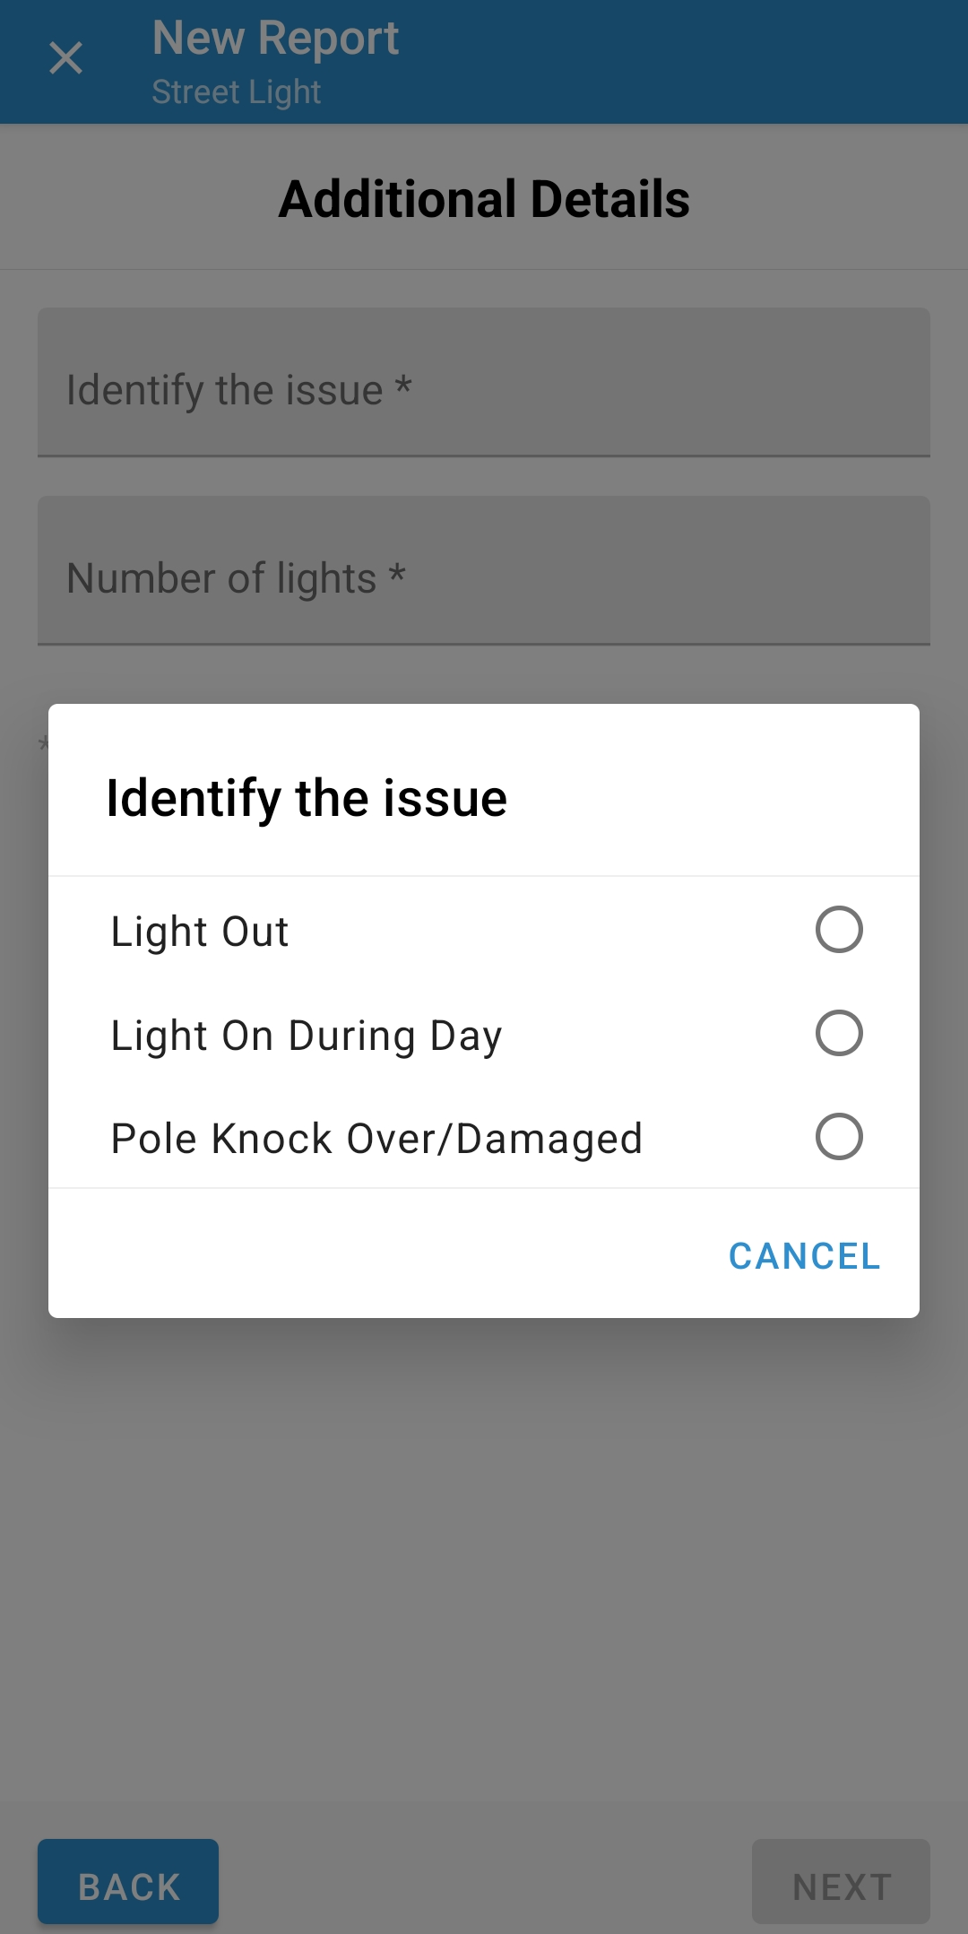
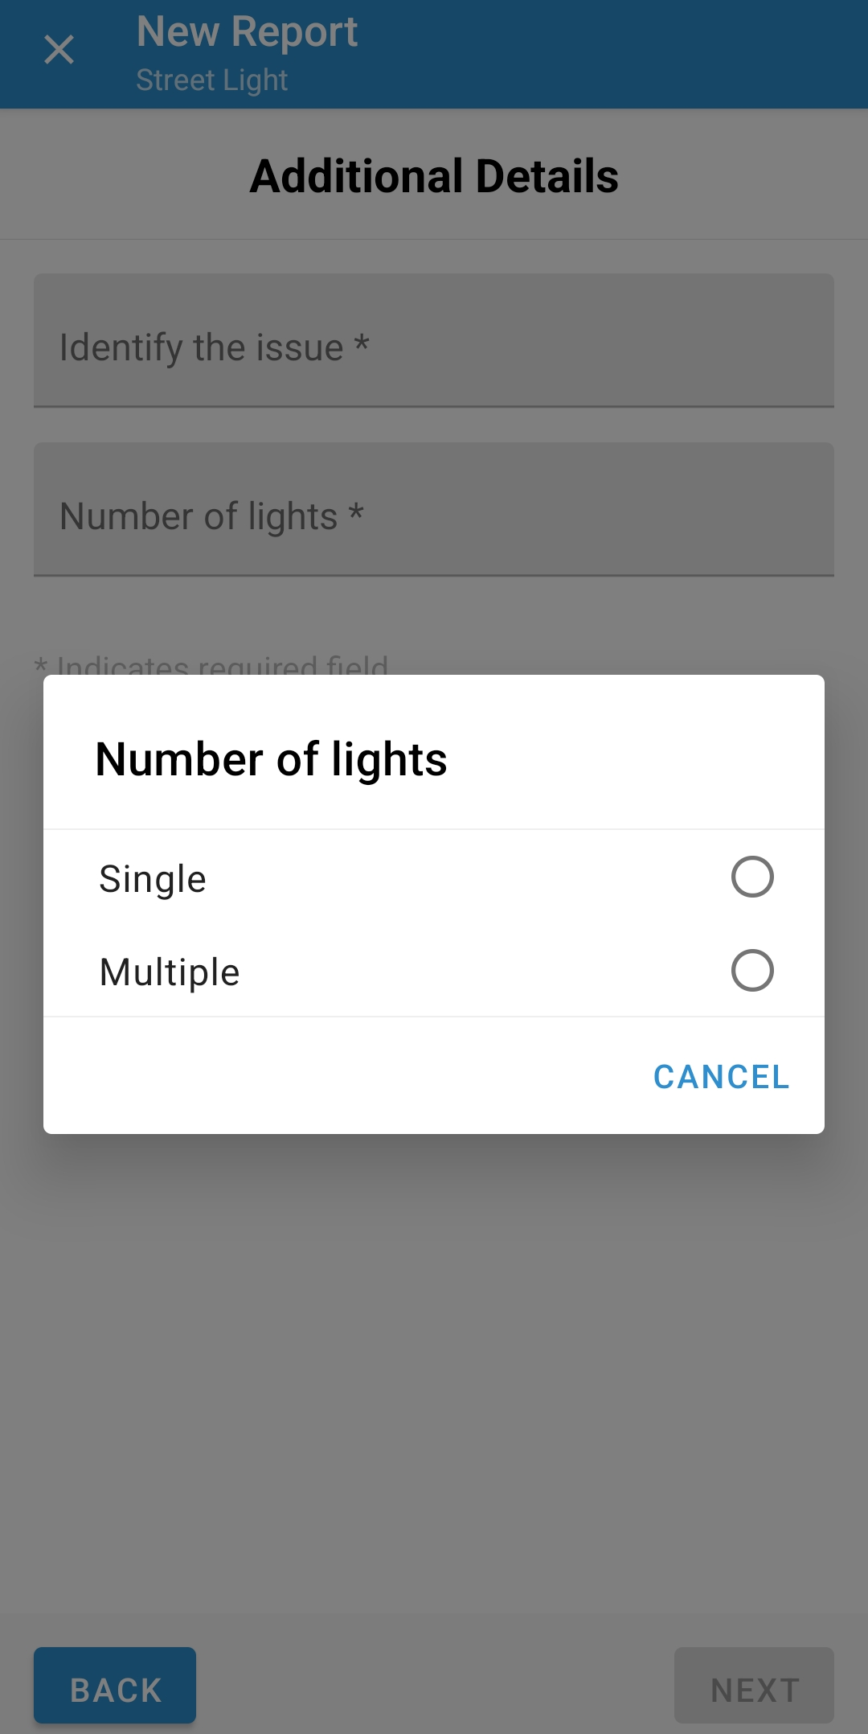
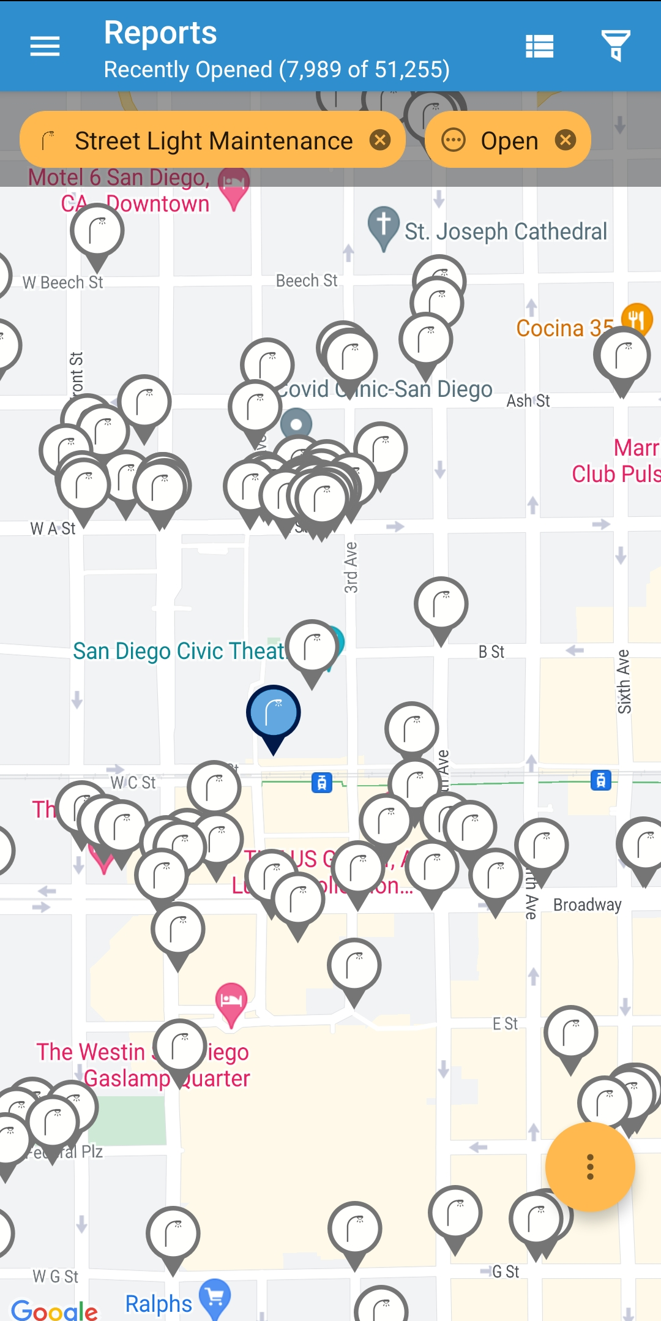
Future Improvements
Accessible data on streetlight condition, number of streetlights, and location (park, school, etc.)
Automate referrals
Add streetlight condition and number of streetlights as factors in determining priority score
Improve crime rate and foot traffic factors in determining priority score
Open report map is accessible to Transportation Department Field Workers to potentially increase number of completed reports
Ambient light data, closer to schools, etc.

