Slide 1
Working with factors
Marquis Hawkins, PhD
Assistant Professor
Department of Psychology

Slide 2
Objectives
Learn to identify various methods for converting characters to factors in R
Learn to apply the appropriate R functions to reorder or relevel the levels of a factor variable.
Learn how to lump or combine levels of a factor variable

Slide 3
Readings
The Epidemiologist R Handbook
Chapter 11 – Factors
Cheatsheets
https://forcats.tidyverse.org

Slide 4
Converting vectors to factors

Slide 5
Factors
Factors are categorical class types w/a fixed set of values
Ordered (e.g., income level) or nominal (e.g., gender)
You typically convert from a character or numeric class if there is an order to the value
Notes:
Typically, less than 10 values will be treated as a categorical variable by default

Slide 6
Why convert to factors?
Factors are important in statistical modeling and data analysis because they allow you to represent categorical data more efficiently
Ensure that R recognizes the variable as having discrete categories rather than continuous values

Slide 7
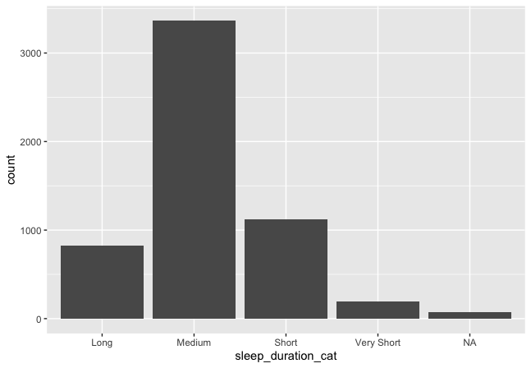
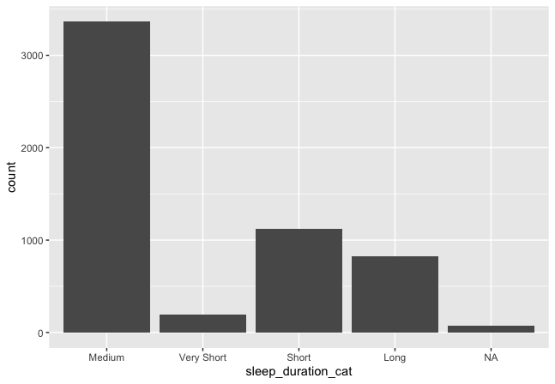
Why convert to factors?
R displays variables non-alphabetically in plots and tables
Changing reference levels
Default display - alphabetical
Reordered as a factor

Slide 8
Packages to handle factors
Base R
factor( )
forcats, short for "For categorical variables
fct_reorder(): Reordering a factor by another variable.
fct_infreq(): Reordering a factor by the frequency of values.
fct_relevel(): Changing the order of a factor by hand.
fct_lump(): Collapsing the least/most frequent values of a factor into “other”.
Haven package
as_factor( )
aweek – for epidemiological weeks

Slide 9
Convert to factor
factor( ) - Base R
Used to create or convert variables into factors
x: The input vector that you want to convert into a factor.
levels: The possible values (or categories) that x can take.
labels: Labels for the levels of the factor. These can be used to rename the levels in a more readable way.
ordered (optional, default = FALSE): If TRUE, the factor is considered an ordered factor
Notes:
x: The input vector that you want to convert into a factor.
levels (optional): The possible values (or categories) that x can take. If not specified, the levels are determined by the unique values in x.
labels (optional): Labels for the levels of the factor. These can be used to rename the levels in a more readable way.
ordered (optional, default = FALSE): If TRUE, the factor is considered an ordered factor, where the levels have a meaningful order.

Slide 10
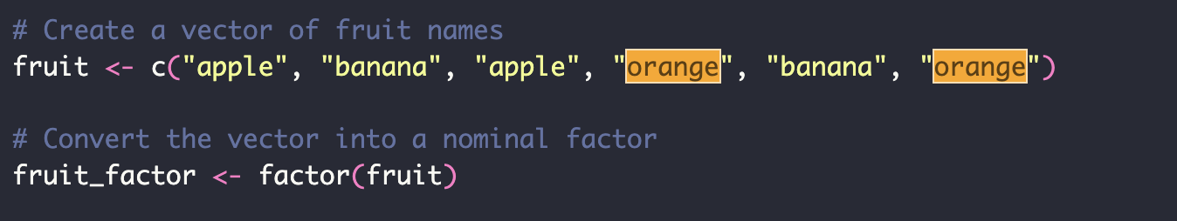
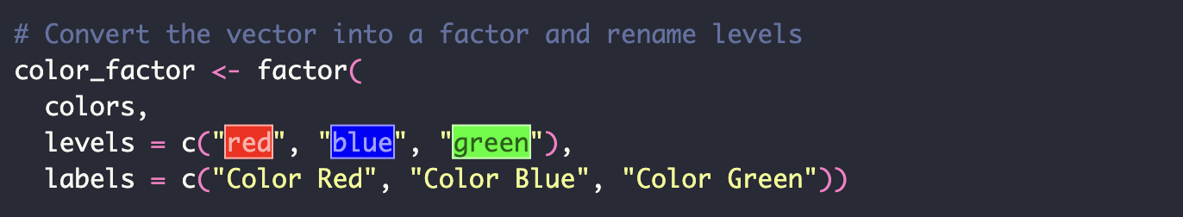
Example: factor()
Notes:
If label argument is not specified, the levels are determined by the unique values in x

Slide 11
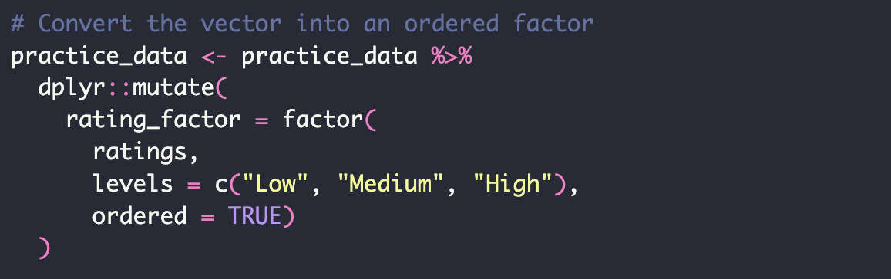
Example: factor()
Notes:
In this example, the rating

Slide 12
haven::as_factor()
Converts labelled and labelled_spss vectors into factors while preserving labels.
Ideal when working with foreign datasets that store categorical data as labelled vectors.
You can choose how to handle levels (labels, values, or default behavior).
Easily integrated with dplyr::mutate() to convert multiple columns in a data frame to factors at once.
Notes:
Labelled vectors are those labelled using the val_labels function in the labelled package

Slide 13
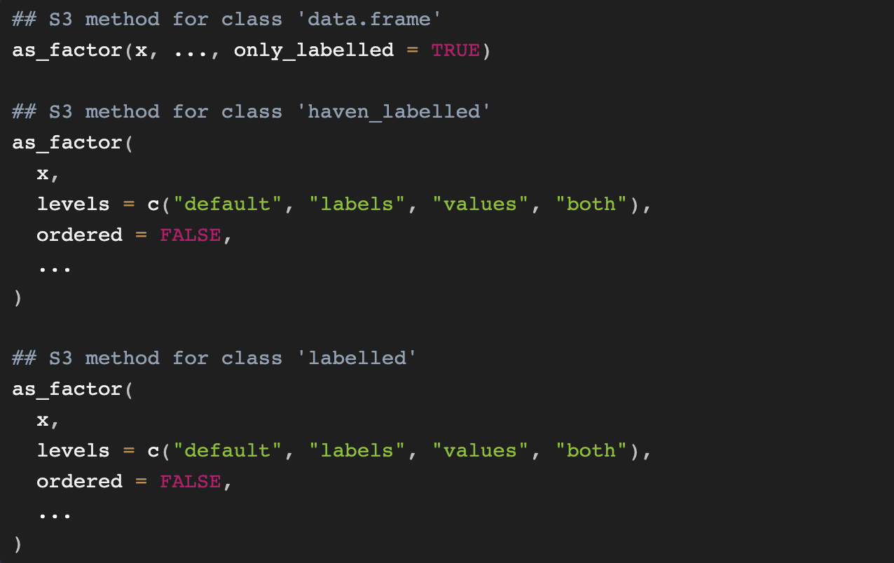
haven::as_factor()
Notes:
"default": uses labels where available, otherwise the values. Labels are sorted by value.
"both": like "default", but pastes together the level and value; The resulting factor levels are a combination of both the label and the underlying value; is useful if you need both the label and the underlying value for clarity, such as in reporting or when debugging.
"label": use only the labels; unlabelled values become NA
"values: use only the values

Slide 14
Summary of differences
factor() used to define the levels and labels explicitly. Useful when you need full control over the factor’s attributes for a factor.
as.factor() when you want a quick, simple vector conversion to a factor, with no need to control the levels or order.
haven::as_factor() used when working with labelled data. Works with externally labeled data (e.g., SPSS, STATA)
Preserve the value labels and handle special cases like missing values or unlabelled categories.
A little more flexible with setting levels

Slide 15
Reorder or lump factor levels

Slide 16
forcats package
The base R functions for working with factors can be cumbersome and unintuitive.
forcats addresses this by providing clear, user-friendly functions for creating, modifying, and analyzing factors.
forcats is particularly useful for tasks like reordering factor levels, lumping small categories together, and handling missing levels.
In visualizations (e.g., ggplot2), factors often need to be reordered based on the data itself. forcats offers functions like fct_reorder() that make this easy.

Slide 17
forcats package
Helpers for reordering factor levels including:
moving specified levels to front
ordering by first appearance
Reversing
randomly shuffling
modifying factor levels (including collapsing rare levels into other, 'anonymising’
manually 'recoding')

Slide 18
Key Functions in forcats
fct_relevel():
Purpose: Manually reorder factor levels by specifying the order you want.
Use Case: You want to move a specific level to the first position for better control over the order.

Slide 19
Manual reorder/relevel
“after” argument shifts, the position of the specified level
after = 0 puts the specified level first
after = 1 puts the specified level second
Etc.

Slide 20
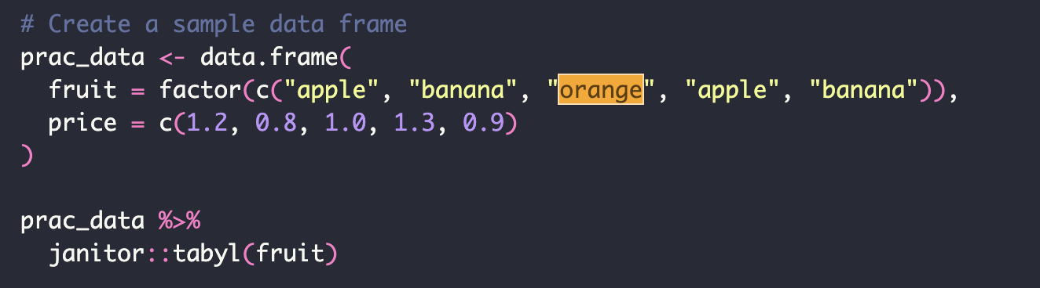
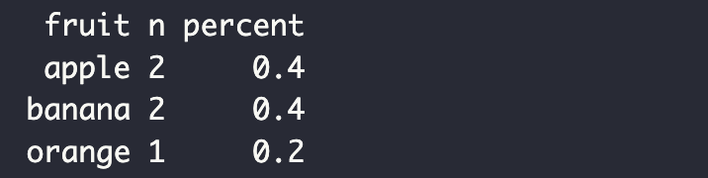
Example: fct_relevel

Slide 21
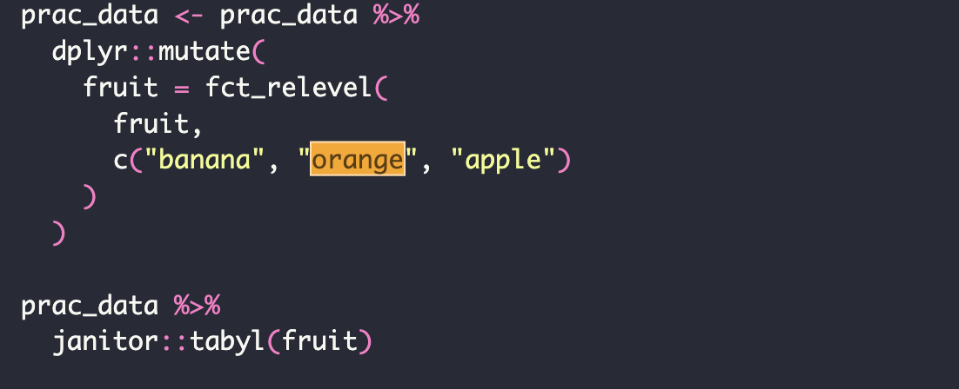
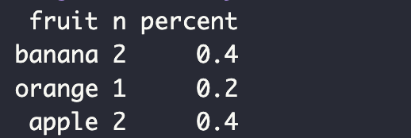
Example: fct_relevel

Slide 22
Auto reorder/relevel
fct_infreq() – order by frequency
fct_rev() – reverse order by wrapping the fct_infreq() function
fct_reorder() – order levels by a summary statistics of another column (e.g., order sleep duration groups by median BMI)

Slide 23
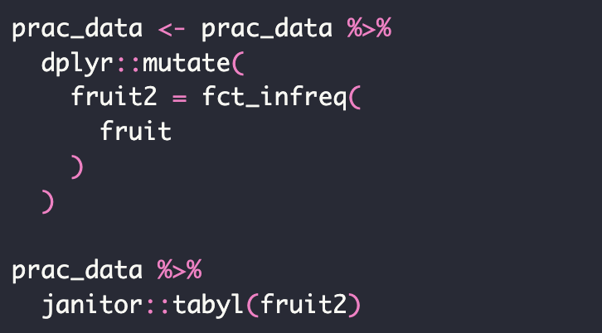
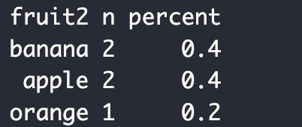
Example: fct_infreq()

Slide 24
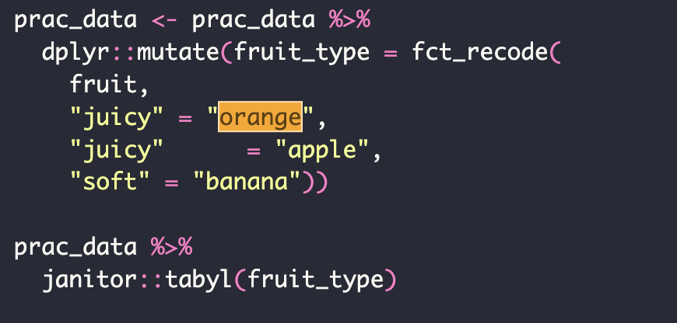
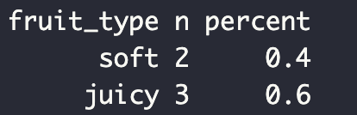
Collapse/lump levels
fct_reorder
Purpose: Manually change levels

Slide 25
Collapse/lump levels
fct_lump( ) – combined low-frequency levels to “other”
Arguments
f = factor or character vector
n = keep most frequency levels (ex. n=2 keeps top 2 levels)
prop = keeps levels above a threshold
other_level = value of level used for “other” values

