Slide 1
R Basics
Marquis Hawkins, PhD
Assistant Professor
Department of Psychology

Slide 2
Objectives
Navigate the RStudio Interface
Identify and describe the main components of RStudio, including the console, script editor, environment pane, and file pane.
Demonstrate how to customize the RStudio layout to suit your workflow preferences.
Understand Key R Concepts
Define and differentiate between key R terms such as objects, functions, arguments, and packages.
Explain the importance of using scripts and R Markdown for reproducible research.
Create and Manipulate Basic R Objects
Use the assignment operator (<-) to create objects in R.
Identify and describe different object classes in R, including numeric, character, logical, and factor.

Slide 3
Objectives
Execute Basic R Functions
Use built-in R functions to perform simple tasks, such as mathematical calculations (e.g., sqrt()).
Apply indexing techniques to access specific elements within objects like vectors and data frames.
Write and Call Simple Custom Functions
Define a basic function in R, specifying input arguments and returning output.
Identify scenarios where writing a custom function would benefit code modularity, task automation, or error handling, such as repetitive data cleaning tasks.

Slide 4
What is R?
R is a programming language and environment for statistical computing and graphics
Open source
Contains many built-in function
Users can create new functions

Slide 5
Why learn R?
Free!
Very large range of functions (well over 2,000 packages)
New statistical methods are quickly implemented
Very easy to automate and integrate
Very good community support, as well as fee-based support via third-party providers
https://www.inwt-statistics.com/blog/comparison-of-r-python-sas-spss-and-stata

Slide 6
Why learn R?
Extensive help resources freely available (manuals, tutorials, and so on)
Very powerful and flexible scripting language (e.g. support of object-oriented programming)
All common platforms are supported (Windows, Linux, MacOS...)
Future-proof due to very large, active developer community
https://www.inwt-statistics.com/blog/comparison-of-r-python-sas-spss-and-stata

Slide 7
Weaknesses of R
Getting familiar with the R syntax presents a barrier to entry
The Epidemiologist R Handbook Chapter 4 – Transitioning to R
Stability/quality of little-used packages is often not as high as the core distribution
Powerful hardware is required when working with very large data sets
https://www.inwt-statistics.com/blog/comparison-of-r-python-sas-spss-and-stata

Slide 8
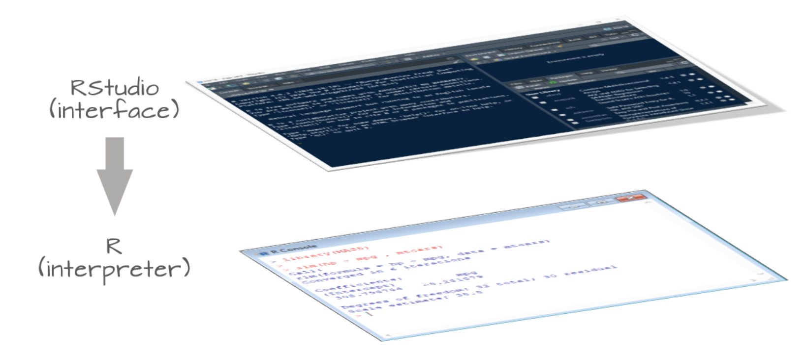
R and R Studio
Adapted from: https://mgimond.github.io/ES218/R_vs_RStudio.html
Notes:
R is the software that peforms R Studio is an interactive interface for R
Makes it easier to use R
You must download R before you can use R Studio

Slide 9
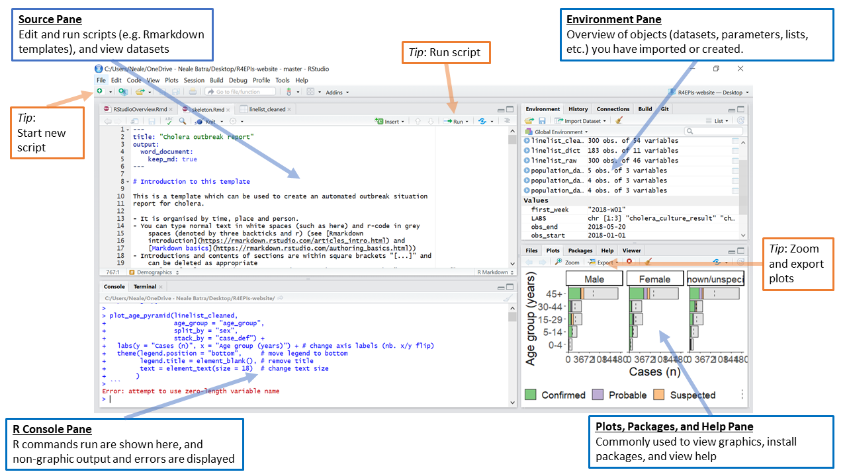
R Studio interface
https://epirhandbook.com/en/r-basics.html#rstudio
Notes:
Customizable interface

Slide 10
Customizing your R studio layout
In-class activity

Slide 11
Key terminology

Slide 12
Key Terms
Objects - everything in R
Functions - performs task on objects
Arguments - tells functions what to do
Packages - collection of user-generated functions

Slide 13
Key Terms
Scripts - place to write your code
R Markdown/Notebook - basic text editor for writing code and producing html, pdf, word, and PowerPoint files
Working directory - default location where R will look for files you want to load and where it will put any files you save
R Projects - organizing all folders and files associate with a project

Slide 14
Key Terms
Objects - everything in R

Slide 15
Object Basics
Everything in R is an object
Includes:
Datasets
Vectors (e.g., variables/columns in a dataset)
List
Functions
Outputs from functions

Slide 16
Defining Objects
Objects are defined using the ‘<-’ operator
object_name <- value/function
Examples:
name <- “Melissa”
age <- 24
reg_results <- lm(weight ~ group)
Objects are also defined using the ‘=’ operator
‘<-’ operator is most often used
= signs are used to specify values of arguments within functions
Good practice to use <- operator to define objects and = when specifying values of an argument

Slide 17
Object classes
Numeric - numbers with decimals
Integer - whole numbers
Logical - two values (e.g., TRUE/FALSE or T/F)
Factor - vectors with limited set of values
Character - any grouping of characters in single or double quotes (e.g., "high school", "college”)
Date/time
NA/NaN - missing data
Data.frame - typical dataset
Tibble - data frame variation that display more nicely
Outputs (e.g., tables, plots)
Notes:
NaN only for numeric objects

Slide 18
Tibbles
“modern” way to produce and display a data frame
“best-of” data frame
They do less than traditional data frames
doesn’t change variable names or types or perform partial matching
Produces more error message
Can lead to cleaner code
as_tibble( ) function converts traditional data frames into tibbles

Slide 19
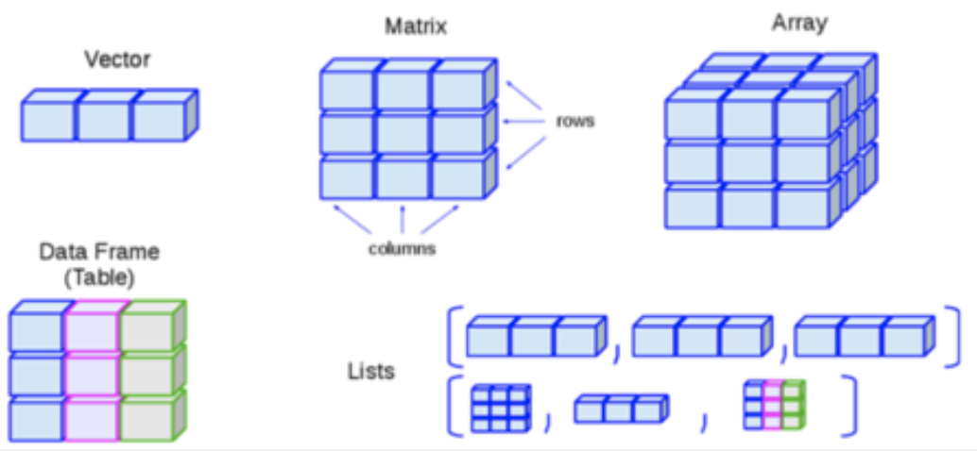
Object Structure
Figure from The Epidemiologist R Handbook

Slide 20
Object Structure
Most often used in epidemiology
Notes:
Vector - set of values with the same class type (e.g., columns in a data set)
Matrix - rows and columns with the same class type
List - Can contain multiple object types including other lists
Data frames - Specific type of list with columns and rows (e.g., data set)

Slide 21
More on vectors
Must be the same class type
If there is a mix of types in a vector, it will be coerced into the lower ranking type
Example:
age <- c(25, 30, 15, "17", 28)
Age is coerced into a character vector
Double quotes indicates a character

Slide 22
More on vectors
Must be the same class type
If there is a mix of types in a vector, it will be coerced into the lower ranking type
Example:
age <- c(25, 30, 15, "17", 28)
Age is coerced into a character vector
Hierarchy for coercion:
logical < integer < numeric < character
Double quotes indicates a character

Slide 23
Columns/variables
Objects can be columns/variables in a data frame
“$” connects column to its data frame
Example - age variable in NHANES data frame
nhanes$age

Slide 24
Creating objects
In-class activity

Slide 25
Access/indexing objects
Indexing is used to view parts of an object
[ ] is used to index
Viewing a specific row and/or column:
data_frame[row, column] - index a specific row(s) and column(s)
data_frame[row, ] - index a specific row(s)
data_frame[ ,column] - index a specific column(s)

Slide 26
Access/indexing objects
How to specify rows and columns
Start value : end value
Example - rows 1 to 10 and columns 1 to 50
data_frame[1:10, 1:50]

Slide 27
Access/indexing objects
How to specify rows and columns
Colon “ : ” operator
Start value : end value
Example
data_frame[1:10, 1:50]
Returns rows 1 to 10 and columns 1 to 50

Slide 28
Access/indexing objects
How to specify rows and columns
By name
Example
data_frame[1:10, c(“age”, “dob” )]
Returns rows 1 to 10 and the age and dob

Slide 29
Viewing an element in a vector
my_vector <- c("a", "b", "c", "d", "e", "f")
my_vector[5]
“e”

Slide 30
Indexing objectives
In-class activity

Slide 31
Key Terms
Objects - everything in R
Functions - performs task on objects
Arguments - tells functions what to do

Slide 32
Functions
Performs tasks
Takes input and produces an output
The function’s purpose dictates the output
Example: sqrt(age)
Many functions come installed with R
More are available for download in packages

Slide 33
Anatomy of a function
Function name
The name given to the function is used to identify and call the function.
It should be meaningful and reflect the function's purpose.
Example:
calculate_average <- function(num1, num2) {
# Function body will be defined here
}
Notes:
Start here

Slide 34
Anatomy of a function
Arguments
Input values that the function requires to perform its task.
Enclosed within parentheses following the function name.
Example:
calculate_average <- function(num1, num2) {
# Function body will be defined here
}

Slide 35
Anatomy of a function
Function body
The block of code enclosed within curly braces {}.
Contains the instructions that define how the function accomplishes its task.
Variables and operations specific to the function's purpose are defined here.
calculate_average <- function(num1, num2) {
average <- (num1 + num2) / 2
# The variable 'average' is calculated here
}

Slide 36
Anatomy of a function
Return or print value
The result or output of the function's computation.
Specified using the return() statement.
Marks the end of the function's execution.
calculate_average <- function(num1, num2) {
average <- (num1 + num2) / 2
return(average)
# The calculated average is returned
}

Slide 37
Calling functions
Calling a function means executing it to perform the specified task.
Use the function name followed by parentheses () to call it.
result <- calculate_average(10, 15)
Notes:
Now, let's explore how to call those functions and provide input for their arguments.

Slide 38
Positional arguments
Arguments are passed based on their position in the function definition.
The order matters, and each argument corresponds to a specific parameter.
calculate_sum <- function(x, y) {
total <- x + y
return(total)
}
result <- calculate_sum(5, 3) # x = 5, y = 3

Slide 39
Named arguments
Arguments can be passed using their names, allowing any order.
Improves code readability when dealing with functions having multiple arguments.
calculate_sum <- function(x, y) {
total <- x + y
return(total)
}
result <- calculate_sum(y=3, x=5)

Slide 40
Default arguments
Functions can have default values for arguments.
If an argument is not provided, the default value is used.
calculate_sum <- function(x, y = 0) {
total <- x + y
return(total)
}
result <- calculate_sum(5) # y takes default value 0

Slide 41
Functions Practice
In-class activity

Slide 42
When to write your own
Situation 1: Repeated Tasks
Description: If you find yourself performing the same task multiple times with slightly different data, it's a sign to create a function.
Example: Iteratively produce graphs for different levels of a variable

Slide 43
When to write your own
Situation 2: Code Modularity
Description: When your code becomes lengthy or complex, creating functions improves code organization and readability.
Example: Dividing a larger analysis into separate functions for data preprocessing, analysis, and visualization.

Slide 44
When to write your own
Situation 3: Abstracting Complex Logic
Description: If you have a complex algorithm or calculation, encapsulating it in a function simplifies the main code.
Example: Creating a function for statistical computations or modeling.

Slide 45
When to write your own
Situation 4: Enhancing Collaboration
Description: Functions make code sharing easier, as others can reuse your functions without understanding their internal workings.
Example: Developing functions for data transformation that colleagues can use.

Slide 46
When to write your own
Situation 5: Error Handling
Description: Functions help isolate error-prone sections of code, making debugging more manageable.
Example: Writing a function to handle missing data uniformly across your analysis.

Slide 47
When to write your own
Situation 6: Improving Readability
Description: Functions with meaningful names document their purpose, making your code self-explanatory.
Example: Creating functions like calculate_average_sleep for readability in epidemiological research.

Slide 48
When to write your own
Situation 7: Task Automation
Description: For repetitive tasks or workflows, functions can automate processes, saving time and reducing manual errors.
Example: Developing a function to process and plot data for different cohorts in your research.

Slide 49
Write your first function
In-class activity

Slide 50
Writing your first functions
Example Task: Calculate the average of two numbers.
Step-by-Step Process:
Define the function name (e.g., calculate_average).
Specify input arguments within parentheses (e.g., num1, num2).
Use curly braces to enclose the function body.
Inside the function body, calculate the average using the formula (num1 + num2) / 2.
Use the return() statement to return the calculated average.

Slide 51
Questions?

