Slide 1
R Basics Pt 2
Marquis Hawkins, PhD
Assistant Professor
Department of Psychology

Slide 2
Objectives
Use Key Operators in R
Apply basic operators (<-, ==, !=, >, <, >=, <=) for comparisons and object assignments.
Use logical operators (&, |, !).
Install and Load R Packages
Install packages from CRAN and GitHub using traditional methods and the pacman package.
Load and manage installed packages in your R environment.
Understand and Utilize Scripts and R Markdown
Differentiate between R scripts, R Markdown, and R Notebooks.
Write and save reproducible code in scripts and use R Markdown for reports.

Slide 3
Objectives
Work with R Projects and Directories
Set and retrieve the working directory using getwd(), setwd(), and here::here().
Organize code, data, and outputs within an R project for better file management.
Get Help and Troubleshoot in R
Use ?, help(), args(), and example() to get help with functions and packages.
Access additional resources such as Stack Overflow, RStudio cheatsheets, and package vignettes.

Slide 4
Key operators
Assignment operator
<- or = basic assignment operator for defining objects
== means equal to
Age == 25
!= defines not equal
2 != 0
> or < greater or less than respectively
>= or <= greater or less than or equal to respectively
is.na( ) value is missing
!is.na( ) value is not missing

Slide 5
Key operators
& means AND
| means OR
( ) groups criteria together
:: returns the value of the exported variable name in namespace package
package name:: function name
Example: dplyr::mutate
Notes:
:: only works if the package is already installed

Slide 6
Packages
Shareable bundle of code and documentation that contains pre-defined functions
Base R contains commonly used packages and functions
User generated packages contain functions that perform specialized tasks
You can install packages from CRAN, Github, or a URL
Preferred packages: The Epidemiologist R Handbook: Chapter 5

Slide 7
Packages
Traditional approach to using packages
Install packages
Install.packages(name_of_package)
Once installed, you must load to use
library(“name_of_package”)
Preferred approach
pacman::p_load(name_of_package)
pacman::p_load_gh(directory/name_of_package)

Slide 8
Installing packages
CRAN is a network of ftp and web servers around the world that store identical, up-to-date, versions of code and documentation for R
Github is an Internet hosting service for software development and version control using Git

Slide 9
Installing packages
CRAN is a network of ftp and web servers around the world that store identical, up-to-date, versions of code and documentation for R
pacman::p_load() – installs from CRAN, then loads
Github is an Internet hosting service for software development and version control using Git

Slide 10
Installing packages
CRAN is a network of ftp and web servers around the world that store identical, up-to-date, versions of code and documentation for R
pacman::p_load() – installs from CRAN, then loads
Github is an Internet hosting service for software development and version control using Git
pacman::p_load_gh() – installs from Github, then loads

Slide 11
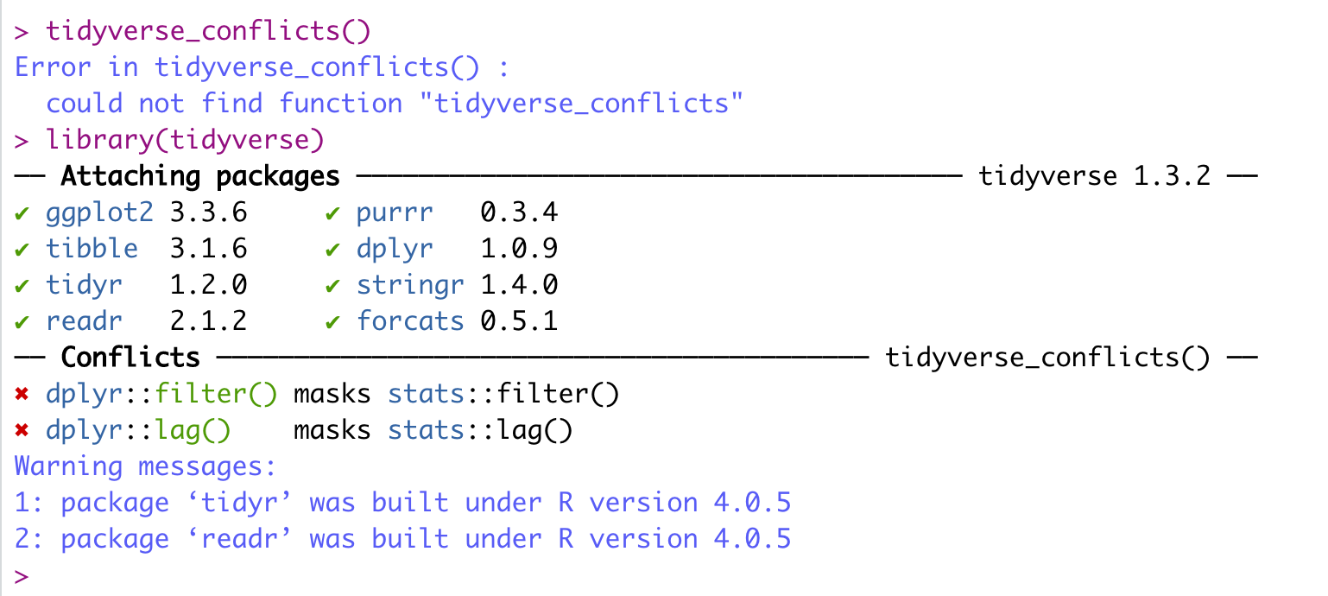
Tidyverse conflicts

Slide 12
Scripts and Markdowns

Slide 13
Scripts
Documents that hold your code (i.e., commands)
Allows your analysis to be portability, reproducible, and version controlled
Allows you to add comments that explain the purpose of your code

Slide 14
R Markdown
A markdown is a basic text editor
R markdown is a basic text editor native to R
Your code and output are in the same document
Outputs are transportable to PDF, Word, HTML, and PowerPoint and more

Slide 15
R Notebook
Same as Markdown, slightly different execution

Slide 16
Shiny
Shiny apps/websites are contained within one script, which must be named app.R. This file has three components:
A user interface (ui)
A server function
A call to the shinyApp function
Epi R handbook Chapter 43

Slide 17
Working directories and R Projects

Slide 18
Working Directory
Default location where R will look for files you want to load and where it will put any files you save
getwd() - to find out your current working directory
here::here() - to find out your current working directory using the here package
setwd(list/file/path/here) - to set your working directory

Slide 19
R Projects
Self-contained working environment with folders for data, scripts, outputs, etc.
Within the project, all the relevant scripts, data files, figures/outputs, and history are stored in sub-folders
The working directory is the project’s root folder
Allows you to use relative file paths

Slide 20
Getting help with R

Slide 21
Getting Help within R
Getting help with a function
?name OR help(function_name)
Help with a function argument
args(function_name)
Seeing an example
example(function_name)

Slide 22
Getting Help within R
Getting help with a package
help(“package_name”)
Seeing a vignette (i.e., documents, tutorials, or reference cards that are installed as part of the package documentation)
vignette(“package_name”)
vignette(“vignette_name”)
vignette() - list of available vignettes

Slide 23
Getting Help within R
Searching the Web for Help
RSiteSearch(“phase”)

Slide 24
Other Resources for Getting Help
Rseek - Google custom search focused on R-specific websites
Stack Overflow - Searchable Q & A for programming issues
Cross Validated - Searchable Q & A for statistical issues
CRAN Task Views - packages related to certain fields
RStudio Cheatsheets - downloadable guidelines for selected packages

Slide 25
Asking Questions
Characteristics of good questions includes:
a title that summarizes the problem
the operating system your using
the version of R and R Studio your using
the purpose of your code
the results of your code
the intended results of your code
sample code and data

Slide 26
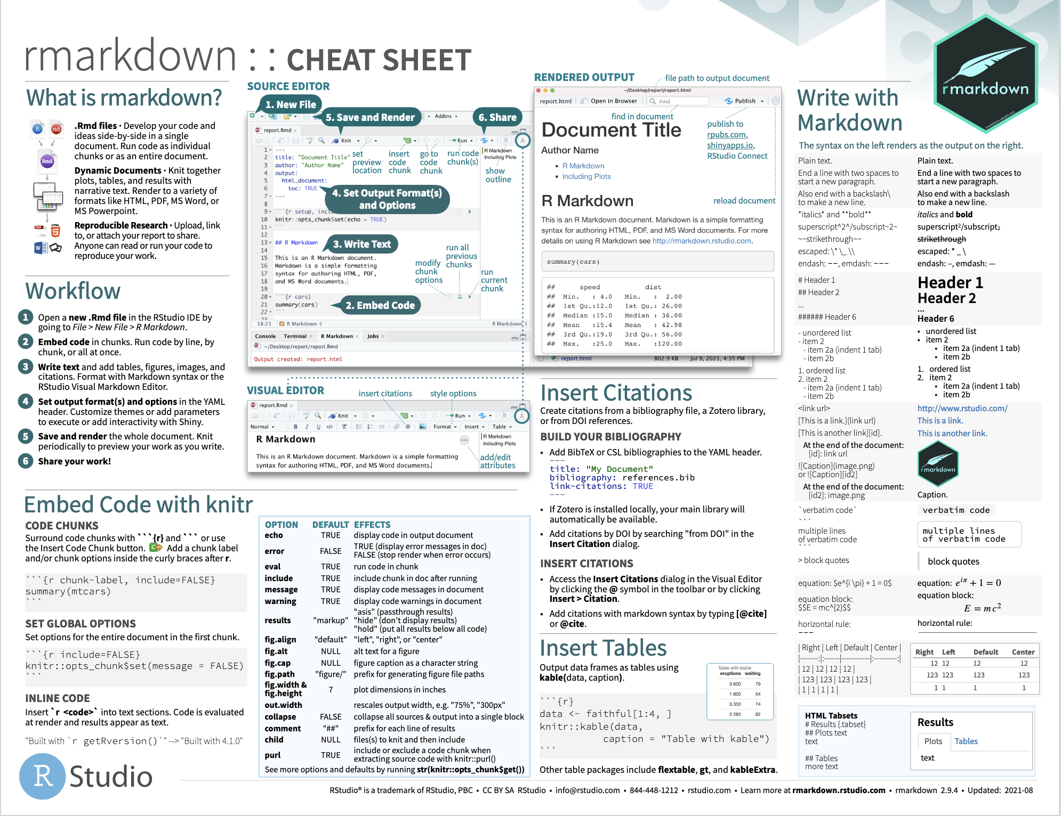

Slide 27
ChatGPT
Strengths
Understanding error messages
Code review
Debugging strategies
Suggest fixes
Alternative approaches
Guide to online resources

Slide 28
ChatGPT
Limitations
It can't execute code, so it won't be able to test solutions for you.
It's not as effective for extremely complex debugging scenarios requiring deep expertise in a specific domain.
Since it doesn't have the capability to view your entire project setup, some issues related to environment or configuration might not be easily diagnosed.

Slide 29
ChatGPT
ChatGPT R package serves as an interface to OpenAI's ChatGPT
Example Functions:
ask_chatgpt(question): Asks a question to ChatGPT and returns a character value with the response.
comment_code(code): Comments on the provided R code.
document_code(code): Documents the provided code in roxygen2 format.
explain_code(code): Explains the given R code.
find_issues_in_code(code): Analyzes the provided code for issues.

Slide 30
In-class activity

