Slide 1
Variable and Value Labels
Marquis Hawkins, PhD
Assistant Professor
Department of Epidemiology

Slide 2
Objectives
Understand the Importance of Variable and Value Labels
Explain how creating variable and value labels enhances data interpretability, quality control, and collaboration.
Describe how labels improve data visualization, reporting, and overall data management.
Follow Best Practices for Labeling
Identify and implement guidelines for effective labeling, including avoiding truncation, using concise labels, and avoiding special characters.
Conduct peer reviews and testing of labels to ensure clarity and accuracy.
Create Variable and Value Labels in R
Use R packages such as labelled, Hmisc, and expss to assign and modify variable and value labels.
Apply functions like var_label() and val_labels() to label data frames and individual variables.

Slide 3
Objectives
Generate and Use Codebooks for Documentation
Create codebooks using R packages like codebook and summary tools to provide metadata and high-level summaries of datasets.
Explain the importance of codebooks for enhancing data reproducibility and facilitating team science.
Test and Refine Labels
Apply a systematic approach to test labels using tables, figures, and peer feedback.
Revise labels based on testing outcomes to ensure they are clear, informative, and error-free.

Slide 4
Understand the Importance of Variable and Value Labels

Slide 5
Why create variable and value labels?
Enhances interpretability
Aids in quality control
Facilitates collaboration
Streamlines data manipulation/cleaning
Improves documentation
Enhances visualization and reporting
Notes:
Certainly, creating variable and value labels before diving into data analysis can offer several advantages. Here's a bulleted list outlining the reasons:
Enhances Interpretability:
- Clarity: Labels provide a quick and easy way to understand the content of each variable, making it easier for analysts and stakeholders to interpret the data.
- Semantic Meaning: Value labels add semantic meaning to numerical or coded data, making it more human-readable.
Aids in Quality Control:
- Error Reduction: Labels act as a guidepost to ensure that you're working with the correct variables, reducing the likelihood of errors.
- Data Validation: Having descriptive labels helps in the validation of the data, making it easier to spot errors or inconsistencies.
Facilitates Collaboration:
- Team Communication: Labels make it easier for team members to understand the dataset quickly, fostering better communication.
- Multi-disciplinary Understanding: For interdisciplinary teams, especially where not everyone may be familiar with technical jargon, labels help bridge the knowledge gap.
Streamlines Data Manipulation:
- Data Transformation: Labels help you remember the purpose and nature of each variable, making data transformation steps more intuitive.
- Subset Selection: When dealing with large datasets, labels can make it quicker to identify the variables needed for specific analyses.
Improves Documentation:
- Metadata: Variable and value labels can serve as in-file documentation, which is especially useful for data archival or when sharing datasets externally.
- Reproducibility: Labels contribute to better data documentation, which in turn enhances the reproducibility of the analysis.
Enhances Visualization and Reporting:
- Graph Labels: When creating visualizations, labels can automatically be used as axis titles or legends, making the graphs more informative.
- Summary Statistics: In statistical outputs, labels make it easier to understand the variables involved, adding context to the numbers.
By taking the time to create thoughtful variable and value labels, you set the stage for a smoother, more effective data analysis process. This is particularly valuable in fields like epidemiology, where clear and accurate interpretation of data is critical.

Slide 6
General steps to creating labels
Planning Phase
Review Data Dictionary
Identify Variables Needing Labels
Identify Values Needing Labels

Slide 7
General steps to creating labels
Label creation
Draft labels
Peer review/testing
Revise labels
Notes:
Variable and value labels should be manuscript-ready, meaning use the labels as you want them to appear in tables and figures. See how they appear in tables and figures and revise as necessary. Get feedback

Slide 8
Best practices

Slide 9
Guidelines for labeling
Beware of truncation (e.g, GDM vs. gestational diabetes mellitus)
Labels should provide keys information
Put important information first, some commands truncate labels
Avoid long labels (<30 characters)
Adapted from Dr. Bianca Manago, Worflow of Data Analysis, Statistical Horizons
Notes:
Be sure to define acronyms in the footnote of tables and figures

Slide 10
Which label is preferable?
sleep_read – “ How likely are you to fall asleep while reading?”
sleep_read – “Sleepiness while reading”
Adapted from Dr. Bianca Manago, Worflow of Data Analysis, Statistical Horizons

Slide 11
Testing labels
Have others check and provide feedback
See the example label review protocol
Create tables and figures using the labels
Revise as necessary
Adapted from Dr. Bianca Manago, Worflow of Data Analysis, Statistical Horizons

Slide 12
Value labels
Assigns text to numeric values
All categorical variables (that aren’t numeric) should have label
Decide how you will handle missing (e.g., label or remove observations)
Clear concise (e.g., <8 characters)
Avoid special characters
Adapted from Dr. Bianca Manago, Worflow of Data Analysis, Statistical Horizons

Slide 13
Creating labels in R

Slide 14
Creating labels in R
Package | Function
expss | apply_labels()
Hmisc | label()
labelled | var_label()

Slide 15
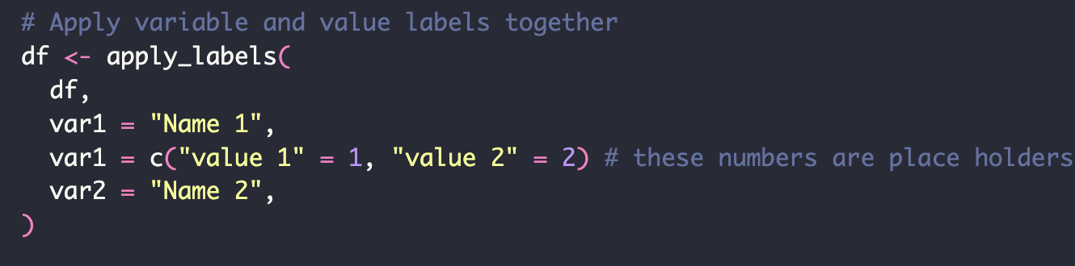
expss Package
Function: apply_labels()
Purpose:
Used to assign variable and value labels to data frames in R.
It allows you to add descriptive labels to both variables and their values, enhancing the readability and interpretability of your dataset.

Slide 16
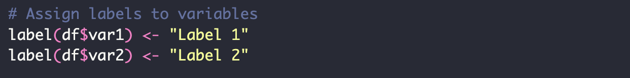
Hmisc Package
Function: label()
Purpose:
The label() function is used to assign or retrieve labels for variables in a data frame.
Not designed to assign value labels
Notes:
Does not work with a piping operator, you must label each variable one at a time

Slide 17
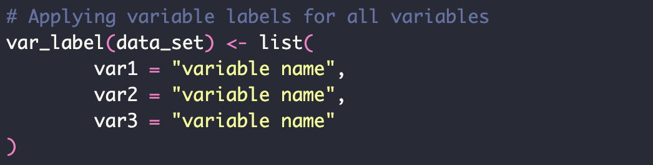
labelled Package
Function: var_label()
Purpose:
var_label() is used to assign labels to variables within a data frame.

Slide 18
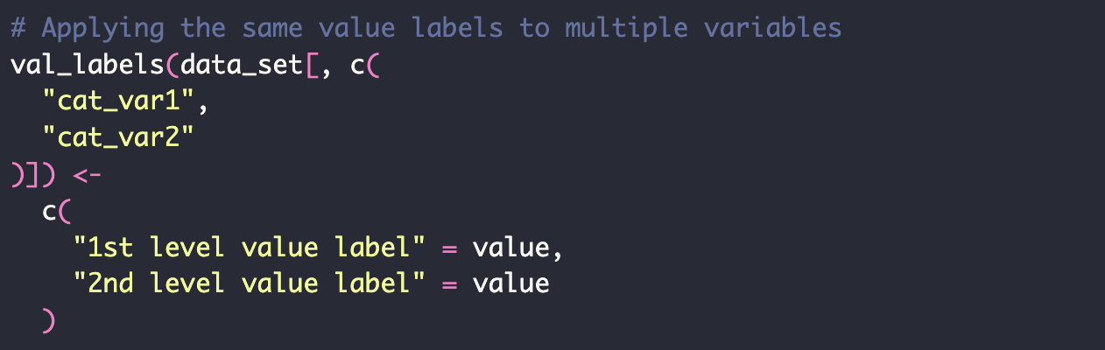
labelled Package
Function: val_labels()
Purpose:
val_labels() is used to assign value labels to variables within a data frame.
Notes:
This assigns the same value labels to multiple variables in the data set

Slide 19
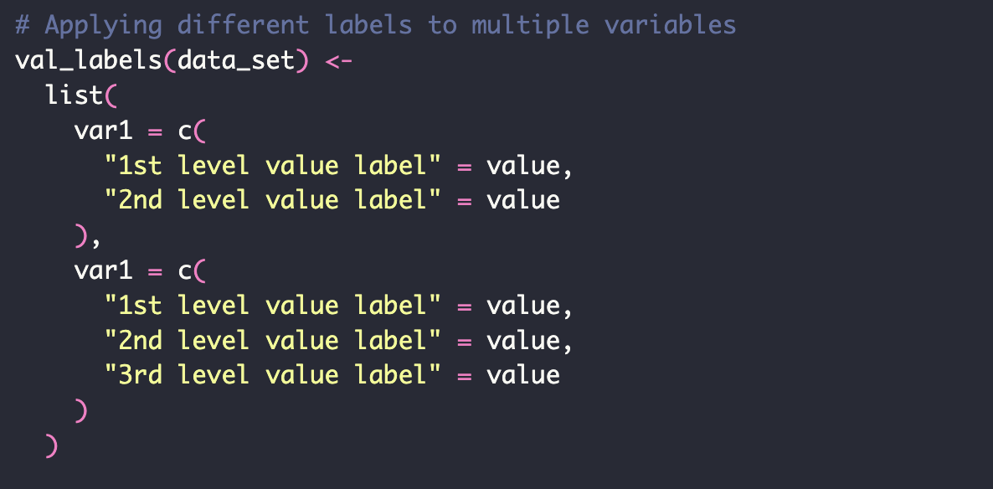
labelled Package
Function: val_labels()
Purpose:
val_labels() is used to assign value labels to variables within a data frame.
Notes:
This applies unique value labels to each variable

Slide 20
expss vs. Hmisc vs. labelled
expss::apply_labels(): Best for applying both variable and value labels in a streamlined way
Hmisc::label(): Ideal for adding descriptive labels to individual variables in a data frame
labelled::var_label(): Useful for setting or retrieving and assigning variable labels
labelled::val_labels(): Useful for setting or retrieving and assigning value labels

Slide 21
Practice
Create a data frame combing the demo.xpt, bmx.dta, and sleep.csv files
Create a subset that include bmxbmi, RIDAGEYR, RIAGENDR, DMDARTL, RIDEXPRG
Create variable labels
Create value labels
Use codebook as a resource

Slide 22
Creating codebook’s

Slide 23
Why create a codebook
Gives a high-level summary of the data and provides meaningful labels
Contains metadata
Explains unfamiliar datasets, aids in interpretation
Facilitates team science
Supports reproducibility
Can detect errors

Slide 24
Codebook packages in R
 | Codebook | Dataspice | summarytools | Dataset Nutrition Label | dataMaid | dataWiz
Machine readable metadata | For dataset and variable labels | For dataset and variable labels | No | No | No | Only citation related
plots | Yes | No | Yes | Yes | Yes | no
Reliability | Yes | No | No | No | No | no
Missing patterns | Yes | No | No | Yes | No | no
Web interface | Yes | Yes | No | No | No | no

Slide 25
The codebook package
Uses the rmarkdown package
codebook::new_codebook_rmd()

Slide 26
Practice
Create a subset that include bmxbmi, RIDAGEYR, RIAGENDR, DMDARTL, RIDEXPREG
Create a codebook

