Slide 1
A2: Step Tracker
Matthew Carlson

Slide 2
Fun features
I wanted to do some sort of a Tamagotchi type feature
But this Tamagotchi would be angry and vengeful
So it needed some way to get angry
I think the best way would be to control your access to the fun parts of the internet, perhaps by turning off access?

Slide 3
Issues
As you can see here: https://github.com/matthewfcarlson/CS590-A2/tree/9f2f0664bf8c66fae7190a5ab55b5cb3402db749 I tried to use FreeRTOS but ran into issues with libraries not being re-entrant (the display logic in particular).
I’ll investigate making the schedule non-pre-emptive? So far it looks tricky
I had to reformat this code so it doesn’t use FreeRTOS
I implemented a cooperative mini RTOS inside FreeRTOS

Slide 4
The design
97%
25 53

Slide 5
The Design
Face would be happy when you did your steps
Gradually it would get bored
It would eventually fall asleep and go into low power mode
It would get angry when you didn’t walk enough that day
It would communicate with nextdns.io and turn on blocking for youtube, facebook, steam, etc.

Slide 6
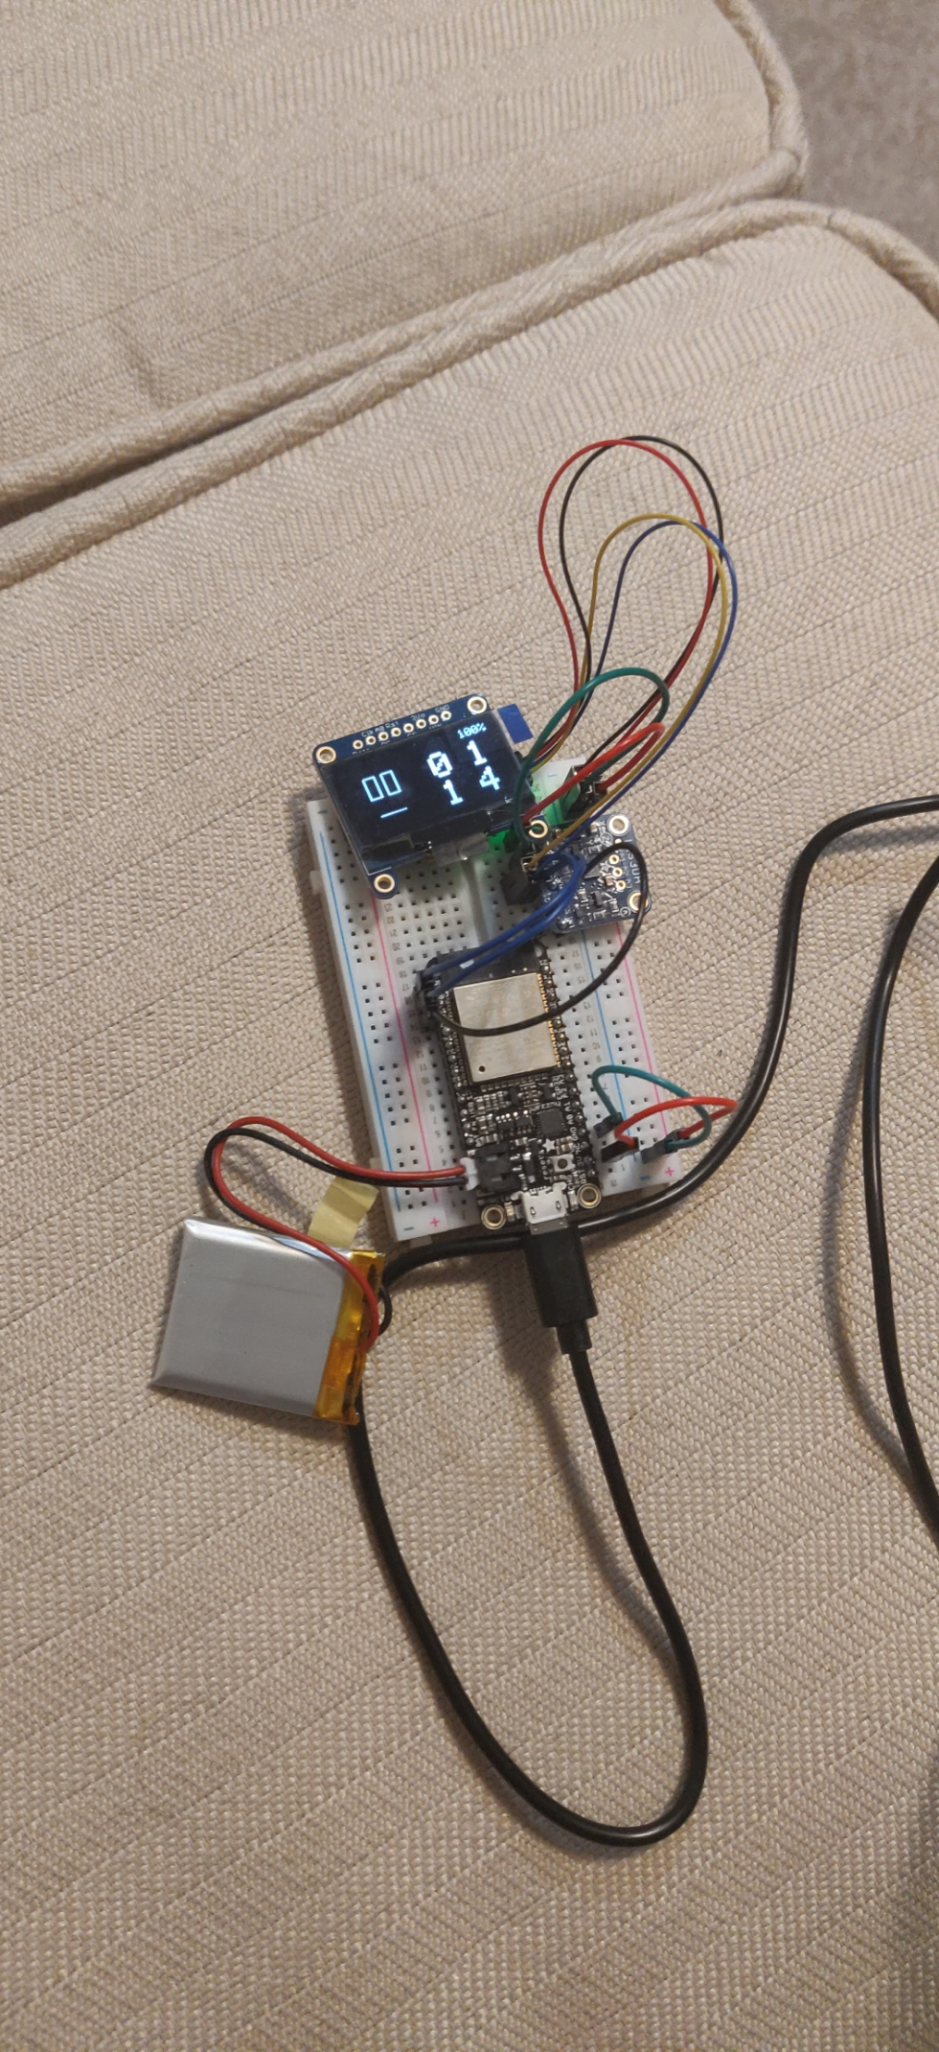
The result

Slide 7
Source Code
https://github.com/matthewfcarlson/CS590-A2
Added new functionality to Adafruit library (https://github.com/adafruit/Adafruit_LIS3DH/issues/29 – fifo, PR is coming soon)

