Slide 1
A1: Responsive Nite Light
Matthew Carlson

Slide 2
The Design
I looked at two designs. A cylinder and something made out of wood
I then realized it was due Tuesday night not Wednesday night.
So cylinder it was

Slide 3
The functionality
I thought about doing some sort of sleep aid that pulses in time with breathing. But I decided against it.
I decided my fun feature would be something with the accelerometer

Slide 4
The Form
Now time to decide the form.
A mason jar was quickly selected due to it’s size and ease of prototyping

Slide 5
Challenges
So I realized that the accelerometer was just an accelerometer, not a gyro. So my plan of detecting rotation was out.

Slide 6

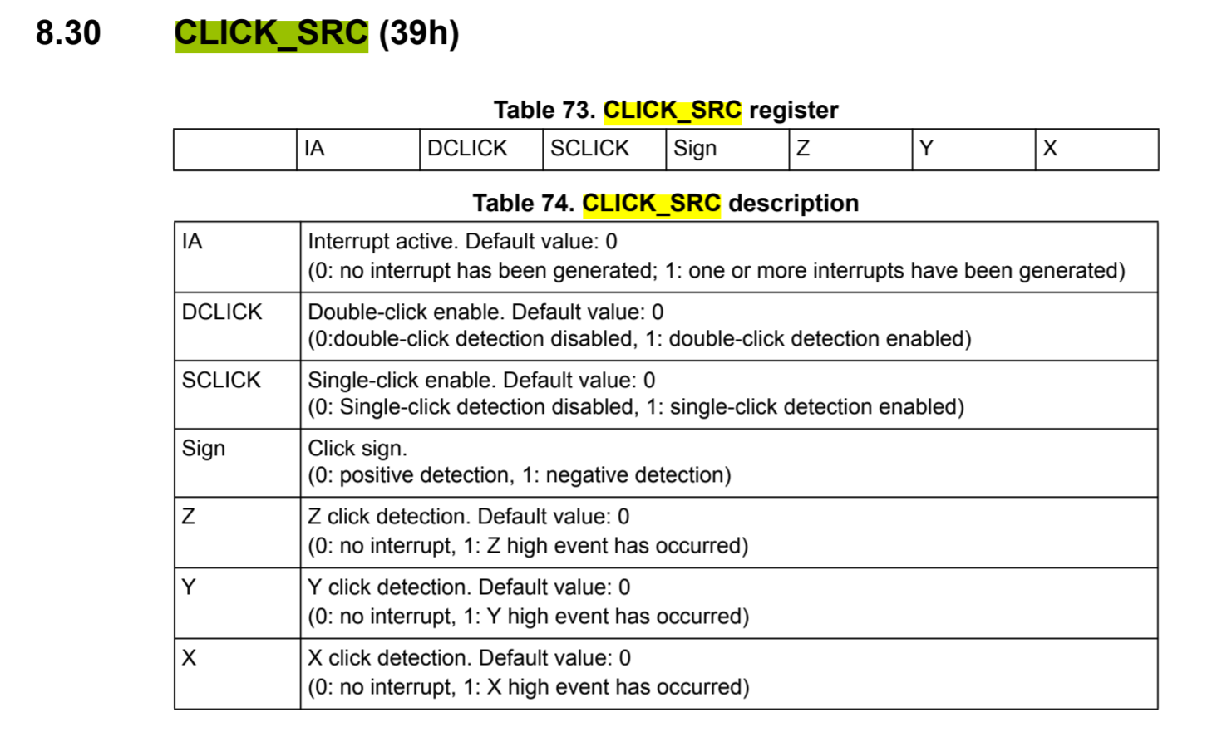
Pivoting
I realized this chip had some nice tap detection features
I’ll just use that
Not as cool as I wanted, but not bad

Slide 7

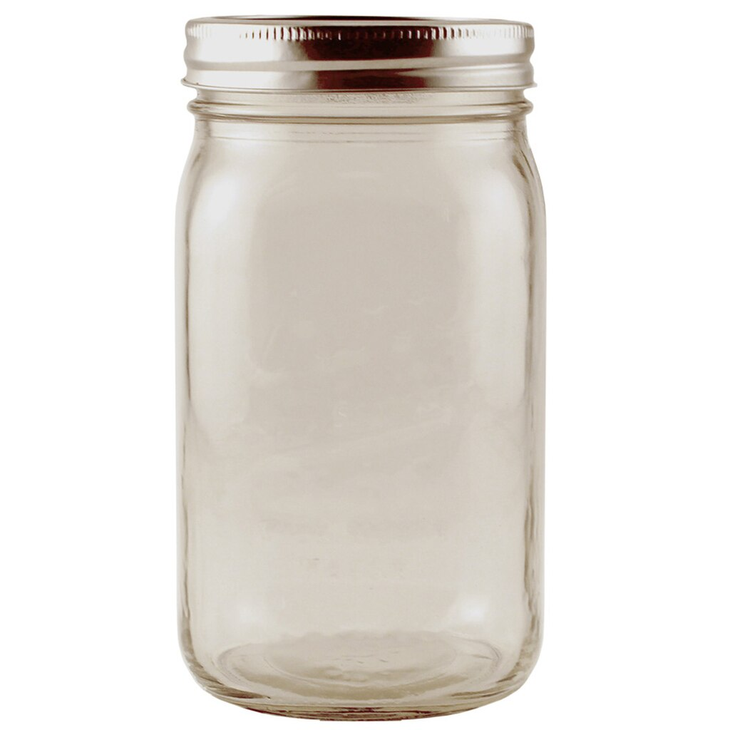
Lo-fi Input
Since my container was a mason jar, I thought it would be cool do some capacitive sensing on the metal lid around the edge of that can
We’ll see how that goes

Slide 8

Sound Sensitivity
I do aN FFT on the incoming mic input
If the absolute magnitude is above a threshold, let the light shine
Bin it into high, low, and mid
You get a bit of a light show that sort of follows the music

Slide 9
The prototype

Slide 10
https://github.com/matthewfcarlson/CS590_A1 (video and code)

