Slide 1
Factors Affecting Income

Slide 2
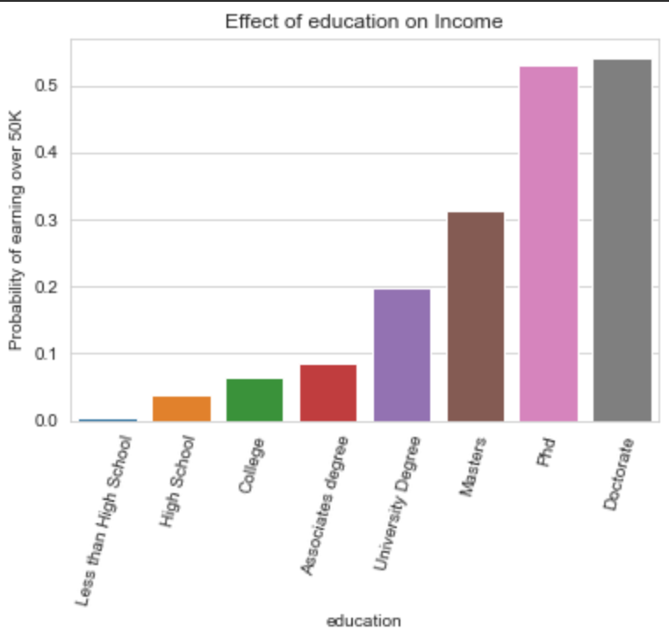
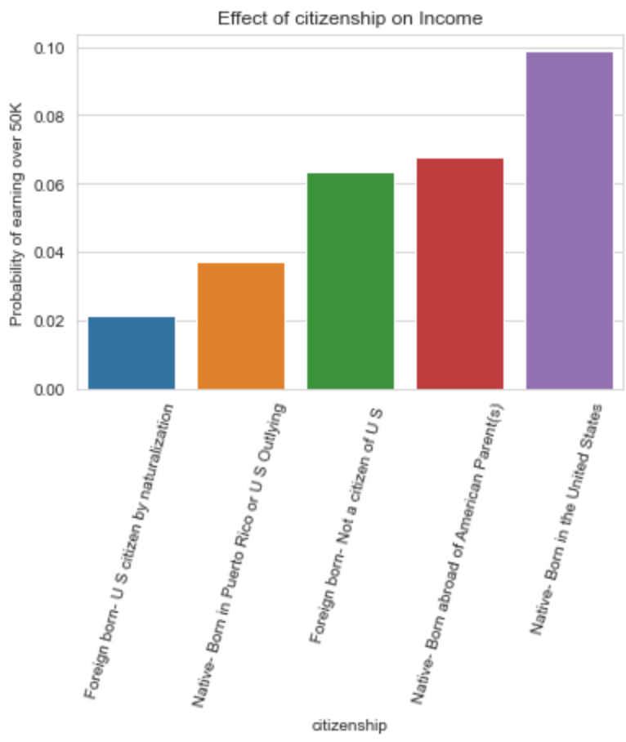
How do Education and Nationality affect Income?
More likely to earn more than 50k if:
Higher level of education
Citizens earn more
Education is the most important predictor

Slide 3
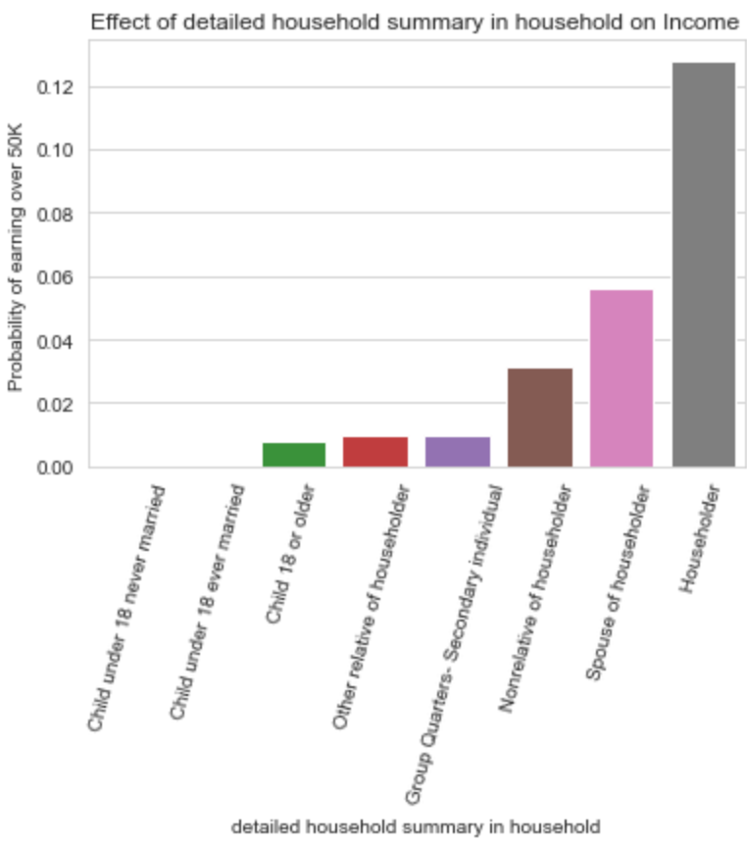
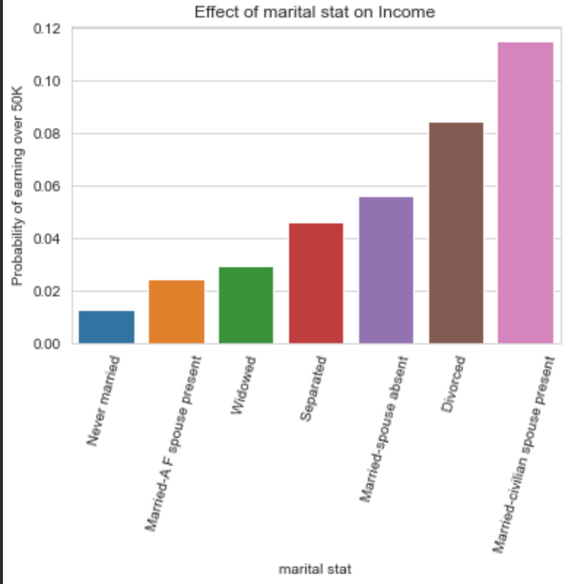
How does Family life affect Income?
Marriage is important
Other than armed forces
Better to be married and divorced than never married
Being a householder or spouse of householder is important
Having children over 18 improves changes, confounding variable of age?

Slide 4
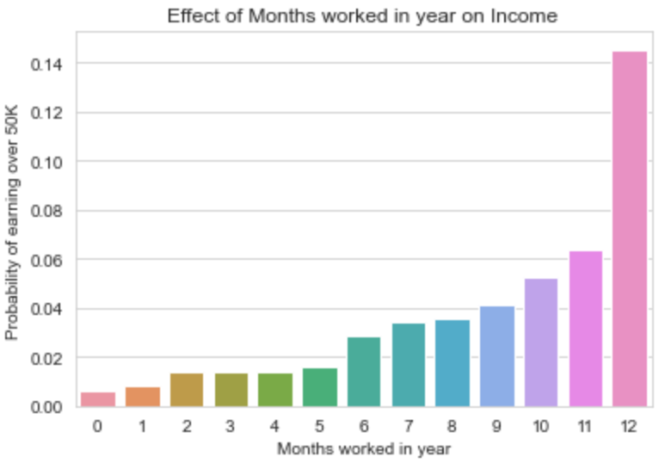
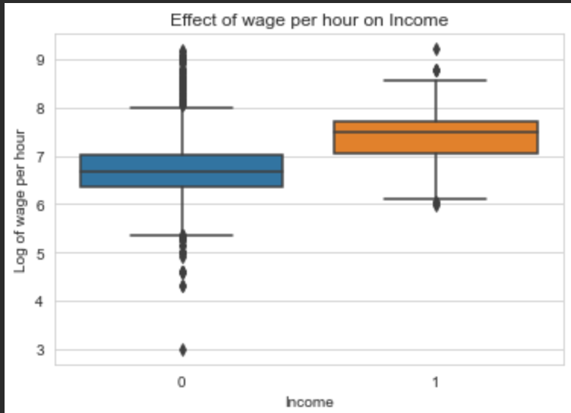
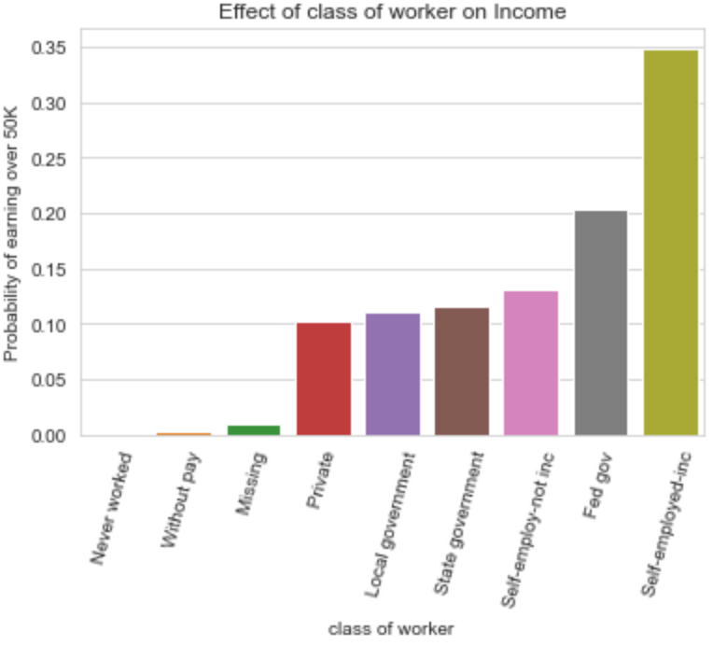
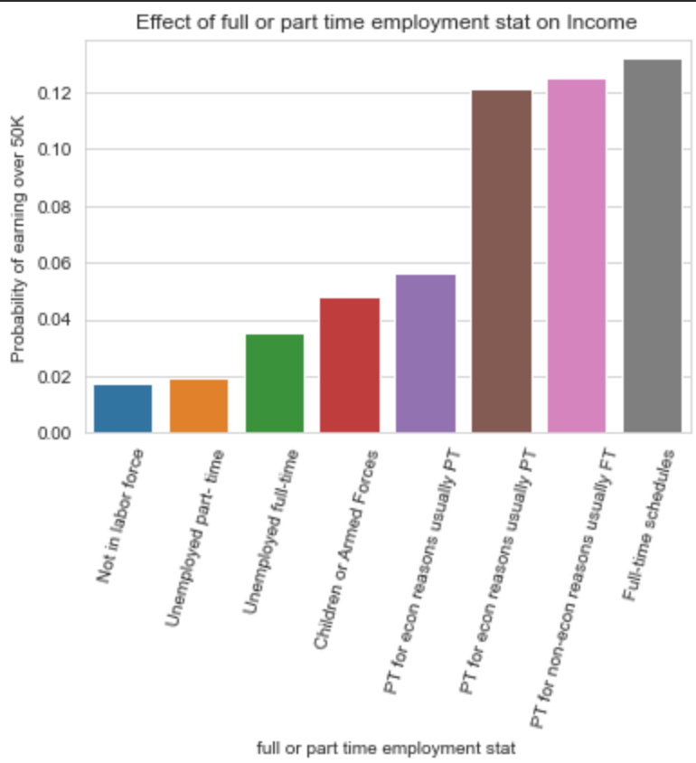
How does Occupation affect Salary?
Being in full time work is better than part time
Working for more months is better
Higher wage per hour is better
Self employed offers the best chance

Slide 5
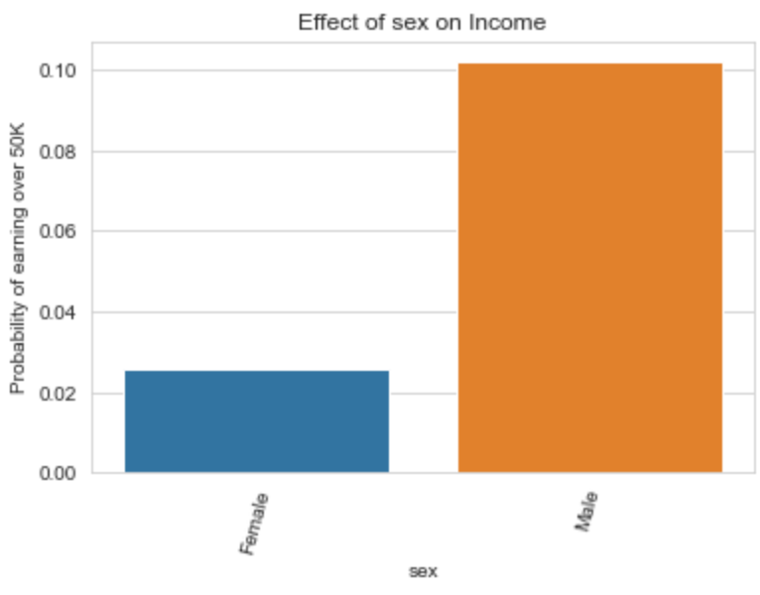
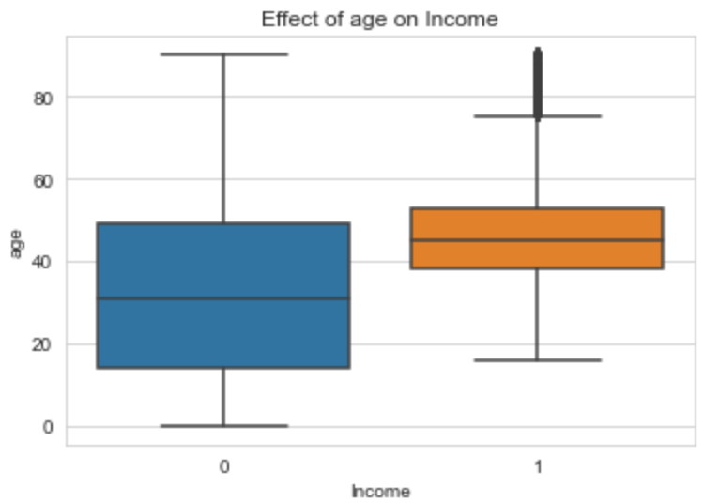
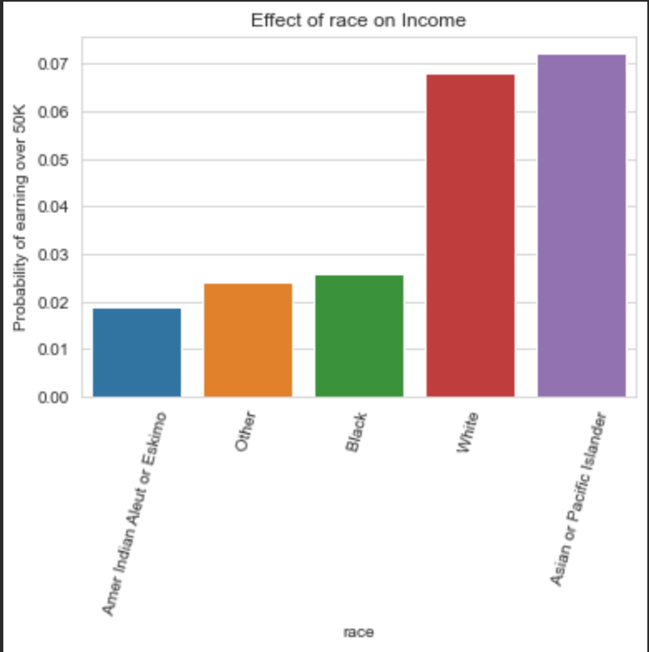
How do Physical Attributes Affect Income?
More likely to earn more if you are:
Male
Older
White or Asian

Slide 6
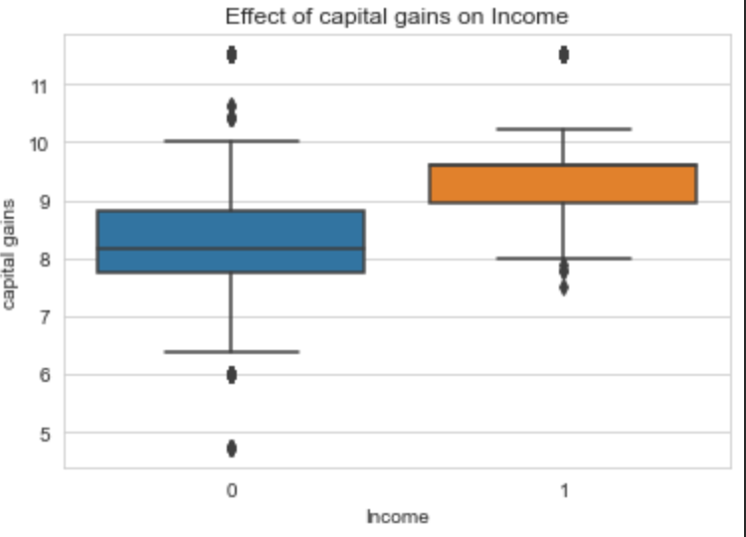
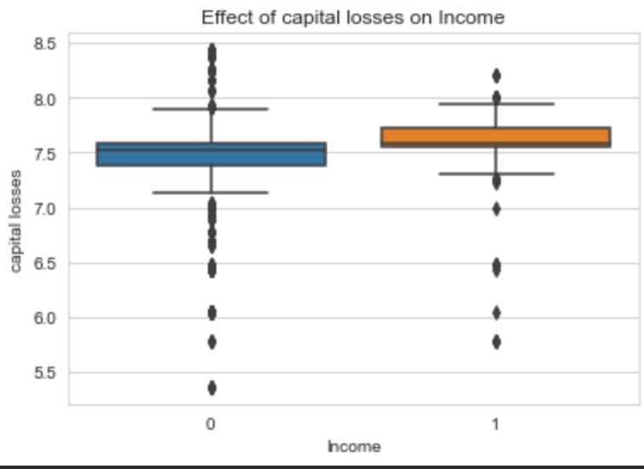
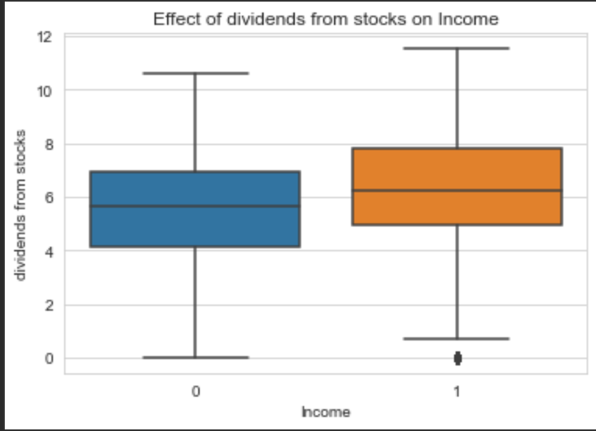
Does having Investments affect Income?
Having Investments increases the likelihood of earning over 50K
Even if they perform poorly

Slide 7
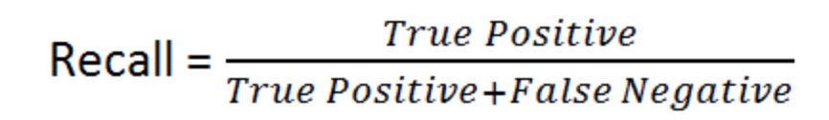
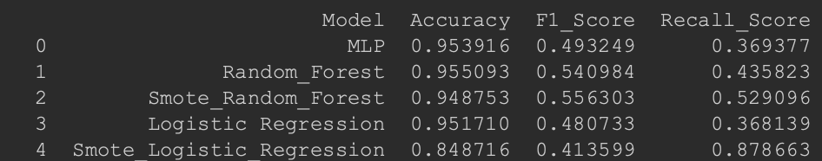
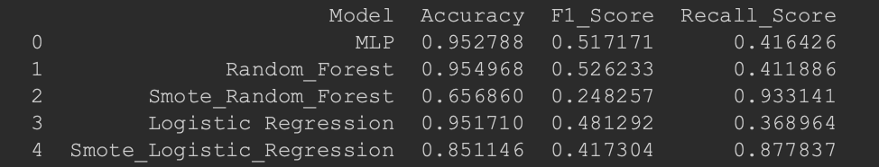
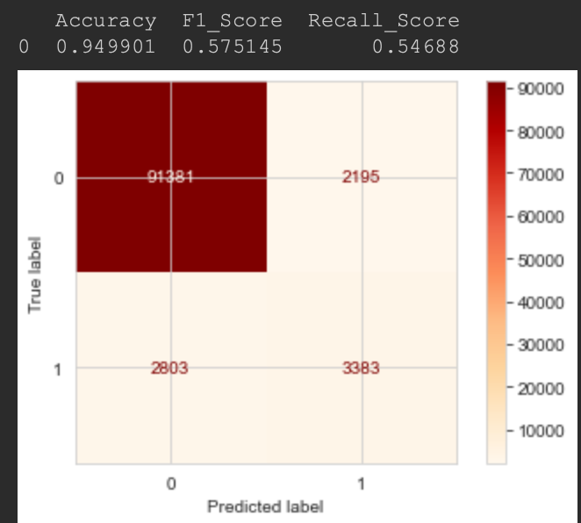
Predictive Performance
Imbalanced dataset towards under 50K
Resampling methods used as well as recall and F1 to bias for positive class
Gaussian normalisation better than min max
Logistic Regression failed to converge
Best model = SMOTE- RF =
Min_MAX
Standard Scalar

Slide 8
Findings, Recommendations and Future Improvements
Findings:
Education is most important variable
The following increase likelihood of earning over 50k:
Older, Male, Self-employed, in full time work, married and having investments
Predictive models are quite poor at predicting positive class without rebalancing of the dataset
Improvements:
Look at variable importance to the model
Further dig into how different career options affect income using visualisations
Identify highly correlated variables for visualisations as well as modelling
Compare One hot vs ordinal encoding for categorical variables
Investigate Resampling methods to correct for imbalance dataset: Undersampling/Oversampling
Investigate Regularisation techniques to bias positive class predictions for algorithms
Hyperparameter optimisation using: random search or gridsearch

Slide 9
Appendix: Technical Details
Following slides contain technical details used for the investigation
Not required for presentation unless requested

Slide 10
Appendix: Data Encoding
Missing Data:
Both ‘?’ and “Not in Universe” identified as pseudo missing data
No Missing Numeric labels
Replaced Categorical variables with a new “Missing” label
Categorical Encoding:
Ordinal Encoding
Works well with tree based algorithms
Does not increase the feature space - like with one hot encoding
Feature Engineering for “Education” category to reduced cardinality/ apply domain knowledge
Compared using MinMax and standard scalar for normalisation
Numerical Encoding:
Feature Engineering log transformation for skewed variables
Compared using MinMax and standard scalar for normalisatio

Slide 11
Appendix: Processing Pipeline
Encode “not in universe” as NA
Fill NA with missing (all categorical)
Feature engineering for education
Log skewed numeric values
Normalise variables (min max or standard scalar)
Drop correlated variables above a threshold
Apply resampling method to deal with class imbalance
Fit predictive model

Slide 12
Appendix: Predictive Modelling
Imbalanced dataset
Resampling methods used - SMOTE
Metric of interest used was recall & F1 to better evaluate the positive class
Linear models failed to converge on rebalance data
Algorithms
Random forest
Logistic regression
MLP

