Slide 1
Factors Affecting Income

Slide 2
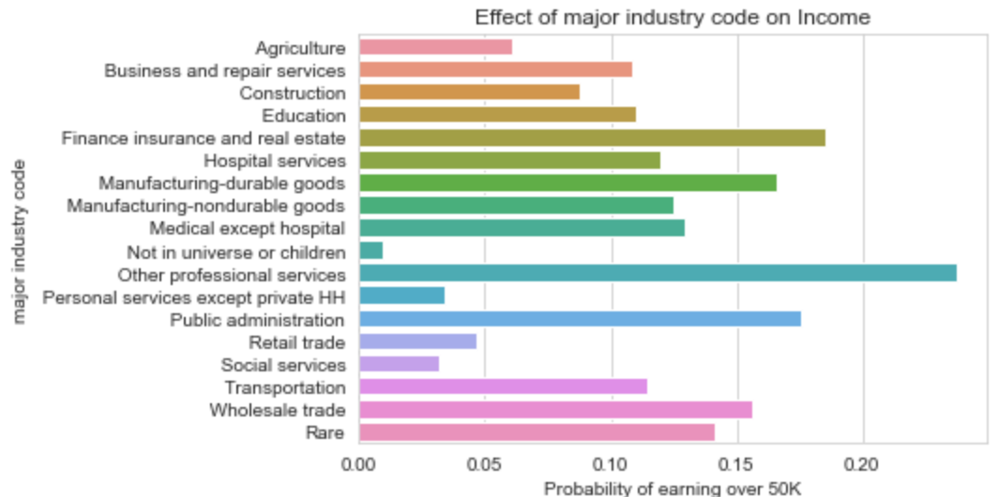
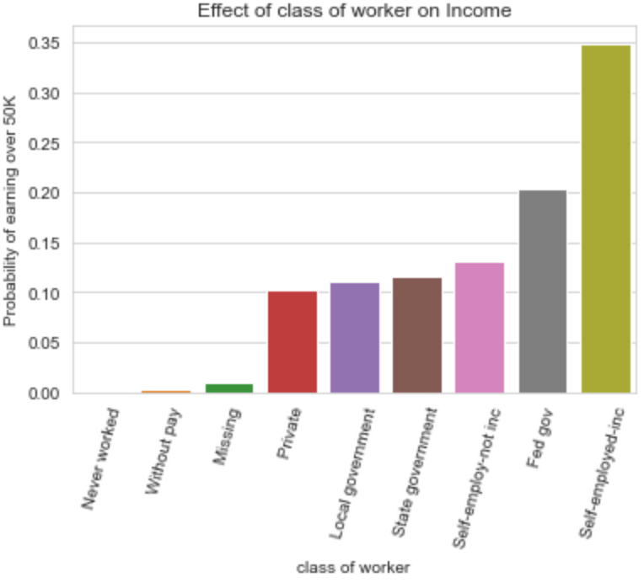
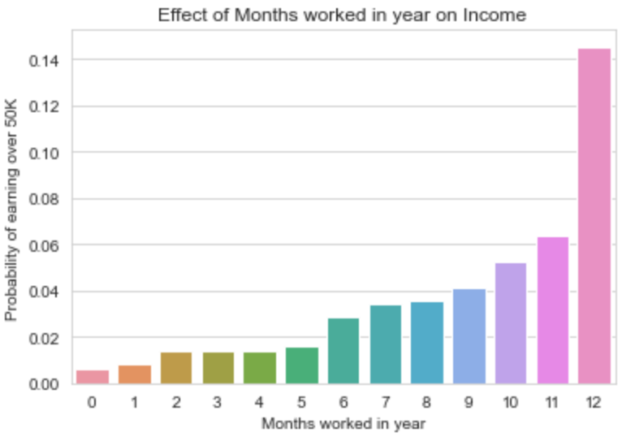
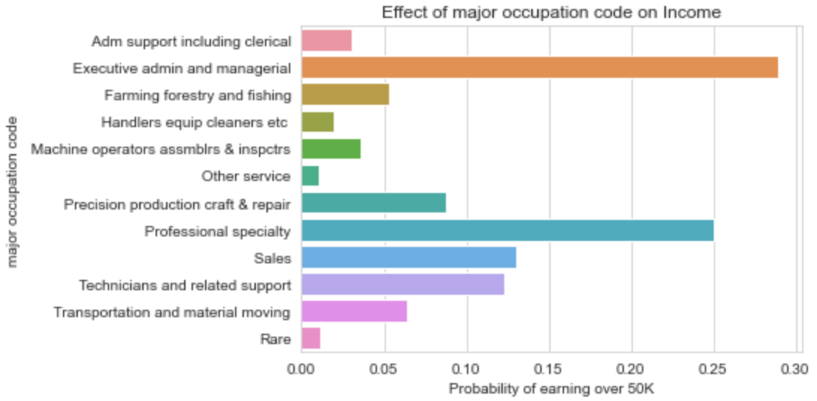
Occupation
Industry and role have a large impact on earning potential
Role within this industry is also very important
Self employed offers the best chance to earn over 50K
Not show: Higher wage per hour better/ Full time better than part time better than no time

Slide 3
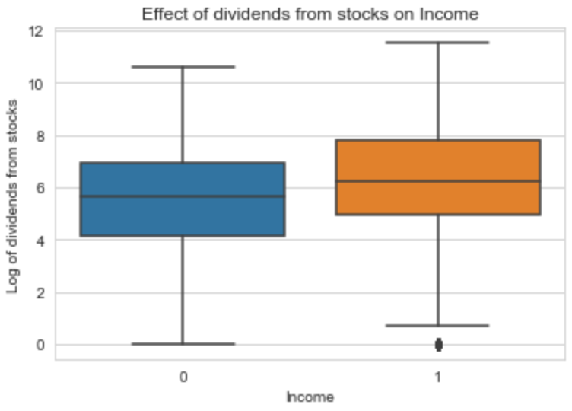
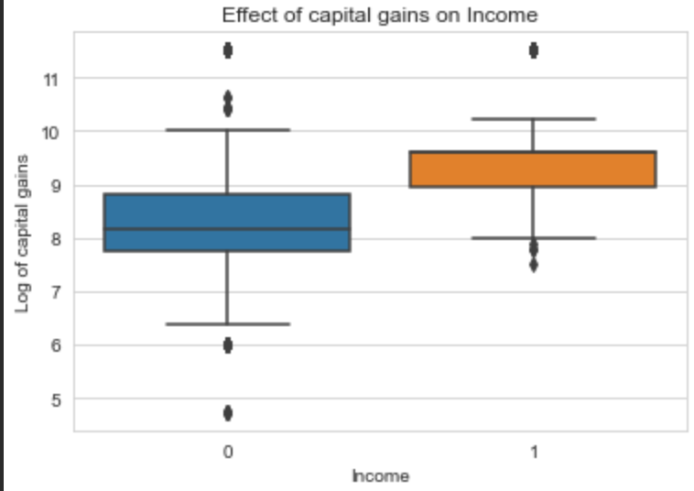
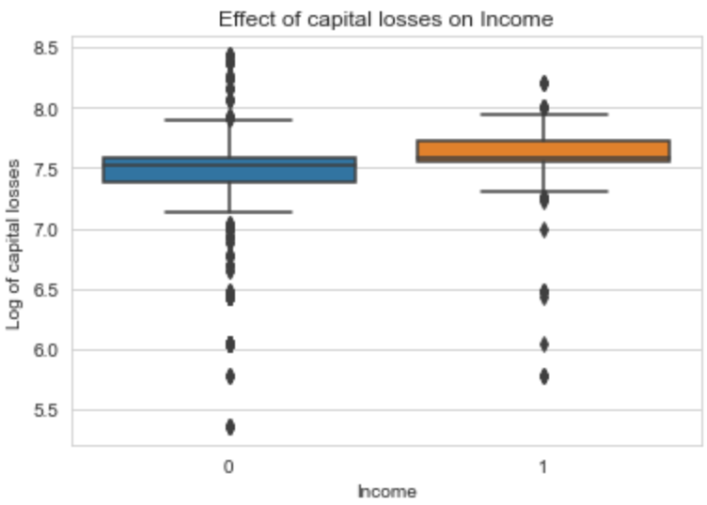
Investments
Having Investments increases the likelihood of earning over 50K
Even if they perform poorly
Not able to distinguish between those that have no investment profile vs making 0
Log values to encourage normal distributions
Better for linear models
Better for visualization

Slide 4
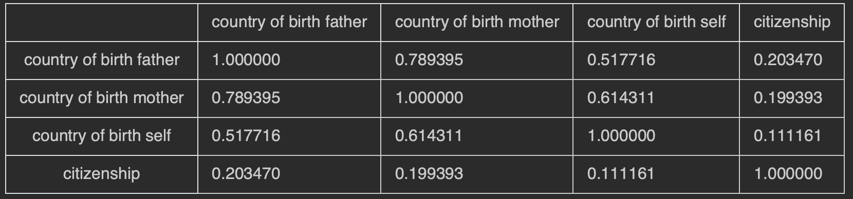
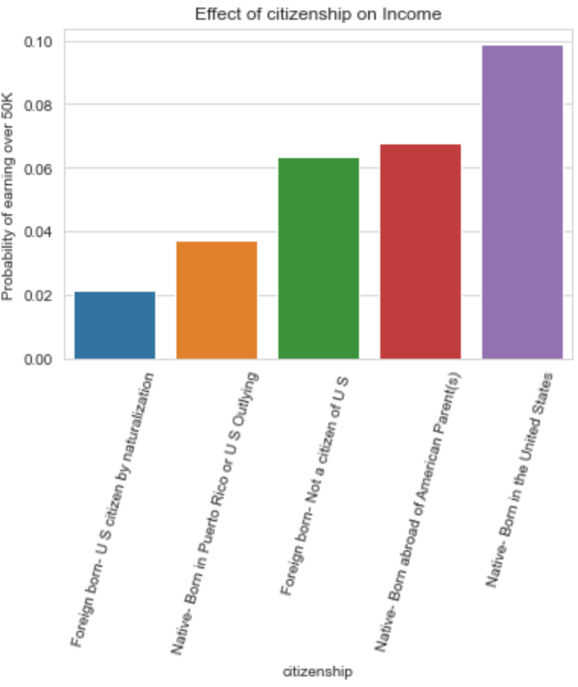
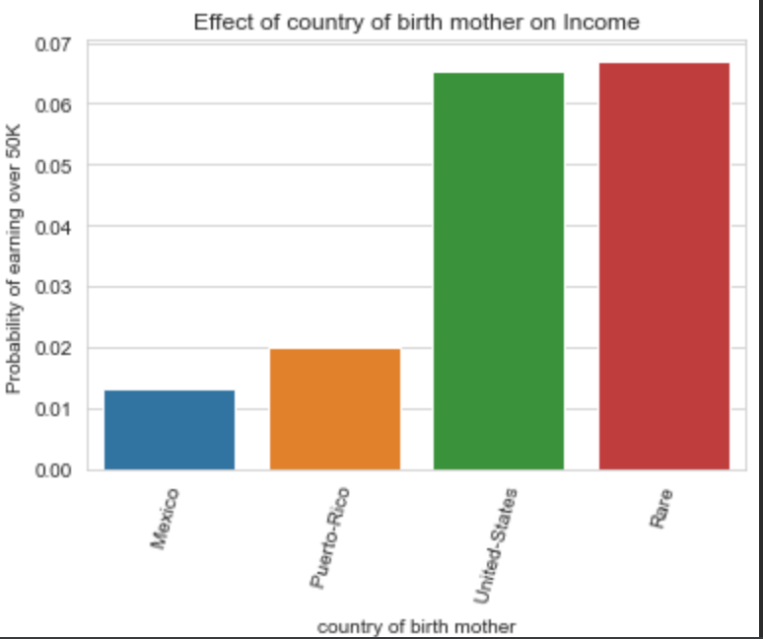
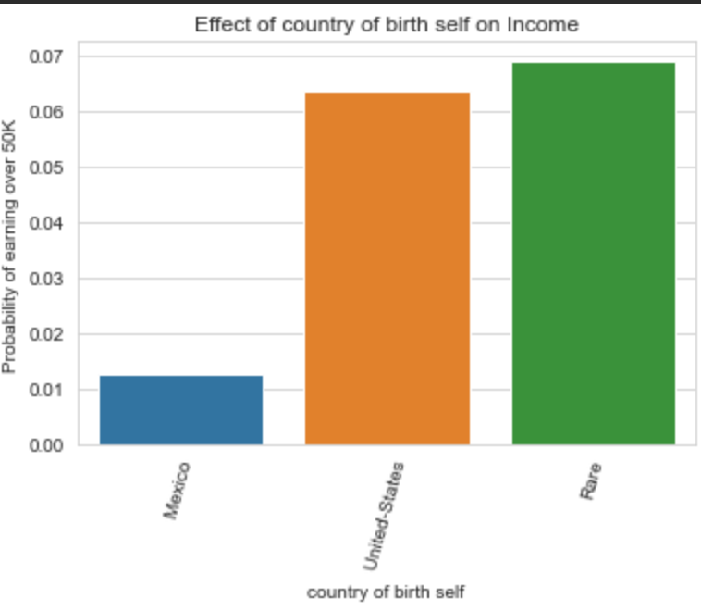
Nationality
High correlation (> 0.7) between mother's country of birth and father's country of birth (not shown)
High correlation between birth of self and parents
Citizenship more nuanced than native, not native -
Generally better to be a native but distinction for us outlying- consistent with birth country
Improvements: Continent instead of country for Rare labels

Slide 5
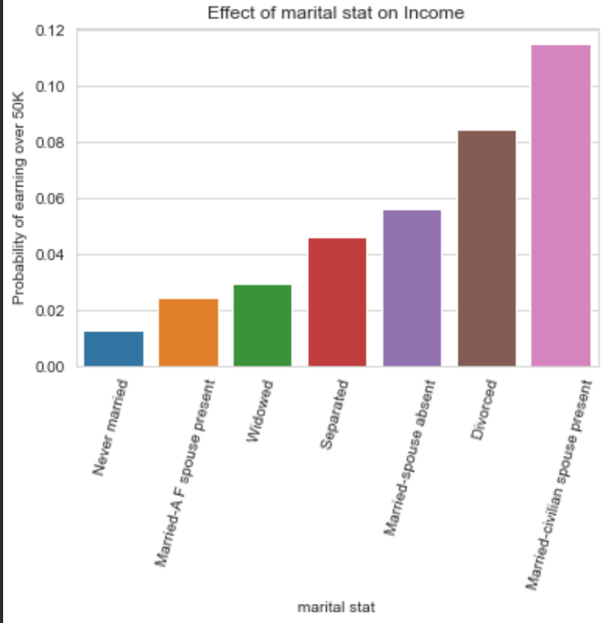
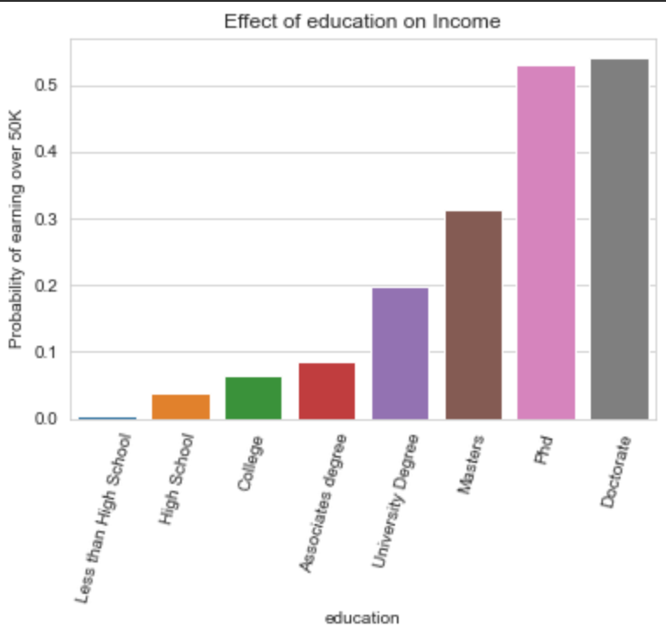
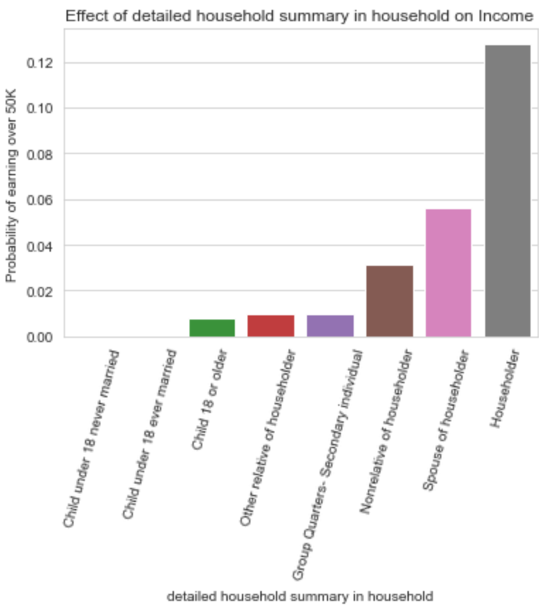
Education & Family Life
Education is the most important predictor
Marriage is important
Other than armed forces
Better to be married and divorced than never married
Being a householder or spouse of householder is important
Having children over 18 improves changes, confounding variable of age?

Slide 6
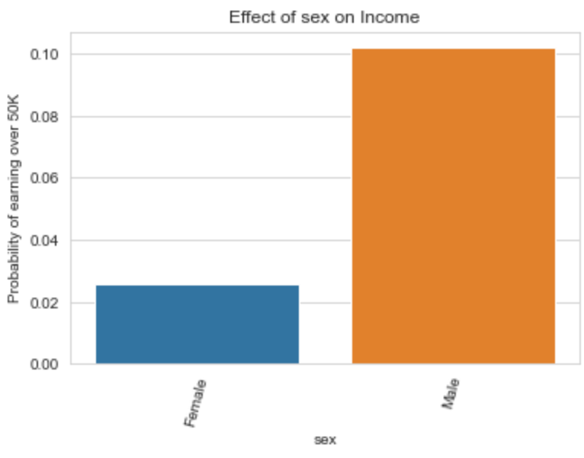
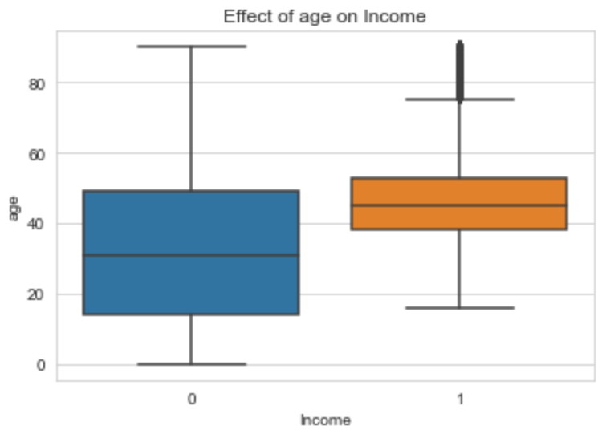
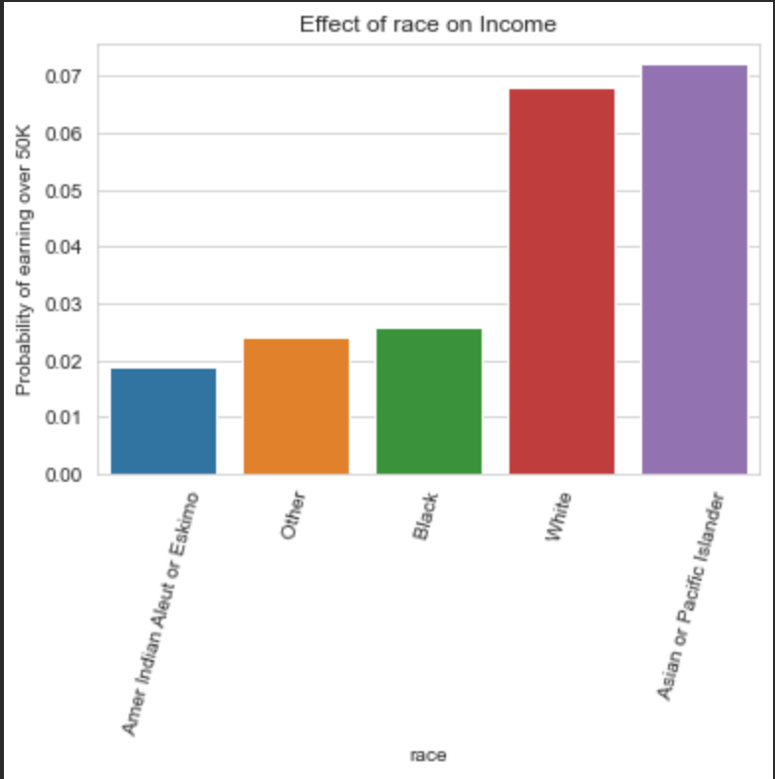
Physical Attributes
More likely to earn more if you are:
Male
Older
White or Asian

Slide 7
Prediction Pipeline
Missing Data:
Encode “not in universe” & “ ?” as N/A
Fill N/A with “missing” (all categorical)
Categorical Processing
Label “Rare” Categories
Feature engineering for Education
Ordered Ordinal Encoding for Categorical
Numeric Processing
Log skewed numeric values
Normalise variables
Drop correlated variables above a threshold
Prediction:
Apply resampling method to deal with class imbalance
Fit predictive model
Hyperparameter tuning for best model

Slide 8
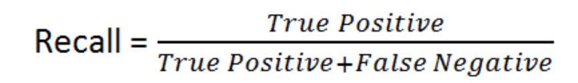
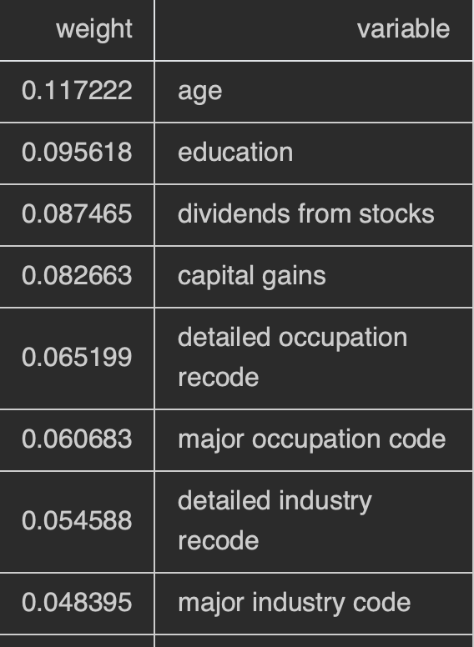
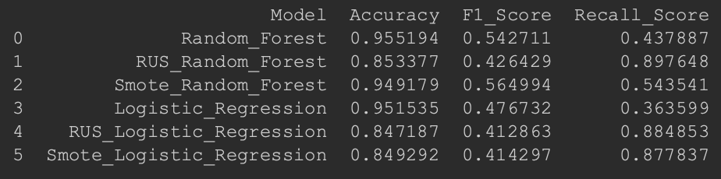
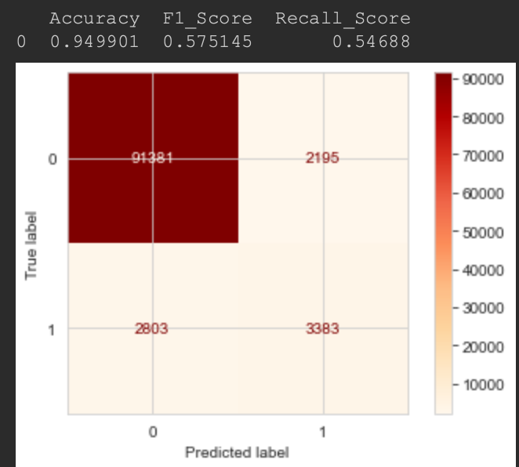
Predictive Performance
Imbalanced dataset towards under 50K - 93.8%
Resampling methods used to rebalance dataset for positive class
Best algorithm hyperparameters established through random search - 5 fold cross validation
Variable importance
Test set performance

Slide 9
Findings, Recommendations and Future Improvements
Findings & Recommendations: Most important factors for earning over 50k:
Most Important: Being older/ better educated / having investments / being a executive in professional services/ working full time
Also important: Male, Self-employed, married, not being born in Mexico
Predictive models are quite poor at predicting positive class
Improvements:
Cross validate a large random search on all preprocessing and hyperparameters
Investigate other methods of feature importance
Investigate Regularisation techniques to bias positive class predictions for algorithms
Further dig into how different career options affect income using visualisations
Identify highly correlated variables for visualisations as well as modelling
Compare One hot vs ordinal encoding for categorical variables

Slide 10
Appendix: Missing Data Processing
Values that contained ‘?’ 2 types: 8 columns total
Migration code missing (multiple) :
Large percentage of the data missing
Relationship to target variable
Country of Birth (multiple):
no relationship to target variable
Not a large number of variables
Values that contained “Not in Universe” : 13 columns total
Generally relationship to target variable
Approaches:
Replace everything with a new missing category
Retains information - important when there is a relationship to target variable
Potentially increase cardinality unnecessarily in some instances
Drop missing data - lose information / less good
Improvements: Combination approach - Drop columns = Smaller features space, missing category for others
Identify why they are missing

Slide 11
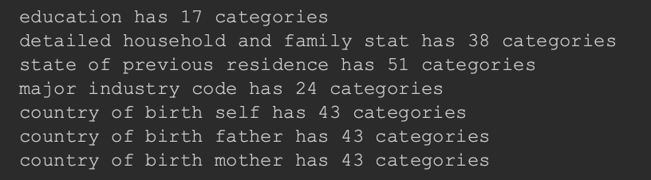
Appendix: Categorical Encoding
Categorical Encoding:
Cardinality: High >15:
Can cause overfitting
Issue with production models
Feature Engineering for “Education” category - using domain knowledge
Encode less common labels as rare: threshold 0.01%:
Better for production models - overfitting and variables in test set
Better suited to visual representations
Reduces feature space
Ordered Ordinal Encoding
Works well with tree based algorithms
Does not increase the feature space - like with one hot encoding
Creates monotonic relationship with target variable
Prefered over one hot which expands features space

Slide 12
Appendix: Numerical Encoding & Normalisation
Continuous: Skewed log transformation for skewed variables to return them to normal
Better for linear models
Quick - but potentially more work needs to be done to handle outliers
Capping
Discrete: Scaled using normalisation
Quick - but potentially more work needs to be done to handle outliers
Reduced cardinality for weeks of years -->months
Better for linear models, reduced over fitting
Normalisation:
MinMax: retains outliers
Potential improvement use robust scalar (to deal with outliers) or Standard scalar to normalise variables

