Slide 1

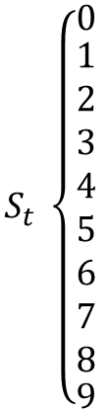
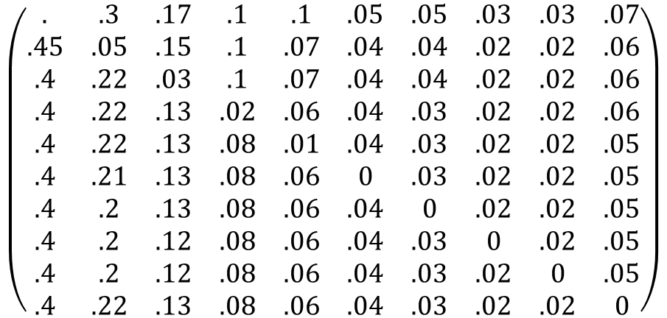
Q1
$$S_{t+1}$$
0 1 2 3 4 5 6 7 8 9
$$S_{t} \left\{\begin{matrix}0 \\ \begin{aligned}1 \\ 2 \\ 3 \\ 4 \\ 5 \\ 6 \\ 7 \\ 8\end{aligned} \\ 9\end{matrix} \right.$$
$$\left(\begin{matrix}. & .3 & .17 & .1 & .1 & .05 & .05 & .03 & .03 & .07 \\ .45 & .05 & .15 & .1 & .07 & .04 & .04 & .02 & .02 & .06 \\ .4 & .22 & .03 & .1 & .07 & .04 & .04 & .02 & .02 & .06 \\ .4 & .22 & .13 & .02 & .06 & .04 & .03 & .02 & .02 & .06 \\ .4 & .22 & .13 & .08 & .01 & .04 & .03 & .02 & .02 & .05 \\ .4 & .21 & .13 & .08 & .06 & 0 & .03 & .02 & .02 & .05 \\ .4 & .2 & .13 & .08 & .06 & .04 & 0 & .02 & .02 & .05 \\ .4 & .2 & .12 & .08 & .06 & .04 & .03 & 0 & .02 & .05 \\ .4 & .2 & .12 & .08 & .06 & .04 & .03 & .02 & 0 & .05 \\ .4 & .22 & .13 & .08 & .06 & .04 & .03 & .02 & .02 & 0\end{matrix}\right)$$

Slide 2

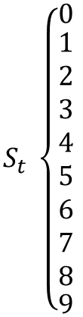
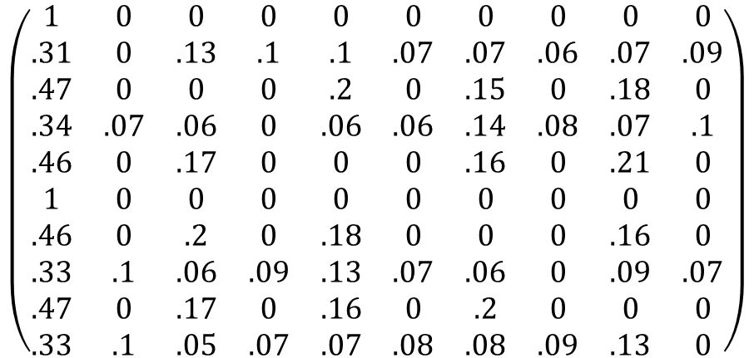
Q2b
$$S_{t+1}$$
0 1 2 3 4 5 6 7 8 9
$$S_{t} \left\{\begin{matrix}0 \\ \begin{aligned}1 \\ 2 \\ 3 \\ 4 \\ 5 \\ 6 \\ 7 \\ 8\end{aligned} \\ 9\end{matrix} \right.$$
$$\left(\begin{matrix}1 & 0 & 0 & 0 & 0 & 0 & 0 & 0 & 0 & 0 \\ .31 & 0 & .13 & .1 & .1 & .07 & .07 & .06 & .07 & .09 \\ .47 & 0 & 0 & 0 & .2 & 0 & .15 & 0 & .18 & 0 \\ .34 & .07 & .06 & 0 & .06 & .06 & .14 & .08 & .07 & .1 \\ .46 & 0 & .17 & 0 & 0 & 0 & .16 & 0 & .21 & 0 \\ 1 & 0 & 0 & 0 & 0 & 0 & 0 & 0 & 0 & 0 \\ .46 & 0 & .2 & 0 & .18 & 0 & 0 & 0 & .16 & 0 \\ .33 & .1 & .06 & .09 & .13 & .07 & .06 & 0 & .09 & .07 \\ .47 & 0 & .17 & 0 & .16 & 0 & .2 & 0 & 0 & 0 \\ .33 & .1 & .05 & .07 & .07 & .08 & .08 & .09 & .13 & 0\end{matrix}\right)$$

Slide 3
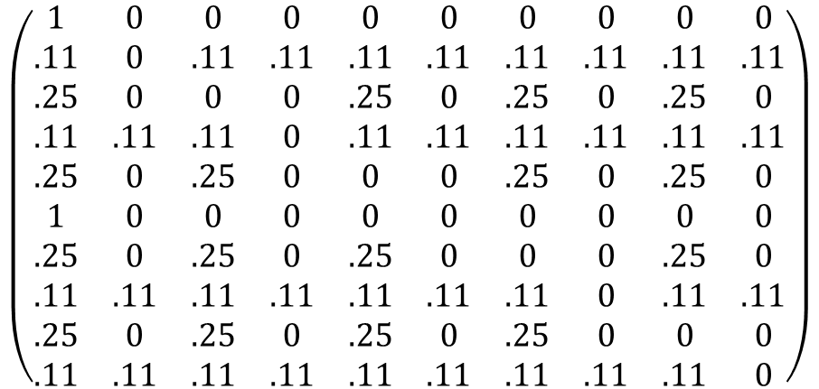
Q2C
$$S_{t+1}$$
0 1 2 3 4 5 6 7 8 9
$$S_{t} \left\{\begin{matrix}0 \\ \begin{aligned}1 \\ 2 \\ 3 \\ 4 \\ 5 \\ 6 \\ 7 \\ 8\end{aligned} \\ 9\end{matrix} \right.$$
$$\left(\begin{matrix}1 & 0 & 0 & 0 & 0 & 0 & 0 & 0 & 0 & 0 \\ .11 & 0 & .11 & .11 & .11 & .11 & .11 & .11 & .11 & .11 \\ .25 & 0 & 0 & 0 & .25 & 0 & .25 & 0 & .25 & 0 \\ .11 & .11 & .11 & 0 & .11 & .11 & .11 & .11 & .11 & .11 \\ .25 & 0 & .25 & 0 & 0 & 0 & .25 & 0 & .25 & 0 \\ 1 & 0 & 0 & 0 & 0 & 0 & 0 & 0 & 0 & 0 \\ .25 & 0 & .25 & 0 & .25 & 0 & 0 & 0 & .25 & 0 \\ .11 & .11 & .11 & .11 & .11 & .11 & .11 & 0 & .11 & .11 \\ .25 & 0 & .25 & 0 & .25 & 0 & .25 & 0 & 0 & 0 \\ .11 & .11 & .11 & .11 & .11 & .11 & .11 & .11 & .11 & 0\end{matrix}\right)$$

Slide 4
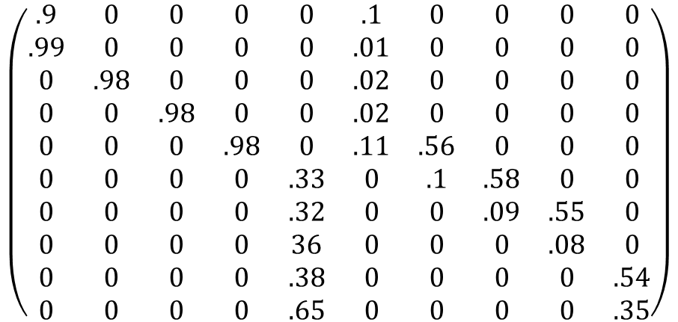
S3
$$S_{t+1}$$
0 1 2 3 4 5 6 7 8 9
$$S_{t} \left\{\begin{matrix}0 \\ \begin{aligned}1 \\ 2 \\ 3 \\ 4 \\ 5 \\ 6 \\ 7 \\ 8\end{aligned} \\ 9\end{matrix} \right.$$
$$\left(\begin{matrix}.9 & 0 & 0 & 0 & 0 & .1 & 0 & 0 & 0 & 0 \\ .99 & 0 & 0 & 0 & 0 & .01 & 0 & 0 & 0 & 0 \\ 0 & .98 & 0 & 0 & 0 & .02 & 0 & 0 & 0 & 0 \\ 0 & 0 & .98 & 0 & 0 & .02 & 0 & 0 & 0 & 0 \\ 0 & 0 & 0 & .98 & 0 & .11 & .56 & 0 & 0 & 0 \\ 0 & 0 & 0 & 0 & .33 & 0 & .1 & .58 & 0 & 0 \\ 0 & 0 & 0 & 0 & .32 & 0 & 0 & .09 & .55 & 0 \\ 0 & 0 & 0 & 0 & 36 & 0 & 0 & 0 & .08 & 0 \\ 0 & 0 & 0 & 0 & .38 & 0 & 0 & 0 & 0 & .54 \\ 0 & 0 & 0 & 0 & .65 & 0 & 0 & 0 & 0 & .35\end{matrix}\right)$$

Slide 5
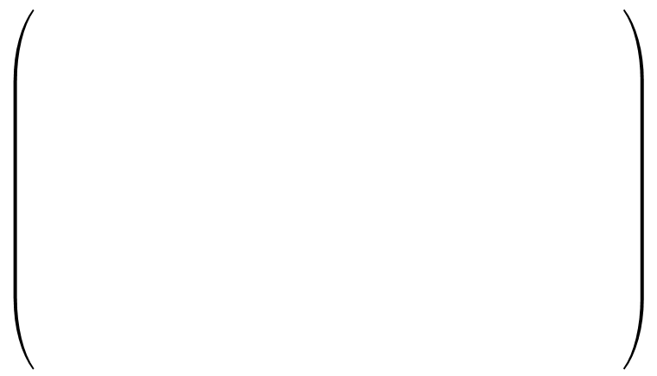
S4
$$S_{t+1}$$
0 1 2 3 4 5 6 7 8 9
$$S_{t} \left\{\begin{matrix}0 \\ \begin{aligned}1 \\ 2 \\ 3 \\ 4 \\ 5 \\ 6 \\ 7 \\ 8\end{aligned} \\ 9\end{matrix} \right.$$

Slide 6
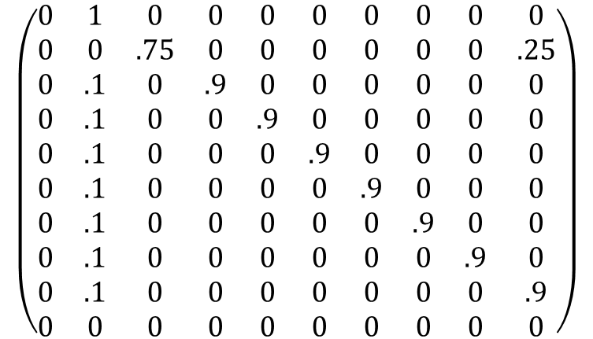
S4
$$S_{t+1}$$
0 1 2 3 4 5 6 7 8 9
$$S_{t} \left\{\begin{matrix}0 \\ \begin{aligned}1 \\ 2 \\ 3 \\ 4 \\ 5 \\ 6 \\ 7 \\ 8\end{aligned} \\ 9\end{matrix} \right.$$
$$\left(\begin{matrix}0 & 1 & 0 & 0 & 0 & 0 & 0 & 0 & 0 & 0 \\ 0 & 0 & .75 & 0 & 0 & 0 & 0 & 0 & 0 & .25 \\ 0 & .1 & 0 & .9 & 0 & 0 & 0 & 0 & 0 & 0 \\ 0 & .1 & 0 & 0 & .9 & 0 & 0 & 0 & 0 & 0 \\ 0 & .1 & 0 & 0 & 0 & .9 & 0 & 0 & 0 & 0 \\ 0 & .1 & 0 & 0 & 0 & 0 & .9 & 0 & 0 & 0 \\ 0 & .1 & 0 & 0 & 0 & 0 & 0 & .9 & 0 & 0 \\ 0 & .1 & 0 & 0 & 0 & 0 & 0 & 0 & .9 & 0 \\ 0 & .1 & 0 & 0 & 0 & 0 & 0 & 0 & 0 & .9 \\ 0 & 0 & 0 & 0 & 0 & 0 & 0 & 0 & 0 & 0\end{matrix}\right)$$

Slide 7
$$S_{t+1}$$
0 1 2 3 4 5 6 7 8 9
$$S_{t} \left\{\begin{matrix}0 \\ \begin{aligned}1 \\ 2 \\ 3 \\ 4 \\ 5 \\ 6 \\ 7 \\ 8\end{aligned} \\ 9\end{matrix} \right.$$

Slide 8
$$S_{t+1}$$
0 1 2 3 4 5 6 7 8 9
$$S_{t} \left\{\begin{matrix}0 \\ \begin{aligned}1 \\ 2 \\ 3 \\ 4 \\ 5 \\ 6 \\ 7 \\ 8\end{aligned} \\ 9\end{matrix} \right.$$

