Slide 1
Final ML Project
Diabetes Hospital
Readmission Prediction
Machine Learning pipeline for predicting 30‑day hospital readmission using patient encounter data.
Final model: 60% Tuned LightGBM + 40% XGBoost with engineered features
Deployment: FastAPI + Streamlit Cloud • Validation‑selected threshold = 0.13
NTI Machine Learning Project

Slide 2
Project roadmap
From raw hospital encounters to a deployed readmission risk model
01
02
03
04
05
06
Data & Problem
EDA & Cleaning
Preprocessing
Modeling
Optimization
Deployment
Target: readmitted within 30 days
Missing values, outliers, duplicates, class balance
Encoding, scaling, patient-level split
Baseline + advanced imbalance handling
Threshold tuning, CV search, ensemble
Joblib bundle, FastAPI, Streamlit
Diabetes Hospital Readmission Prediction

Slide 3
Problem & objective
Predict early readmission risk from diabetic patient encounter information
PROBLEM FRAMING
Can we identify patients who are likely to be readmitted within 30 days?
<30 days
Recall / F1
Target class
Primary focus
early readmission
minority-class metrics
Task type: binary classification
Positive class: readmitted in less than 30 days
Business goal: surface higher-risk patients earlier
Evaluation must focus on minority-class performance, not accuracy only
Why accuracy alone is misleading
The dataset is imbalanced: most encounters are not readmitted within 30 days. A model can appear accurate while missing many high-risk patients. We therefore track Precision, Recall, F1, ROC-AUC and PR-AUC.
Clinical judgment remains essential
Diabetes Hospital Readmission Prediction

Slide 4
Dataset & target
Real hospital readmission data with an imbalanced minority class
101,766
50
Binary
≈11.4%
Rows
Initial columns
Task
Positive class
<30 readmission
Class balance
Feature groups
Demographics: race, gender, age
Admission details: type, source, disposition, time in hospital
Clinical activity: labs, procedures, medications, diagnoses
Diabetes medications and treatment changes
Previous inpatient / emergency / outpatient visits
Diabetes Hospital Readmission Prediction

Slide 5
Libraries & tools
Key Python packages used across analysis, modeling and deployment
Data & EDA
ML Core
Deployment
pandas
scikit-learn
joblib
numpy
xgboost
FastAPI
matplotlib
lightgbm
Uvicorn
seaborn
imbalanced-learn
Streamlit
All dependencies are captured in requirements.txt for reproducible local and cloud deployment.
Diabetes Hospital Readmission Prediction

Slide 6
Data cleaning & EDA
Turning raw encounter data into a trustworthy modeling dataset
Missing values
Converted “?” markers, handled lab-result missingness, dropped weight due to very high missing rate.
EDA outputs used in the report
Numerical distributions and skewness
Feature correlation heatmap
Readmission class imbalance
Outlier visual checks
Target relationship with key utilization features
Wrong / duplicate data
Checked duplicates and removed invalid / expired / hospice cases to match the prediction objective.
Outliers
Used IQR and boxplots; retained clinically plausible extreme values instead of blind deletion.
≈11.4%
0
EDA
Summary statistics, histograms, boxplots, correlations and class-balance analysis.
Positive class
Duplicates
imbalanced data
after checking
Diabetes Hospital Readmission Prediction

Slide 7
Preprocessing & split strategy
Designed to prevent leakage and support realistic evaluation
Raw data
Cleaning
Encoding
Scaling
Group split
Models
encounter records
missing / invalid values
OneHotEncoder
StandardScaler
patient-level split
train / validation / test
Why patient-level split?
Validation first, Test last
Multiple encounters can belong to the same patient. Splitting by patient ID prevents the model from seeing a patient during training and validation/test at the same time.
Thresholds, hyperparameters and ensemble weights were selected on validation data only. The untouched test set was used once for the final estimate.
Diabetes Hospital Readmission Prediction

Slide 8
Feature engineering
New features were created to strengthen the signal for readmission risk
New engineered features
Feature importance finding
total_previous_visits = outpatient + emergency + inpatient
hospital_utilization = emergency + inpatient
total_clinical_activity = labs + procedures + medications
medications / labs / procedures per hospital day
diagnosis_burden = diagnoses per hospital day
history flags for previous inpatient, emergency, outpatient visits
number_inpatient
hospital_utilization
Top feature
Engineered feature
previous inpatient history
entered top features
The engineered utilization features appeared among the most important variables, confirming that the feature engineering was meaningful rather than random.
304 processed features after encoding
Diabetes Hospital Readmission Prediction

Slide 9
Baseline modeling
A simple baseline was established before advanced optimization
Three core algorithms were trained first, then advanced models were compared against this baseline.
Logistic Regression
Random Forest
XGBoost
Interpretable linear baseline
Tree ensemble baseline
Strong boosting baseline
Best baseline candidate
Baseline performance showed moderate ranking ability but weak minority-class precision/recall trade-off, motivating imbalance handling and threshold optimization.
≈0.287
≈0.238
Baseline XGBoost F1
Baseline PR-AUC
Diabetes Hospital Readmission Prediction

Slide 10
Imbalance handling experiments
Multiple strategies were tested because the positive class is rare
Class weighting
SMOTE
Weighted XGBoost and balanced LightGBM increased minority-class sensitivity.
Full SMOTE balanced the training data 1:1, but did not improve overall PR-AUC.
Partial SMOTE
Threshold tuning
A less aggressive 0.5 ratio was tested, but still underperformed.
Validation-based thresholds were essential; 0.50 was too conservative for many models.
Main lesson: rebalancing alone did not solve the problem. The final gains came from combining tuned models and probabilities.
Diabetes Hospital Readmission Prediction

Slide 11
Model optimization
Searching beyond default settings and default thresholds
WHAT WAS OPTIMIZED
XGBoost RandomizedSearchCV with StratifiedGroupKFold
LightGBM RandomizedSearchCV with StratifiedGroupKFold
Validation threshold search for F1 / recall-precision trade-off
Ensemble probability weights: 60% LightGBM + 40% XGBoost
Threshold selection rule
All thresholds were chosen on validation only. The test set was used once for the final unbiased evaluation.
Diabetes Hospital Readmission Prediction

Slide 12
Final model architecture
Weighted probability ensemble selected from validation performance
Tuned LightGBM
Original preprocessing
Patient
Encounter
Weighted Average
0.60 + 0.40
Risk
Class
XGBoost
Engineered features
0.13
0.3001
0.2369
Selected because it delivered the best validation F1 and strongest overall ranking performance among tested candidates.
Final threshold
Validation F1
Validation PR-AUC
Diabetes Hospital Readmission Prediction

Slide 13
Validation model comparison
Final candidate selected before the test set was touched
Model | Precision | Recall | F1 | ROC-AUC | PR-AUC
Weighted XGBoost | 0.2131 | 0.4806 | 0.2953 | 0.6785 | 0.2293
Tuned LightGBM | 0.2097 | 0.5144 | 0.2979 | 0.6803 | 0.2350
50/50 Ensemble | 0.2106 | 0.5183 | 0.2996 | 0.6815 | 0.2365
60/40 Weighted Ensemble | 0.2111 | 0.5189 | 0.3001 | 0.6815 | 0.2369
0.3001
0.2369
The weighted ensemble was selected because it improved F1 slightly while also maintaining the best PR-AUC among validation experiments.
Best validation F1
Best validation PR-AUC
Diabetes Hospital Readmission Prediction

Slide 14
Final test evaluation
Untouched test set used once after model selection was complete
0.1968
0.4986
0.2822
0.6768
0.2390
Precision
Recall
F1-score
ROC-AUC
PR-AUC
Interpretation
The model detects almost half of actual early readmissions. Precision is lower because the validation-selected threshold prioritizes catching more high-risk patients, creating more false-positive alerts.
Test evaluation remained stable
Diabetes Hospital Readmission Prediction

Slide 15
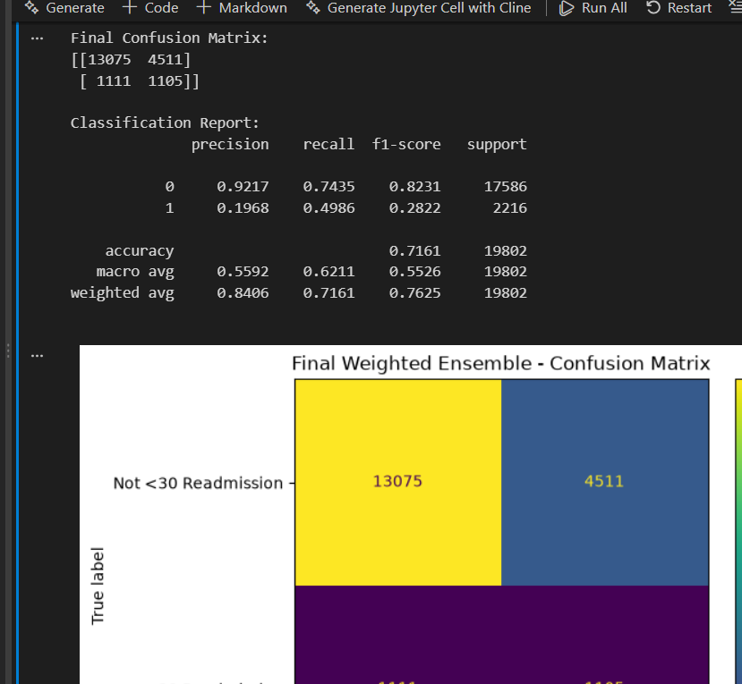
Confusion matrix
Detailed error analysis for the final model on the test set
1,105
1,111
True positives
False negatives
detected readmissions
missed readmissions
4,511
13,075
False positives
True negatives
extra alerts
correct low-risk
Recall for class 1 = 0.4986
The final model catches approximately half of patients actually readmitted within 30 days, which matches the project’s recall-oriented goal for an imbalanced clinical risk task.
Diabetes Hospital Readmission Prediction

Slide 16
Deployment
The final model is packaged and exposed through both API and web UI
Notebook
Joblib Bundle
inference.py
FastAPI
Streamlit
training + evaluation
models + preprocessing
clean + predict
/predict endpoint
user-facing UI
Deployment bundle contains
Live demo
Tuned LightGBM + XGBoost models
Encoders, scalers and engineered-feature preprocessor
Weights: 0.60 / 0.40 and threshold: 0.13
Streamlit Cloud is connected to the GitHub repository. Updates to app.py are pushed to main and redeployed automatically.
FastAPI tested with code 200
Diabetes Hospital Readmission Prediction

Slide 17
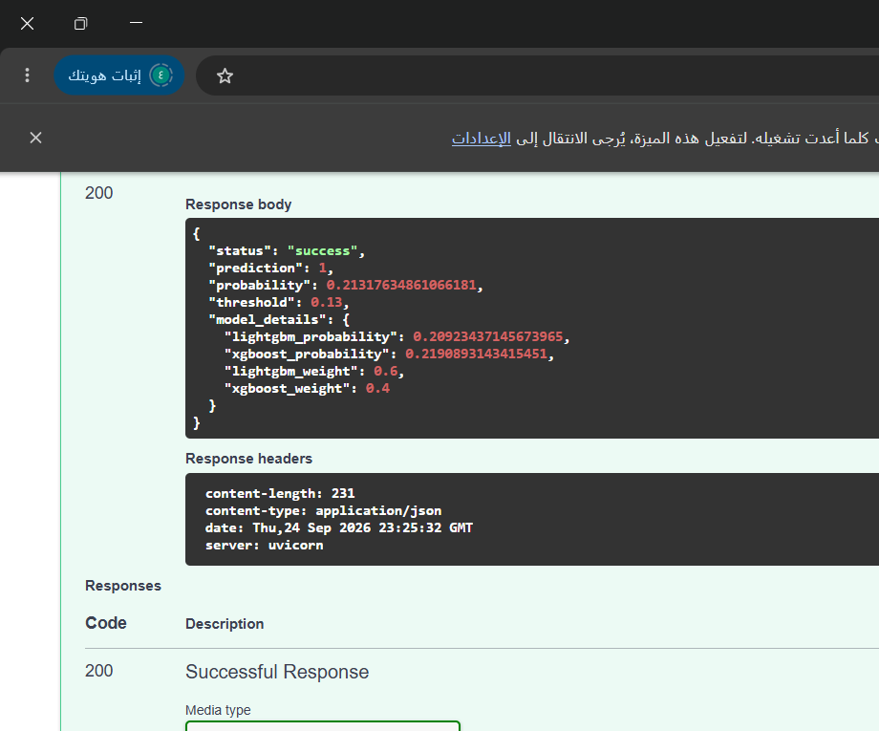
Working demo evidence
Streamlit form and FastAPI endpoint were both validated
Streamlit Cloud UI
Form-based patient input
Race
Gender
Age group
Admission type
Time in hospital
Medical specialty
Lab procedures
Medications
Diagnoses
Previous visits
ICD codes
Diabetes meds
Predict Readmission Risk
Streamlit app deployed
FastAPI /predict returns 200
Diabetes Hospital Readmission Prediction

Slide 18
Conclusions & limitations
What worked, what did not, and what could be improved next
What worked
What did not add much
Feature engineering, LightGBM tuning and probability ensembling gave the strongest validation performance.
Full SMOTE, partial SMOTE and feature selection did not clearly improve the final ranking metrics.
Main trade-off
Future work
Lower threshold increased recall, but also increased false positives and reduced precision.
Try richer clinical variables, calibrated probabilities, temporal features and external validation.
Final takeaway: the project delivers a leakage-aware ML pipeline and a working web/API deployment, while making the precision–recall trade-off explicit.
Diabetes Hospital Readmission Prediction

Slide 19
Final deliverables
Files, repository and cloud demo ready for submission
Project files
Links
Notebook with full ML pipeline
final_readmission_ensemble.joblib
inference.py, api.py, app.py
requirements.txt and README.md
IDS_mapping.csv
GitHub Repository
https://github.com/ahmedalwaer1/diabetes-readmission-ml
Streamlit Demo
https://diabetes-readmission-ml-ehkdw6rnzrjqcbfugsenjz.streamlit.app
Ready for final submission
Diabetes Hospital Readmission Prediction

