Slide 1
Predicting Position of NBA Players
Matthew Hui and Jinichi Zhou

Slide 2
Research Question
Can we more accurately predict a player’s position by their style of play (statistics) or by their physical attributes (height and weight)?

Slide 3


Data Collection
Kaggle Dataset – Season Data
API – Physical attributes

Slide 4
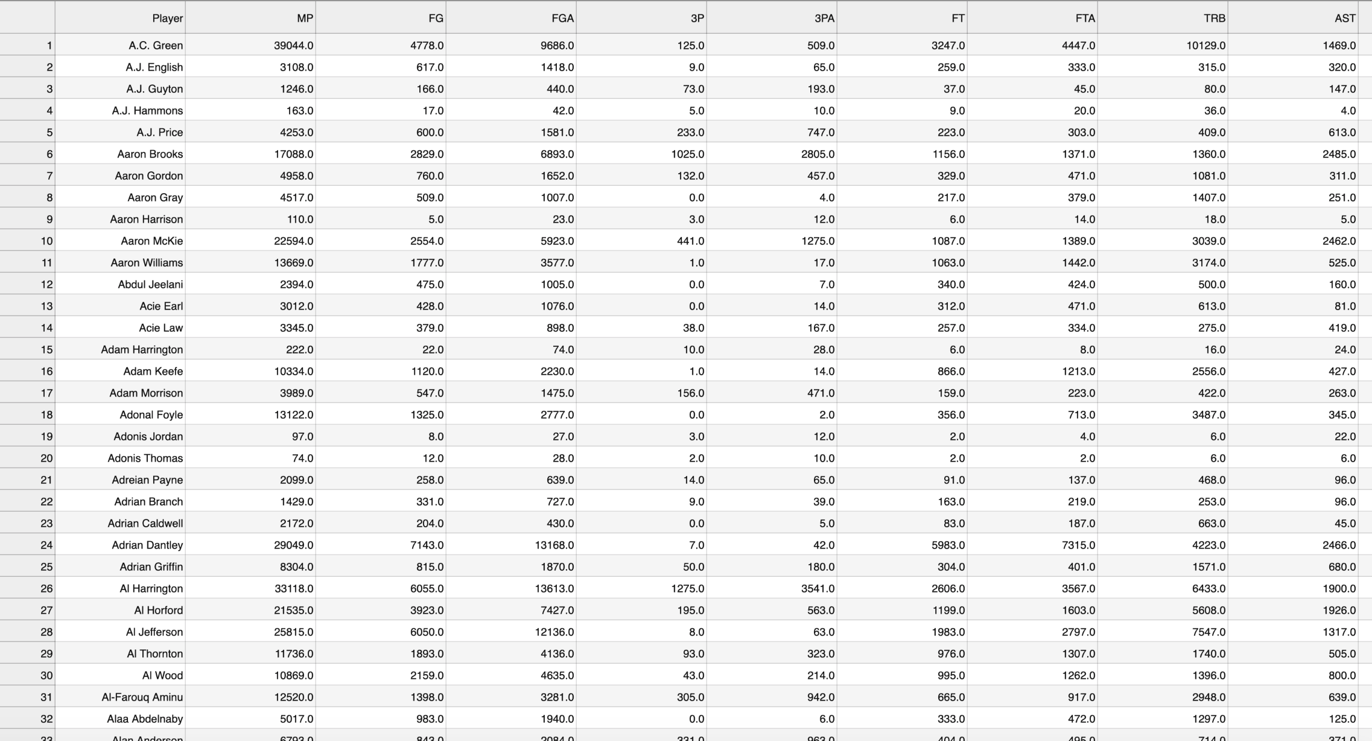
Cleaning and Finalizing Data
Season Data -> Career Data
Position Cleaning
Statistic Transformations
Merging datasets together

Slide 5
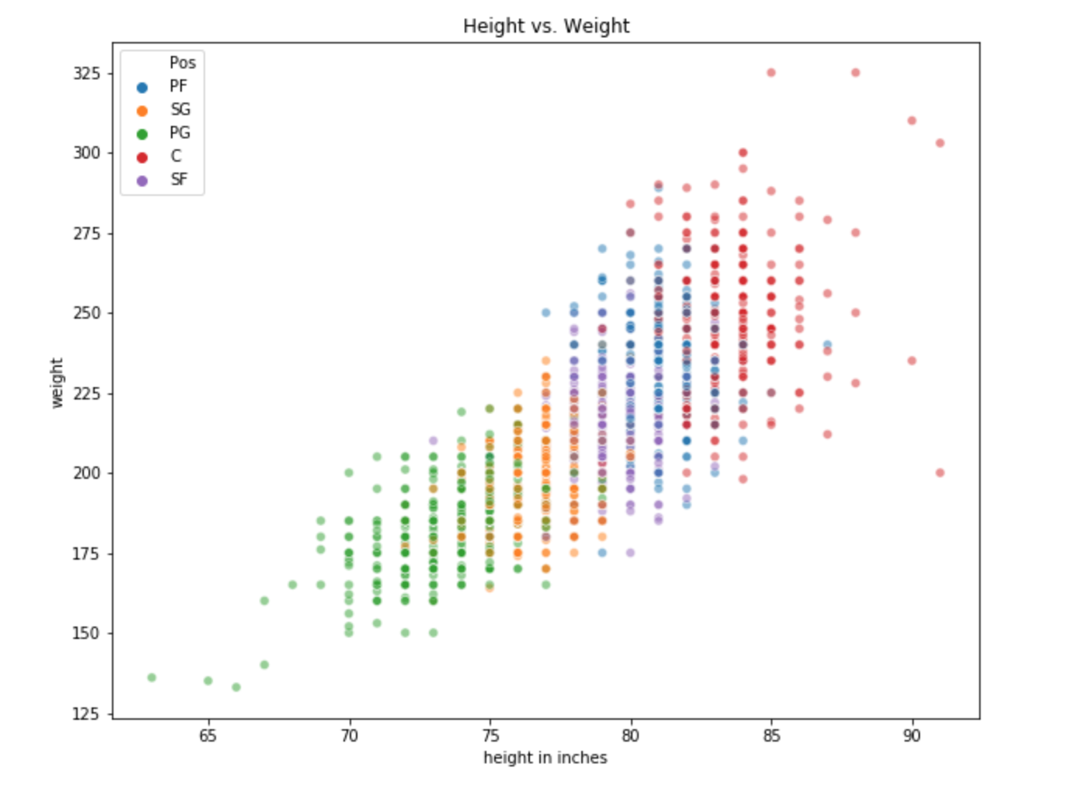

Slide 6
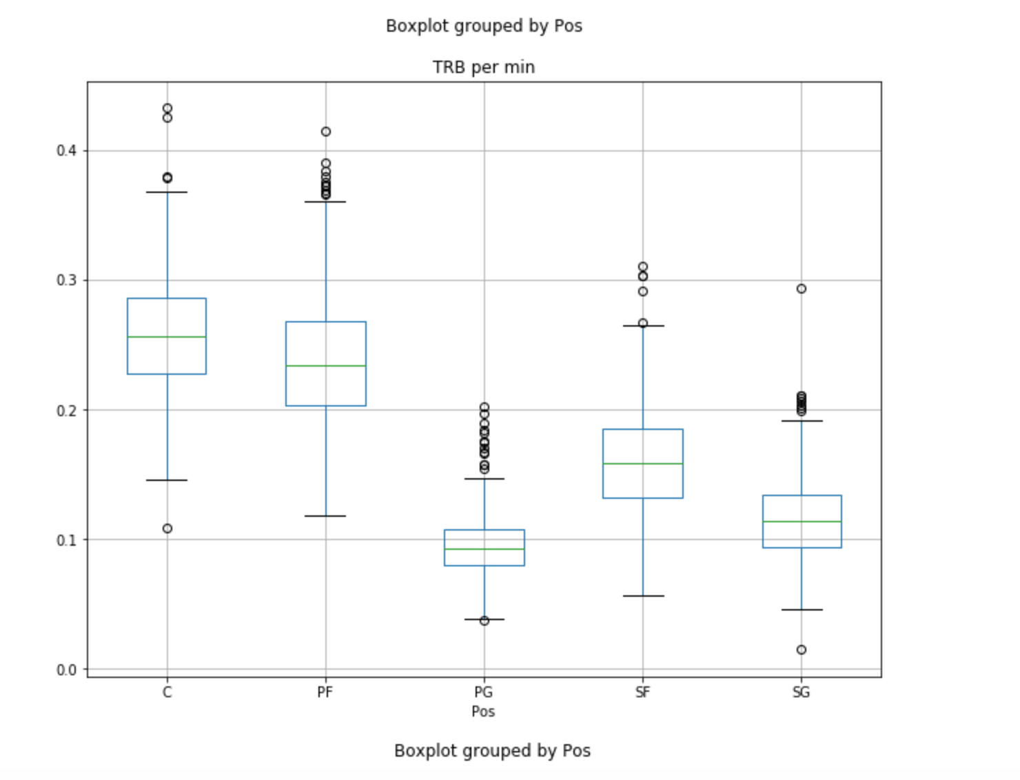
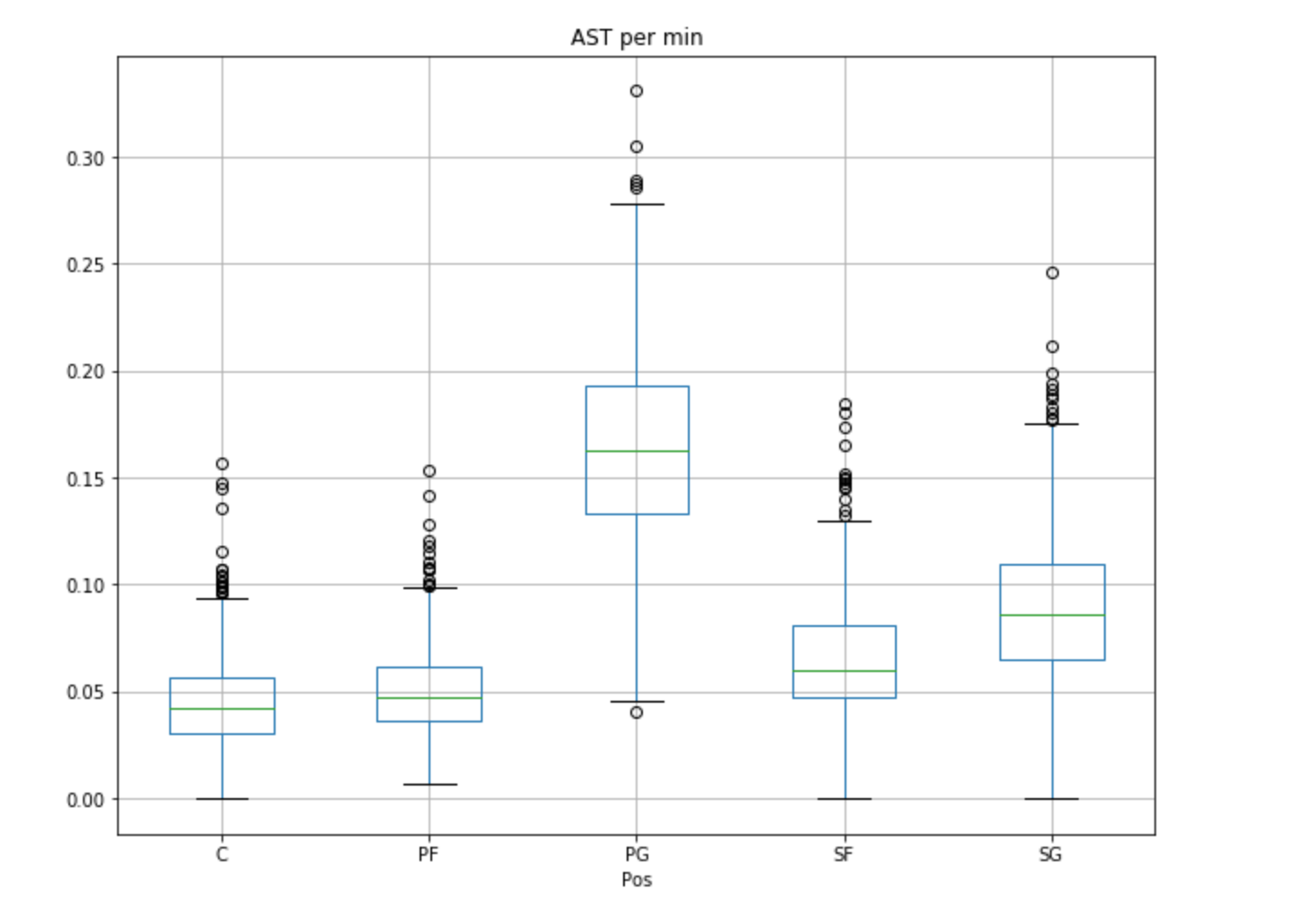
Box plots

Slide 7
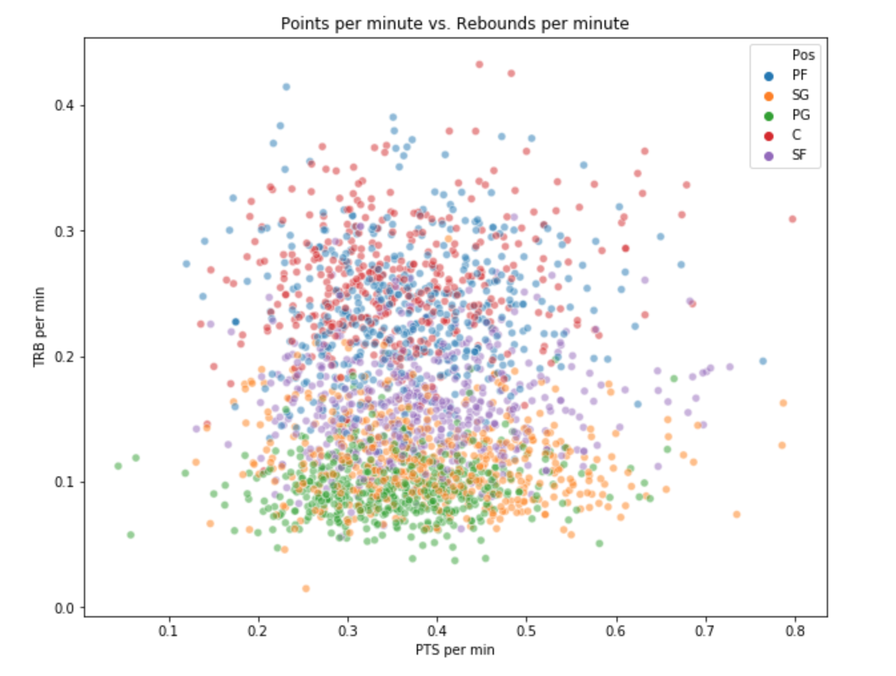
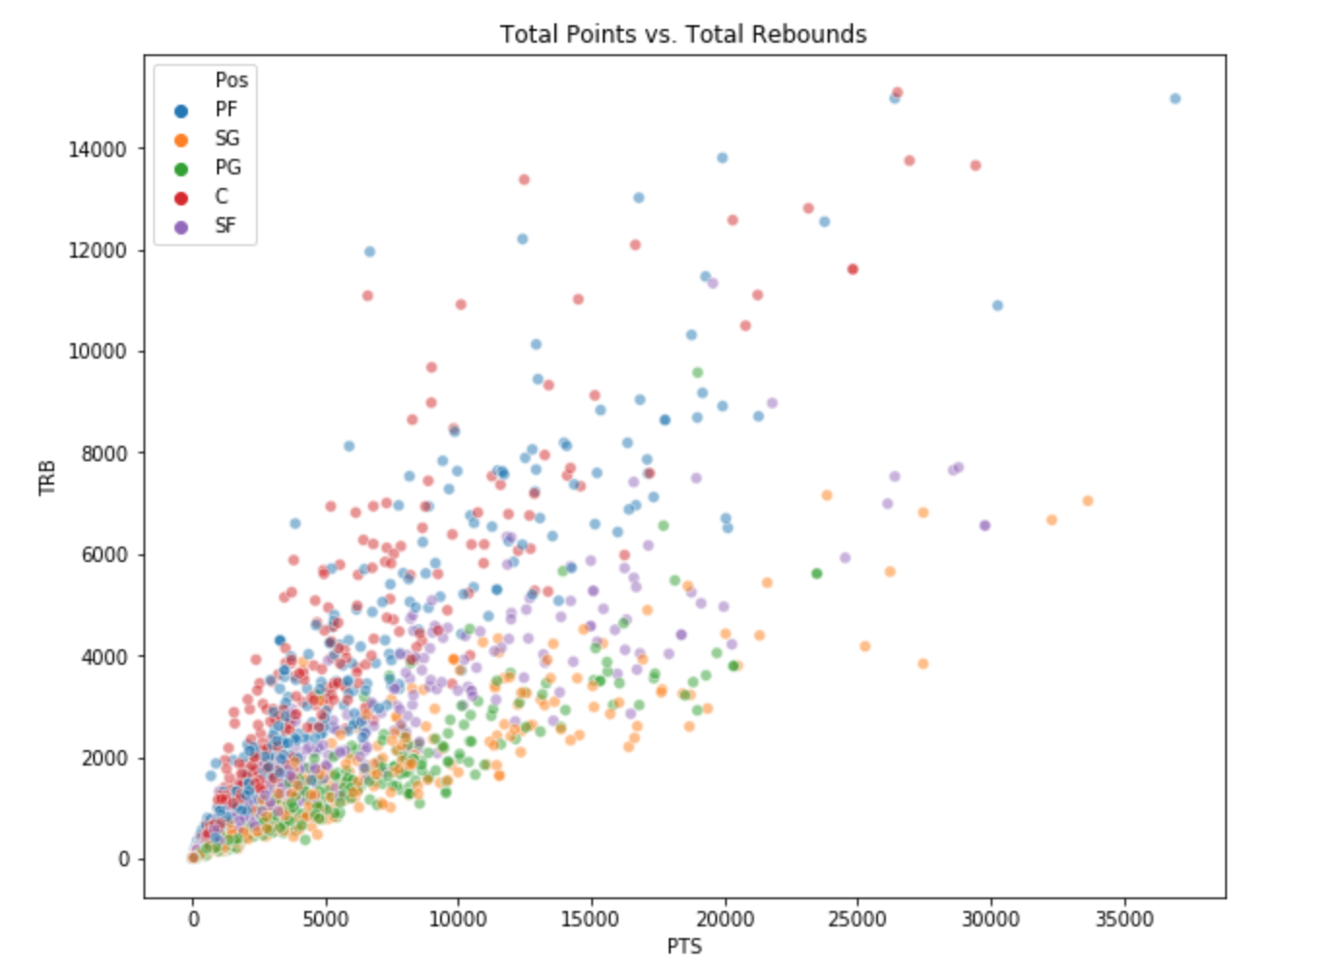
Points vs Rebounds Scatter

Slide 8
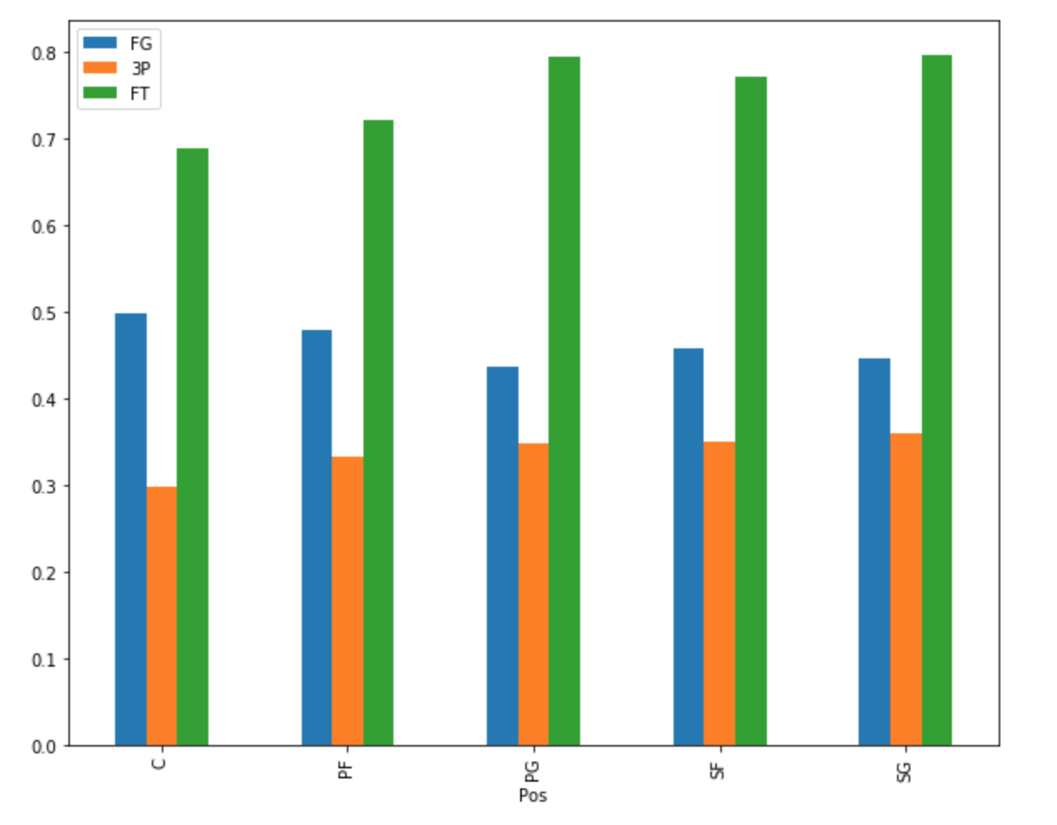
Shooting Percentages by Position

Slide 9
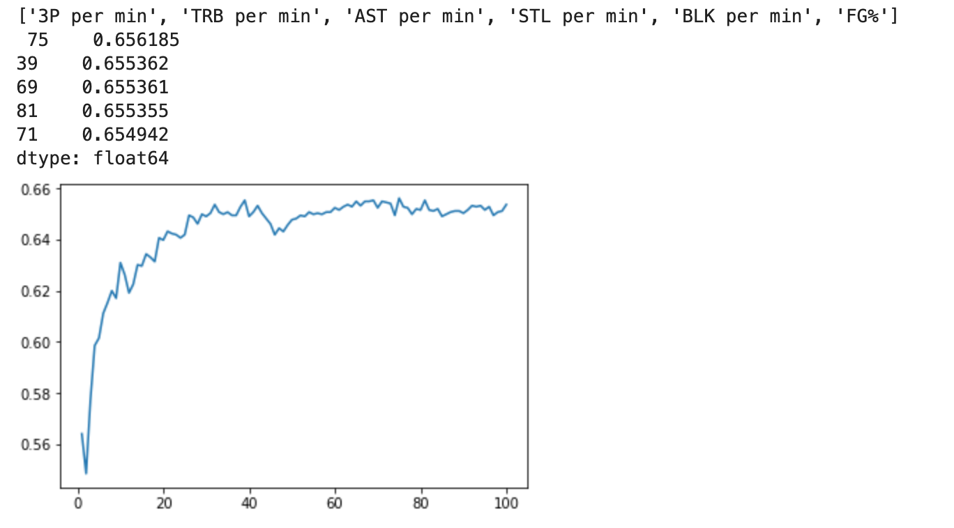
Classifier model using statistics

Slide 10
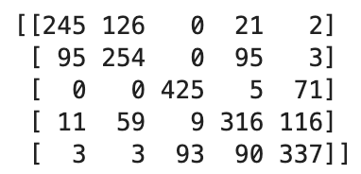
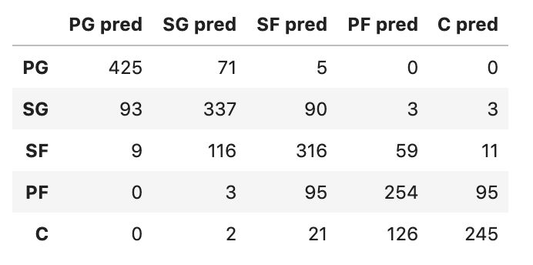
Confusion matrix of optimal model - Statistics
K = 75
Features: 3P per minute, TRB per minute, AST per minute, STL per minute, BLK per minute, FG%

Slide 11
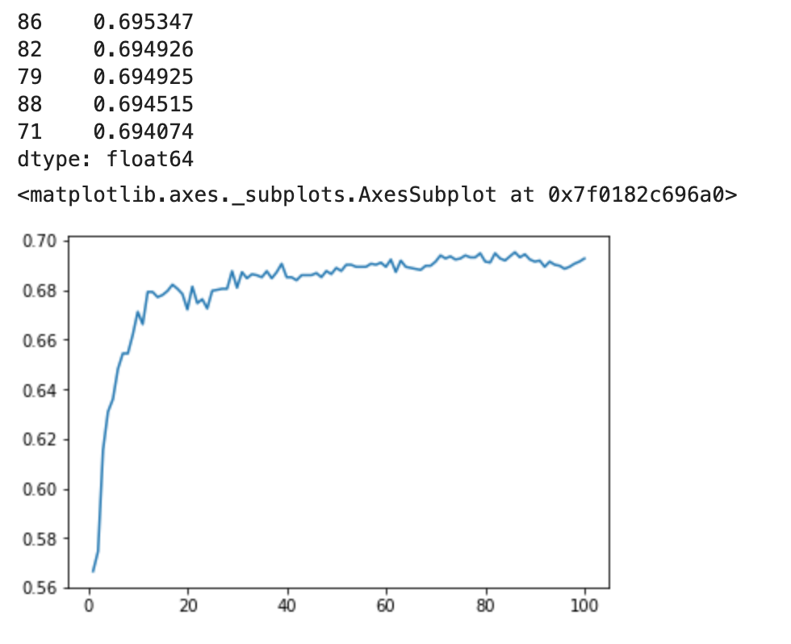
Classifier Model using Physical attributes

Slide 12
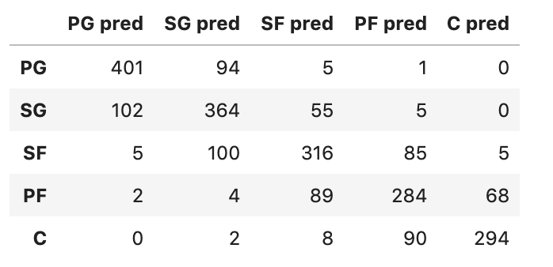
Confusion matrix of optimal model – Physical

Slide 13
Comparison and Results
Accuracy of Statistics model: 66.3%
Accuracy of Physical model: 69.7%

Slide 14
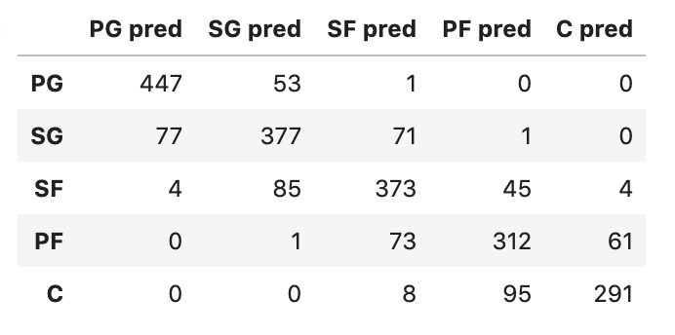
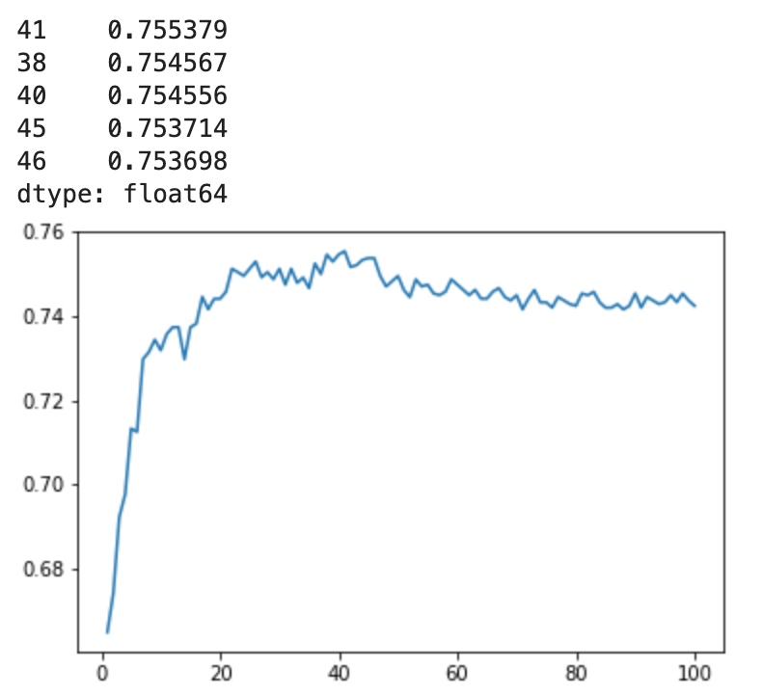
Combined model
Same traits from statistics model + height and weight
K = 41
Accuracy of model: 75.7%

Slide 15
Questions?

