Slide 1
Predicting Position of NBA Players
Matthew Hui and Jinichi Zhou

Slide 2
Research Question
Can we more accurately predict a player’s position by their style of play (statistics) or by their physical attributes (height and weight)?

Slide 3
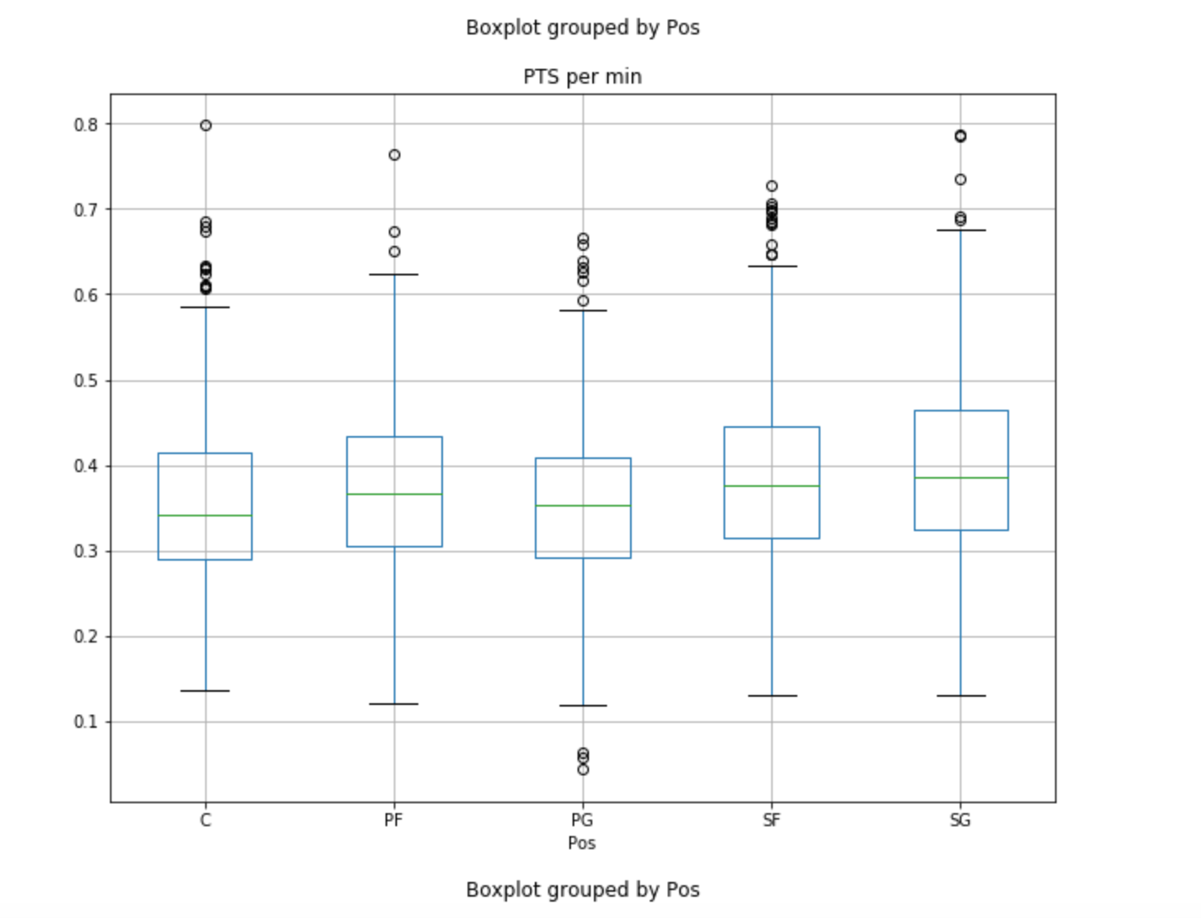
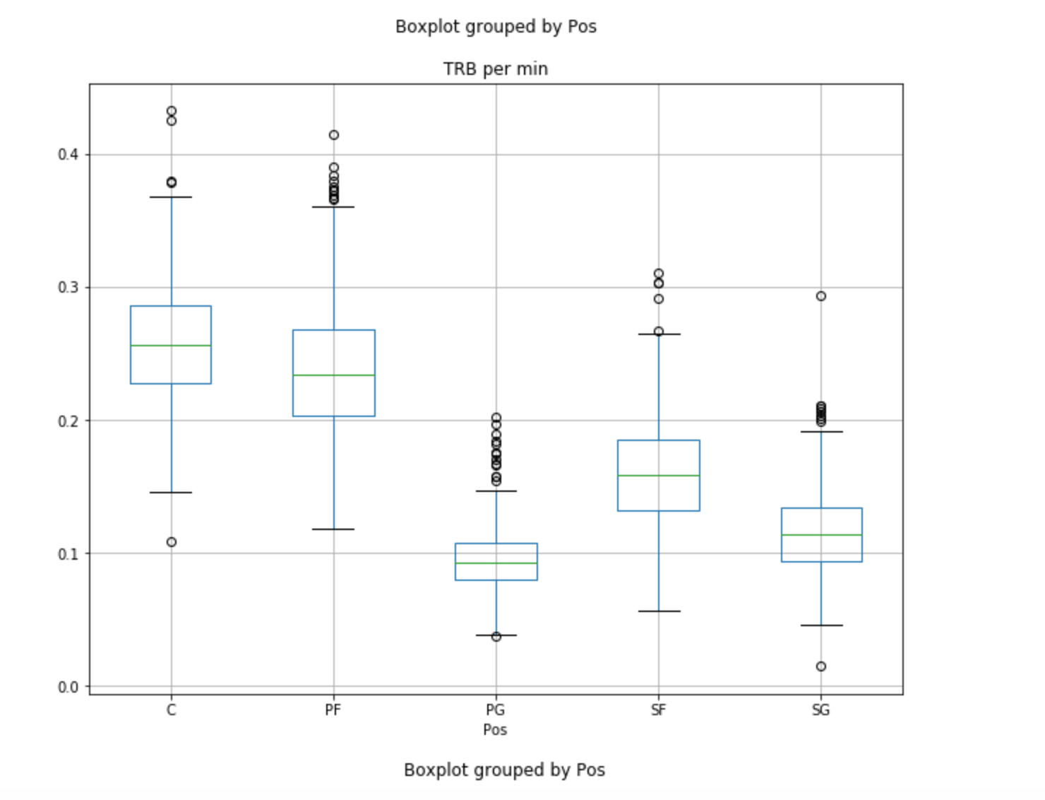
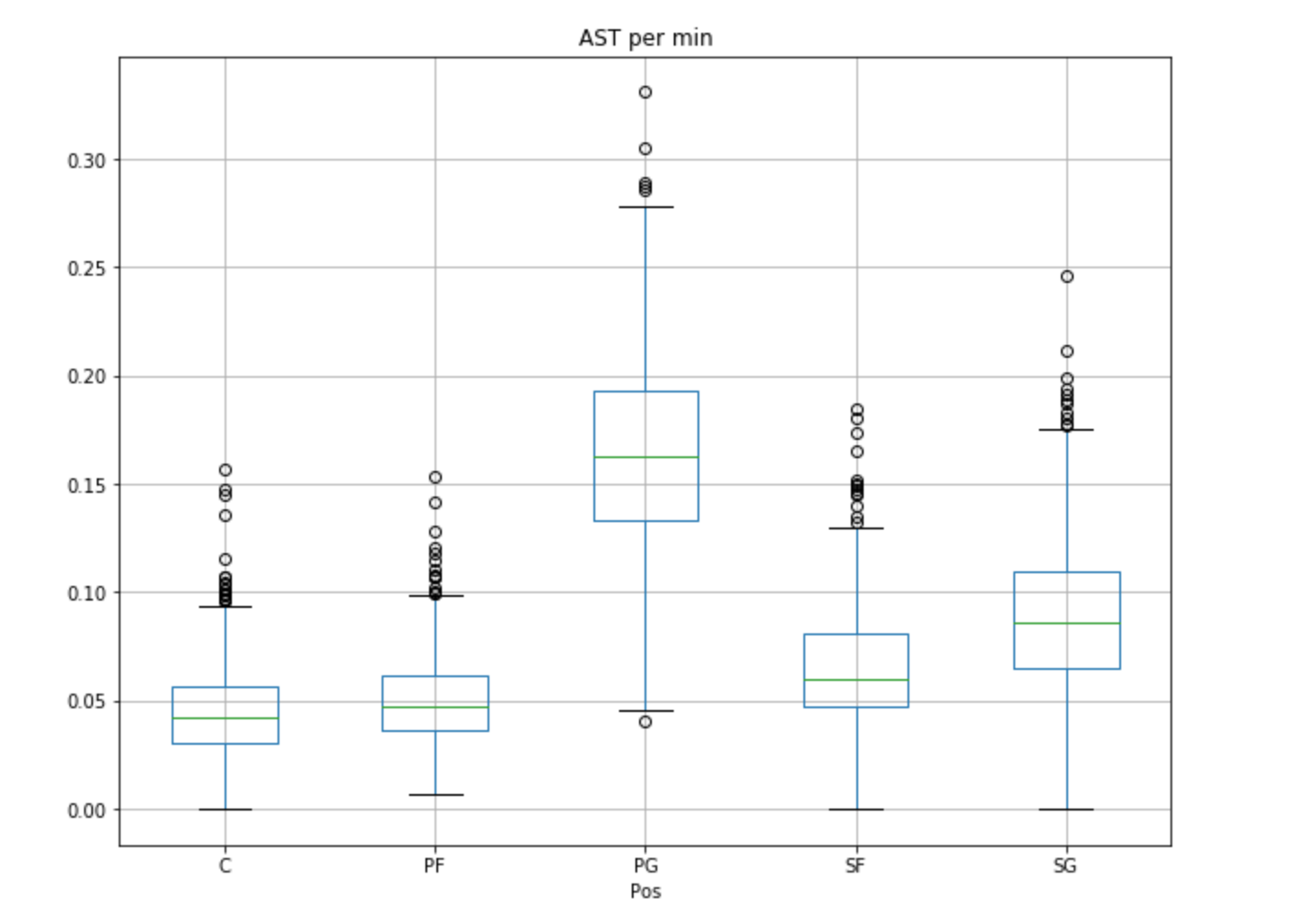
Box plots

Slide 4
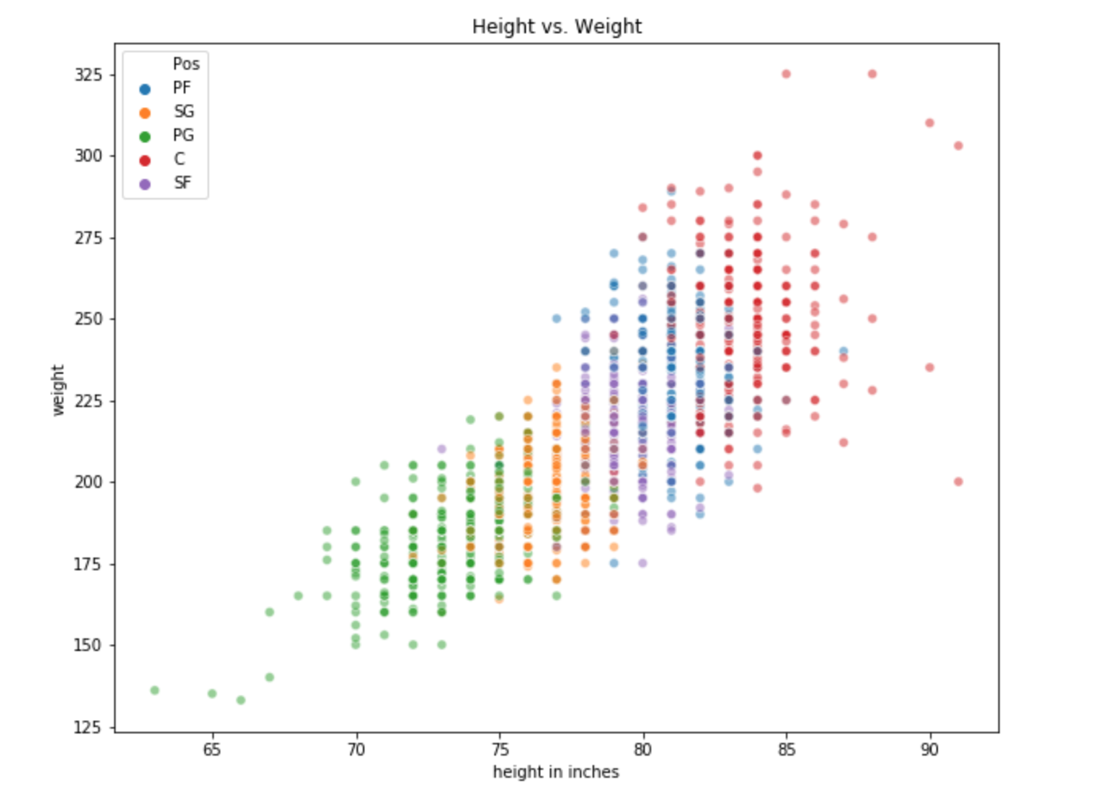

Slide 5
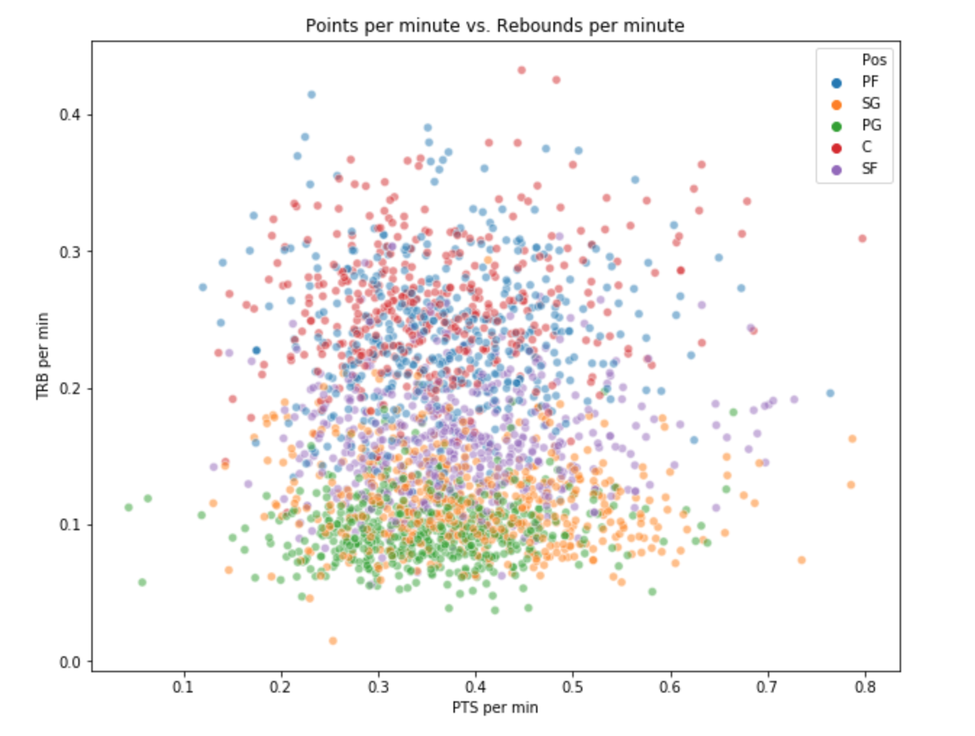
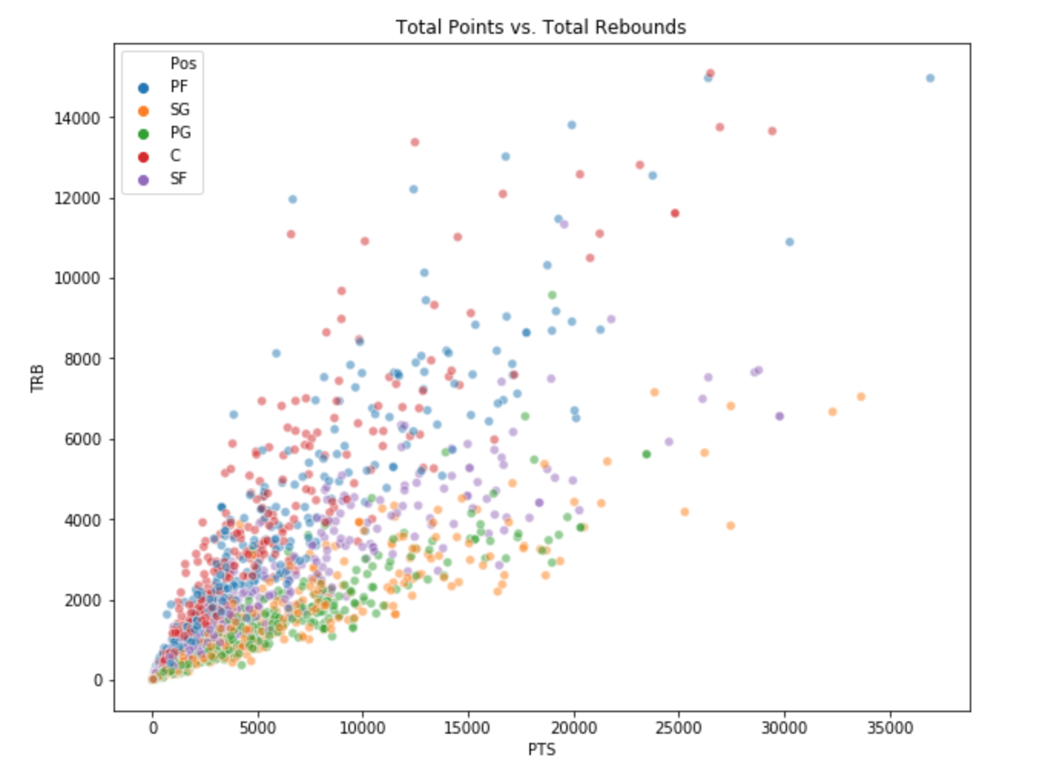
Points vs Rebounds Scatter

Slide 6
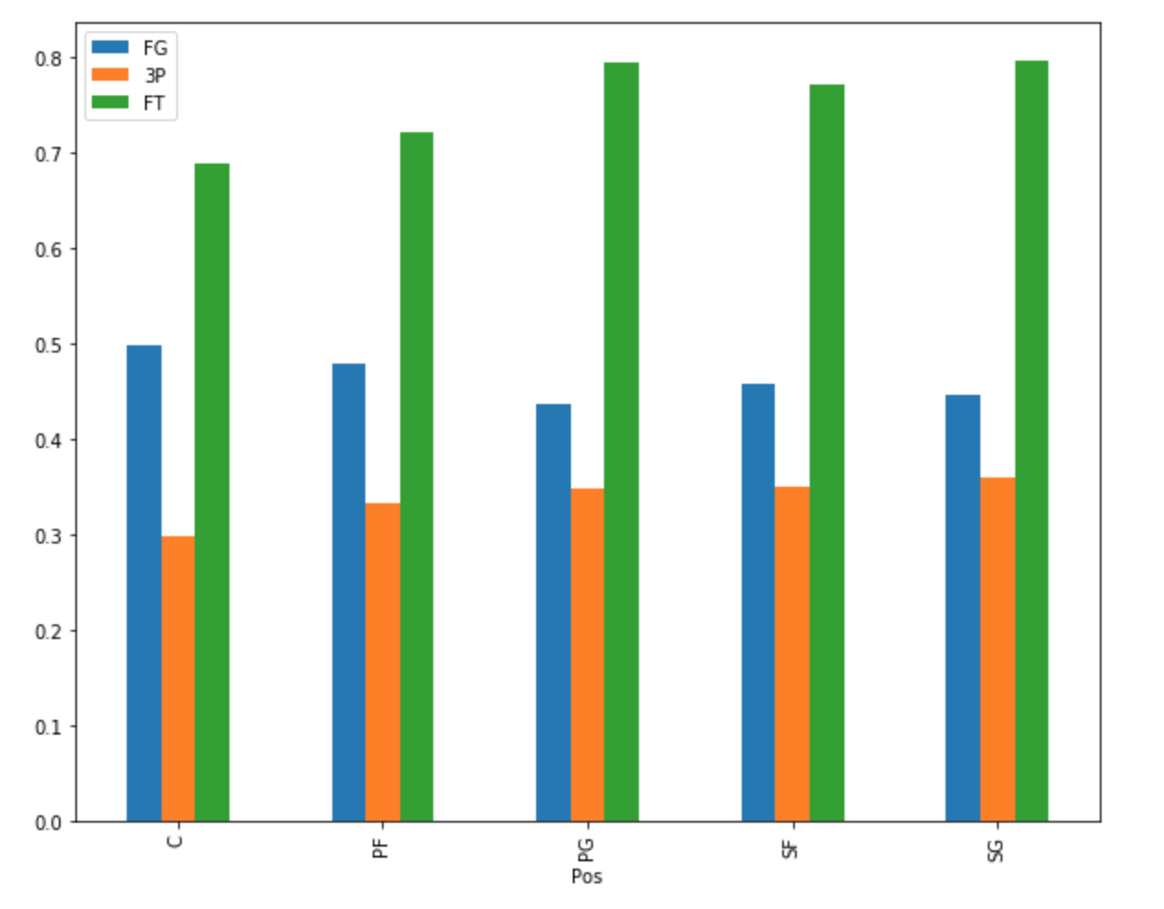
Shooting Percentages by Position

Slide 7
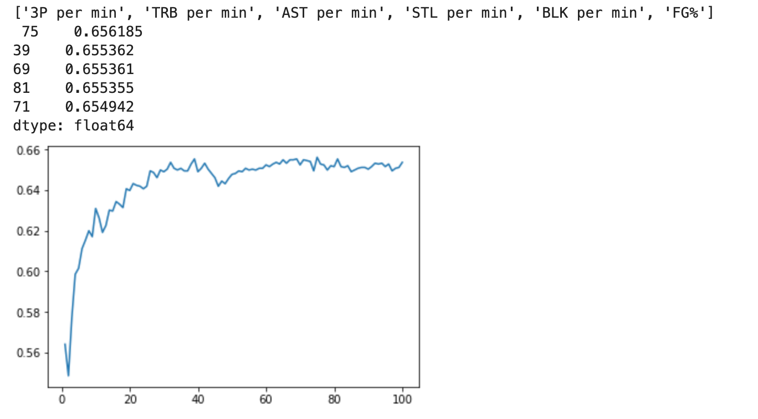
Classifier model using statistics

Slide 8
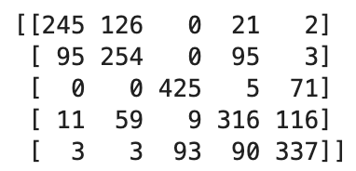
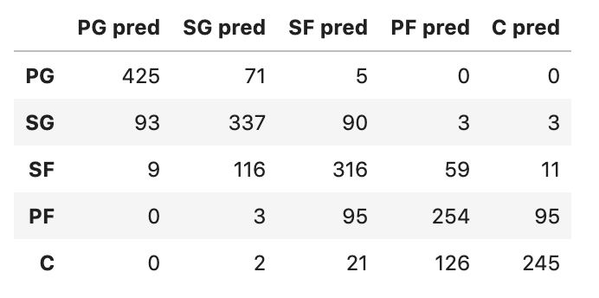
Confusion matrix of optimal model - Statistics
K = 75
Features: 3P per minute, TRB per minute, AST per minute, STL per minute, BLK per minute, FG%

Slide 9
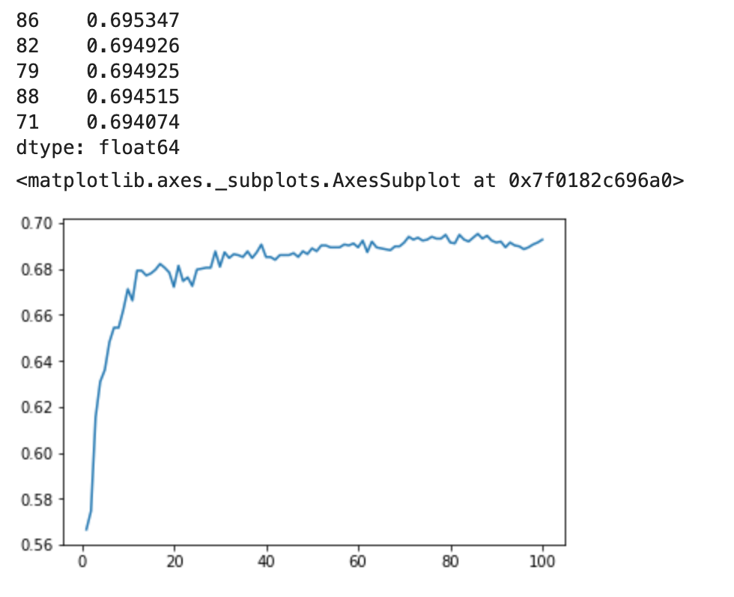
Classifier Model using Physical attributes

Slide 10
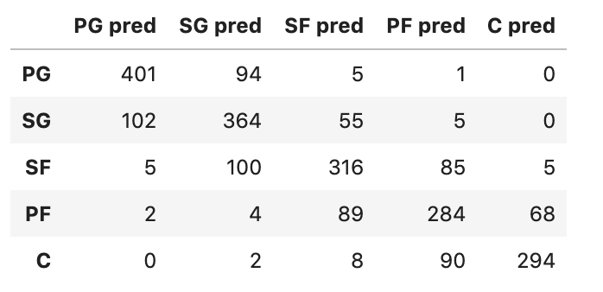
Confusion matrix of optimal model – Physical

Slide 11
Comparison and Results
Accuracy of Statistics model: 66.3%
Accuracy of Physical model: 69.7%

Slide 12
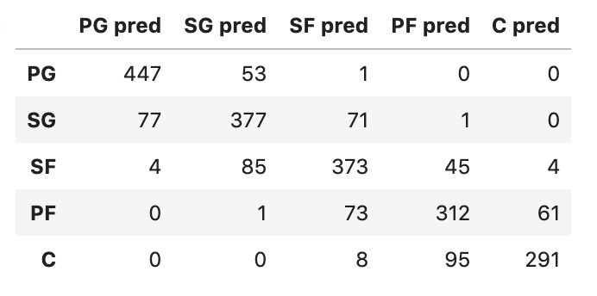
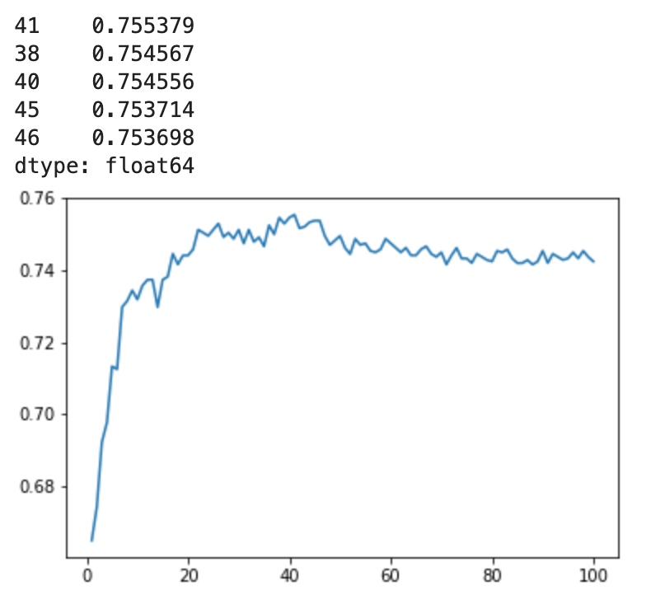
Combined model
Same traits from statistics model + height and weight
K = 41
Accuracy of model: 75.7%

Slide 13
Questions?

