Slide 1

Exploratory Data Analysis
G2M Insight for Cab Investment
10/21/2023

Slide 2
Agenda
Background
EDA
EDA Summary
Recommendations

Slide 3
Background
XYZ is a private equity firm in US. Due to remarkable growth in the Cab Industry in last few years and multiple key players in the market, it is planning for an investment in Cab industry.
Objective : Provide actionable insights to help XYZ firm in identifying the right company for making investment.
The analysis has been divided into four parts:
Data Understanding
Forecasting profit and number of rides for each cab type
Finding the most profitable Cab company
Recommendations for investment

Slide 4
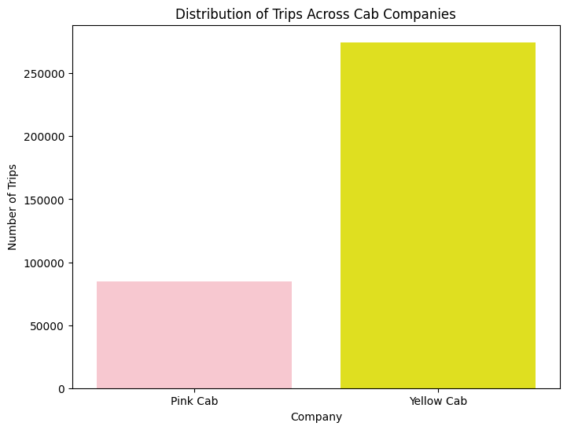

Customer Preference and Loyalty
Customers are three times as likely to pick Yellow Cab over Pink Cab.
Yellow Cab customers are also more loyal, taking an average of 6.88 trips while Pink Cab customers take an average of 2.62.

Slide 5
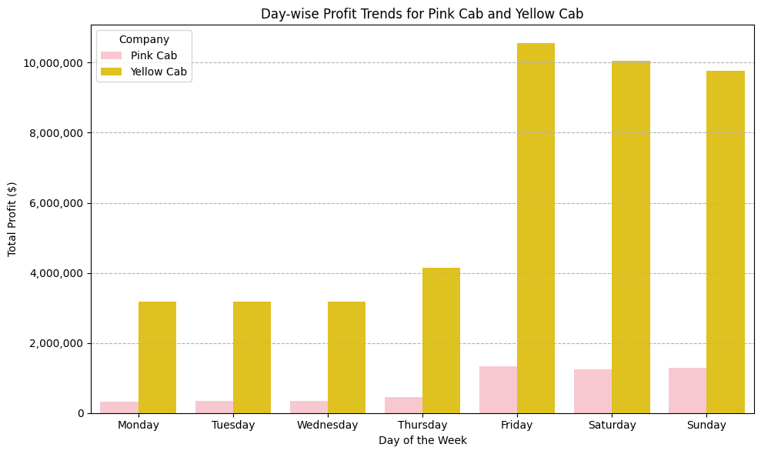
Weekly Usage Trends
Customer traffic increases greatly Friday through Sunday.

Slide 6
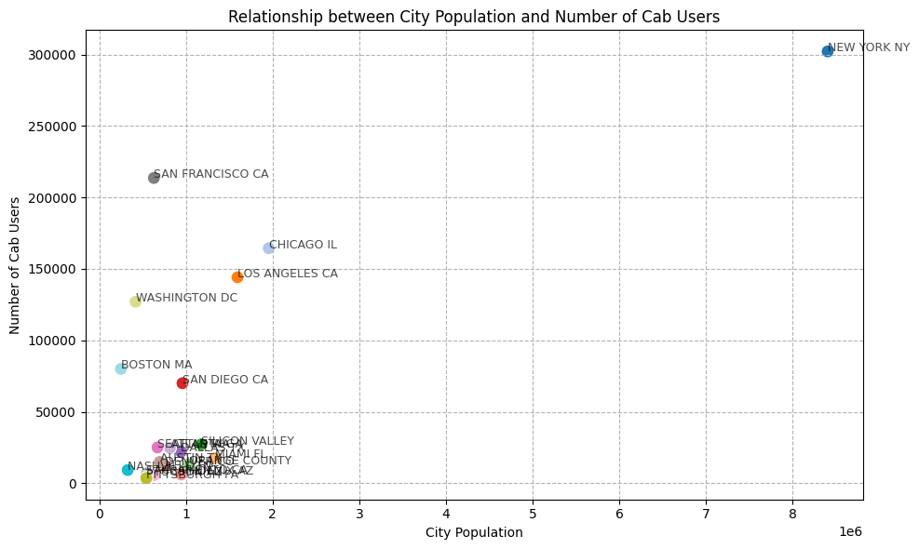
Usage By City
San Francisco, Washington DC, and Boston all have high cab user to population ratios at over 30%.
Studies into the car-to-population ratio, public transport availability, traffic patterns, and size of the these cities can be used to identify specific cities to invest in.

Slide 7
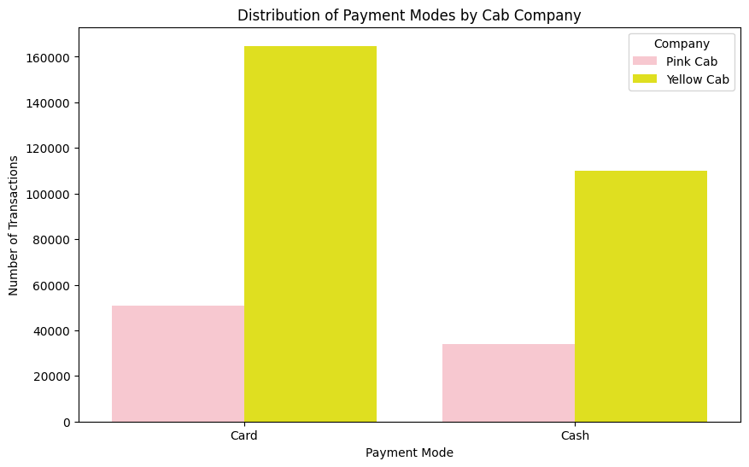
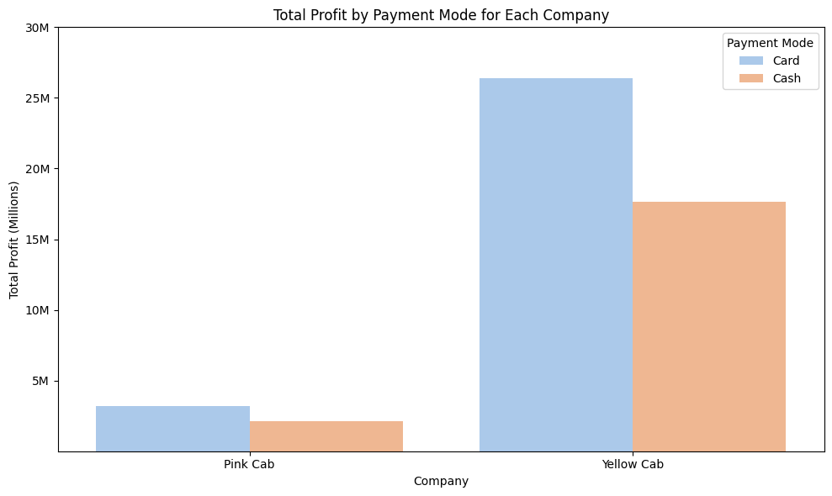
Payment Preferences
Both companies’ customers show a preference for card, but both payment methods share a significant portion of transactions.
The profit distribution mirrors the distribution for both companies.

Slide 8
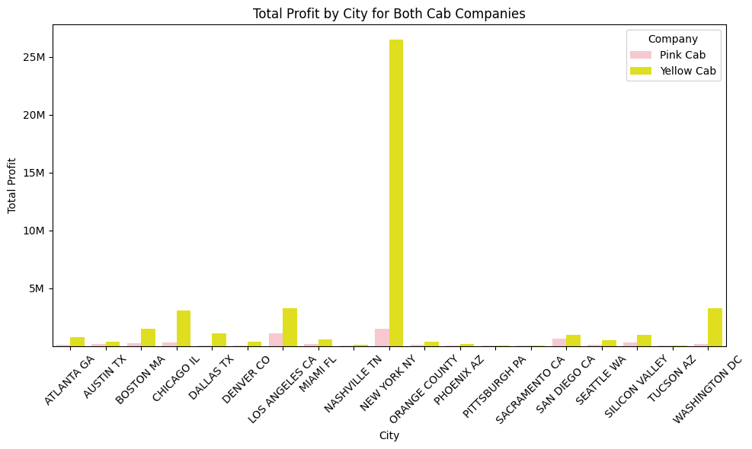
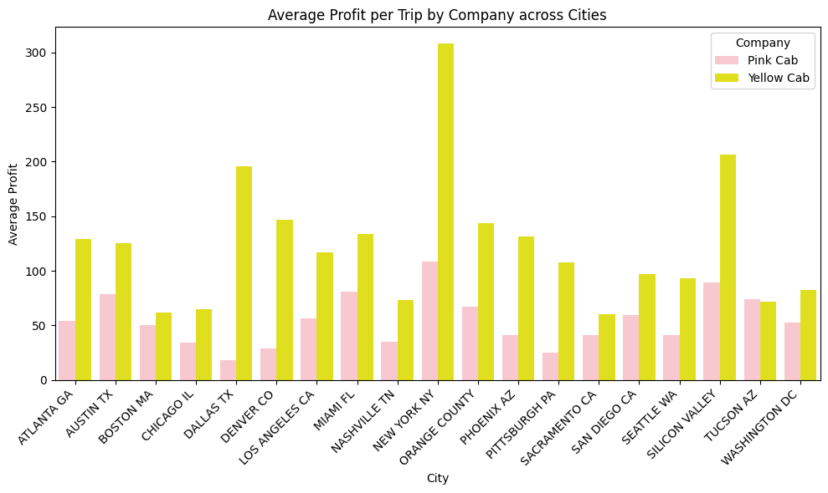

Profit Comparison
Yellow Cab dominates profit in nearly every city. This gap is more significant the bigger the city is.
Yellow Cab also boasts double the profit the margin or more in most cities.

Slide 9
Conclusions
Yellow Cab has a more extensive presence and higher number of trips across most cities.
Age does have an influence on the amount paid for cab rides. Middle-aged customers (around 30-40 years) tend to spend more on their trips.
The preference for payment mode varies between companies. Pink Cab users have a more balanced preference between cash and card, while Yellow Cab users have a noticeable inclination towards using cards.
he number of cab users isn't always directly proportional to the population of the city. Some cities with smaller populations have a relatively high number of cab users, suggesting factors other than just population size influencing cab usage. Miami, Silicon Valley, and Orange County have very low cab user to population ratios and should be further investigated.
There is evident seasonality in the number of customers using the cab service. Both companies experience a surge in demand around the months of December and January, possibly due to holidays and festive seasons.

Slide 10
Recommendation and Investment Strategy
Overall Recommendation:
Considering the broader market presence, consistent higher profitability, and positive trends over time, Yellow Cab is a safer and more promising investment opportunity for XYZ.
Target Middle-aged Customers
Given that middle-aged customers tend to spend more on cab rides, marketing strategies can be tailored to appeal more to this age group.
City-specific Approaches
While expanding in cities with high populations is intuitive, there's potential in smaller cities where cab usage is disproportionately high. Investing in understanding the unique needs of such cities will yield high returns.
Leverage Seasonal Peaks
Special promotions or offers during December and January can further boost the already high demand during these months while people are traveling.

Slide 11
Thank You

