Slide 1
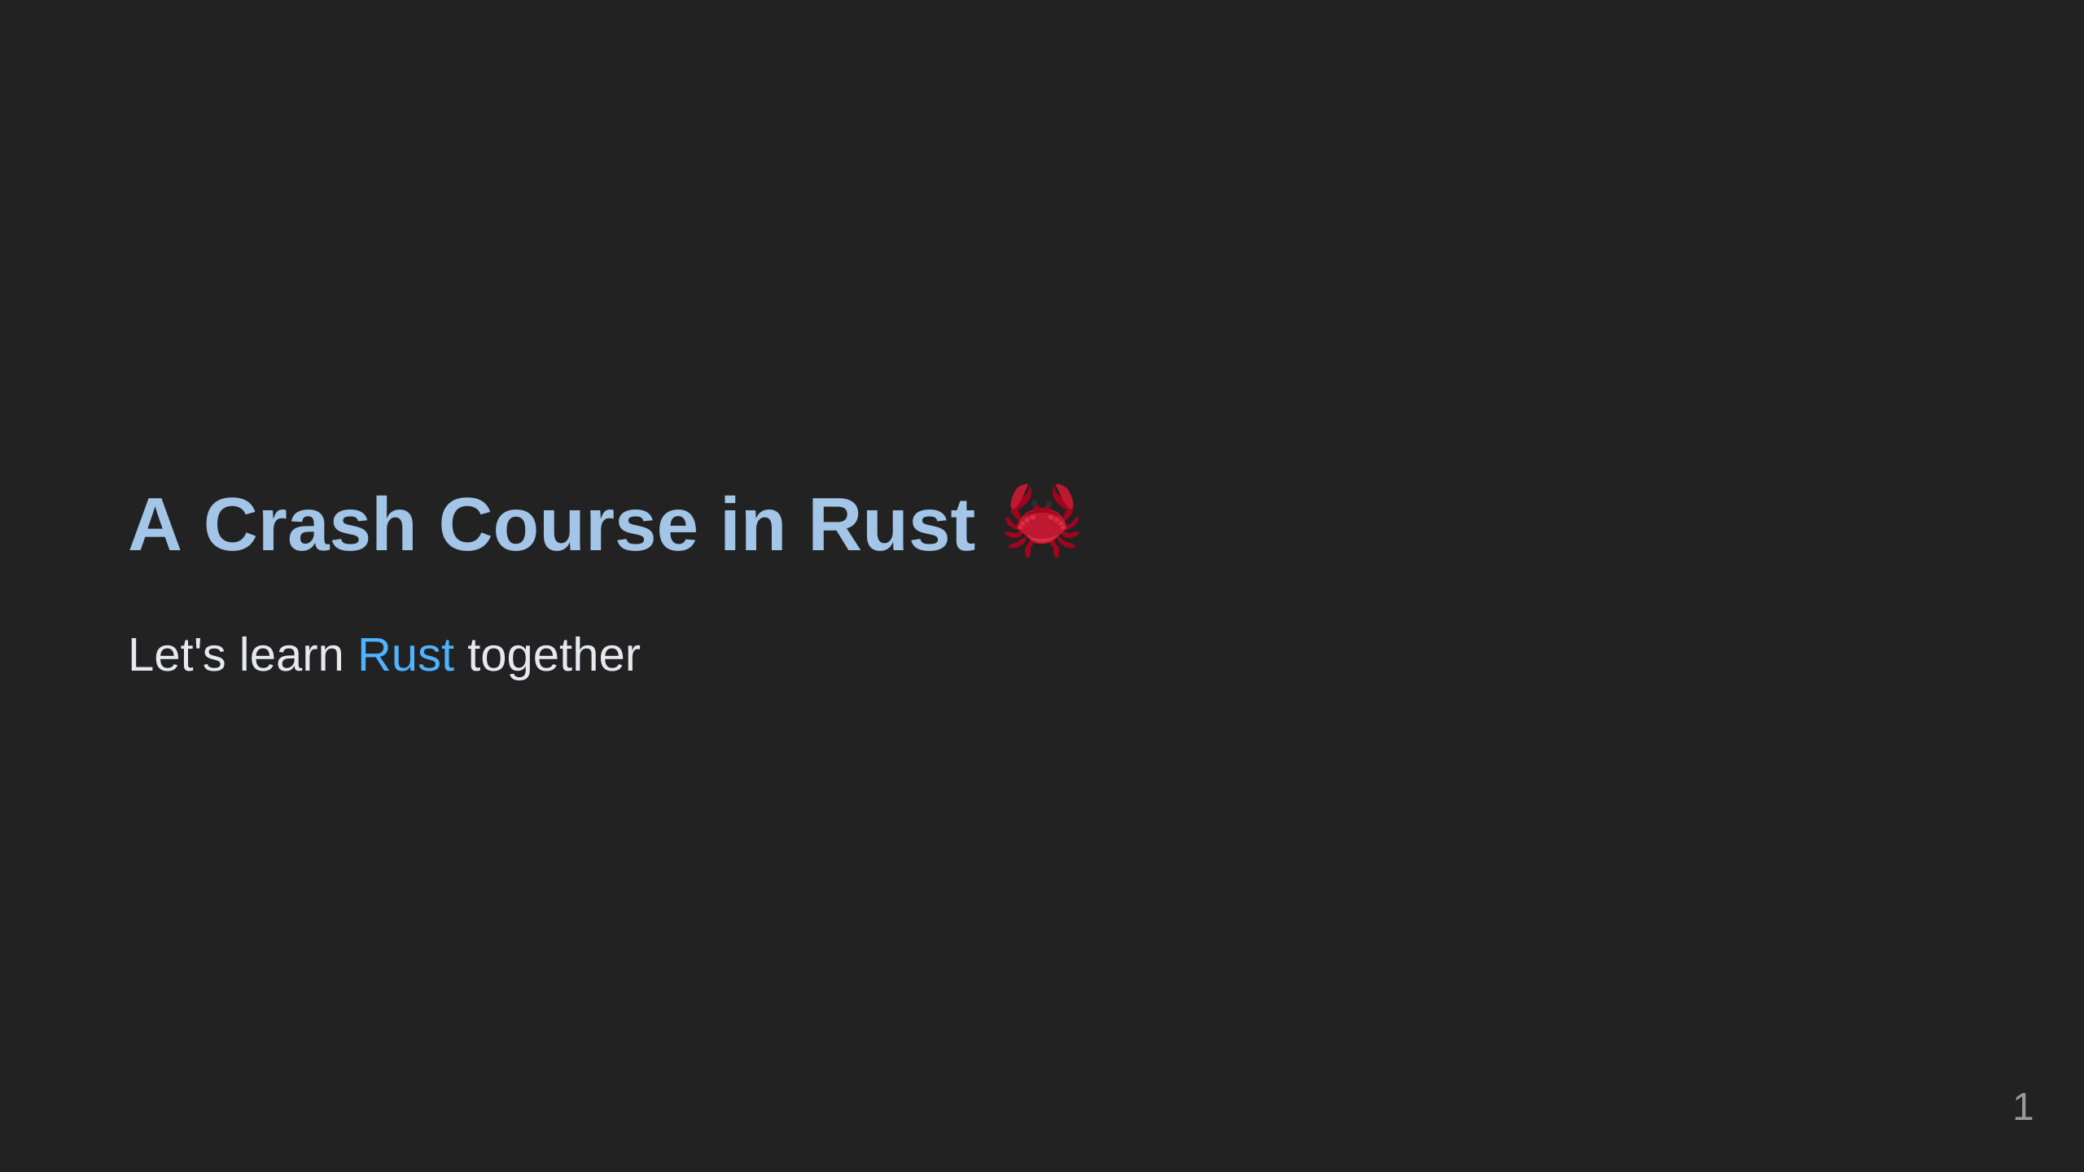

Slide 2
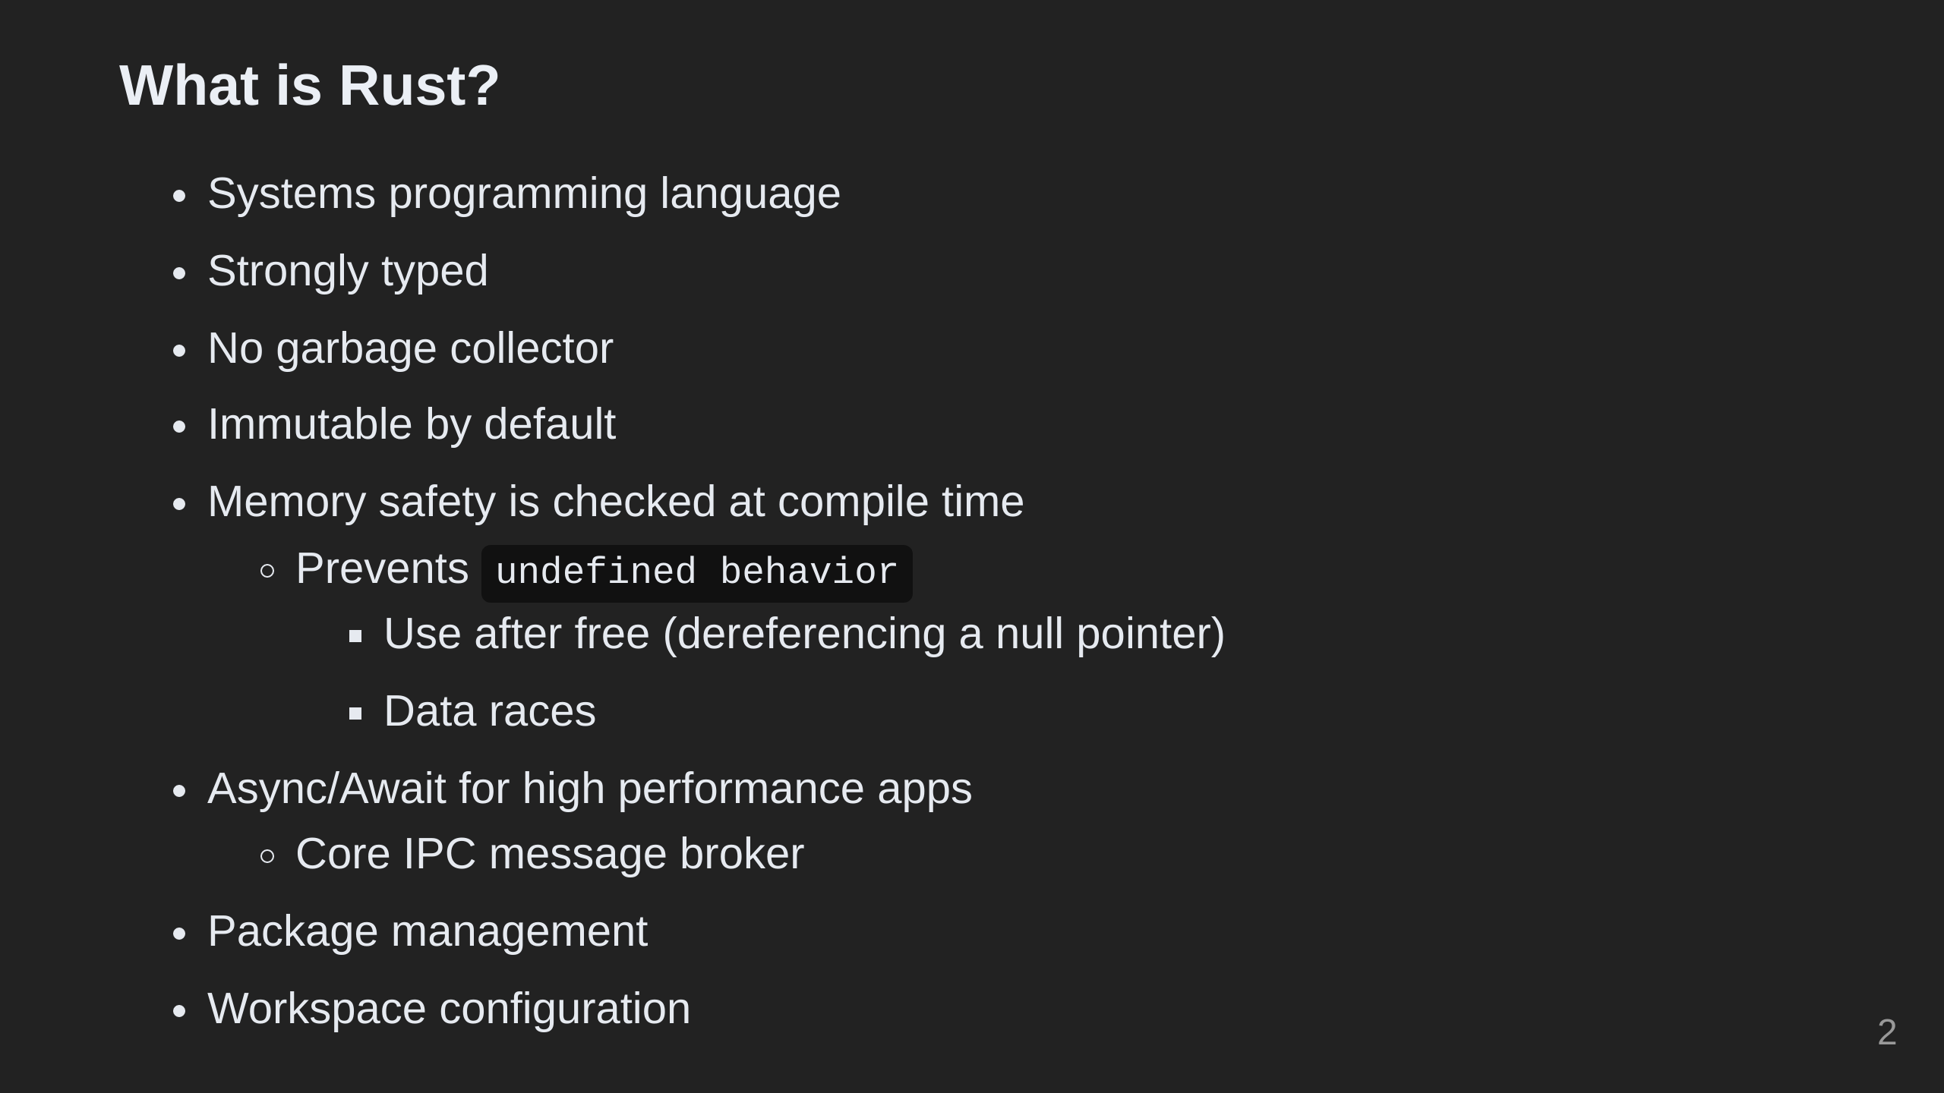

Slide 3
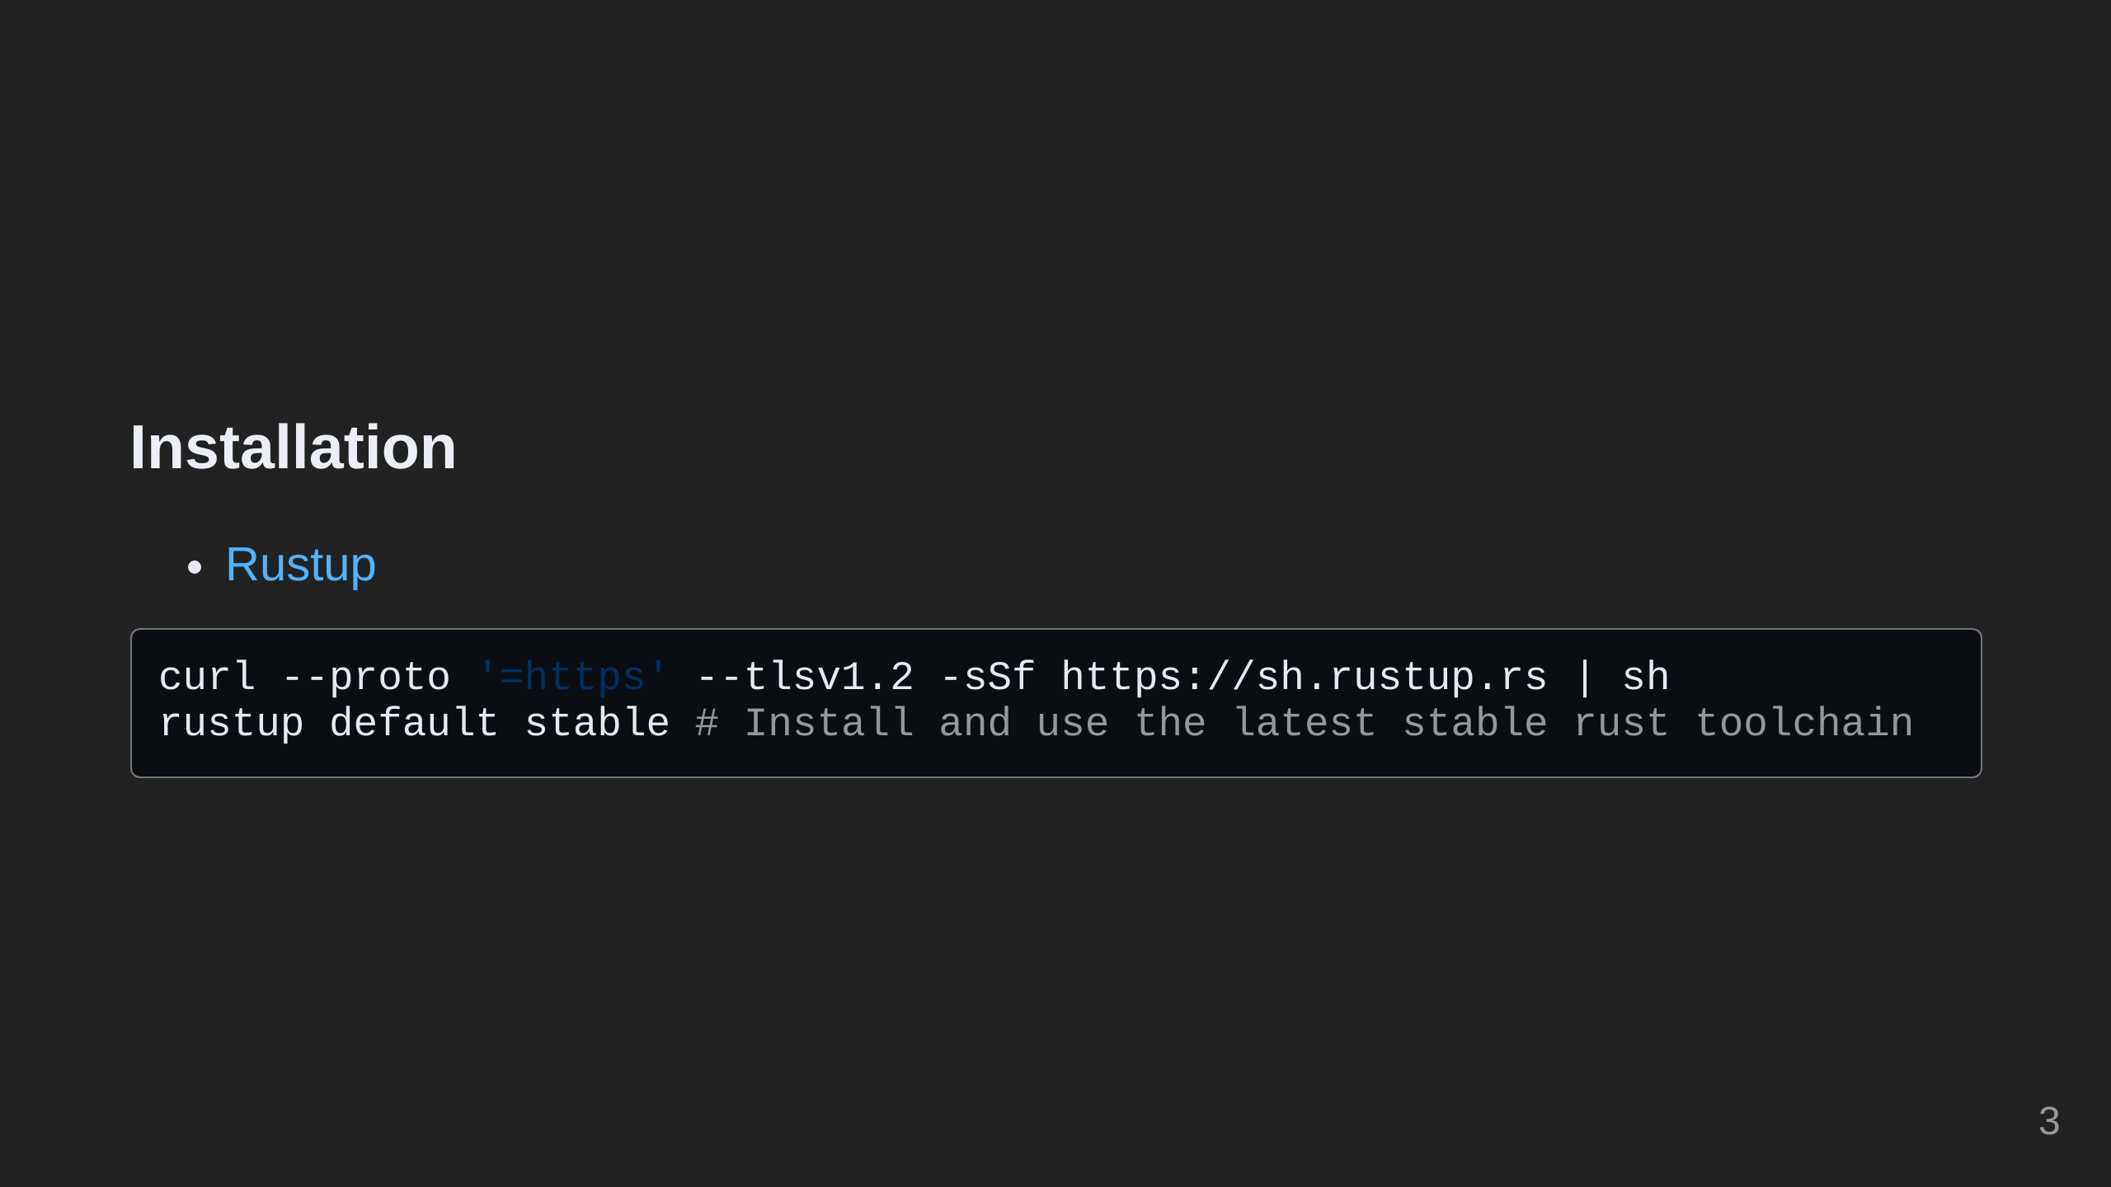

Slide 4
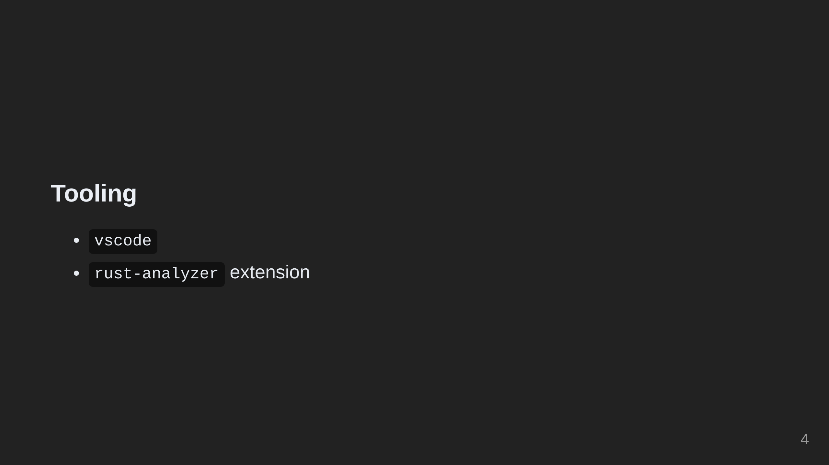

Slide 5
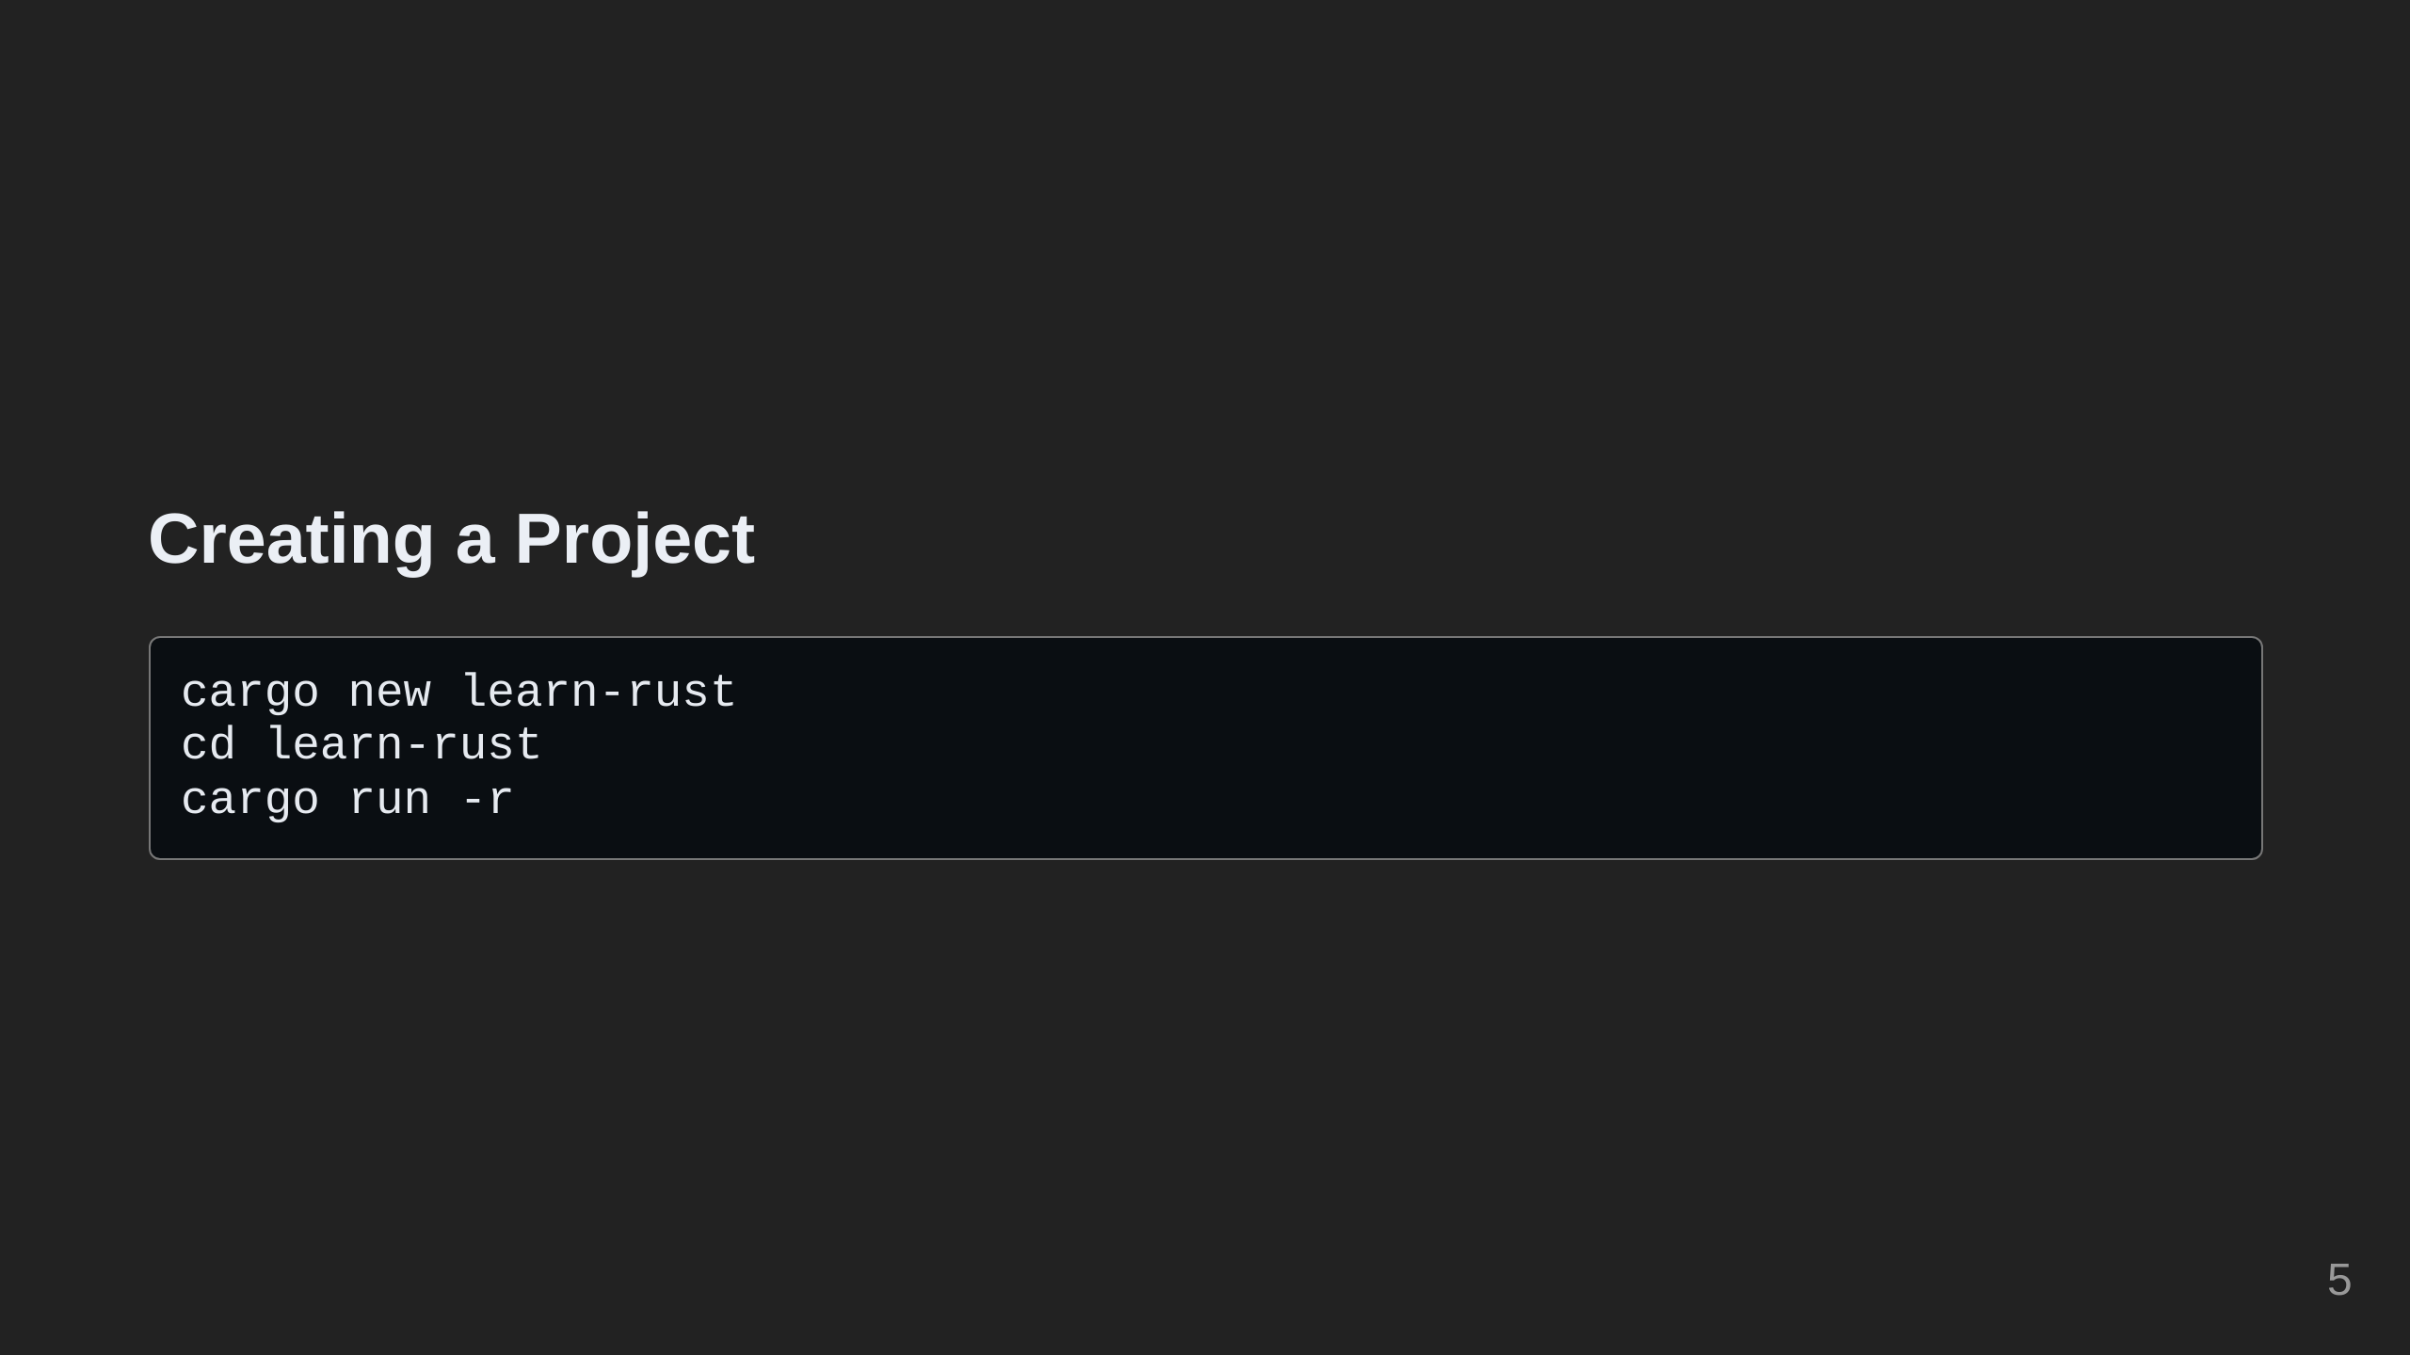

Slide 6
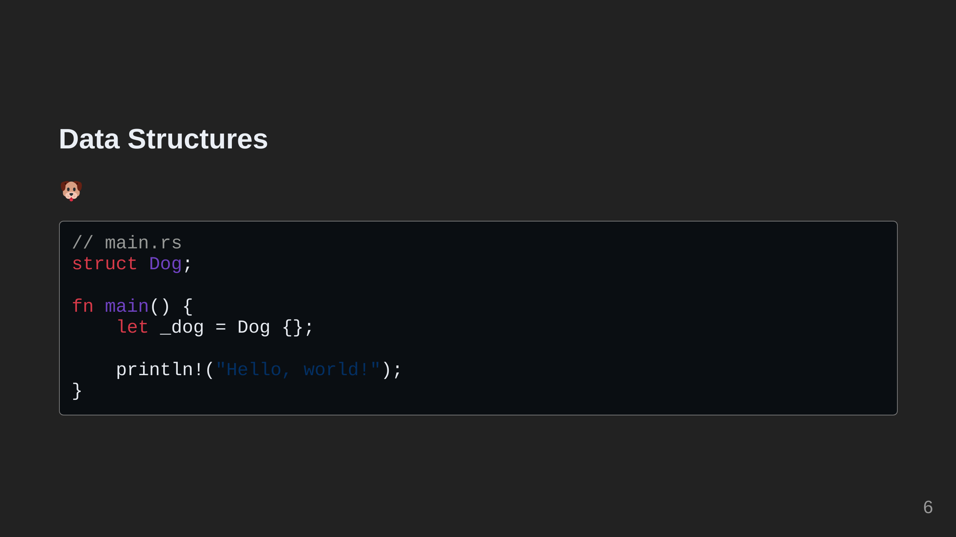
Notes:
Everyone loves pets, so let's start by adding a pet to our project.

Slide 7
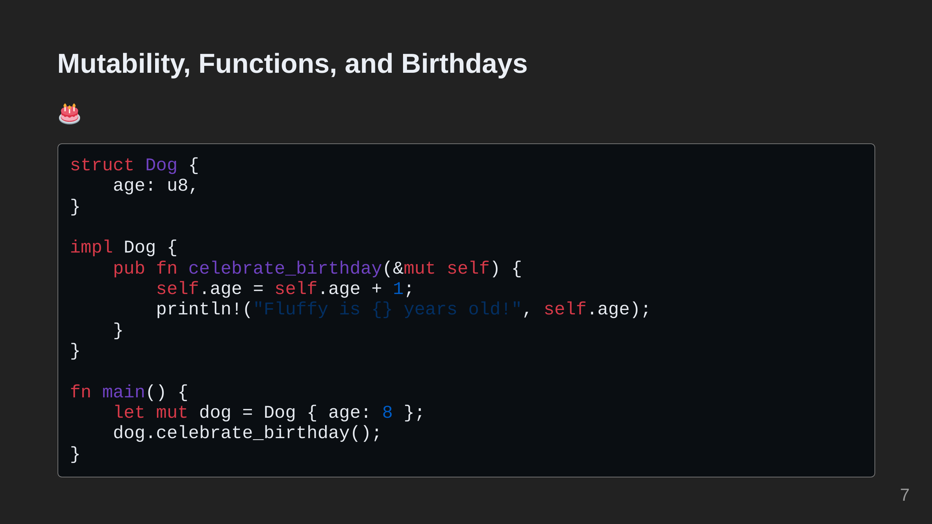
Notes:
Let's give our dog an age and make it possible for them to celebrate their birthday. Note that we have to add the mut keyword to the dog to be able to mutate it. In this case, the mutation is incrementing its age when celebrating its birthday. In Rust, objects are immutable by default.

Slide 8
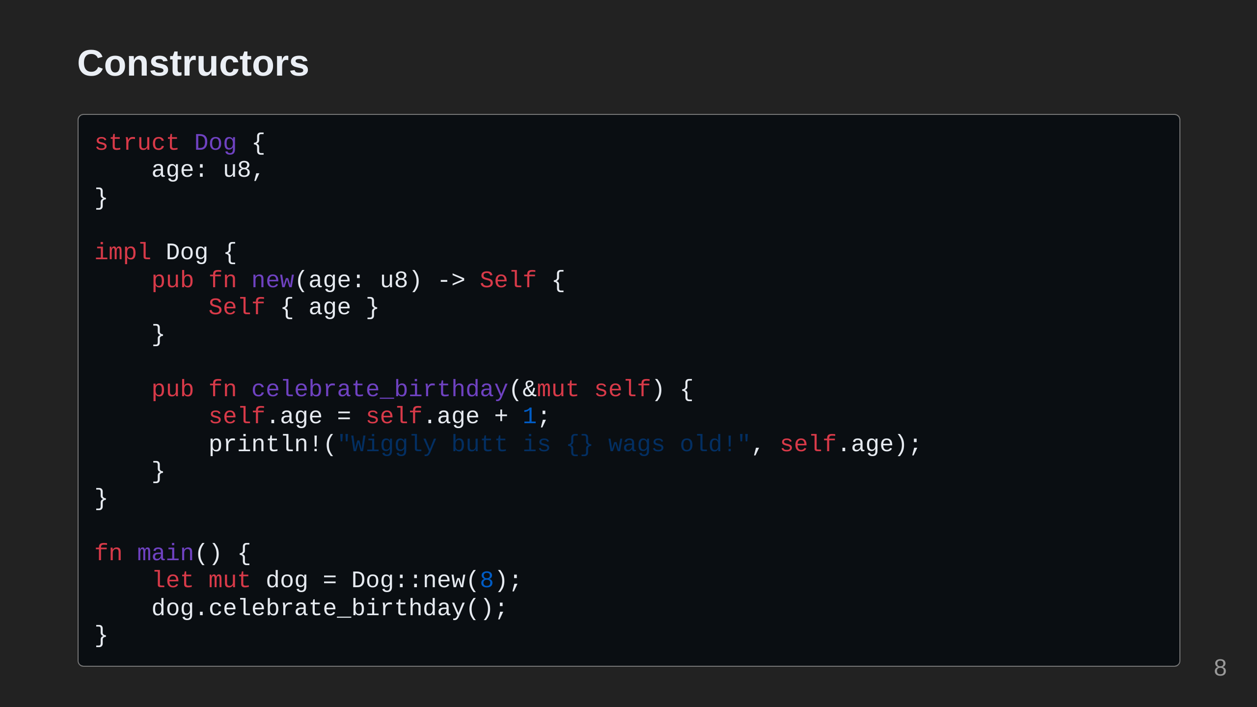
Notes:
Constructors in Rust are just functions that return an instance of an object. They are not treated specially by the language itself like they are in C++. Because they do not take `self` as a parameter, they are considered `associated functions` instead of `methods`.

Slide 9
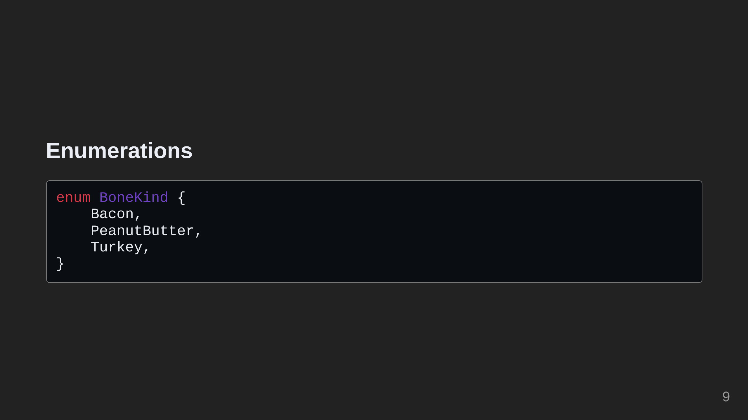
Notes:
Now we can add an enumeration to our program the represents various bone flavors.

Slide 10
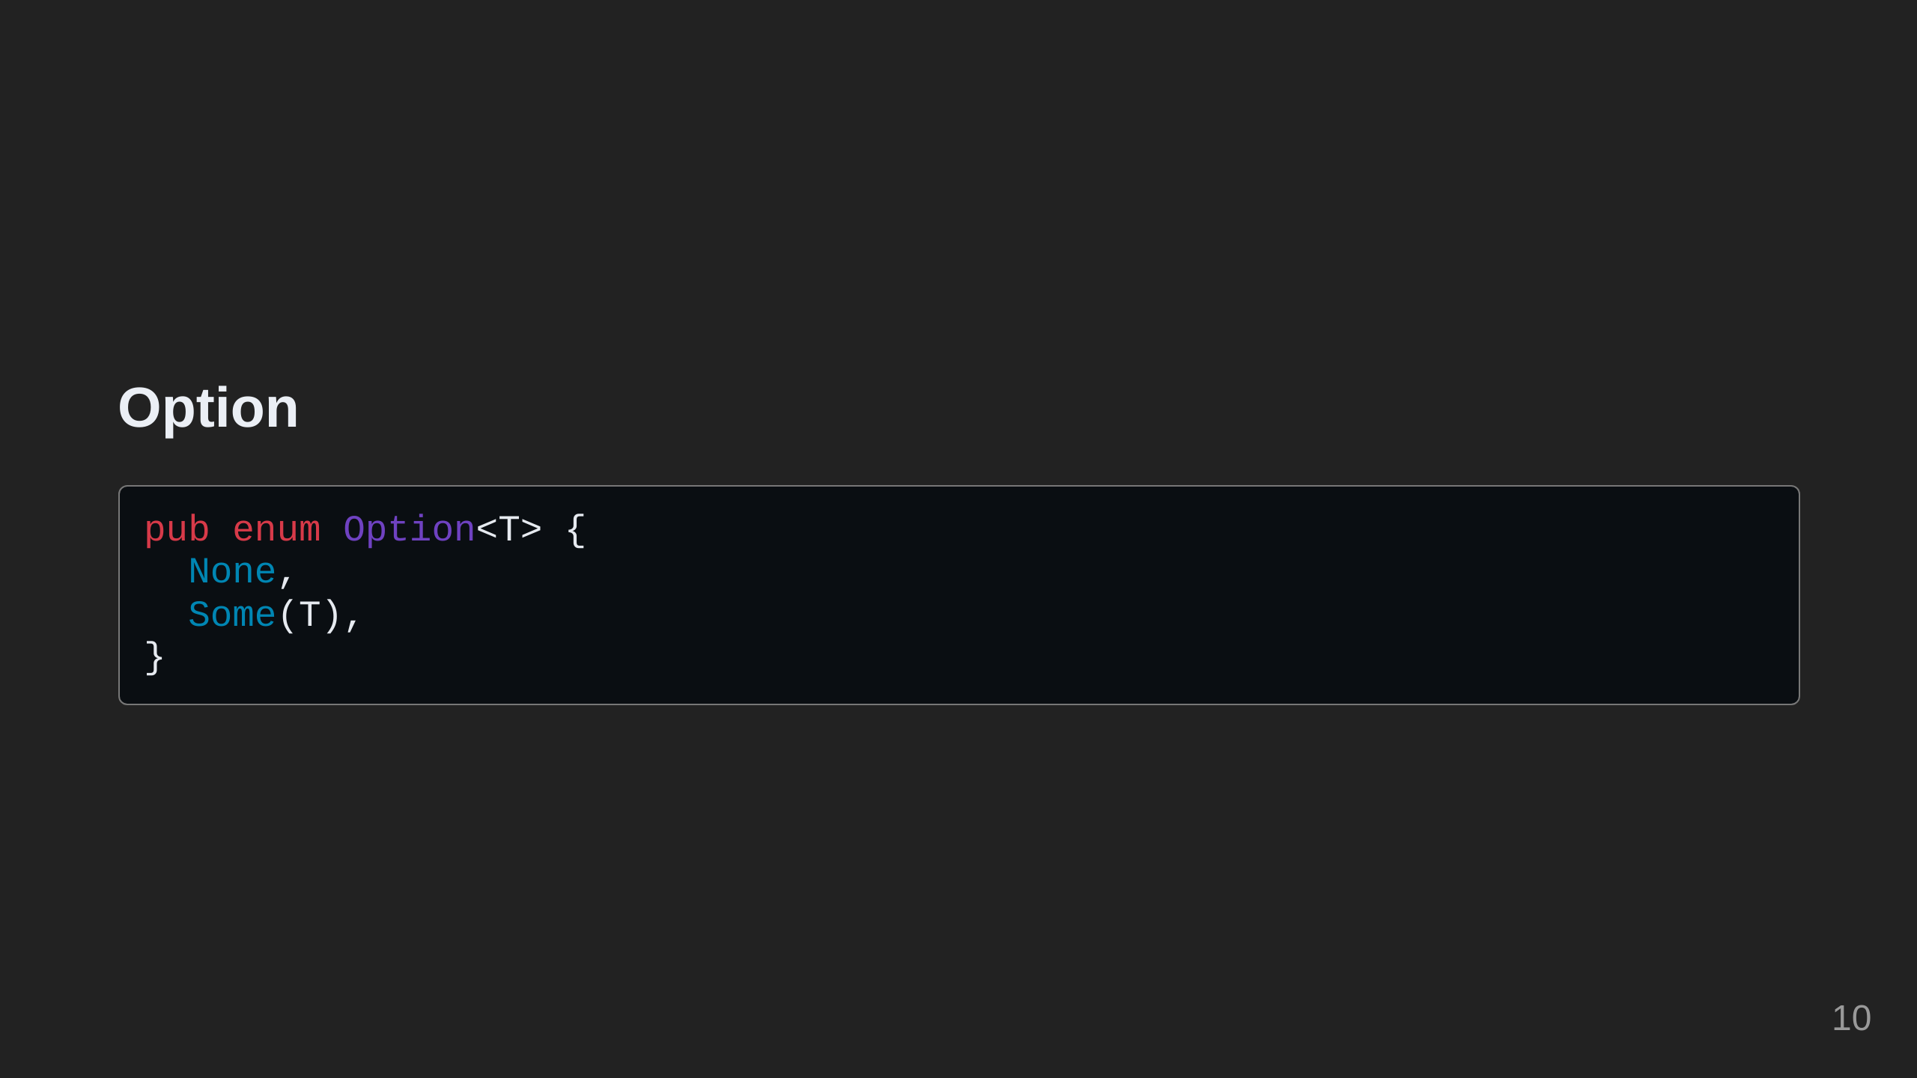
Notes:
Now we need a way to represent the dog having a bone or not having a bone. We can represent this using the `Option` type. `Option` is a generic enumeration with two variants.

Slide 11
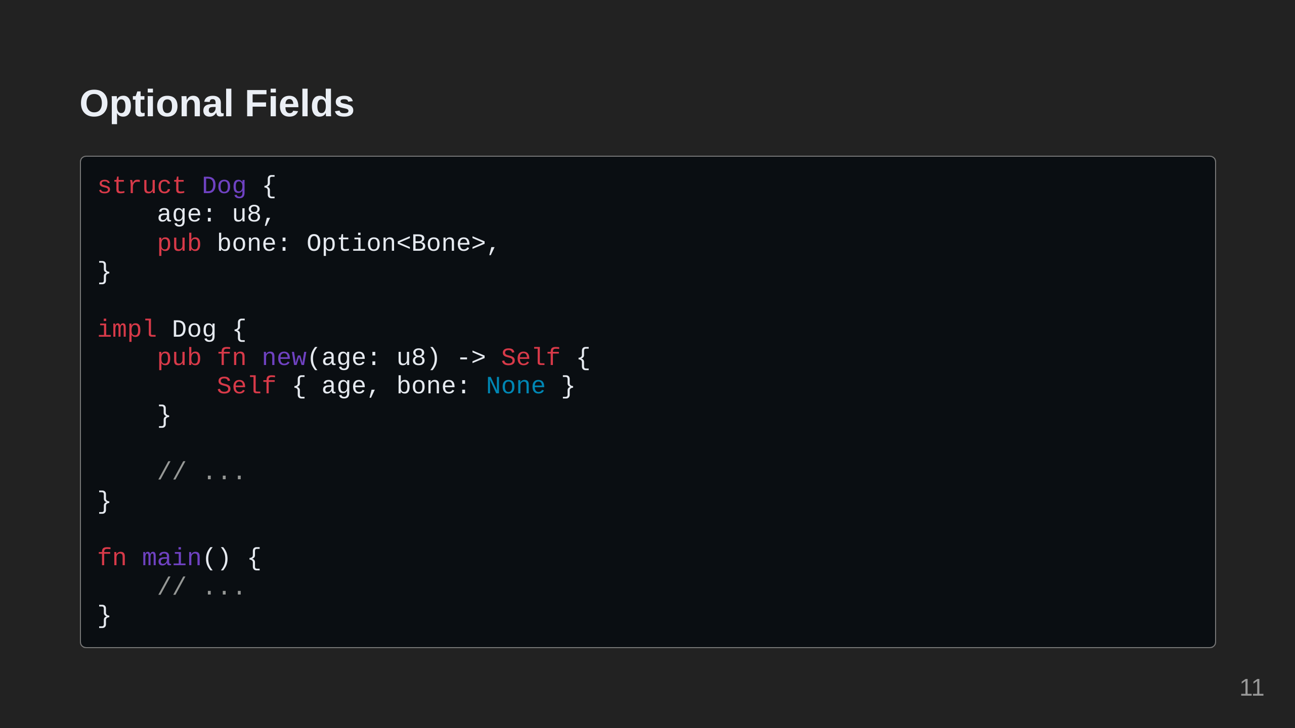
Notes:
Let's add an optional `bone` field to our `Dog`.

Slide 12
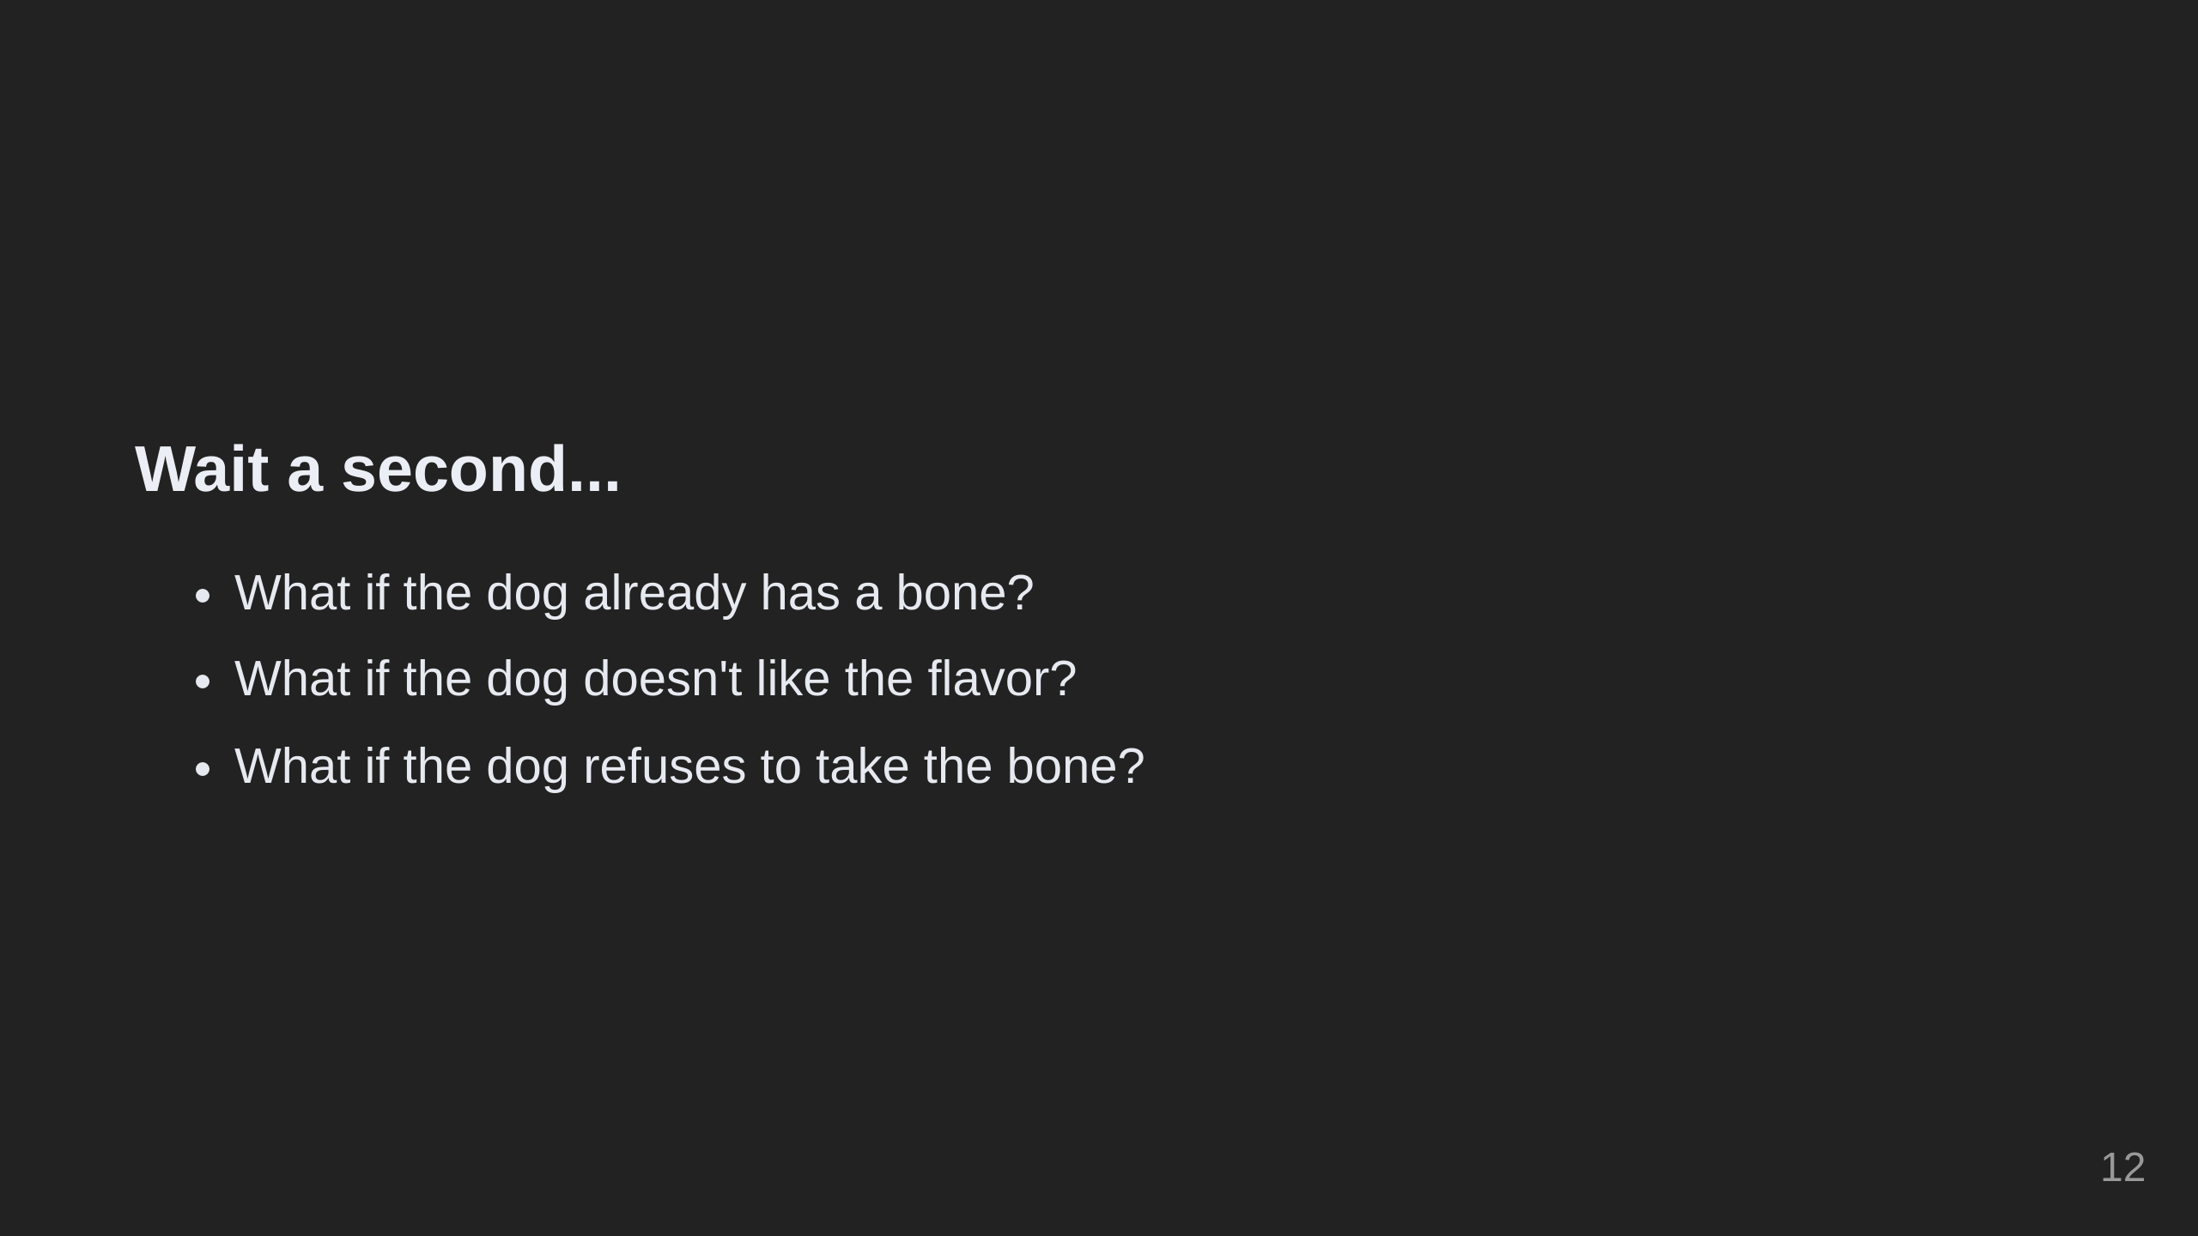
Notes:
Now our dog can hold onto a Bone! However, things get more complicated when we want to start giving and taking bones. What if the dog already has a bone? What if the dog doesn't like the flavor? What if the dog refuses to take the bone? In the next section, we'll cover how to handle fallibility in our program. First, we will take a look at the full program so far.

Slide 13
