Slide 1
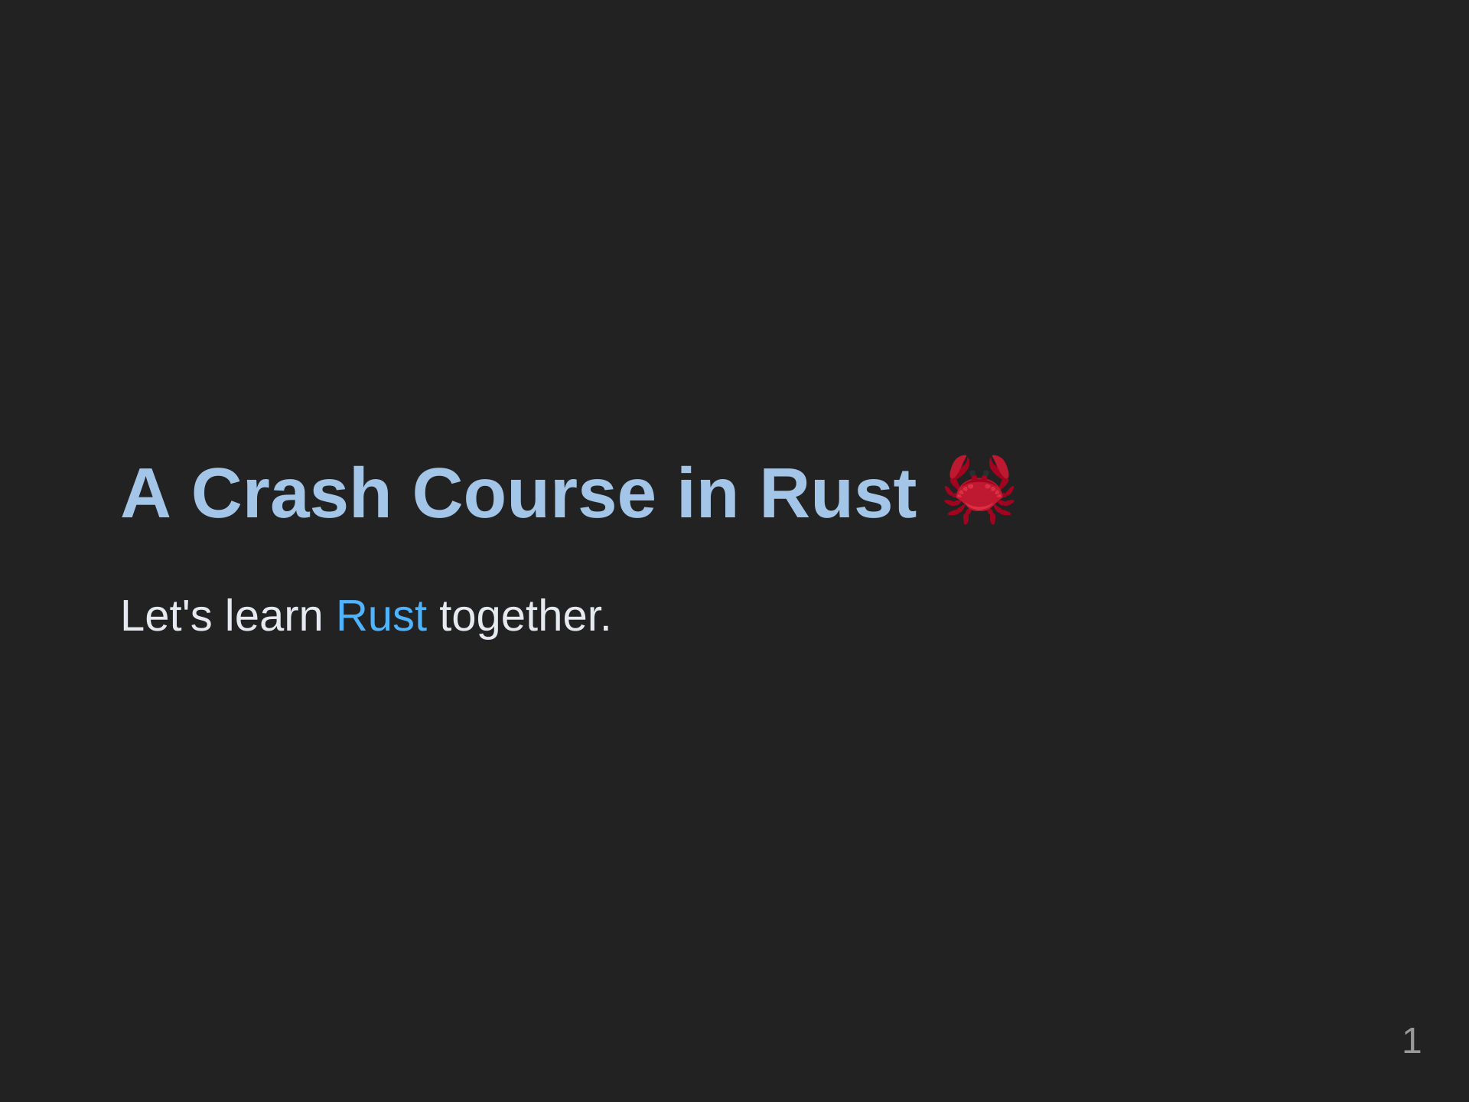

Slide 2
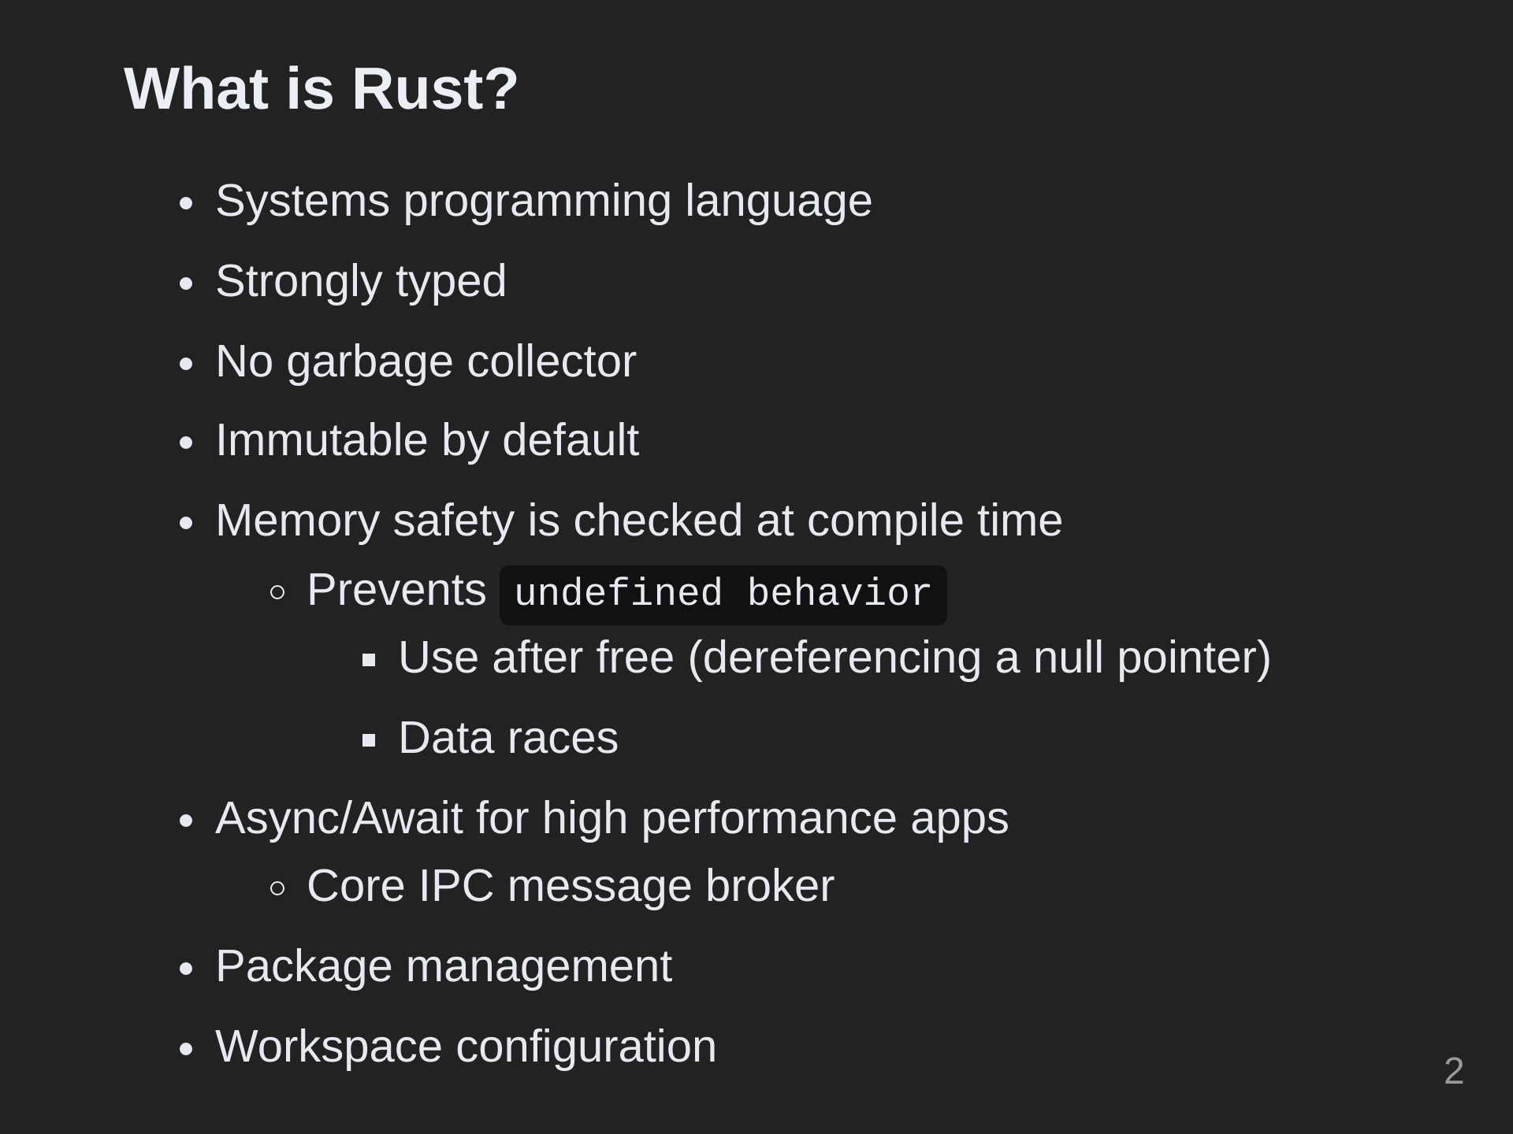

Slide 3
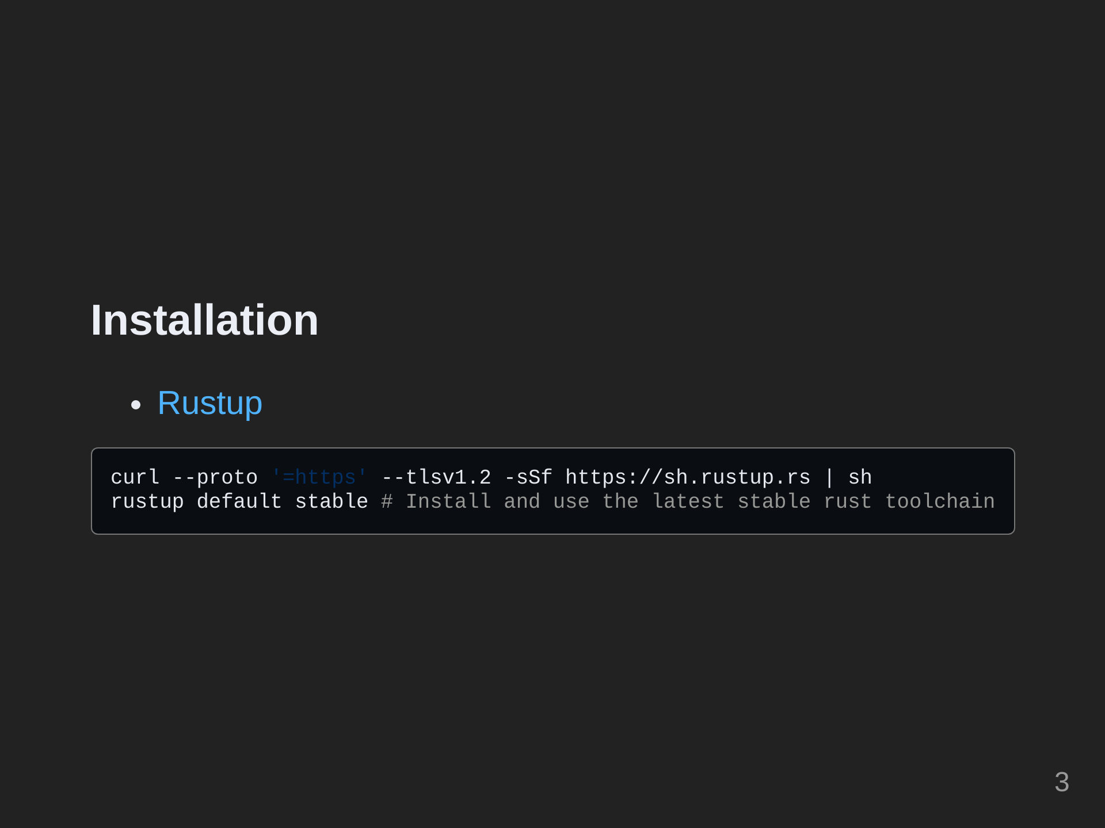

Slide 4
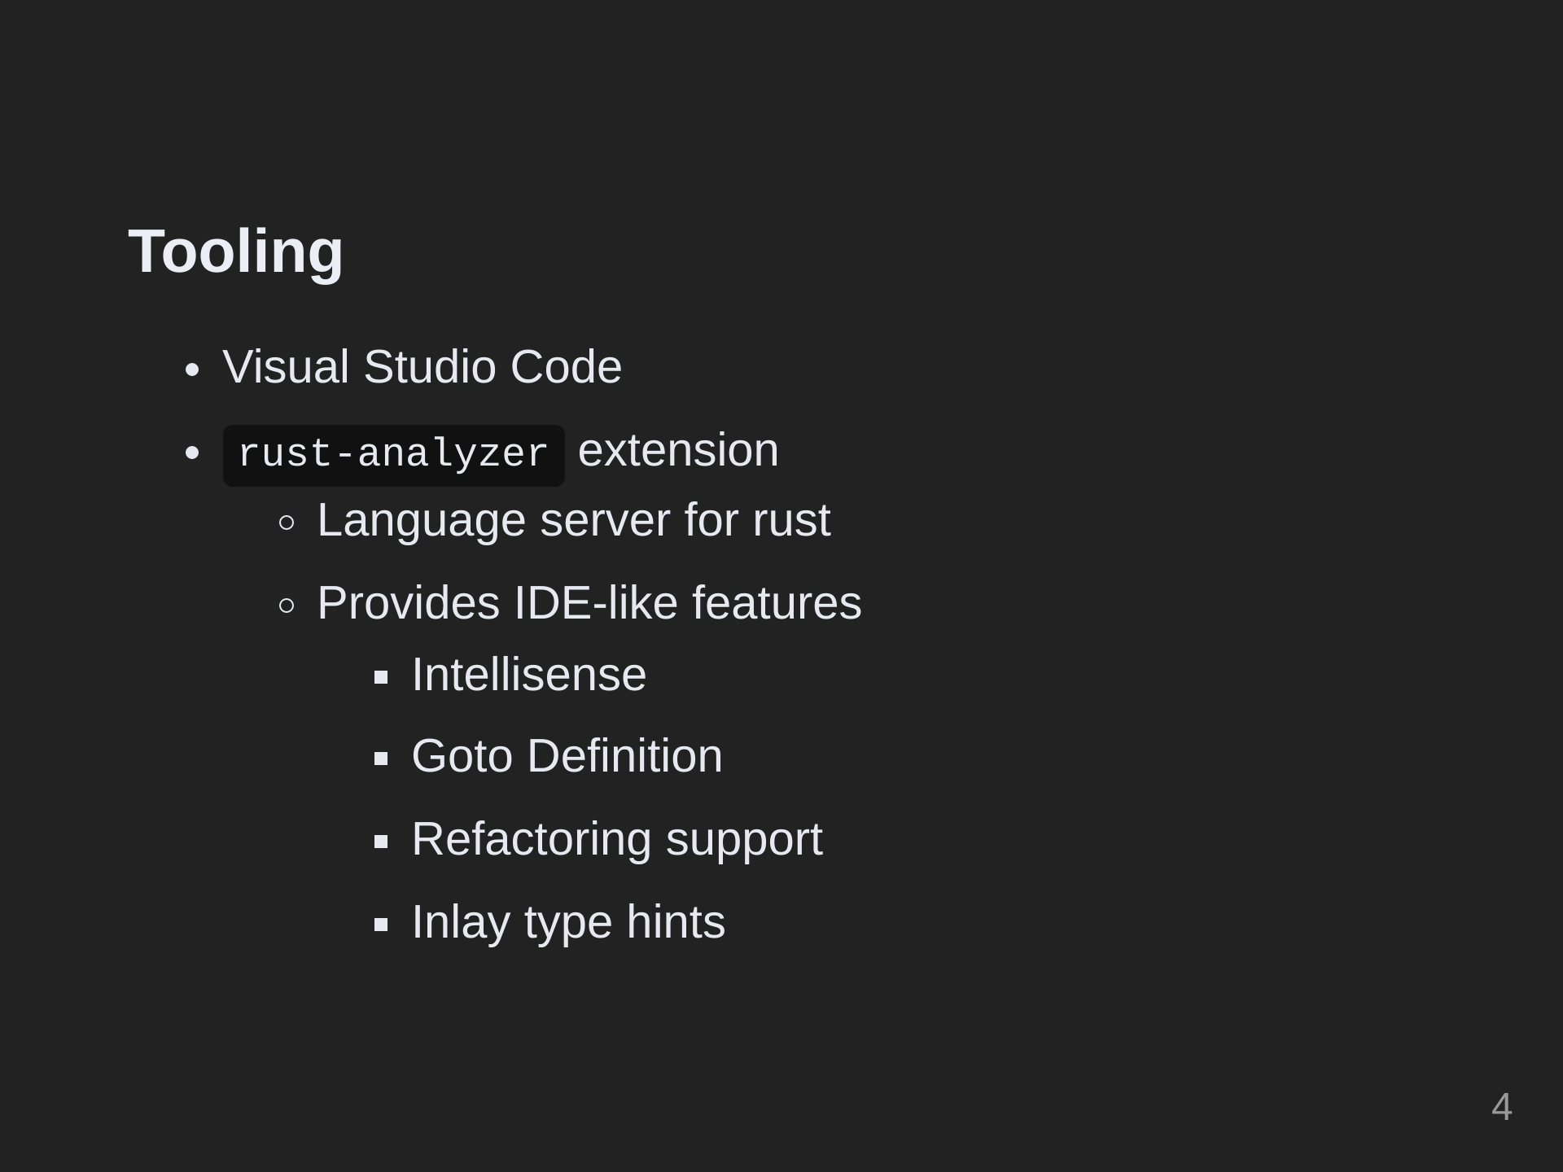
Notes:
> - Language server for rust that provides IDE like features using JSON-RPC with editor plugins that support Microsoft's language server schema.

Slide 5
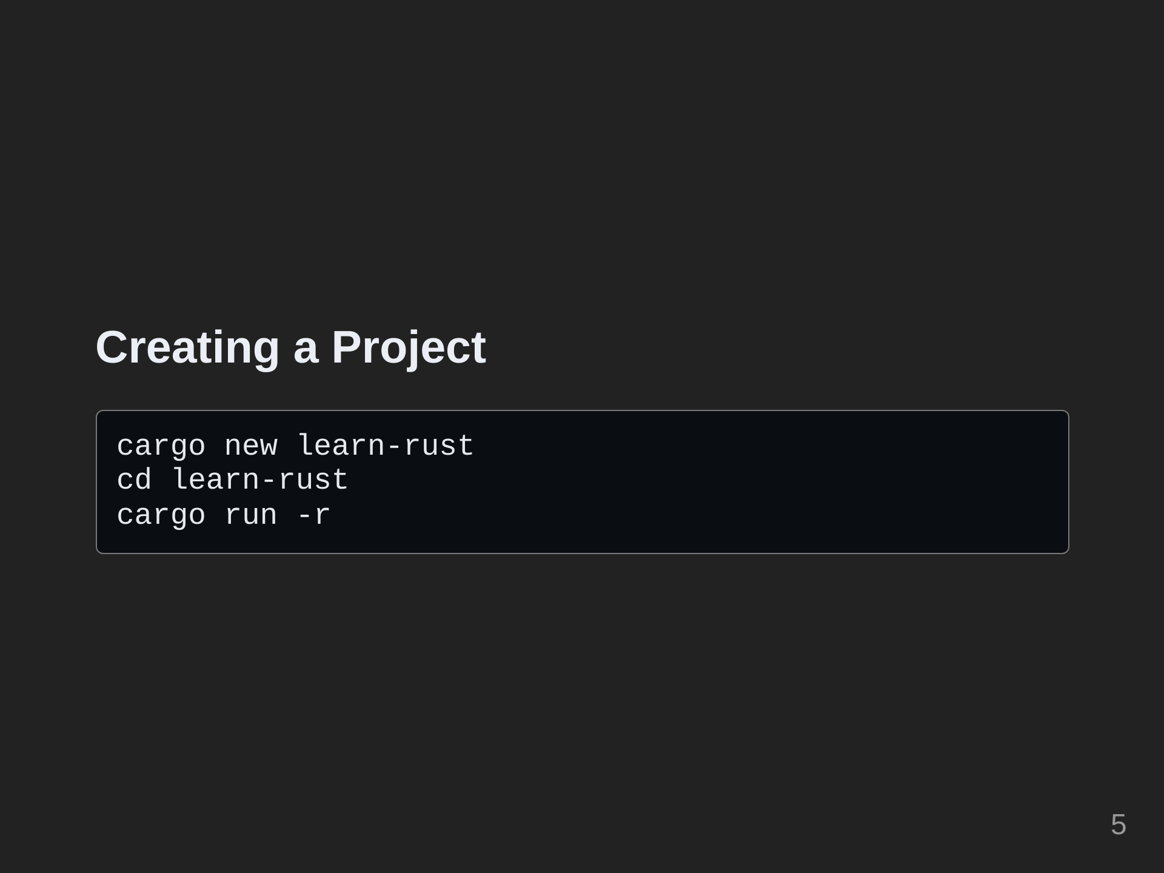

Slide 6
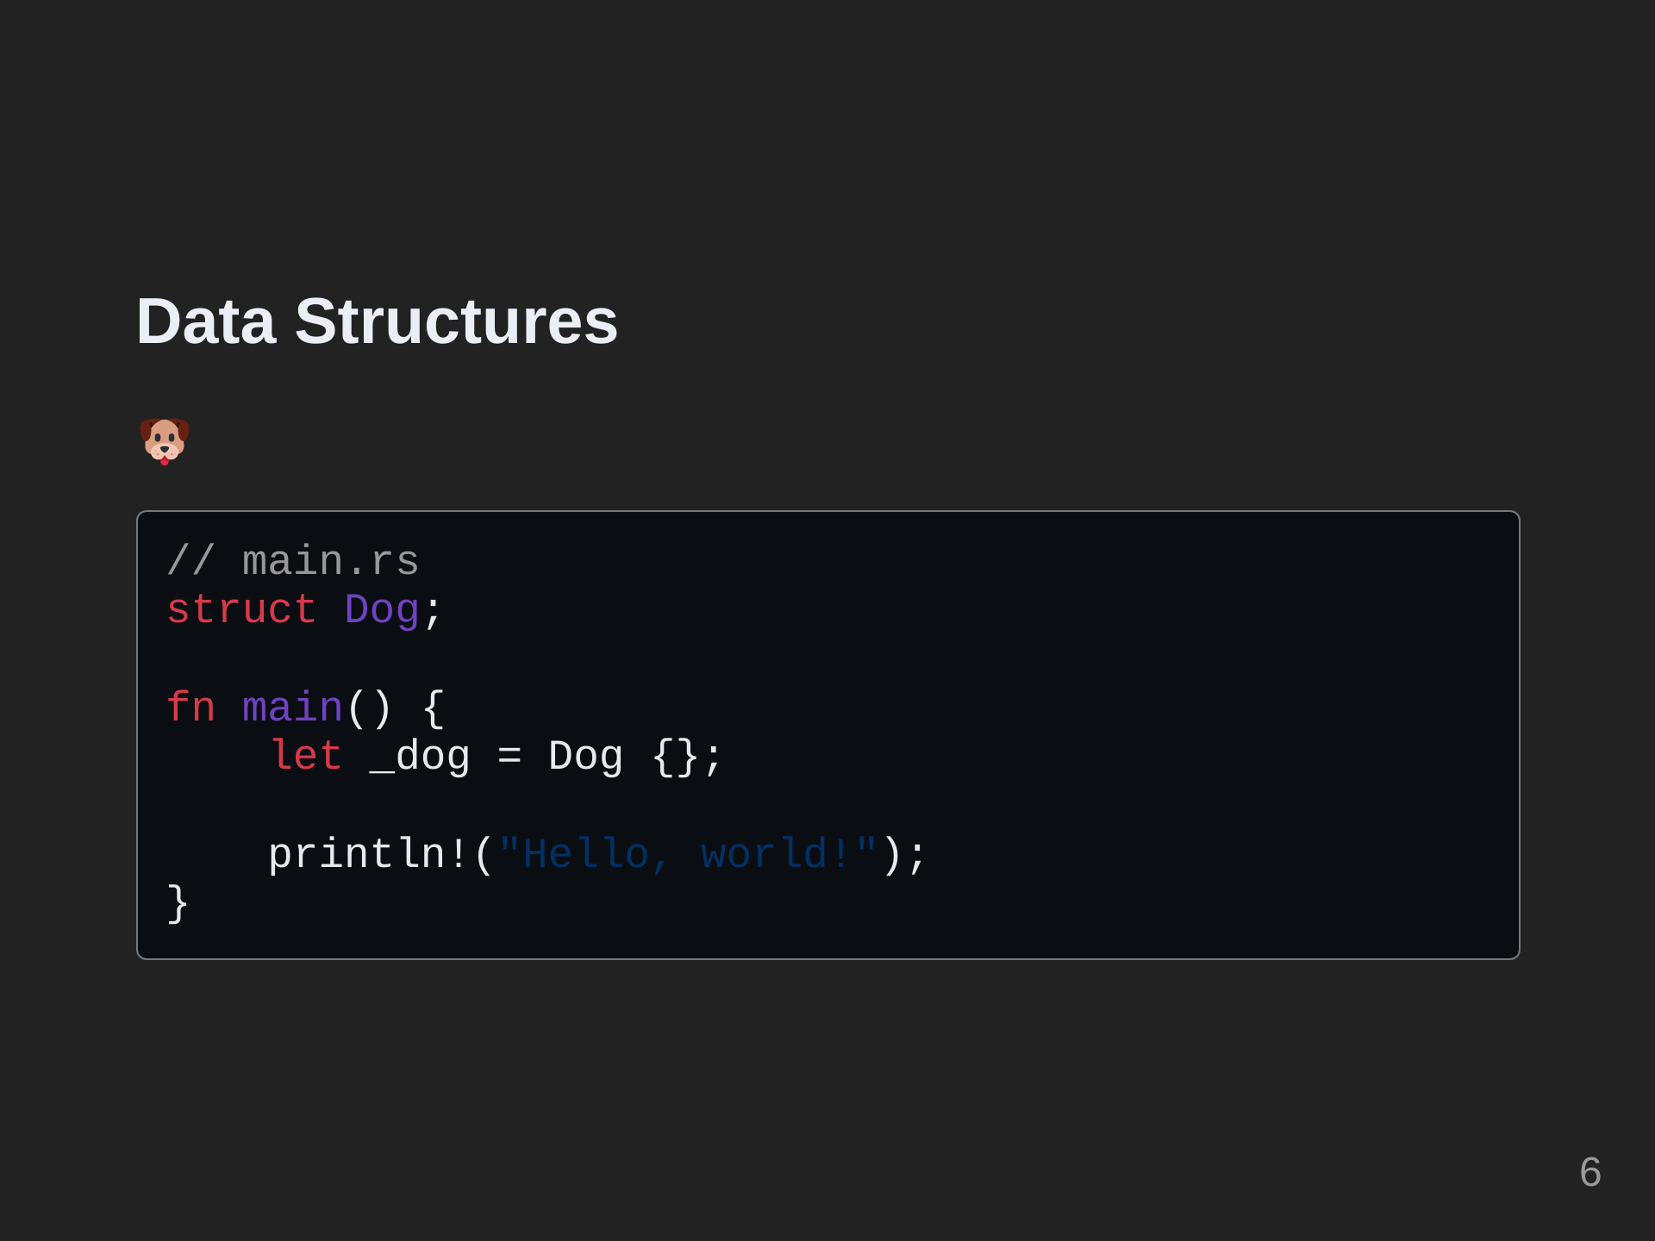
Notes:
Everyone loves pets, so let's start by adding a pet to our project.

Slide 7
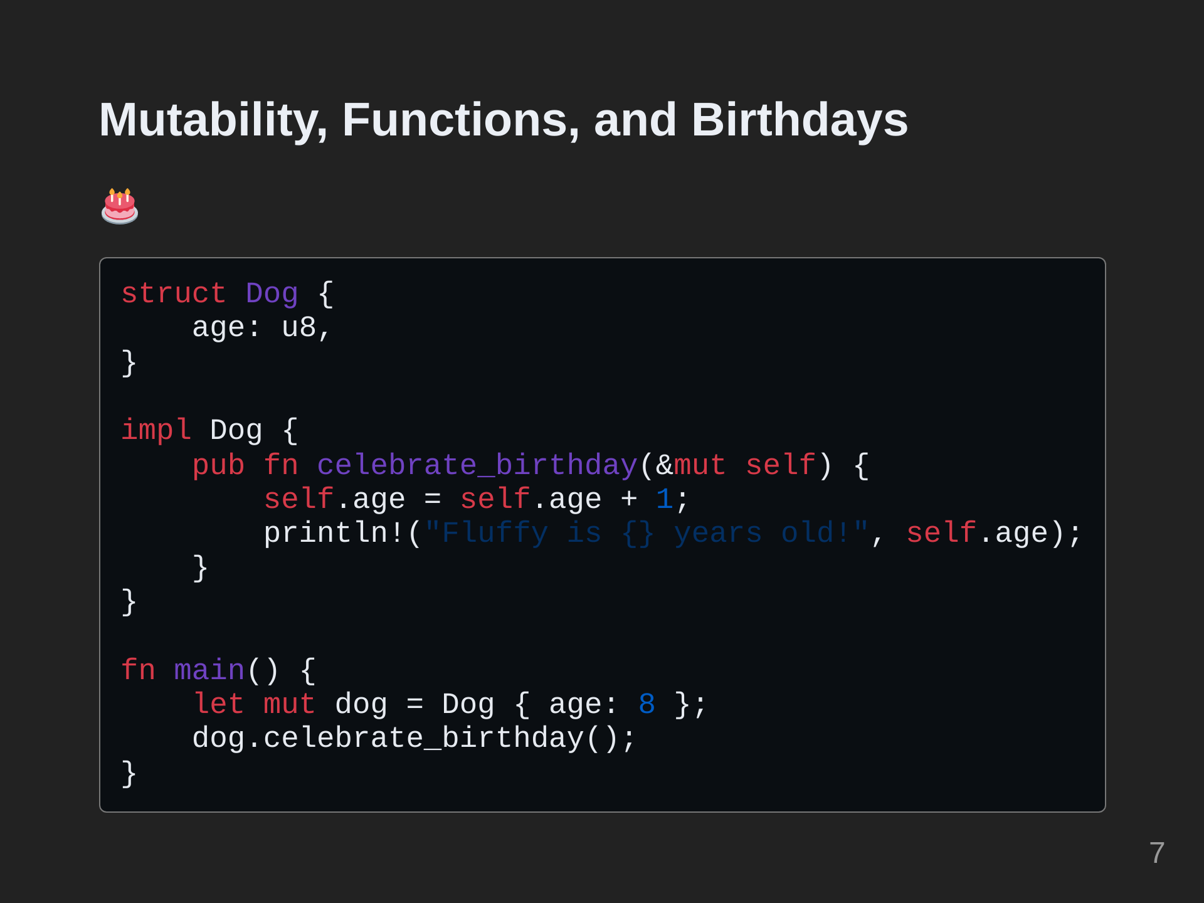
Notes:
Let's give our dog an age and make it possible for them to celebrate their birthday. Note that we have to add the mut keyword to the dog to be able to mutate it. In this case, the mutation is incrementing its age when celebrating its birthday. In Rust, objects are immutable by default.

Slide 8
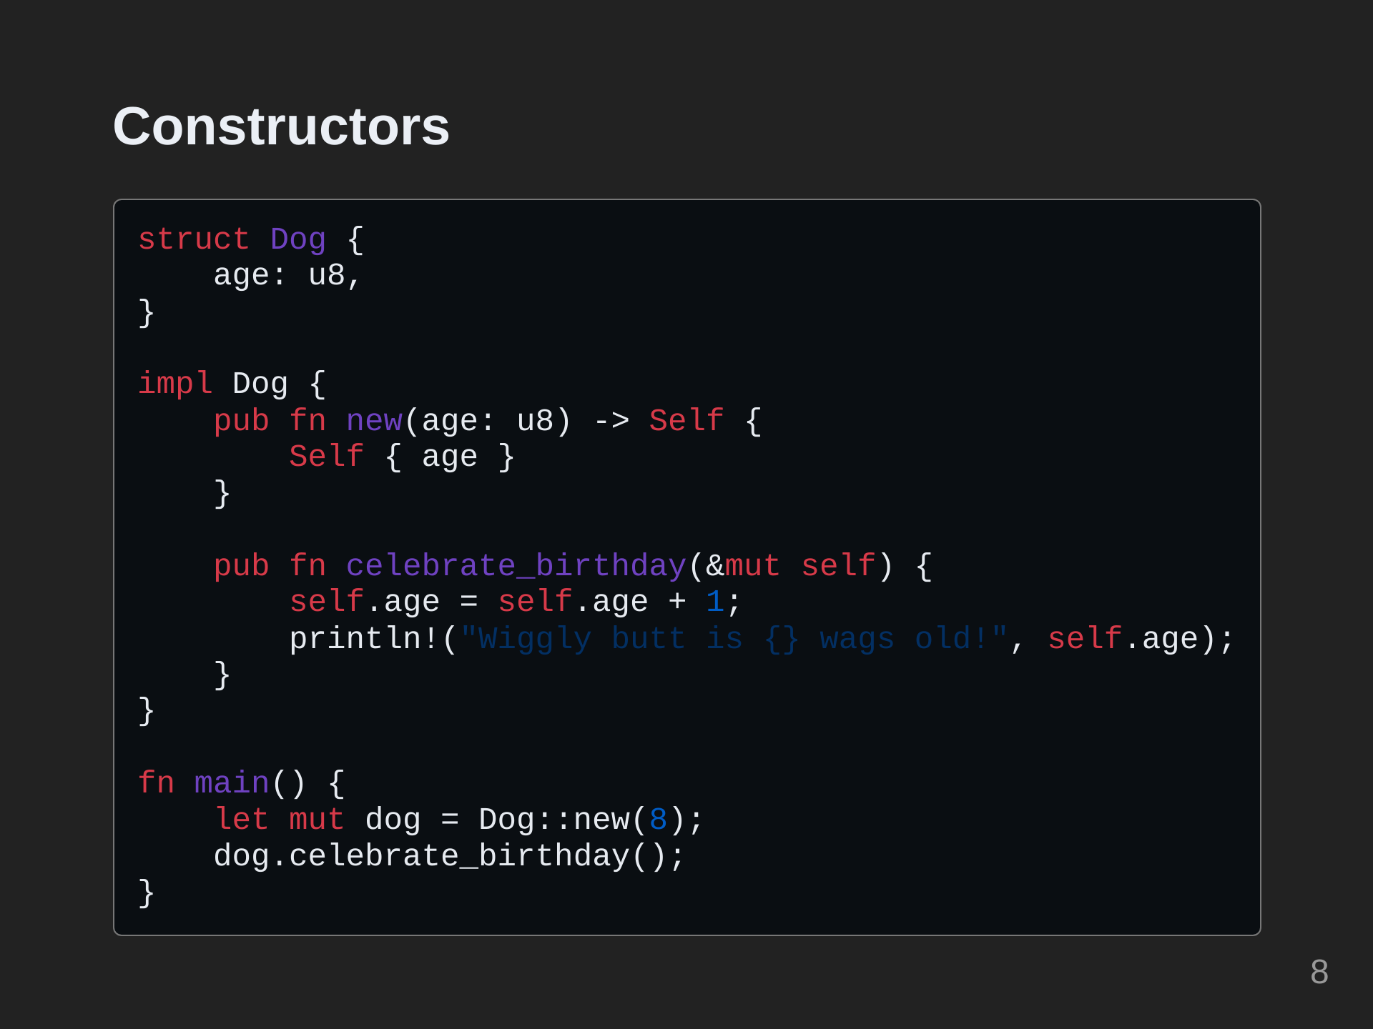
Notes:
Constructors in Rust are just functions that return an instance of an object. They are not treated specially by the language itself like they are in C++. Because they do not take `self` as a parameter, they are considered `associated functions` instead of `methods`.

Slide 9
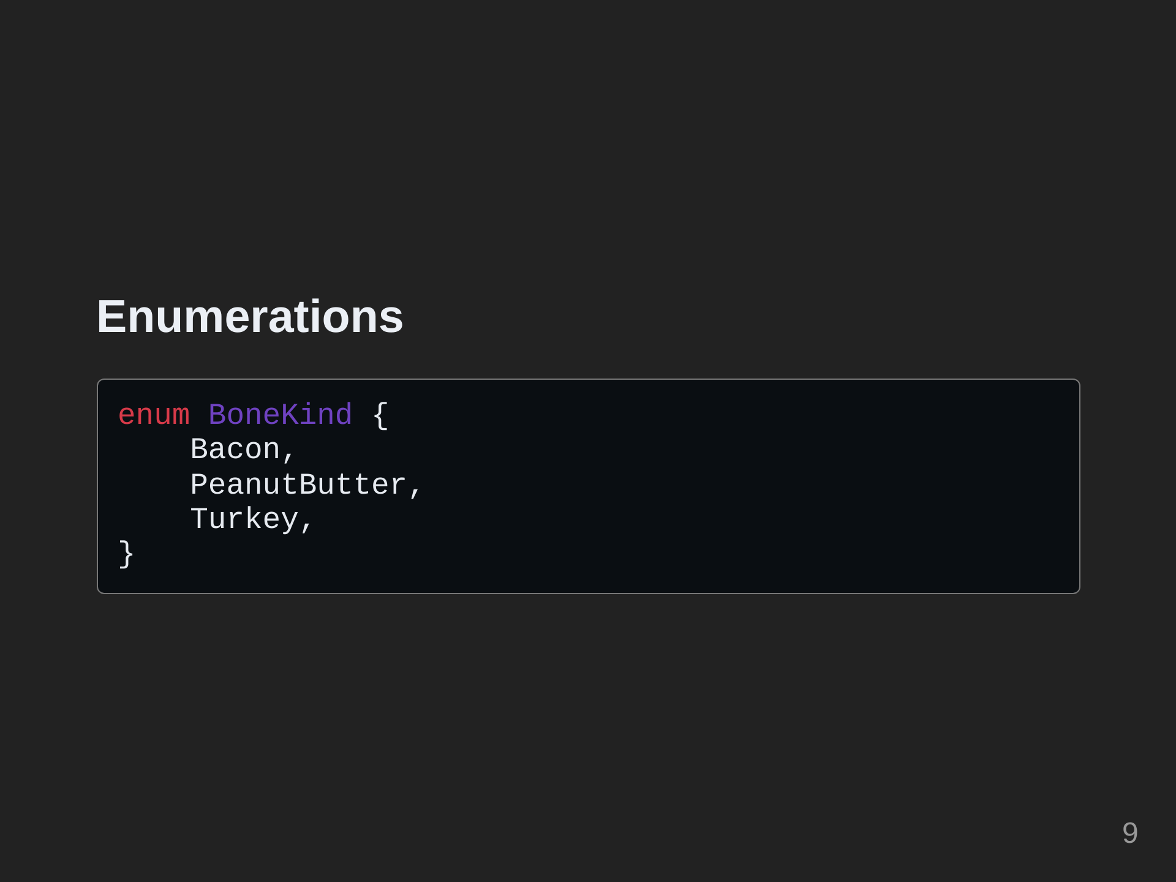
Notes:
Now we can add an enumeration to our program the represents various bone flavors.

Slide 10
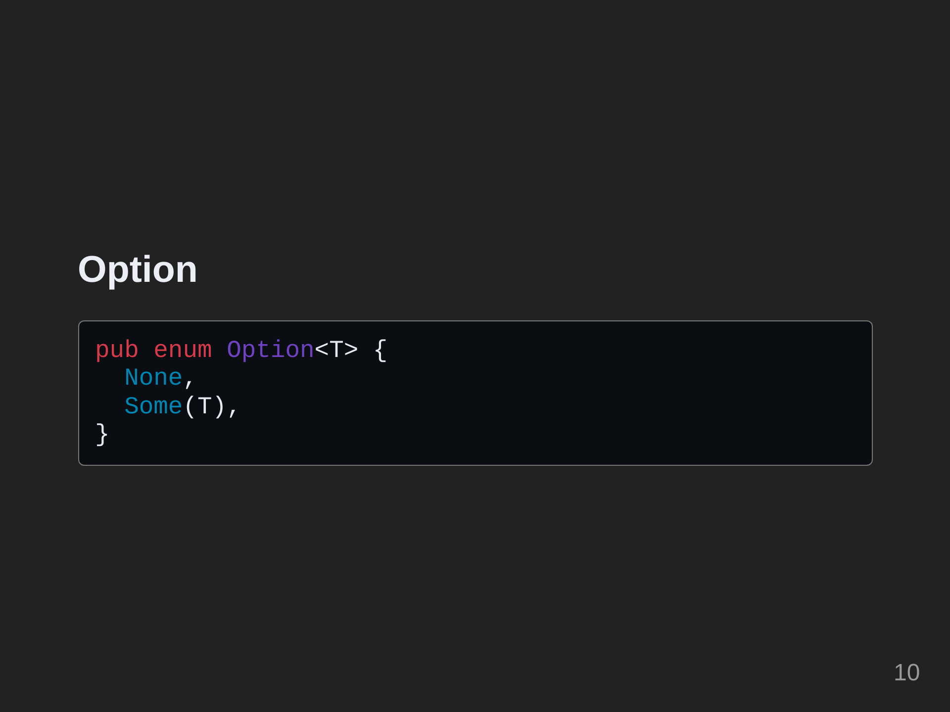
Notes:
Now we need a way to represent the dog having a bone or not having a bone. We can represent this using the `Option` type. `Option` is a generic enumeration with two variants.

Slide 11
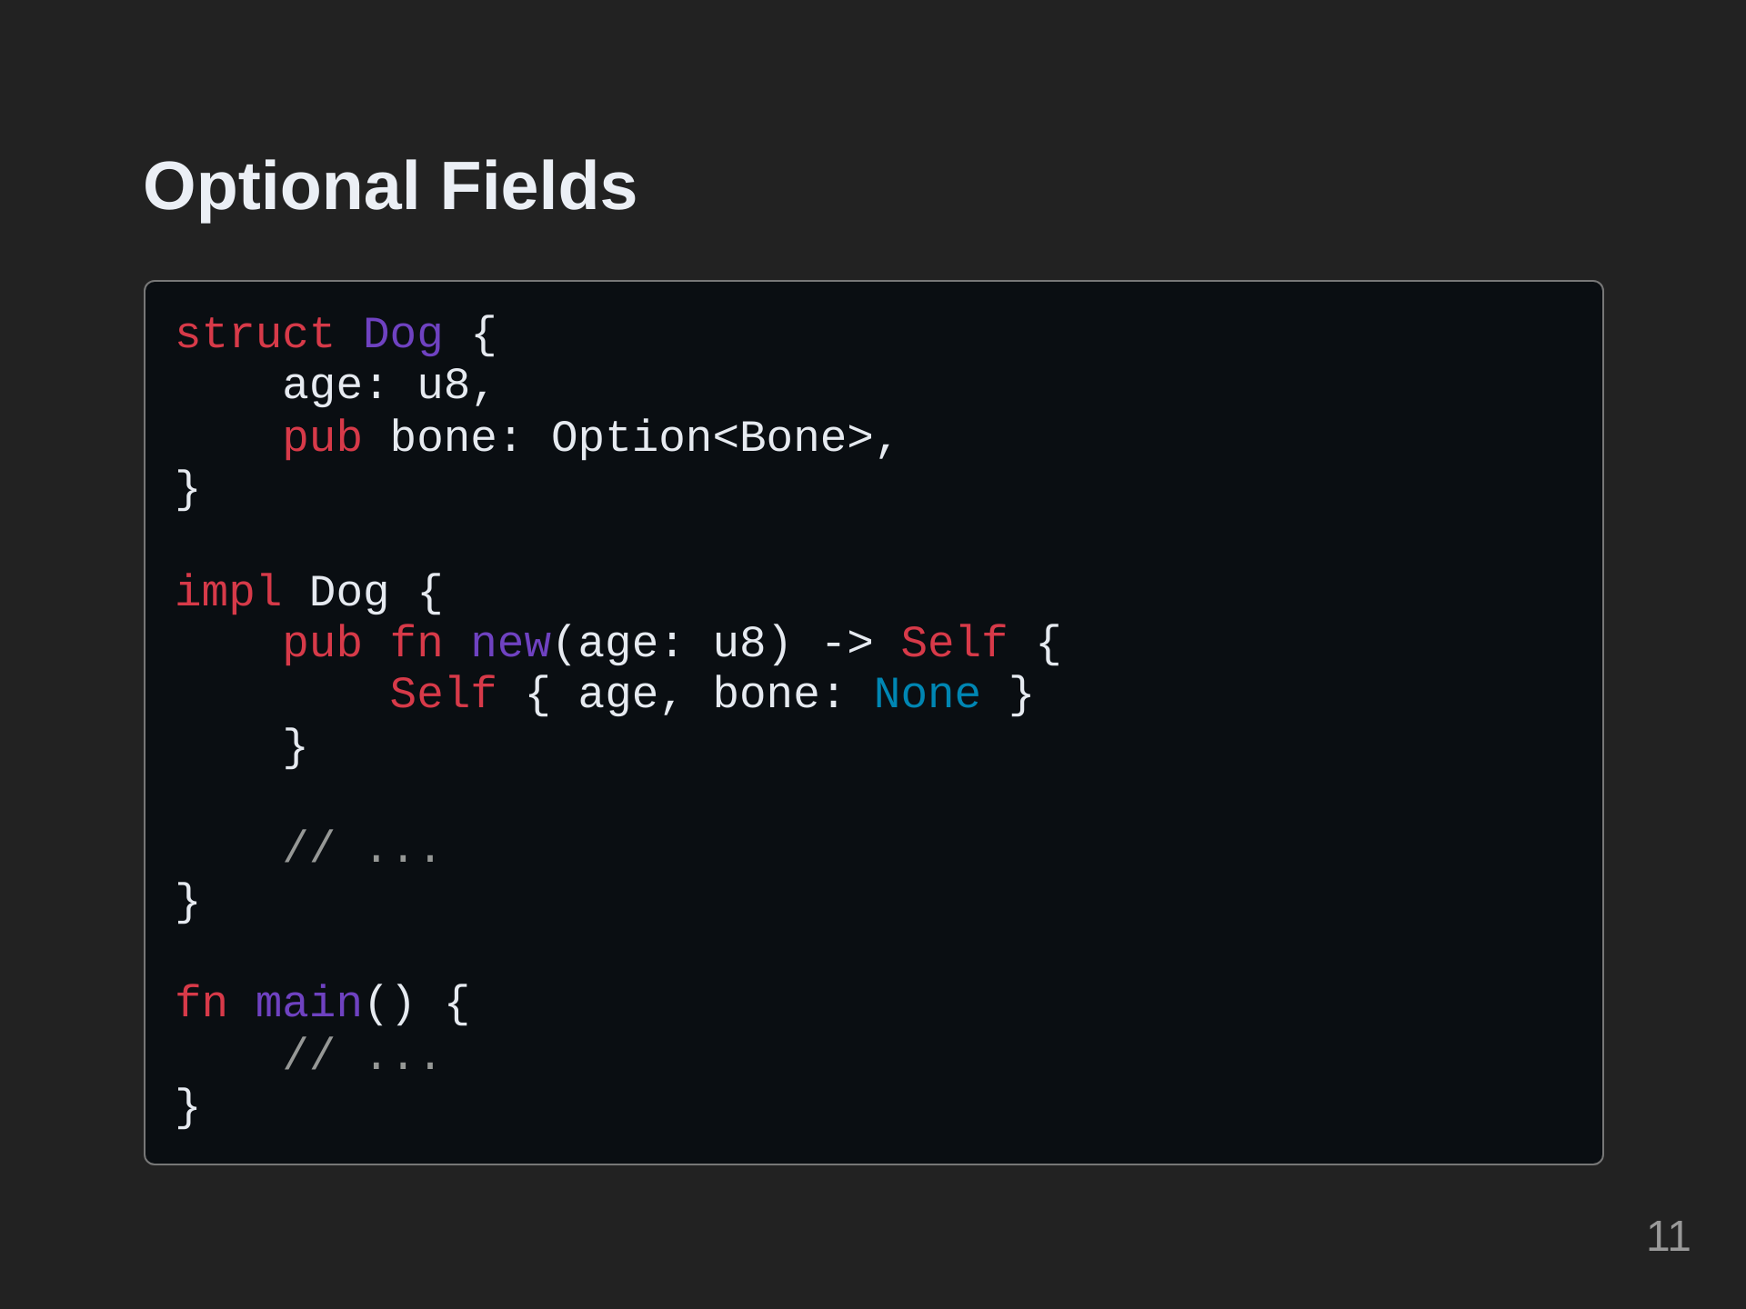
Notes:
Let's add an optional `bone` field to our `Dog`.

Slide 12
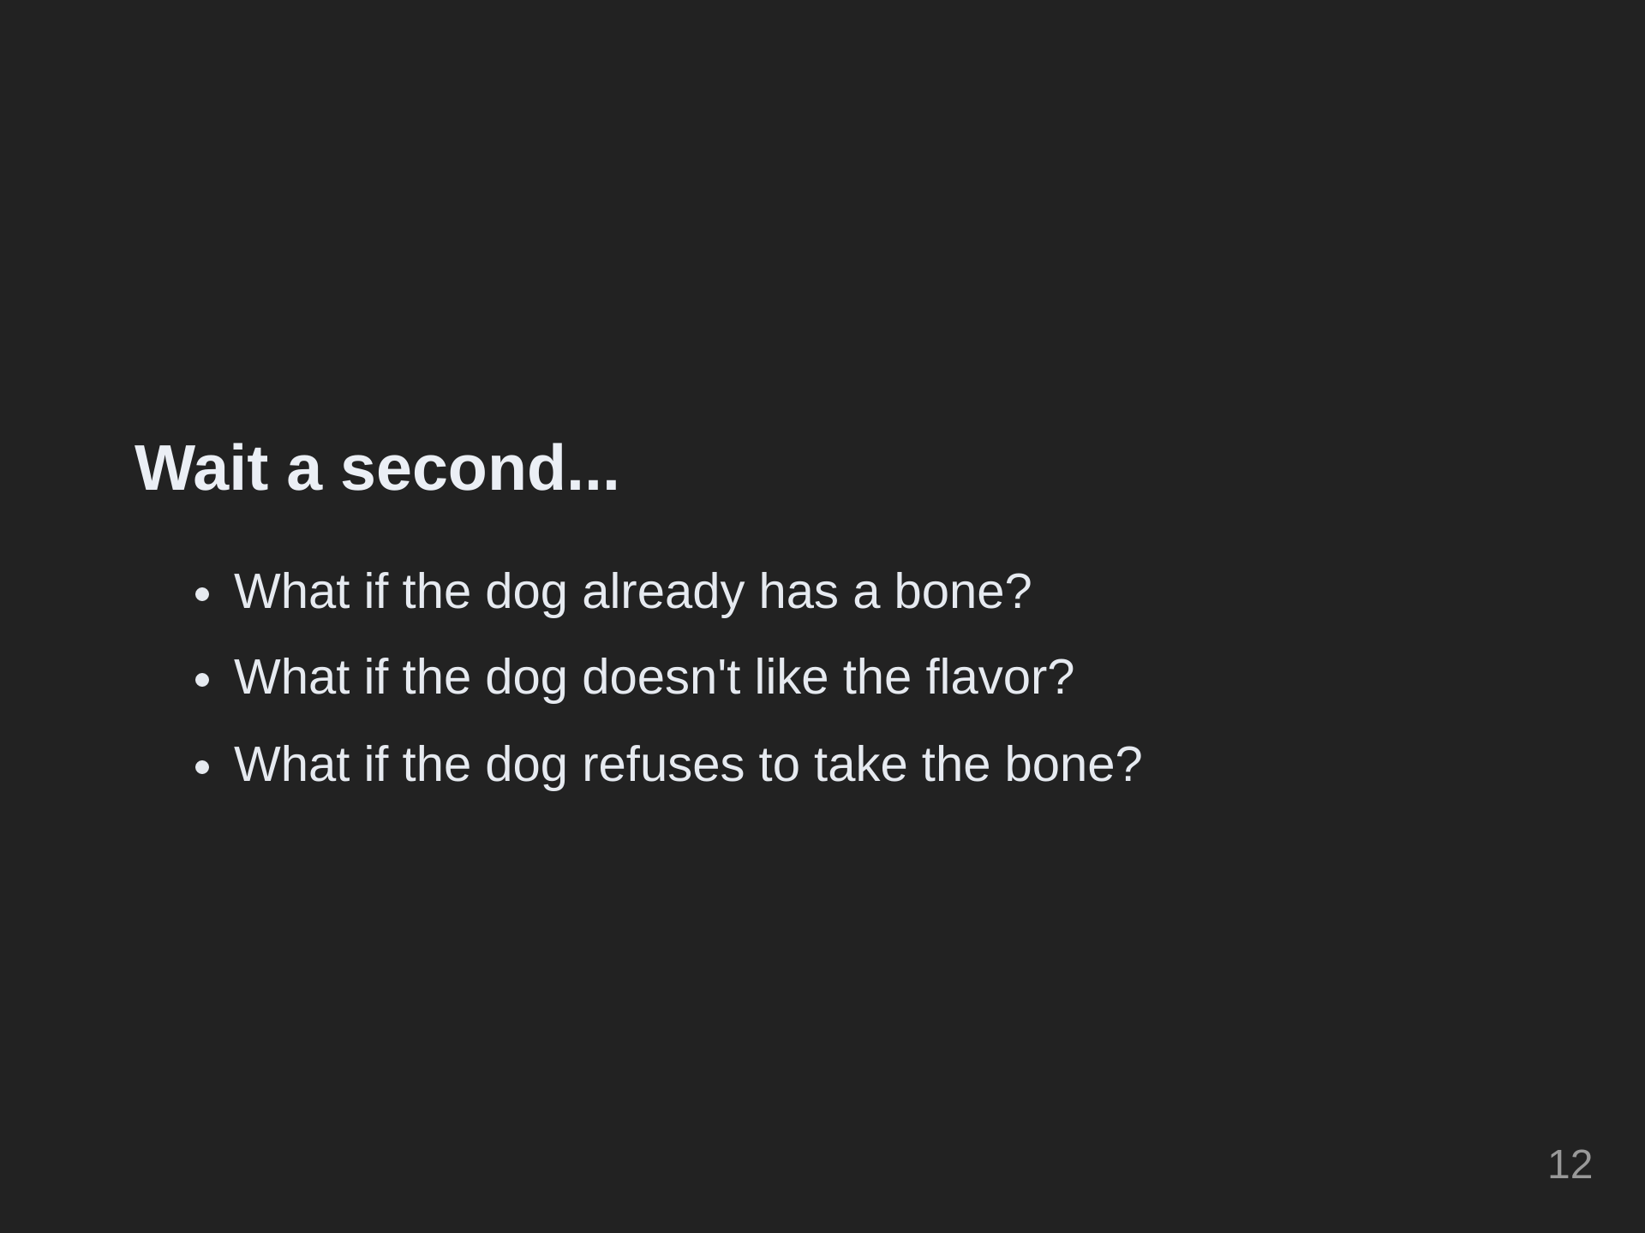
Notes:
Now our dog can hold onto a Bone! However, things get more complicated when we want to start giving and taking bones. What if the dog already has a bone? What if the dog doesn't like the flavor? What if the dog refuses to take the bone? In the next section, we'll cover how to handle fallibility in our program. First, we will take a look at the full program so far.

Slide 13
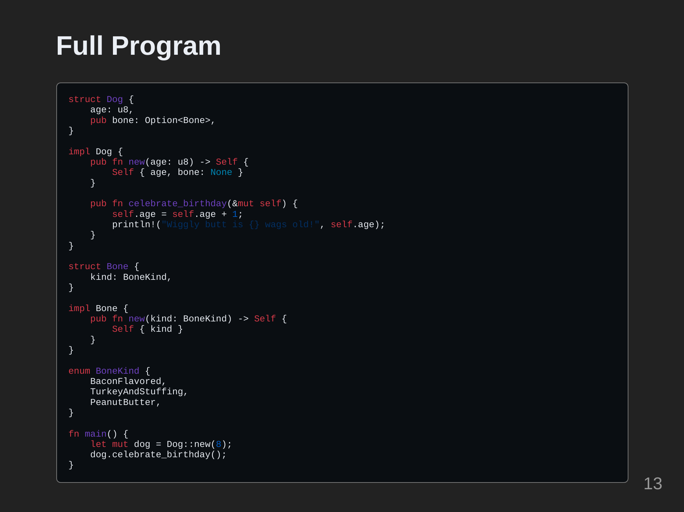

Slide 14
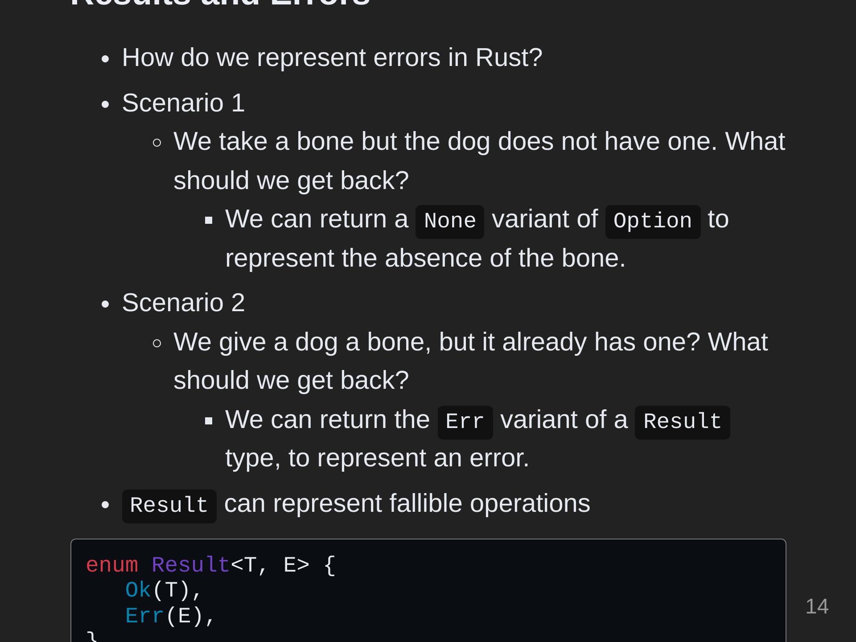
Notes:
Now we want to be able to give the dog a bone and take it away to throw for fetching. These operations can fail for various reasons. We can represent fallible operations by making them return a Result type, and we will specify our own Error type.

Slide 15
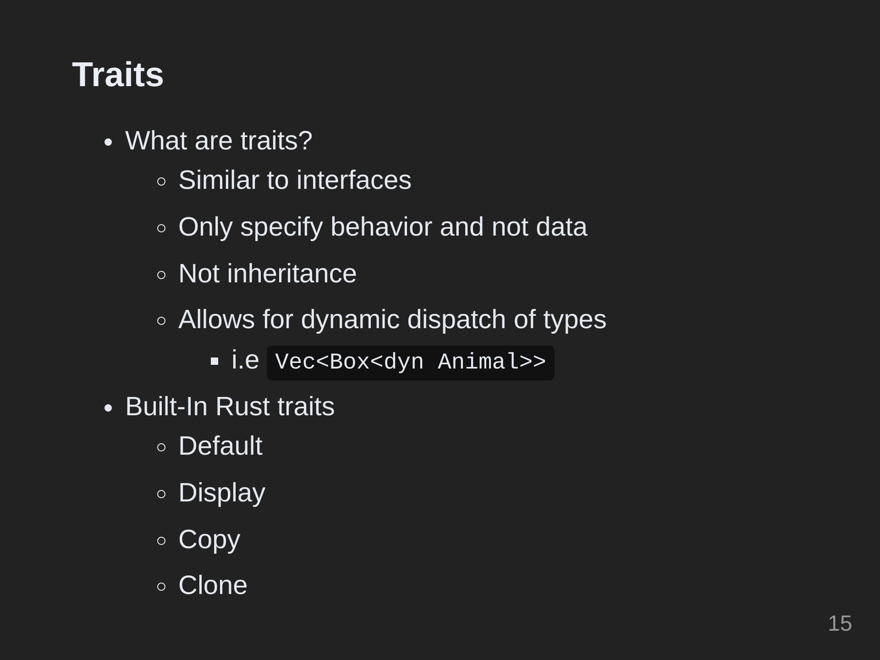
Notes:
To understand the next section explaining errors, we'll need to discuss the concept of traits. Traits are like interfaces in other languages, except in Rust, traits only specify behavior and not data. Traits only represent functions and not variables. There is a `std::error::Error` trait that the Result type uses as a type-constraint on its generic Error parameter. Result can only accept error types that implement the `std::error::Error` trait. For us to create a custom error type we have to implement the `std::error::Error` trait on our AnimalError custom error type. We can implement other similar traits as well, such as Display. Display specifies how an object should present itself in a user-facing for text. The equivalent for debugging is called Debug. Traits allow rust to use dynamic dispatch, which is the process of selecting which implementation of a polymorphic operation (method or function) to call at run time.

Slide 16
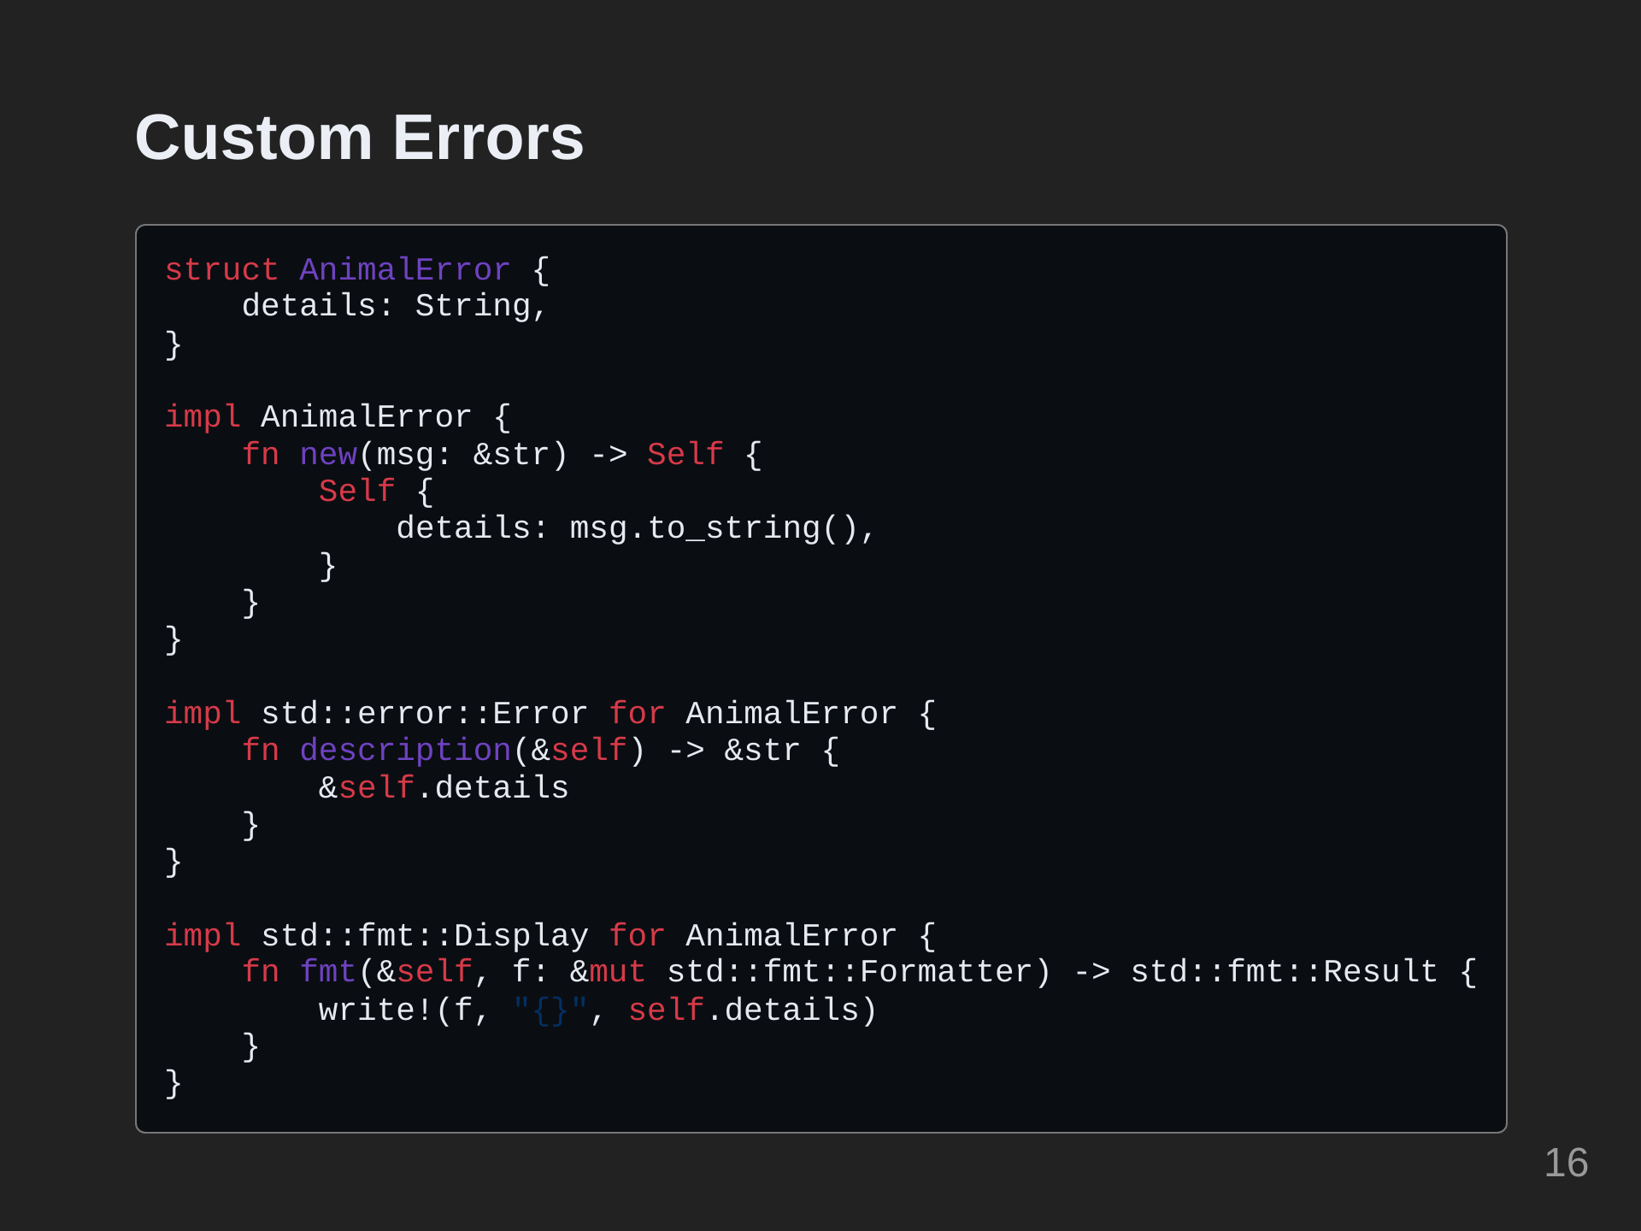
Notes:
To represent an error when interacting with an animal, we can create a custom error type. Here we have a custom `AnimalError` type that stores a string for error details. We also implement Display on it so it can be printed to the console.

Slide 17
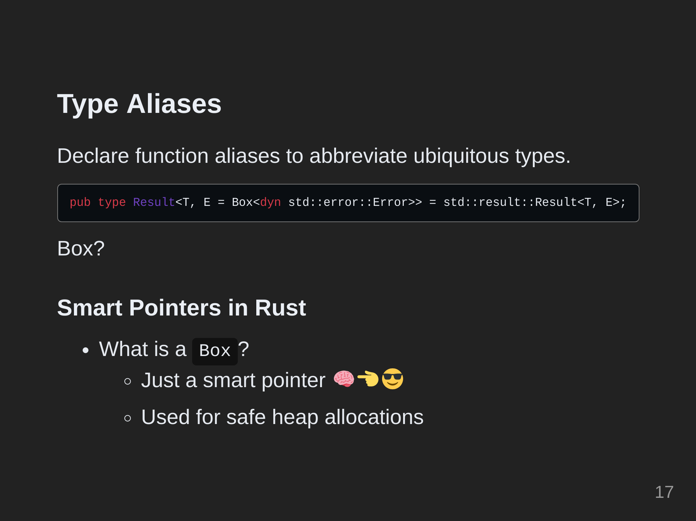
Notes:
To prevent us from having to write the full signature for a Result that uses our custom error type, we can create a type alias at the module root to shorten the signature. In rust, a `Box` is a smart pointer to a heap allocated value of a particular type. This is a value on the `stack` that holds the starting address of a contiguous region of `heap` memory as well as its length. When a box goes out of scope, its destructor is called, the inner object is destroyed, and the memory on the heap is freed. This prevents double free and use after free errors without any extra code. Rust must know the sizes of all values on the stack at compile time. Trait objects can vary greatly in size depending on what data structures they are implemented for. To make them all a known size at compile time, they are contained in a `Box`.

Slide 18
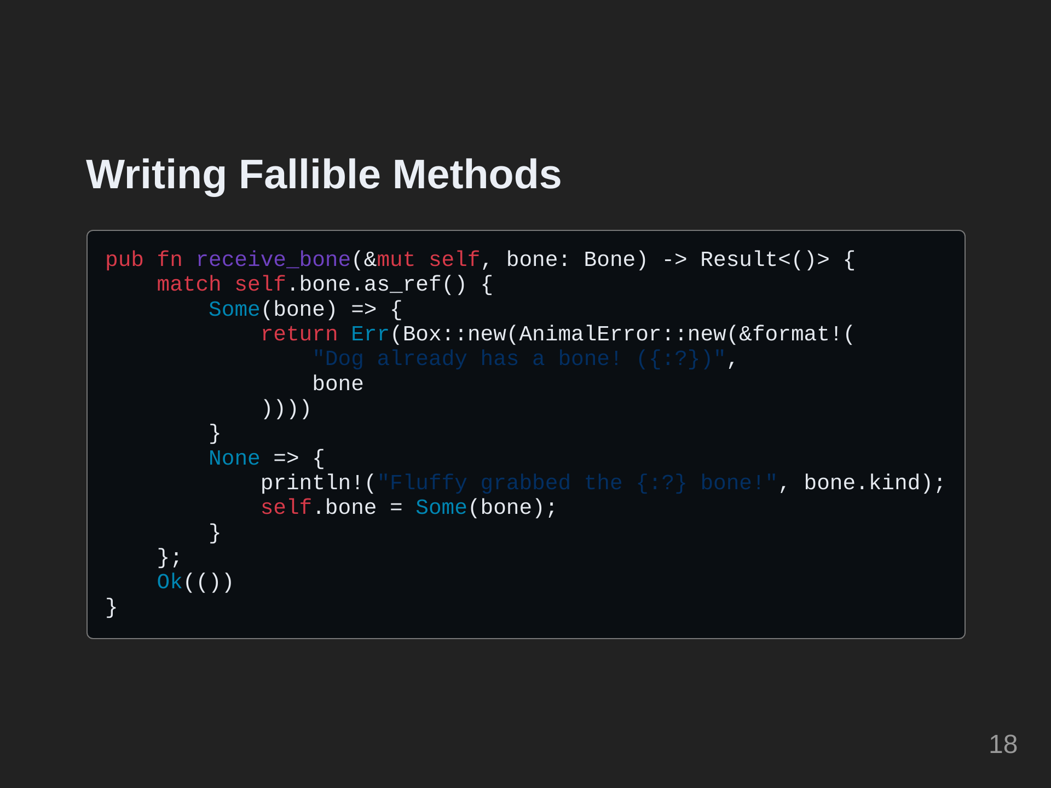
Notes:
With all that in mind, we can now write out methods for giving and taking a bone from a dog.

Slide 19
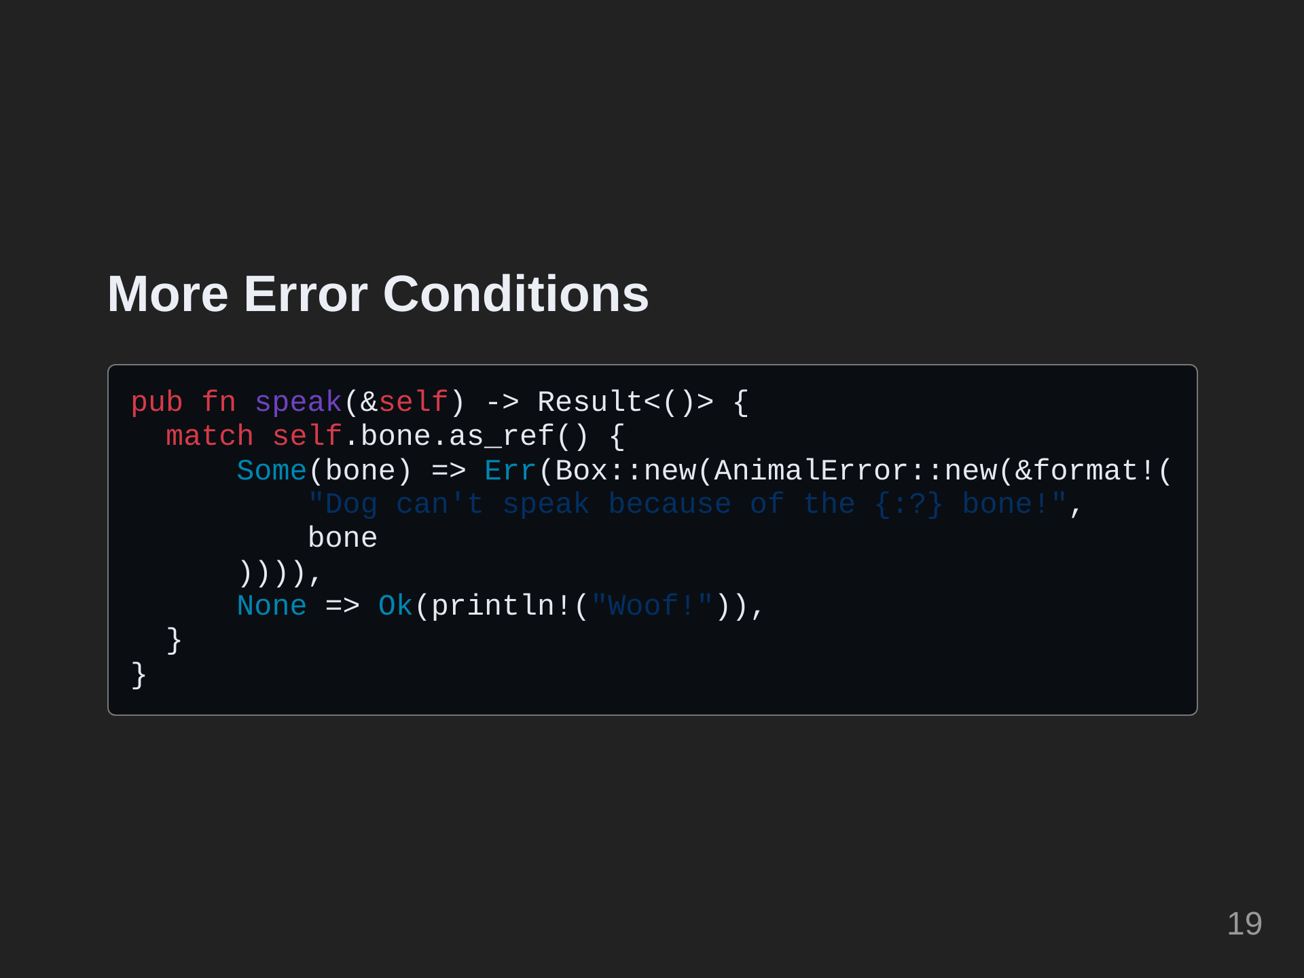
Notes:
Naturally, the dog won't be able to speak while holding the bone. So let's add that now.

Slide 20
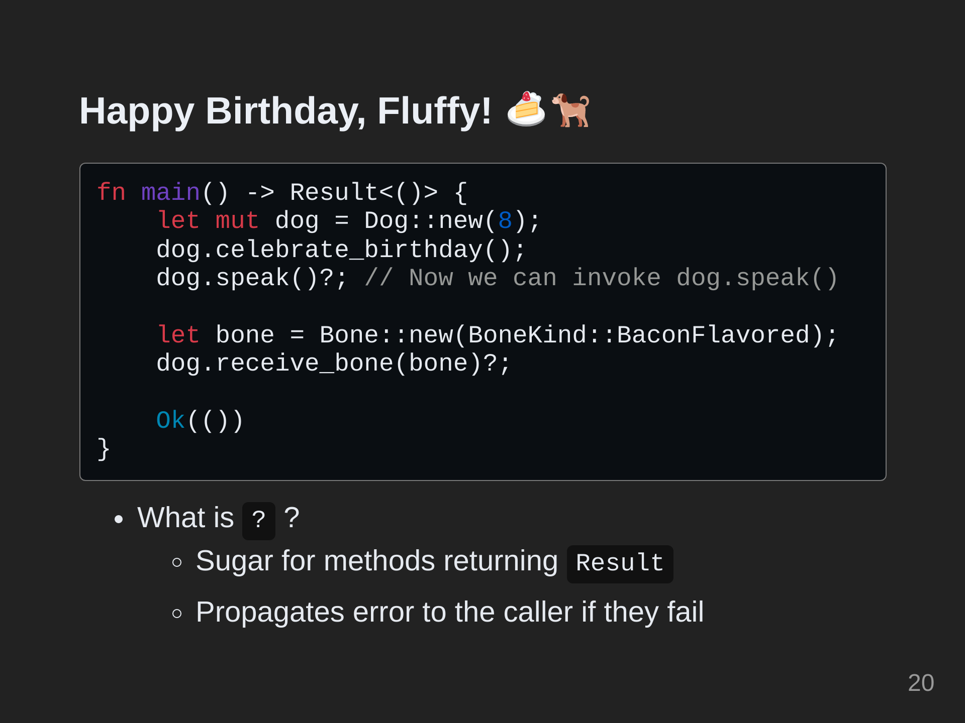
Notes:
Now we can invoke these methods in main with a slight change to the return type of main. Note that the ? operator can invoke fallible methods and forward their errors to the caller if they fail. We can call dog.speak()? now because main has a return type of Result<()>. The function must return a Result, so at the end we use the Ok() variant of Result with the empty type represented by a pair of parentheses like in the signature.

Slide 21
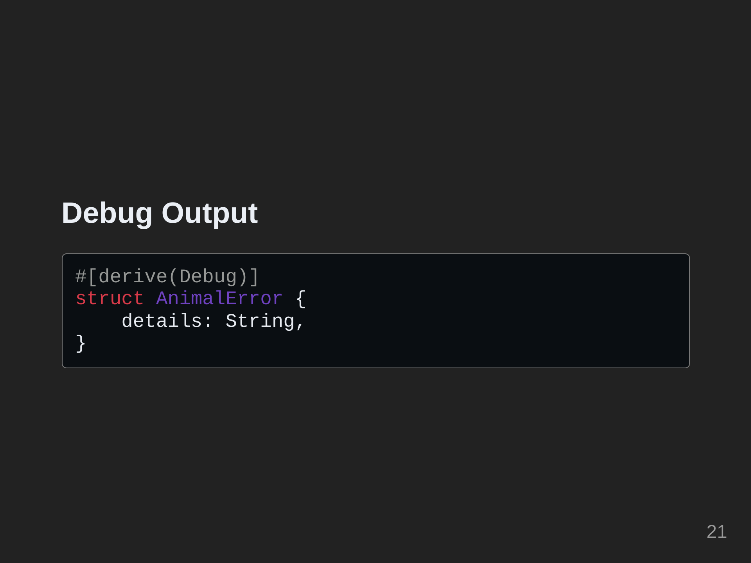
Notes:
Earlier we mentioned that we could get debug representations of types by implementing the Debug trait. Add the #[derive(Debug)] attribute to any struct or plain enum you want to print debug string output for. Its members must also all implement Debug, and Debug is already implemented for all primitives and most types from the standard library.

Slide 22
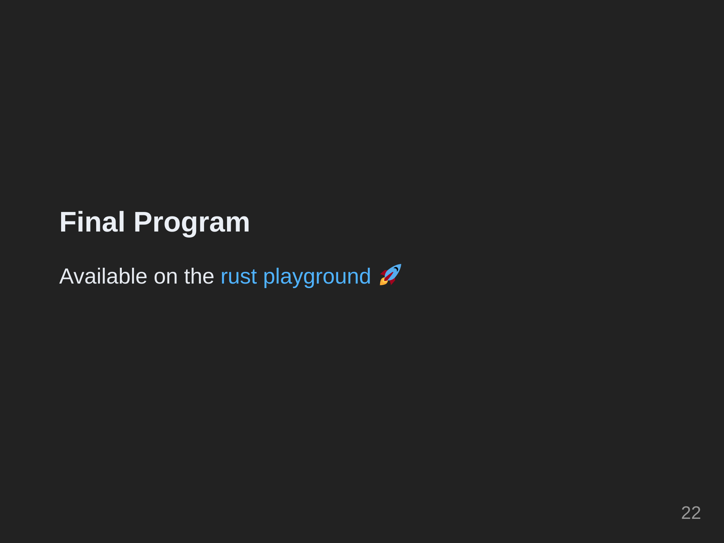

Slide 23
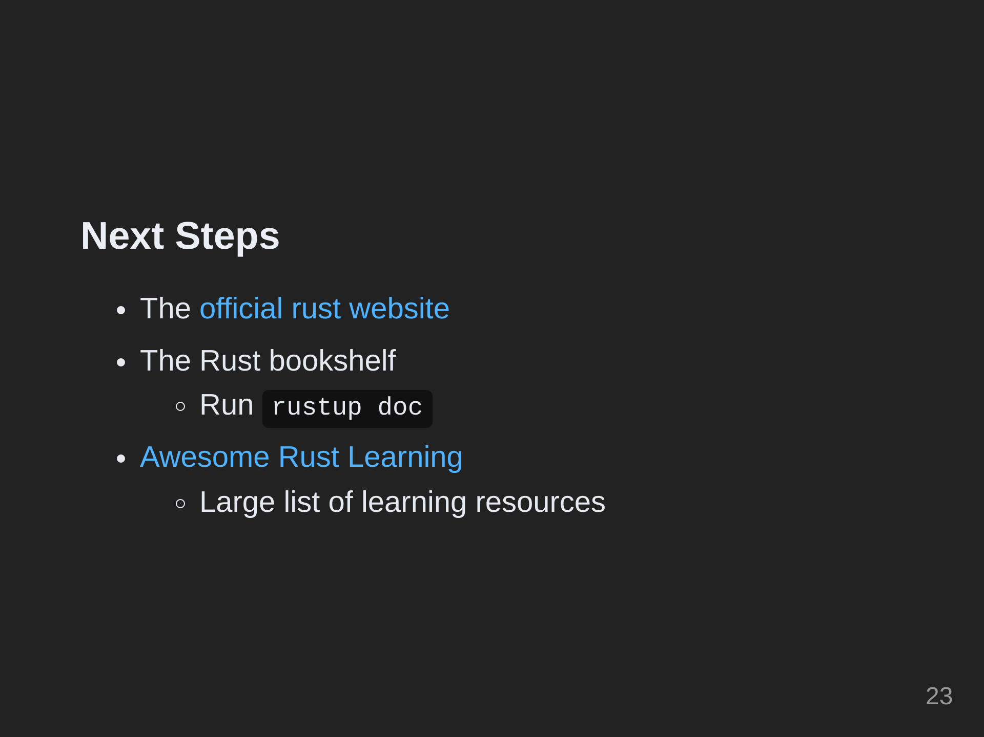
Notes:
Rustup doc will open a page in the browser containing a large collection of standard, official documentation and rust learning resources.

