Slide 1
PPOL 628: Text as Data – Computational Linguistics for Social Scientists
Class 4: Parts of Speech and Phrases

Slide 2
Today
Lecture: key points from readings
Reading discussion
Theory assignment questions
Lab: partsofspeech.R
Website: github.com/matthewjdenny/PPOL_628_Text_As_Data

Slide 3
Parts of Speech
Grammatical Categories for words ←→ parts of speech.
Nouns: ﻿typically refer to people, animals, concepts and things.
Cat, dog, watermelon, car, boat, chair, Matt, Susan, space, time.
Verbs: typically express the action in a sentence.
Run, throw, treat, show, write, walk, climb
Adjectives: Describe the properties of nouns:
Fast, green, interesting, small, hard, frequent
“Substitution test” – determine which words belong in the same class.

Slide 4
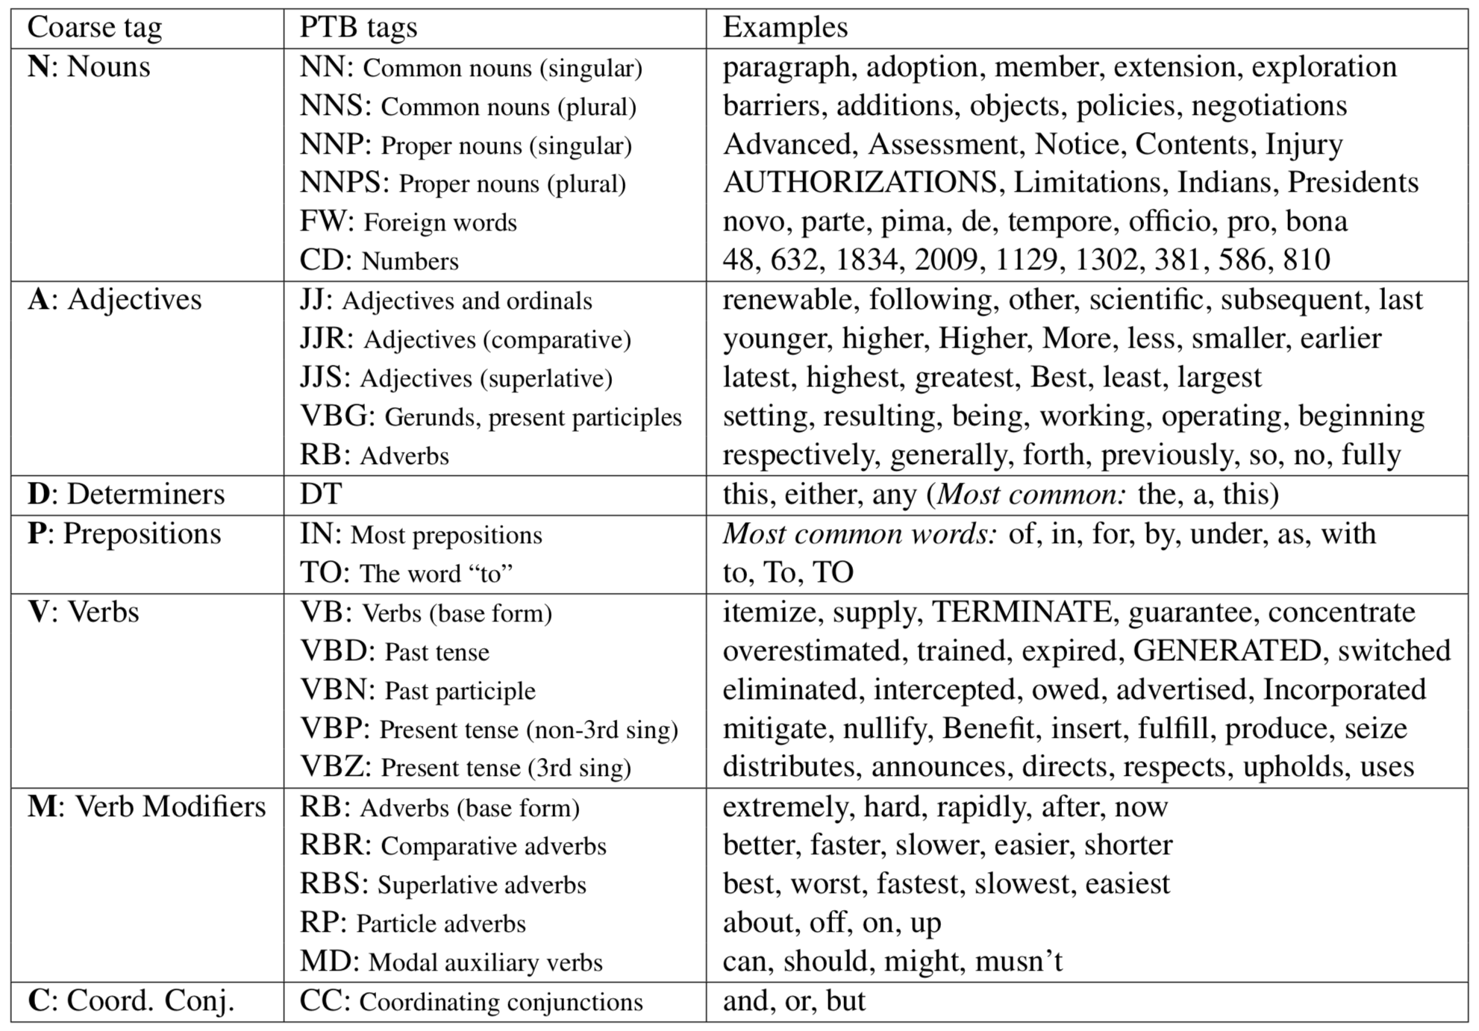

Slide 5
Part of Speech Tagging
Process of assigning a part of speech (POS) “tag” to each word in a document.
Canonical training set of POS tags (in English) is the Penn Treebank (1999) which is maintained by the Linguistic Data Consortium:
https://catalog.ldc.upenn.edu/LDC99T42
In practice, this means employing either hand coding, a heuristic approach, a maximum likelihood model, a neural net, or some combination to assign POS tags to terms.
Quality of POS taggers is dependent on training data
Challenges in other languages, Twitter, etc.

Slide 6
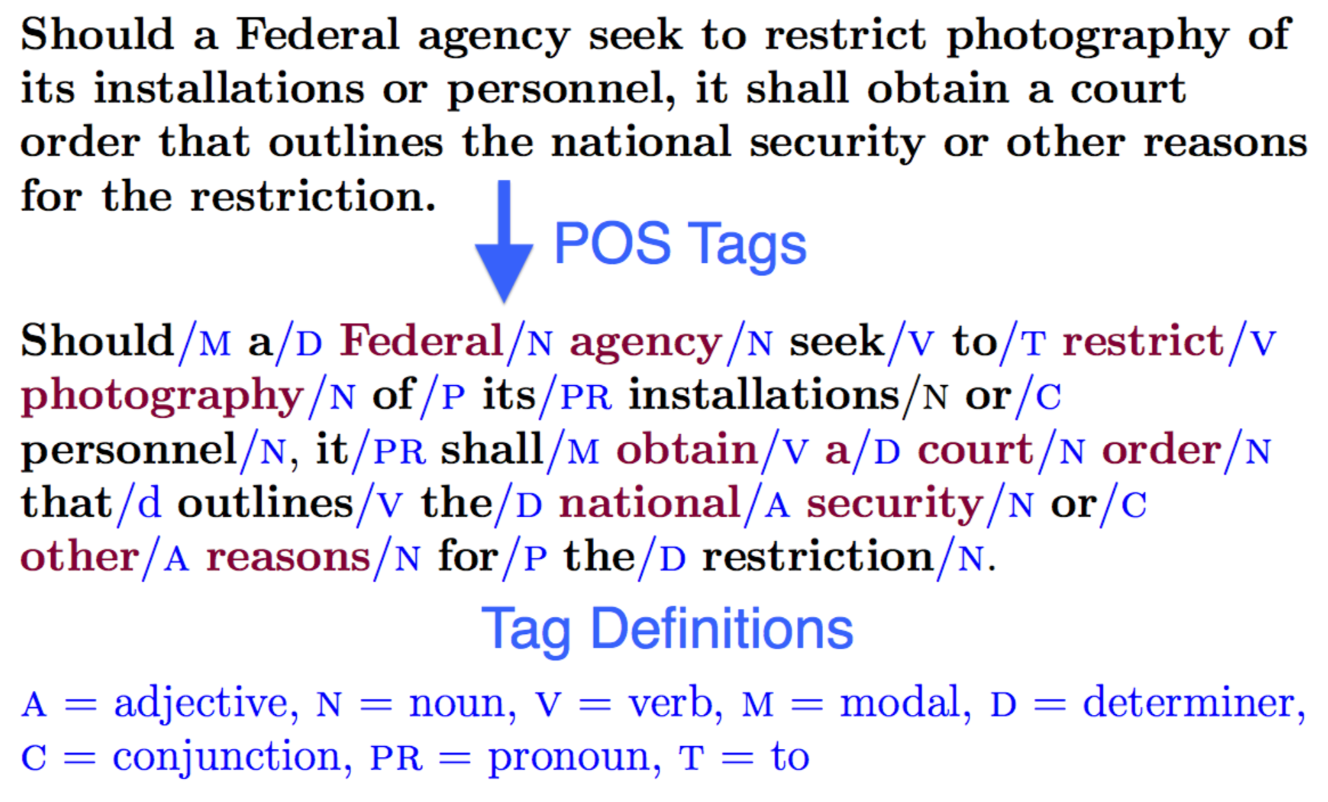
Part of Speech Tagging

Slide 7
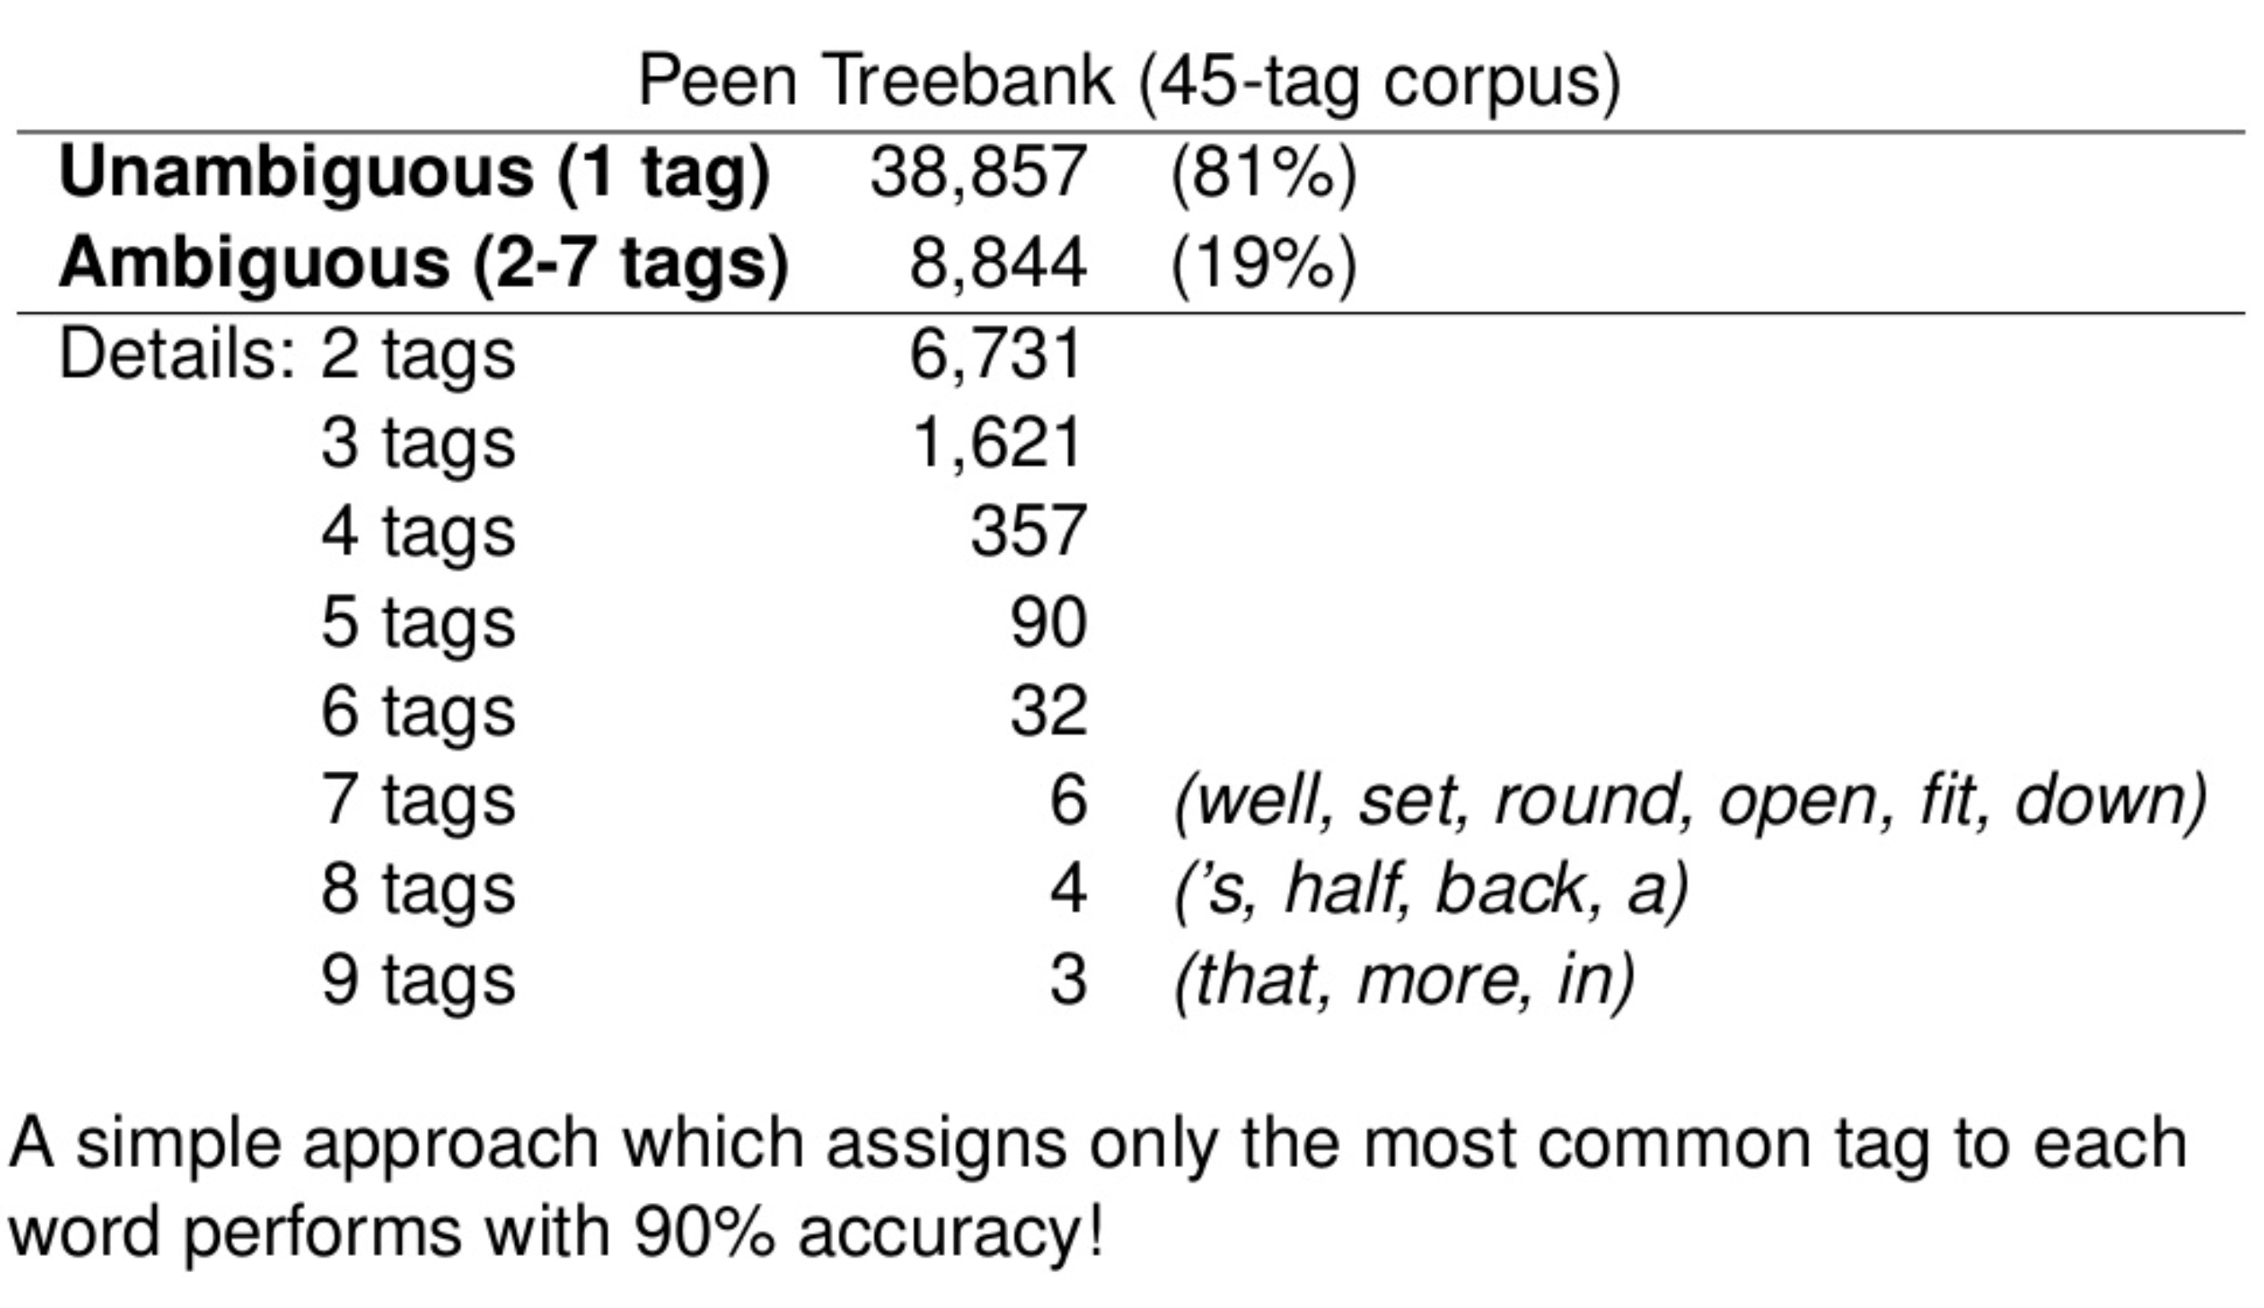
Part of Speech Tagging
https://www.slideshare.net/franciscozamoraceu/a-connectionist-approach-to-partofspeech-tagging

Slide 8
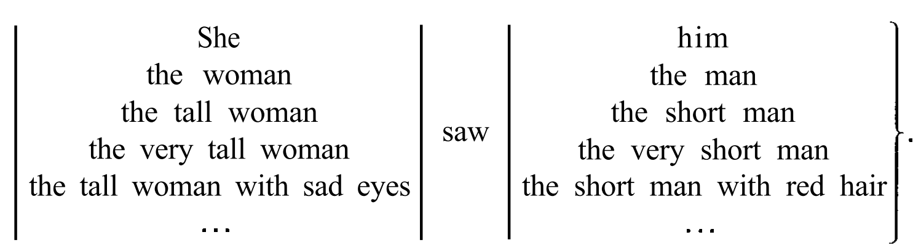
Syntax → Phrases
﻿Syntax is the study of the regularities and constraints of word order and phrase structure.
Phrases are syntactically coherent groupings of words.
Manning and Schutze (1999, p.94)

Slide 9
Phrases
﻿Noun phrases. A noun is usually embedded in a phrase a syntactic unit of the sentence in which information about the noun is gathered. The noun is the head of the noun phrase, the central constituent that determines the syntactic character of the phrase. Noun phrases are usually the arguments of verbs, the participants in the action, activity or state described by the verb.
﻿Verb phrases. Analogous to the way nouns head noun phrases, the verb is the head of the verb phrase (VP). In general, the verb phrase organizes all elements of the sentence that depend syntactically on the verb
Manning and Schutze (1999, p.95)

Slide 10
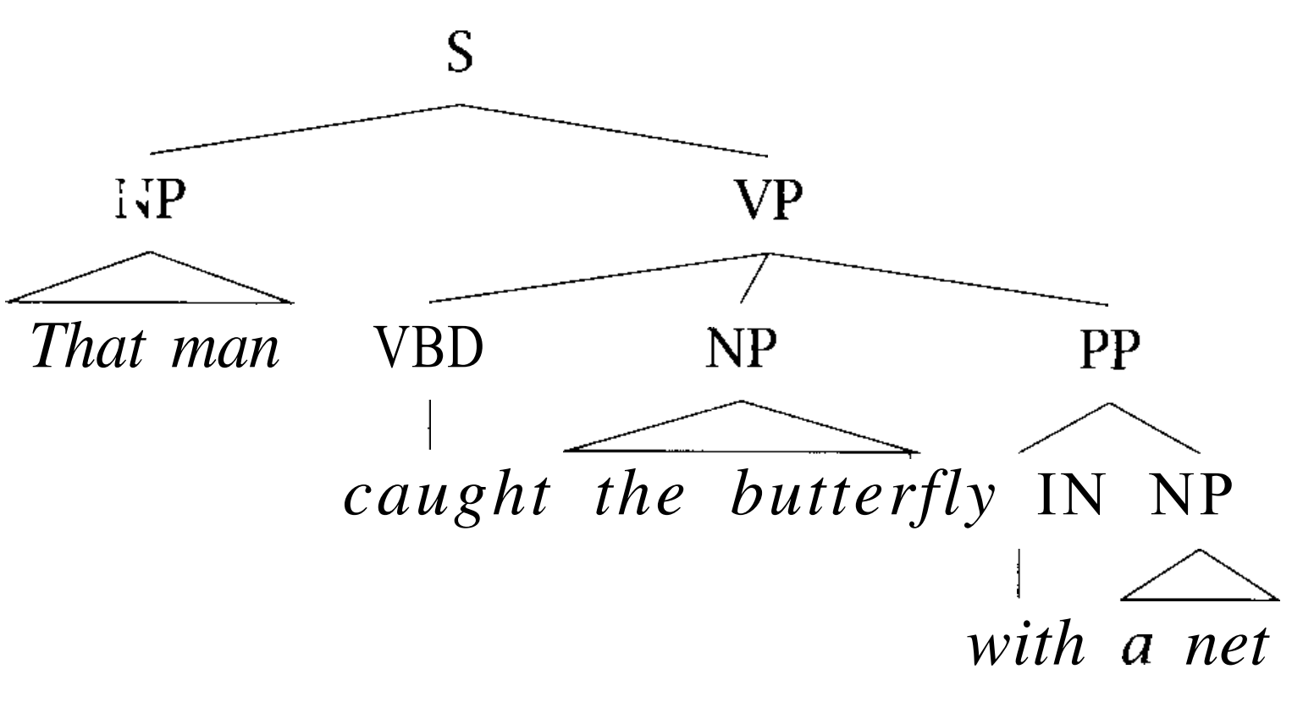
Tree Structure of Sentences
Manning and Schutze (1999, p.95)

Slide 11
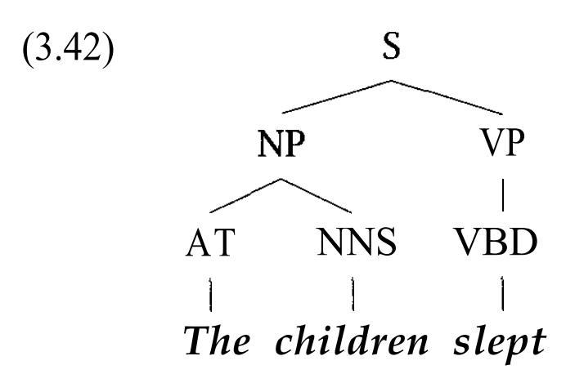
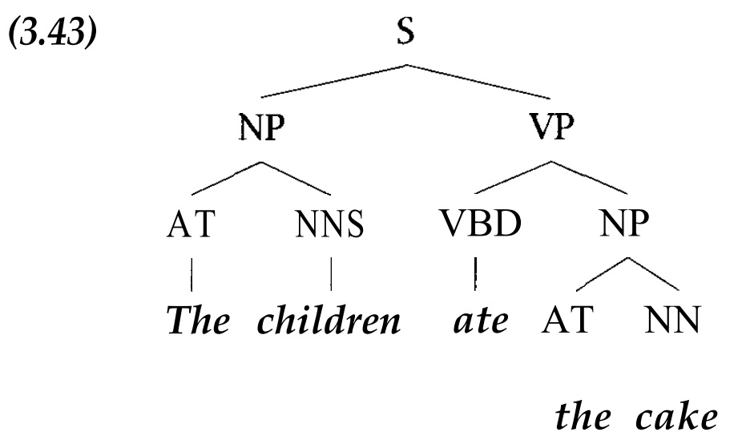
Tree Structure of Sentences
Manning and Schutze (1999, p.95)

Slide 12
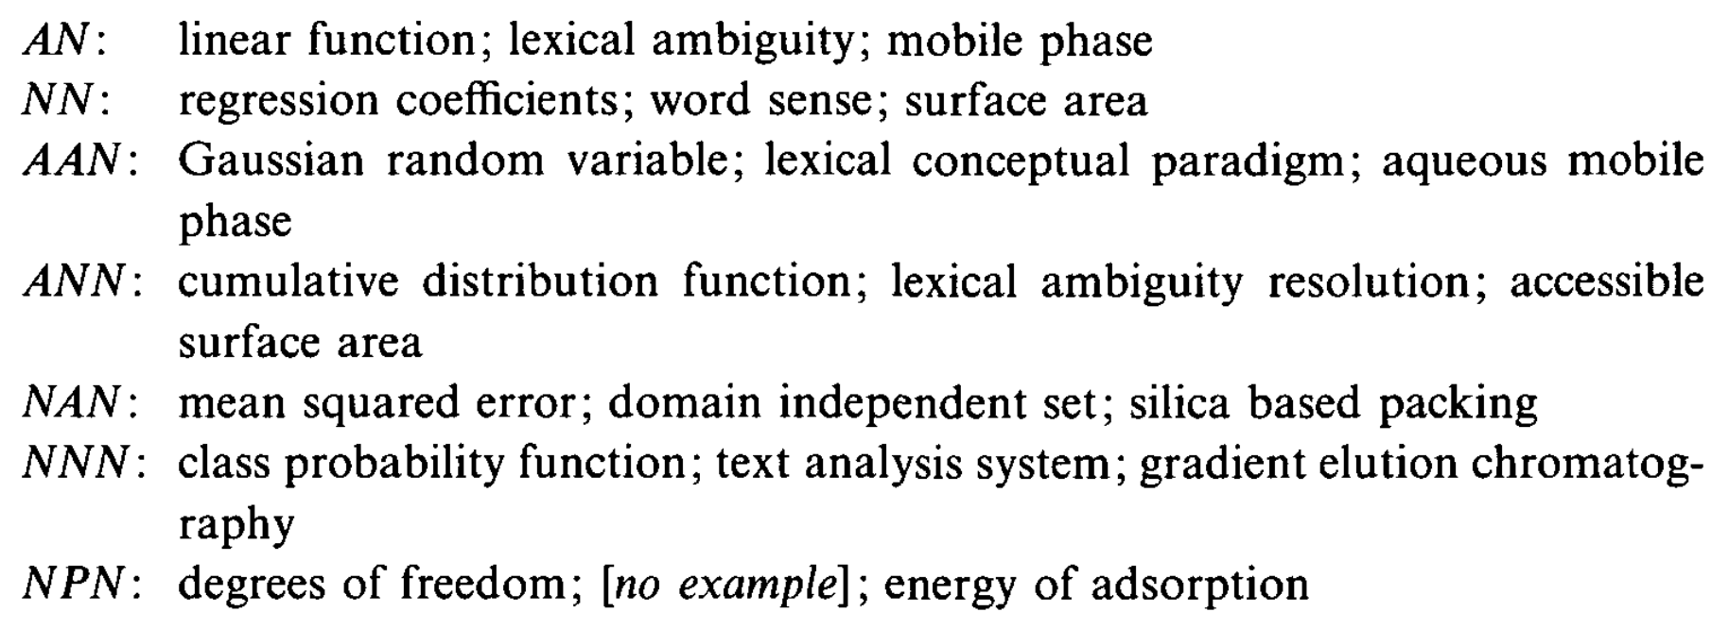
Justeson and Katz (1995) – TERMS
﻿﻿Technical terminology (the kind of stuff you would put in an index) tends to consist of noun phrases).
Simple heuristic algorithm to find these noun phrases efficiently in a document.

Slide 13
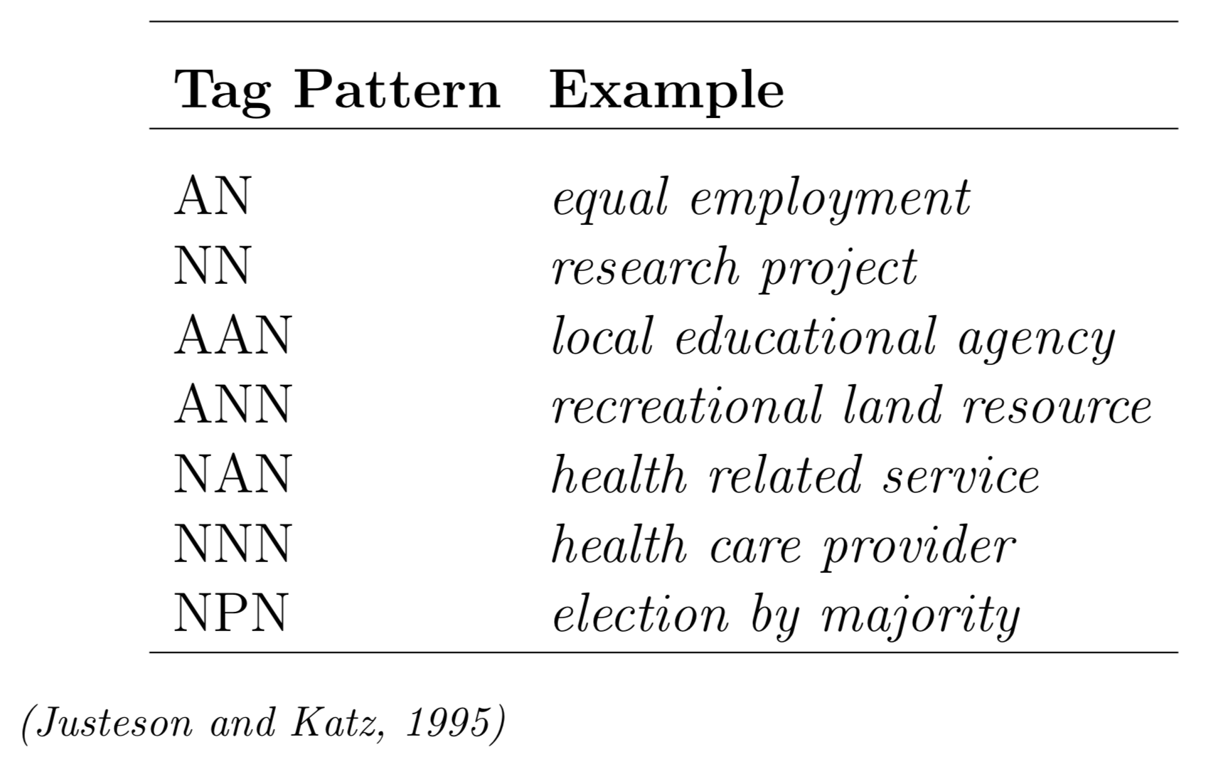
POS Tag Patterns → Noun Phrases

Slide 14
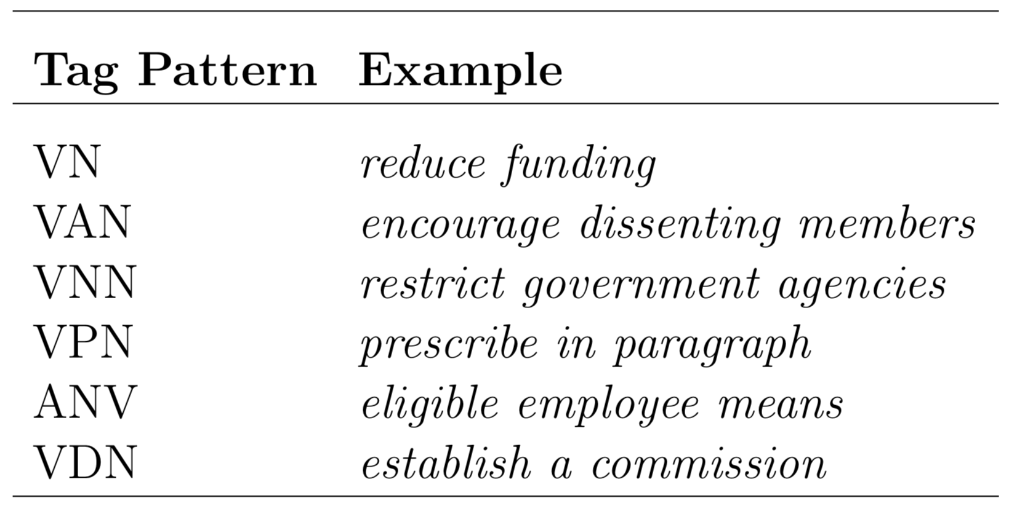
POS Tag Patterns → Verb Phrases

Slide 15
Regular Expressions over POS Tags
﻿﻿Noun Phrases: (A|N)*N(PD*(A|N)*N)*
Zero or more adjectives or nouns, followed by a noun, followed (optionally) by zero or more groups of terms containing a preposition and zero or more determiners, then zero or more adjectives or nouns, and ending in a noun.
Verb Groups: (M(CM)*|V)*V(M(CM)*|V)*
Modifier followed by zero or more coordinating conjunction-modifier pairs, or a verb, all repeated zero or more times, then a verb, then a modifier followed by zero or more coordinating conjunction-modifier pairs, or a verb, all repeated zero or more times.

Slide 16
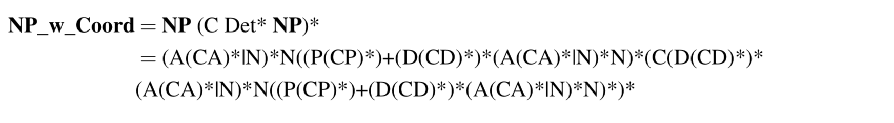
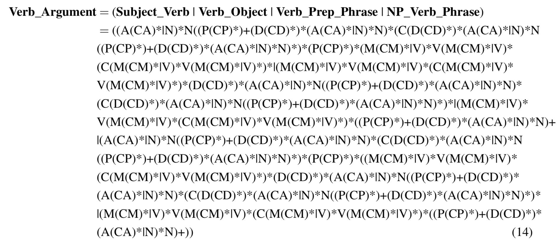
Full Generalization

Slide 17
The Readings This Week
Manning & Schtze, H. (1999). Foundations of Statistical Natural Language Processing. Chapter 3.
Justeson, J. S., & Katz, S. M. (1995). Technical terminology: some linguistic properties and an algorithm for identification in text. Natural Language Engineering, 1(01).
Handler, A., Denny, M. J., Wallach, H., & OConnor, B. (2016). Bag of What? Simple Noun Phrase Extraction for Text Analysis. EMNLP + CSS

