Slide 1
PPOL 628: Text as Data – Computational Linguistics for Social Scientists
Class 5: Dictionaries and Sentiment Analysis

Slide 2
Today
Follow-up questions about phrases, rJava, etc.
Lecture: key points from readings
Reading discussion
Lab: dictionaries.R
Website: github.com/matthewjdenny/PPOL_628_Text_As_Data

Slide 3
Dictionary Based Methods
How did we get here? Qualitative coding and analysis.
The simplest dictionary method – grep.
Constructing dictionaries.
Supervised vs. dictionary vs. unsupervised methods.
Sentiment analysis.
Some takeaways.

Slide 4
Hand Coding →
Research question →
Relevant information in text →
Coding guidelines →
Data collection and validation →
Analysis
One natural extension is to use hand coded documents as a training set for supervised methods.
Another approach is to manually formulate dictionaries, then use counts of those words in documents as scalable approach.

Slide 5
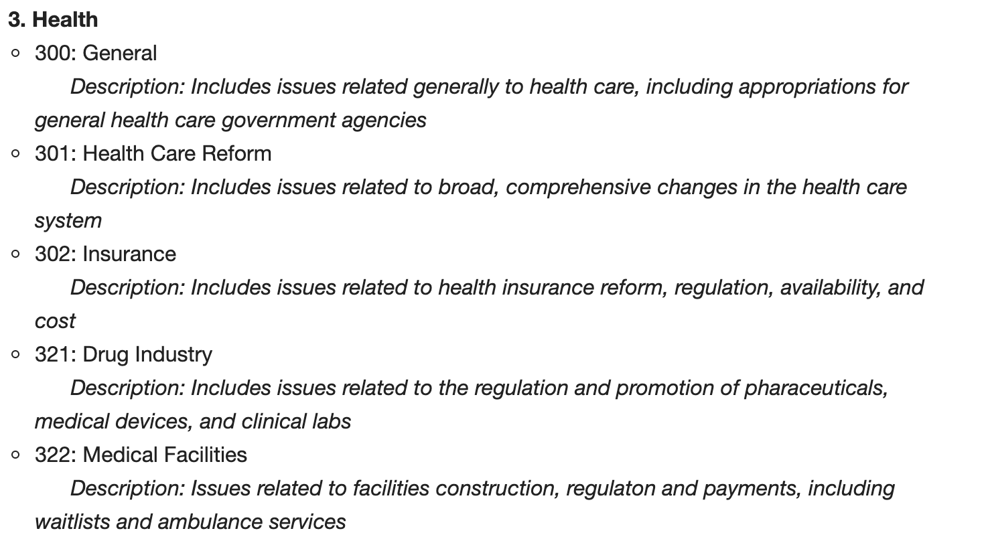
https://www.comparativeagendas.net/pages/master-codebook

Slide 6
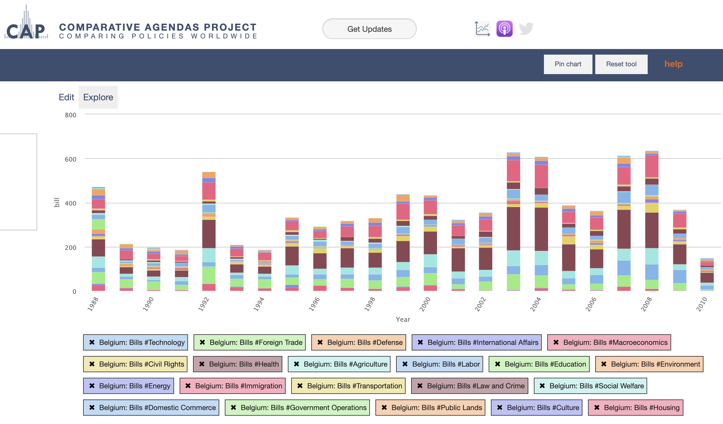
https://www.comparativeagendas.net/tool/fRWkfk8T

Slide 7
Dictionary Methods as Preprocessing and Analysis – grep
grep has been around since 1974 – simplest form of dictionary method is to check for whether/number of times a single word appears in each document.
Using grep()/stringr::str_extract_all() allows you to match arbitrary character sequences/regular expressions.
If all you care about is the use of a well defined set of terms, you just use this approach and have total control/flexibility over how terms are matched.
Key challenge is in construction of dictionary.

Slide 8
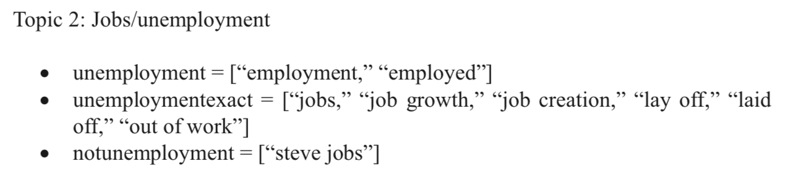
Gou et al. Dictionary Creation
A-priori – 16 major issue areas from literature review.
Stem, remove punctuation, numbers, special characters, “stopwords”.
Only look at words that appeared more than 1,000 times.
Look at top terms and determine which ones should go with which issue areas:

Slide 9
Supervised vs. Dictionaries vs. Unsupervised
Supervised: Hand coding documents and then training a model on features of those document to predict class of unseen documents.
If you have a good coding scheme and enough coders, works really well.
Dictionaries: Come up with a list of terms and look for them.
Strongly depends on ability to generate good dictionary.
Better performance when looking for specific content over general classification.
Unsupervised: Computer determines clusters of words that co-occur, user interprets.
Good for discovery, can feed into dictionaries, has its own problems we will learn about!

Slide 10
Sentiment Analysis
Basic Idea: some words have positive/negative valence.
We can create a dictionary of words of each type.
Then count how many words of each type appear in each document.
Take difference in proportions.
From Young and Soroka:
“Net tone,” our core measure of automated tone, is the proportion of positive words minus the proportion of negative words in an article, that is: (# positive words/all words) − (# negative words/all words).24 So a score of −2.4 for crime means that, on average, in crime stories there is a 2.4-percentage-point gap between the number of negative words and the number of positive words.

Slide 11
Sentiment Analysis (continued)
Challenges and Limitations:
Dictionaries mostly not portable to other languages.
Some words have different valence in different contexts (e.g. Twitter, News, Sports Television, young vs. old people, etc.)
Tricky to handle negation, sarcasm:
That was so not cool!
Yea that hat totally looks “great” on you.
Emotional words may have little correlation to emotions in some domains (e.g. social media).
Beasley et al (2016) “Inferring Emotions and Self-Relevant Domains in Social Media: Challenges and Future Directions”

Slide 12
My Take
With advent of topic models and other unsupervised methods, people have moved away from dictionary methods.
We should use dictionaries more often.
Creating a dictionary can be an iterative process.
New field of CS research called “query expansion”.
Start with seed terms, use topic models for expansion, manual/KWIC checks.
Dictionaries are especially useful when you have a limited number of categories you are interested in.
Sentiment analysis via dictionaries: be careful with interpretation.
Still lots of work to do in this field, still very important.

Slide 13
The Readings This Week
Young, L., & Soroka, S. (2012). Affective News: The Automated Coding of Sentiment in Political Texts. Political Communication
Guo et al. (2016) Big Social Data Analytics in Journalism and Mass Communication: Comparing Dictionary-Based Text Analysis and Unsupervised Topic Modeling.

