Slide 1
PPOL 628: Text as Data – Computational Linguistics for Social Scientists
Class 9: Supervised Learning

Slide 2
Today
Lecture: an overview of supervised learning for text.
Lab: supervised_learning.R
Website: github.com/matthewjdenny/PPOL_628_Text_As_Data

Slide 3
Supervised Learning with Text
What it is: Using document covariates (such as term counts in those documents) to predict a label for those documents.
Prerequisites: You need to have training data.
Usually in the form of some number of hand labeled documents.
Can also take the form of document metadata (labels assigned by some other process).
When we use it: For problems where we cannot just mechanically look for the answer in the text, and where we care about a categorical class label at the document level.
e.g. document was ESL author vs. most important topic is the economy.

Slide 4
Supervised Learning with Text (continued)
Binary vs. Multiclass: How many different categories you want to make predictions for.
Binary is most common, by far the easiest. Multi-class can be turned into binary problem.
Multiclass: the more classes you have, the harder the problem and the more training cases you need.
Key challenges with text: high dimensionality, worse sense ambiguity.
Removing stop words and infrequent terms, regularization.
Be careful about preprocessing with respect to term ambiguity, with respect to prediction problem (e.g. same word has different meanings across contexts).
Generalization to new documents (vocabulary overlap).

Slide 5
Collect Documents
Collect New Documents
Preprocess Text Data
Evaluate Performance
Make Predictions on Unlabeled Data
Form Test/Train Splits
Train Classifier
Sanity Checks
Generate Training Data Labels
Use Predicted Labels
Active Learning

Slide 6
Constructing Training Data
Determine what to annotate
Need a theory about what categories you expect.
Need enough examples from each category.
Formalize annotation instructions
Write them down! Provide examples, talk through how to adjudicate unclear cases.
Perform pilot annotation
Need to assess how quick it is to annotate a single document, and how much training a person needs to do the annotation.
Need to determine whether coders are able to agree on annotations.
Annotate data
Assess inter-coder reliability
If inter-coder reliability is unacceptably low, need to improve instructions, better coder training, recode data.
Release data

Slide 7
Preprocessing Text
Tradeoff between including lots of features which may improve performance, and tractability/speed.
Generally want to remove terms that will not help distinguish classes.
Very infrequent terms are often not useful.
Including n-grams (1-3 is usually sufficient), phrases will typically improve performance.
Think about terms that may be used in different contexts in different classes – may want to remove these terms or only include in n-grams.
Now is the time to experiment with different preprocessing specifications and see which ones yield highest accuracy/AUC.
Can combine text data with metadata to train model.

Slide 8
Classifiers
There are many different classifiers out there – no one best classifier for all use cases.
Text features are interpretable, so may want to prioritize models where we can assess feature importance.
Number of distinct features will often be larger than number of documents, so you will want a classifier that can handle this.
Regularization: Penalty that shrinks most feature parameters to zero.
It’s ok to try a few different classifiers, compare performance.
LASSO (glmnet) and boosted trees (xgboost) are common classifiers used with text – handle large numbers of features well.
This is not a class about machine learning – I expect you have/will put in the time to learn how to use classifiers appropriately.

Slide 9
Iteration and Active Learning
Because we have a well defined problem (maximize classifier accuracy), it is ok to iterate, tweak things.
This only holds so long as you evaluate on held-out data/employ cross validation.
Active Learning: train an classifier, classify new documents, use the newly classified documents as input to be coded and added to training data, repeat until classifier is stable.
Useful if you are trying to classify a rare class – can be hard to get enough positive cases. Using predictions to find new positive cases to code can iteratively improve model performance.
Want to keep going until you do not add many/any new cases.
Calculate accuracy on final test split.

Slide 10
Sanity Checks
Look at results, spot check some predictions to see if they make sense on new data.
Apply coding criteria to cases classifier found difficult.
Can feed back into Active Learning process.
Can report results as a robustness check.
Come up with tests based on available metadata
Try to think of associations that should theoretically hold between your class labels and some other available metadata and check to see if they hold.
For example, if you expect that 5-10% of your documents should be in a particular class and you see 40%, need to investigate and square with your theory.
Report all sanity checks in your write up.

Slide 11
Types of Classification Problems
Infrequent class(es) of interest: The class(es) of documents that you care about identifying are relatively rare within the corpus.
Assess source of errors. May want to employ active learning.
Balanced classes: All of the classes occur with reasonably similar frequency in the corpus.
Relative importance of false positives vs. false negatives.
False positives worse – favor high precision, low recall. Example: classifying a document as terrorist recruitment materials.
False negatives worse – favor low precision, high recall. Example: identifying hate speech for further review.

Slide 12
Assessing Classifier Performance
Metrics: Accuracy, precision, recall, AUC, experiments.
Report/evaluate based on multiple measures.
Different applications → different points on P/R curve.
Held out test set, cross validation and generalization error:
Always evaluate model performance on something other than training set.
Selecting a high quality training set:
Enough cases, representative sample, labels not derived from input features.
Active learning as an option: repeated optimization.
Helpful resource: http://brenocon.com/confusion_matrix_diagrams.pdf

Slide 13
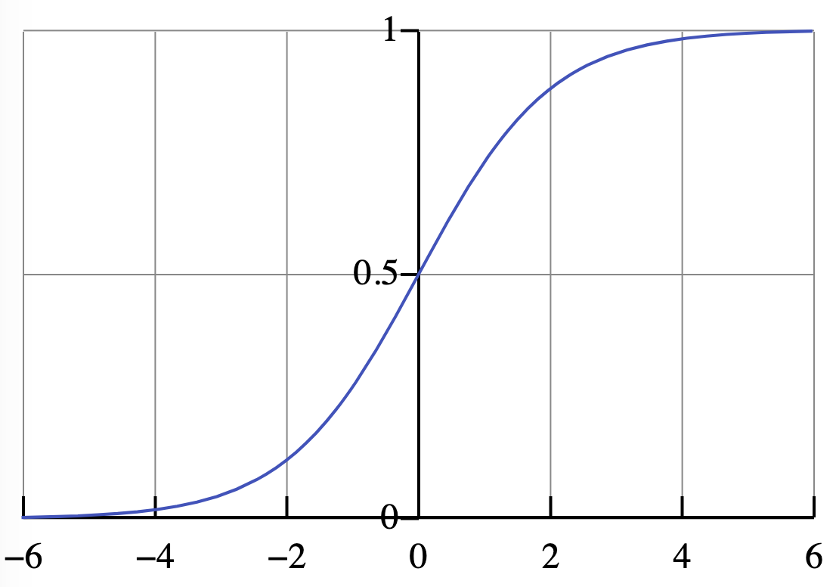
Performance is Always Relative to a Threshold
All classifiers output a score which can be transformed into a probability of being in a class (easy to see with logistic regression).
In order to make 0, 1 predictions, we have to select a classification threshold.
Choice of threshold can have significant impact on accuracy, precision, recall.

Slide 14
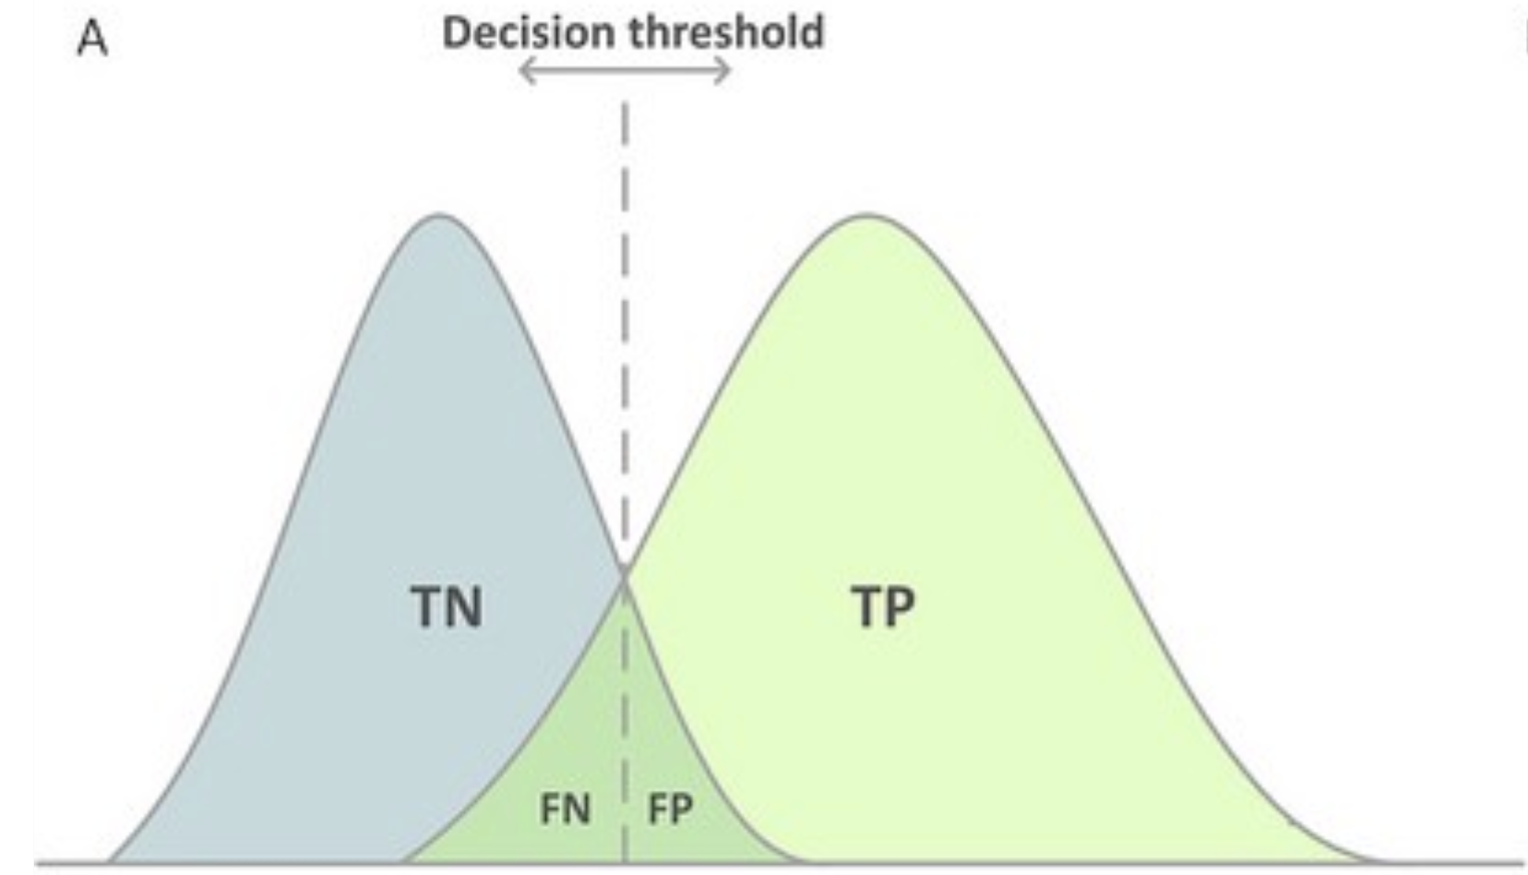
Performance Depends on Threshold Selection

Slide 15
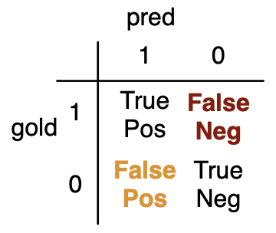
Confusion Matrices:
Predicted vs. Observed
True Positive: prediction in class matches human label in class.
True Negative: prediction not in class matches human label not in class.
False Positive: prediction in class does not match human label not in class
False Negative: prediction not in class does not match human label in class.

Slide 16
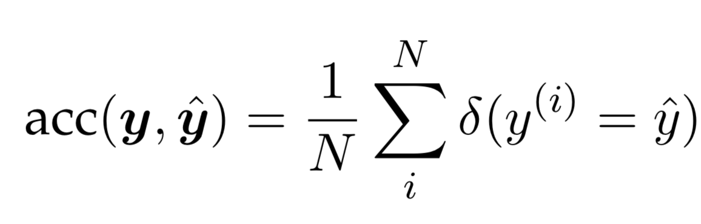
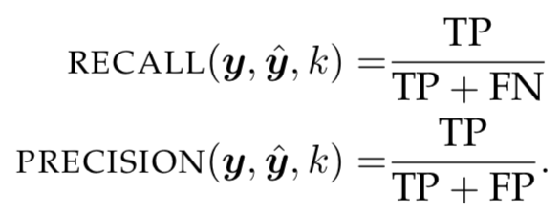
Accuracy, Precision, Recall
Accuracy: prop. of predictions classifier got correct on the test set. Can also calculate accuracy on training set.
Recall: the proportion of instances in the test set where the classifier correctly predicted that observations in the focal class were in that class.
Precision: the proportion of focal class predictions that were correct.

Slide 17
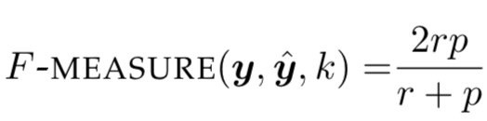
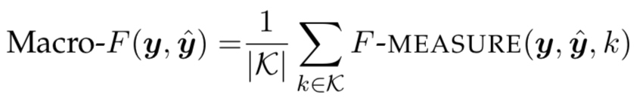
F-score
An F score is just the harmonic mean of precision (p) and recall (r) for a given classifier.
Will take a maximum value of 1 when precision and recall are both 1.
Can also calculate a macro-F measure in the multiclass case.
For each class, make that the focal class and calculate precision + recall with some given threshold.
Take average across these individual class F measures.

Slide 18
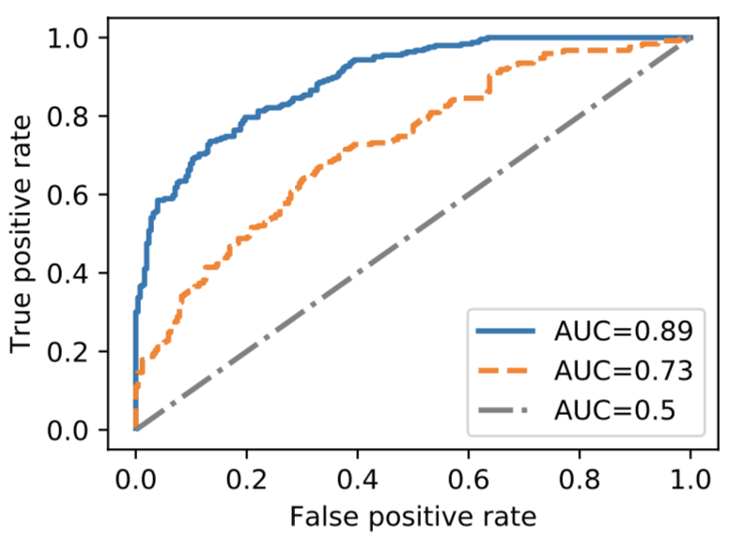
Classification Thresholds → ROC and AUC
We can vary the classification threshold from zero to 1 to generate a receiver operating characteristic curve (ROC) curve.
Shows tradeoff between TPR and FPR.
Area Under the Curve (AUC) is literally the integral of the ROC curve (ranges from 0 to 1).

Slide 19
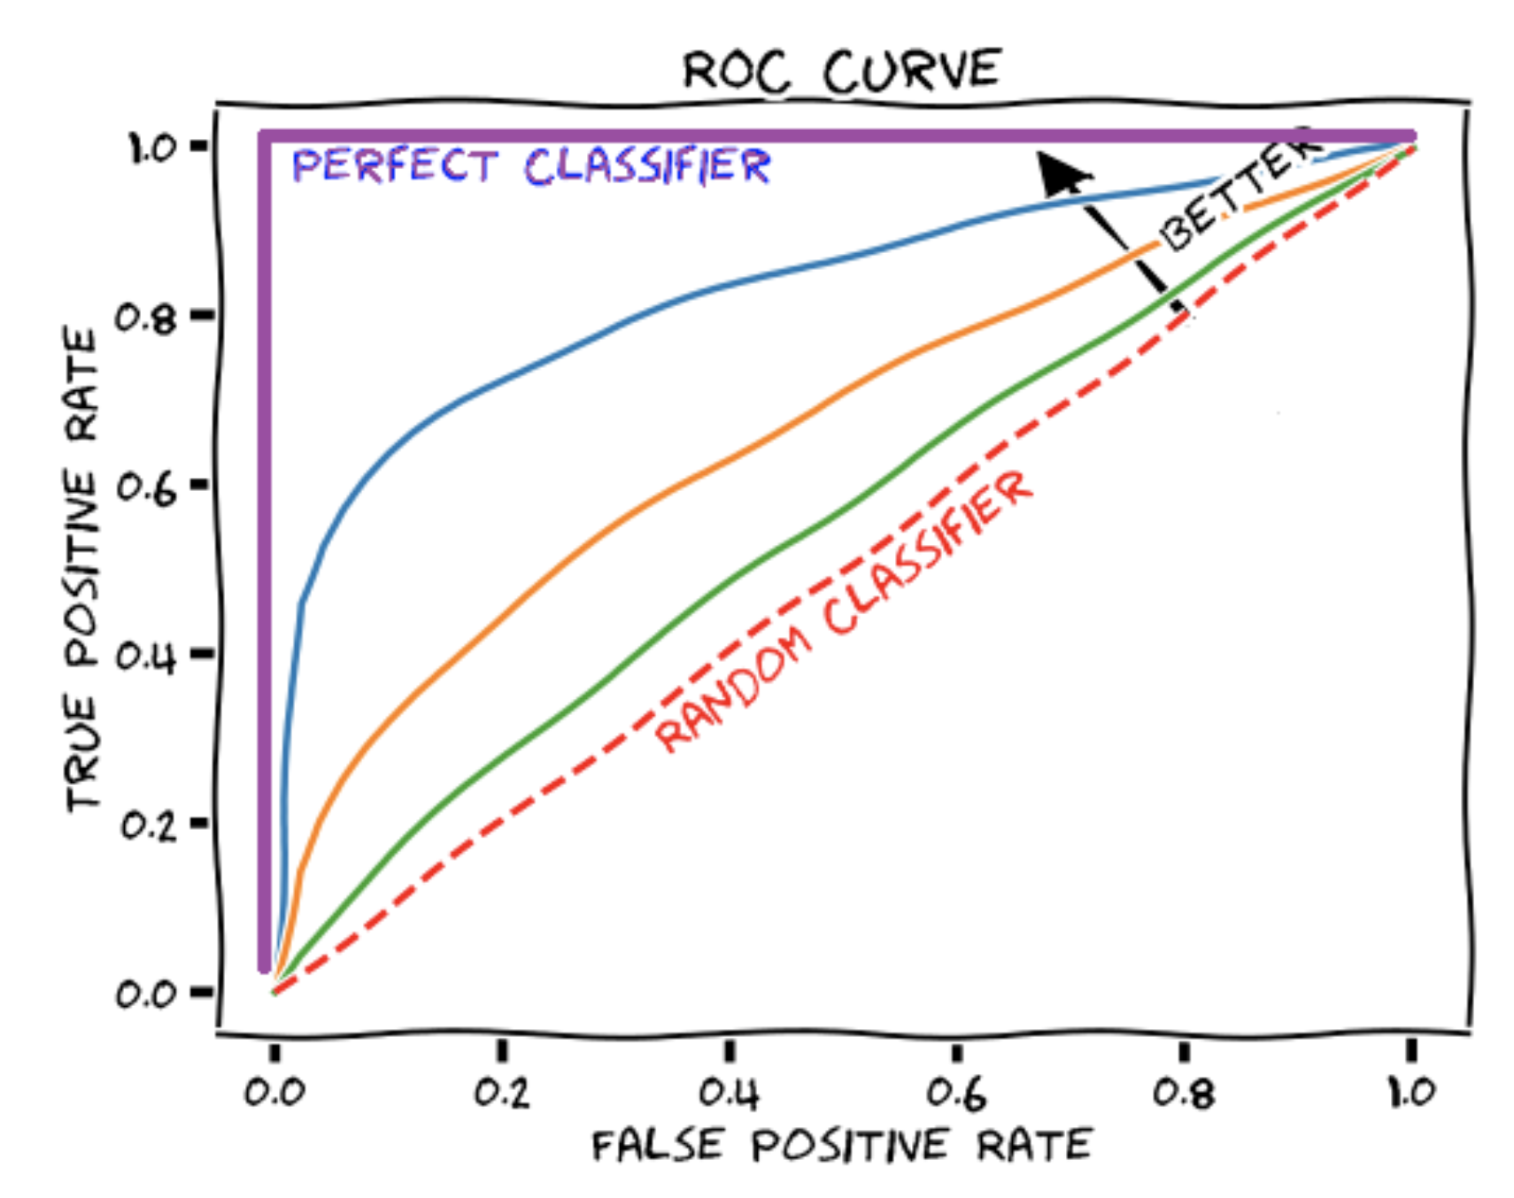
ROC, AUC and Performance
A perfect classifier will have an AUC of 1 – can predict 100% of true positives with zero false positives, for some threshold.
Random classifier will have AUC of 0.5 – TPR and FPR will track each other ~1:1.
Higher AUC is better.

Slide 20
Tradeoffs
Precision-Recall Tradeoff: Except in the case of a perfect classifier, setting a classification threshold to increase recall will lower precisions, and vice versa.
Need to think about your application and the relative costs.
Feature Complexity: Adding tons of features (e.g. 1-12 grams) will improve in-sample accuracy, may improve held out accuracy, but may also lead to greater generalization error.
How likely are the terms I am using to appear in the unseen documents I am classifying.
Will they have the same meaning?

Slide 21
General Takeaways
Supervised learning with text is like supervised learning with any other features, ours just happen to be counts of words.
Optimize text preprocessing towards accuracy/AUC.
Iterative process -- can take the form of active learning.
No one universally optimal classifier.
Validation and replicability are key!
Document the process you went through to arrive at final specification.
Clearly lay out coding guidelines – with theory ahead of time.
Checks to determine if your results “make sense”, comparison to other approaches, metadata.

