Slide 1
PPOL 628: Text as Data – Computational Linguistics for Social Scientists
Class 1: Overview of the Field and Data Collection

Slide 2
Today
Lecture: key points from readings
Reading Discussion
Questions about data collection
Lab: Web_Scraping.R
Website: github.com/matthewjdenny/PPOL_628_Text_As_Data

Slide 3
An Overview of The Field
Text As Data methods are useful in a variety of settings.
Social scientists have placed strong emphasis on text as a measure of social variables.
Over the past decade, emphasis has shifted from supervised to unsupervised methods.
Constant methods development – there are literally hundreds of different statistical/ML methods for text with social scientific applications.
Emphasis on scale (“artisinal” vs. massive data), methods that scale.

Slide 4
An Overview of The Field
Very little emphasis on everything that happens before a model is run.
Very little emphasis on corpus description, qualitative analysis, reading the documents.
We are beginning to understand how fragile unsupervised methods are.
Robustness as a major developing focus: preprocessing, specification decisions, model initialization as significant sources of variation.

Slide 5
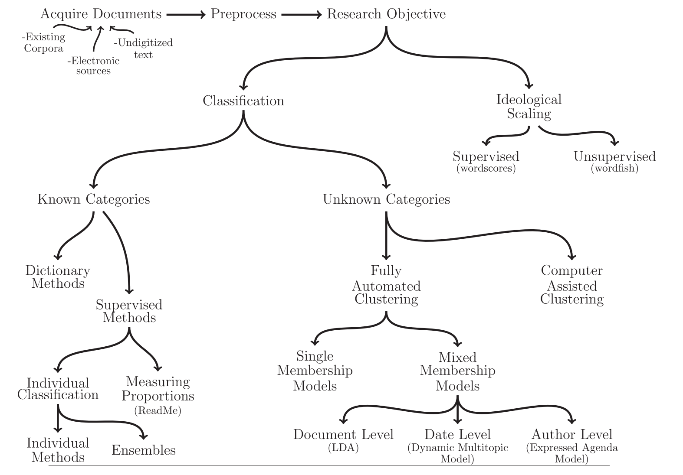
Philosophical Perspectives
From Grimmer and Stewart (2014)

Slide 6
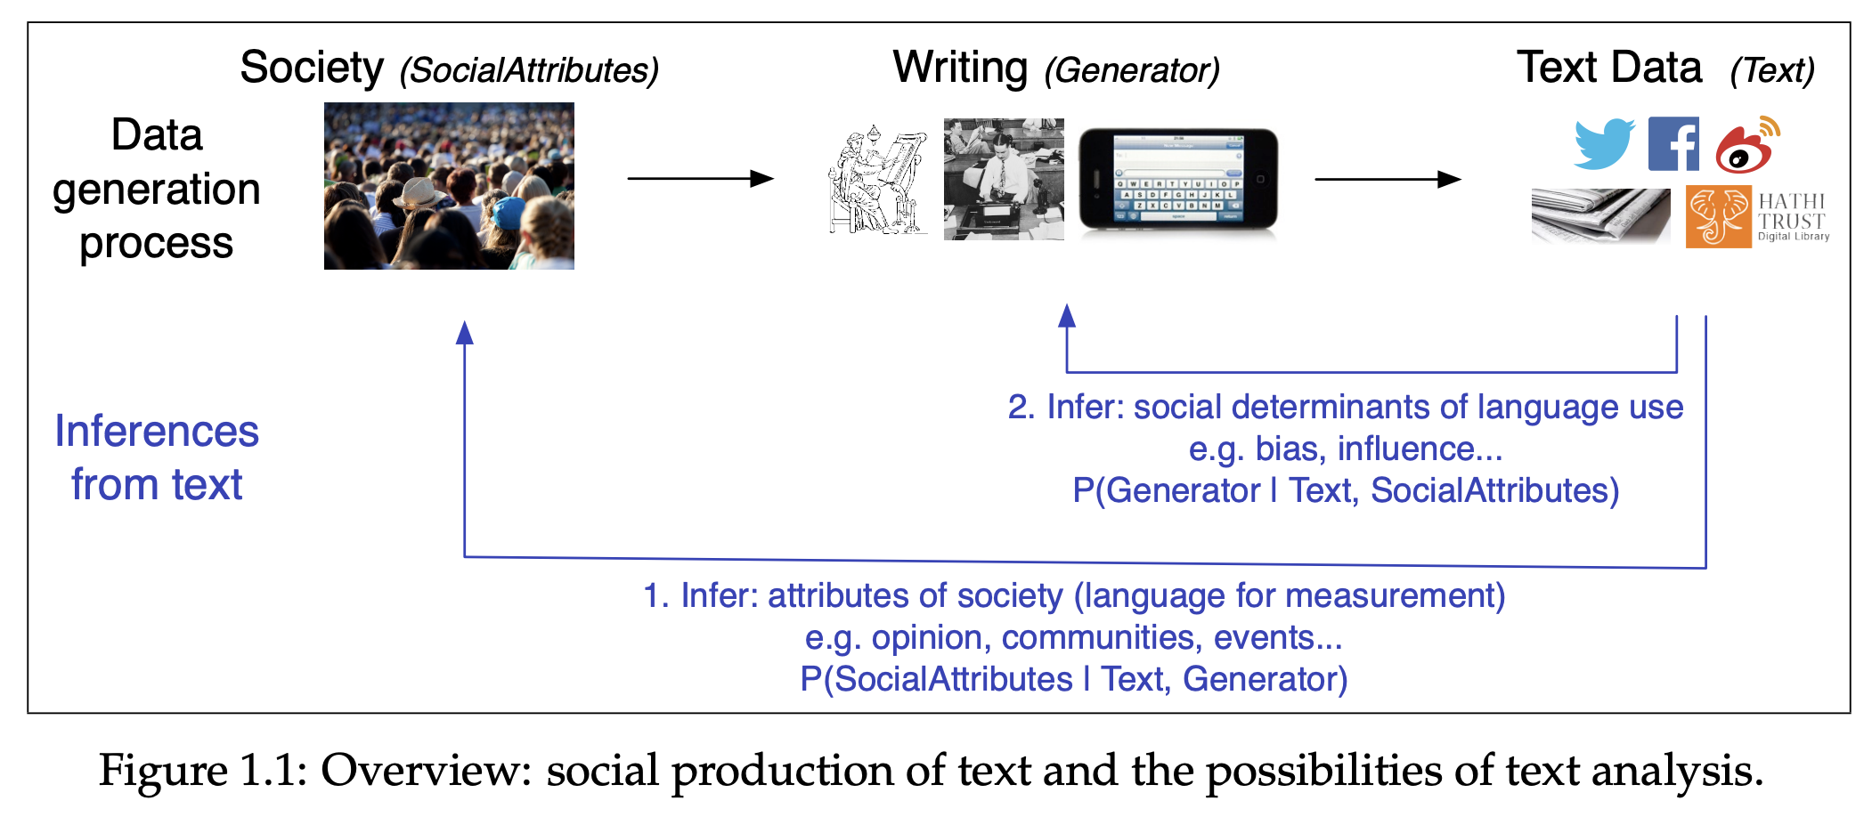
Philosophical Perspectives
From O’Connor (2014) p. 9

Slide 7
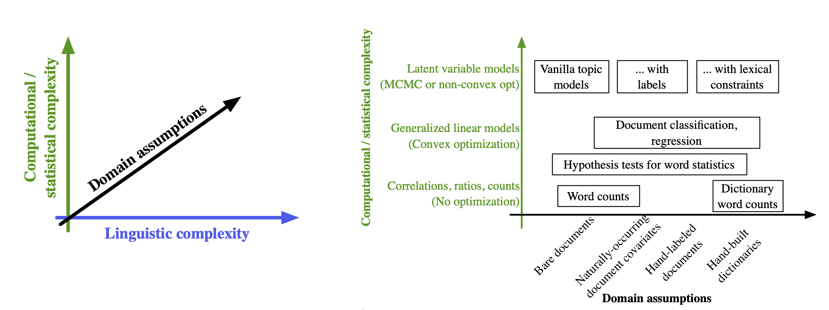
Philosophical Perspectives
From O’Connor (2014) p. 12

Slide 8
What The Field Could Be (Tipping my hat)
More of a focus on how people use language in politics, etc.
Text as a way to understand relationships among actors/entities.
Feature extraction from text (something we do in industry quite a lot).
What we can learn from “simple” methods?

Slide 9
The Process of Text As Data Research
What do you want to study? Can a set of documents tell you what you want to know?
Read your documents, use automated methods to develop qualitative understanding of what is important in those documents.
Develop a theory for how text should be represented/preprocessed.
Provide reader with description of corpus.
Decide what your analysis will be beforehand, then stick to that plan.
Validate your findings, assess their robustness.
Conclude something about the world.

Slide 10
The Readings This Week
Grimmer & Stewart (2013). Text as Data: The Promise and Pitfalls of Automatic Content Analysis Methods for Political Texts.
Wilkerson & Casas (2016). Large-scale Computerized Text Analysis in Political Science: Opportunities and Challenges.
O’Connor (2014). Statistical Text Analysis for Social Science.

Slide 11
Data Collection
You will be asked to collect your own corpus (collection of documents) for this class. You may use a dataset you find online, one your adviser already has, one you have already collected, or one you collect for this class.
You dataset must contain:
100+ documents (come see me if you really want to use one with fewer).
Dataset should be 100+ pages (~30,000+ words) in total.
Your dataset should have one categorical variable and one continuous variable per document for at least 100 documents. You can hand-code these for a subset of documents.

