Slide 1
PUBLIC INTELLIGENT TRANSPORTATION SYSTEMS
ROADWAY (BUS) AND RAILWAY: MARKET ASSESSMENT AND INVESTMENT THESIS
Written Case Prepared for Alvarez & Marsal | Matthew Kang | November 2026

Slide 2





Executive Summary: A ~$29B market growing ~5% a year, with a ~$4B software and services pool best entered via buy-and-build in North America
EXECUTIVE SUMMARY
TOPIC
KEY FINDINGS
MARKET SIZE AND SEGMENTATION
Only ~$4B of the ~$29B bus and passenger rail ITS market is open to a new entrant
Nearly three-quarters is rail signalling, and the open part is software and services in bus and other rail ITS
GROWTH TO 2031
Software and services outgrow the market: ~7% a year vs ~5% overall
Signalling drives most growth but grows a little slower than the market, and hardware is losing share to software
COMPETITIVE DYNAMICS
Signalling is a closed oligopoly, while North American bus ITS is consolidating around Modaxo and Hitachi
A long tail of privately held vendors remains, and newer cloud firms sell add-ons to agencies' existing systems
RISKS AND BARRIERS
Agencies rarely put installed systems out to bid, but challengers usually win when they do
Near-term risks: US federal transit funding may fall in FY2027, and Europe's ETCS rollout is behind schedule
INVESTMENT THESIS
Most attractive entry: a privately held North American mid-market bus ITS vendor, below a software multiple
Returns hinge on a software exit multiple like IVU's ~2.6x, while exiting at Clever's ~1.6x barely returns capital
Verdict: attractive only as a software-led buy-and-build in bus ITS, not a debt-heavy buyout of a hardware business, and not in rail signalling
Note: The market is sized for 2025 and excludes fare collection.
Sources: Berg Insight (2026), UNIFE World Rail Market Study 2026, SCI Verkehr (2026), Global Market Insights (2026), Hitachi Q1 FY2026 results, IVU trading data as of 6 Nov 2026, agency award records, analysis

Slide 3
Market Size: A ~$29B market, but half is mainline signalling bought mainly by rail infrastructure managers, and only ~$4B of software and services is open to entrants
MARKET SIZE AND SEGMENTATION
ADDRESSABLE MARKET
EST. ADDRESSABLE MARKET FUNNEL, 2025, BILLIONS USD
WHO BUYS EACH SEGMENT, AND CAN AN ENTRANT COMPETE?
$40-60B
Segment | 2025, $B | Main buyers | Main suppliers | Open to an entrant, $B
Mainline and commuter signalling | $14.6 | Infrastructure managers (Amtrak, DB InfraGO, Network Rail, RFI) | Signalling majors on multi-year contracts | NO
Urban signalling (metro, light rail) | $6.2 | Metro and light rail agencies | Signalling majors with safety-certified systems | NO
Bus and tram ITS | $4.6 | Transit agencies and bus operators | Modaxo, Hitachi, INIT, IVU and a fragmented long tail | $2.5 software + services
Other rail ITS (passenger info, CCTV, monitoring) | $3.2 | Rail and metro operators | Train makers and specialist firms | $1.7 software + services
Total | $28.6 |  |  | $4.2
Global ITS market
Broad ITS reports add road traffic, tolls and aviation
$28.6B
Public ITS: bus + passenger rail
Hardware, software and services, but not fare collection
$14.0B
Transit-operator core
Less mainline signalling: mainly rail infrastructure managers
$7.8B
Contestable pool
Less urban signalling: an oligopoly of safety-certified suppliers
~15%
$4.2B
OF CASE SCOPE OPEN TO A NEW ENTRANT
Open software and services
Software and services are open to a new entrant because transit agencies buy them from many vendors, while signalling is locked up by a few certified suppliers on long contracts
Less bus and rail hardware, left to equipment partners
Note: Figures may not sum due to rounding.
Sources: Berg Insight (2026), UNIFE World Rail Market Study 2026, SCI Verkehr (2026), Global Market Insights (2026), umbrella ITS reports (MarketsandMarkets, Grand View Research, Precedence Research, Mordor Intelligence), analysis

Slide 4





Market Growth: Public ITS grows ~5% a year to ~$39B by 2031, mostly from signalling modernisation, while the open software and services pool grows faster, at ~7%
MARKET GROWTH
GROWTH DRIVERS TO 2031
PUBLIC ITS MARKET BY SEGMENT, GLOBAL, 2025-2031E, BILLIONS USD
KEY GROWTH DRIVERS AND HEADWINDS
2025-31E CAGR:
EU law requires digital signalling (ETCS)
▲ HIGH
Most main rail lines are not yet fitted, leaving tens of billions of euros of work
Bus and tram ITS
$39.3B
5.4%
$35.3B
$37.3B
Faster than the market, led by rest of world
$33.5B
6.3%
Cities are replacing old metro signalling
▲ HIGH
$30.2B
$31.8B
New York, Paris, Toronto and Hong Kong are funding the work
$28.6B
7.0%
Other rail ITS
Bus systems come up for renewal by 2031
▲ HIGH
Faster than the market, helped by wear sensors
Dispatch and tracking systems at many major US and Canadian agencies date from 2009-16
Rail signalling
5.0%
Electric buses and bus-lane cameras
▲ MID
Just below the market, but its pace moves the total most
Most new European city buses are now electric, and US cities are adding bus-lane cameras
2025
2026E
2027E
2028E
2029E
2030E
2031E
US funding reset and ETCS delays
▼ MID
Software and services
$4.2B
$6.3B
7.0%
Federal transit funding may fall in FY2027, and the UK cut its ETCS budget
Software and services outgrow the market:
~7% a year vs ~5% overall
▲ raises and ▼ lowers 2025-31 growth. HIGH or MID is the size of the effect on its segment
Sources: European Commission ERTMS Work Plan (2026), MTA 2025-29 Capital Program, MTR, Sustainable Bus (DVV Media), FTA, H.R. 8870, Network Rail CP7, Berg Insight (2026), UNIFE World Rail Market Study 2026, SCI Verkehr (2023, 2026), Global Market Insights (2026), analysis

Slide 5


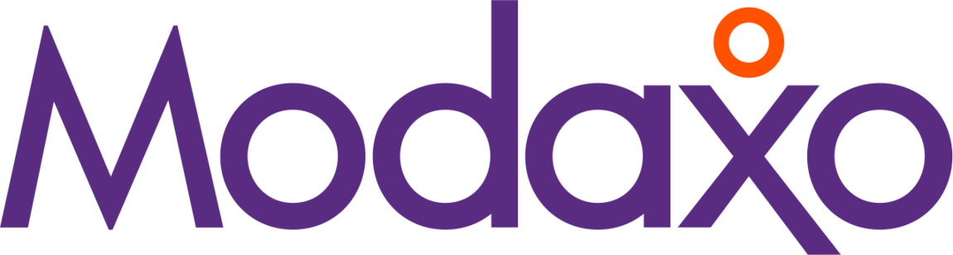



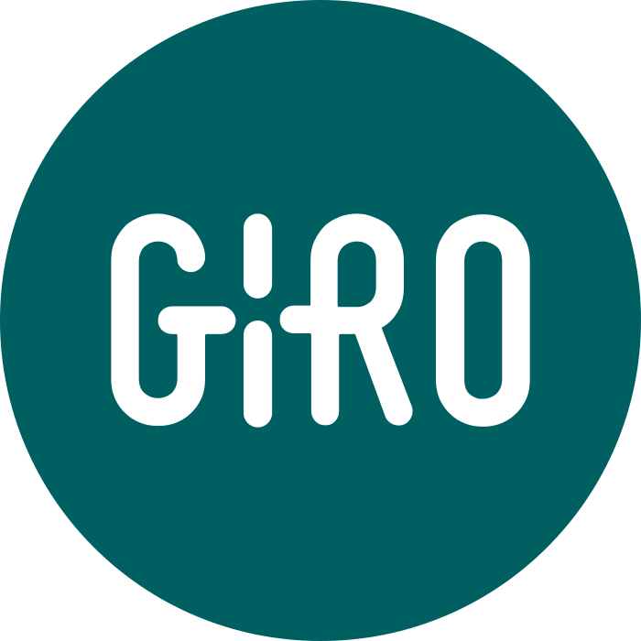


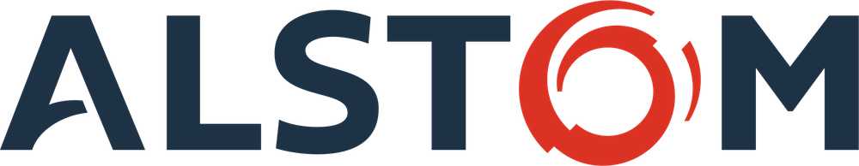



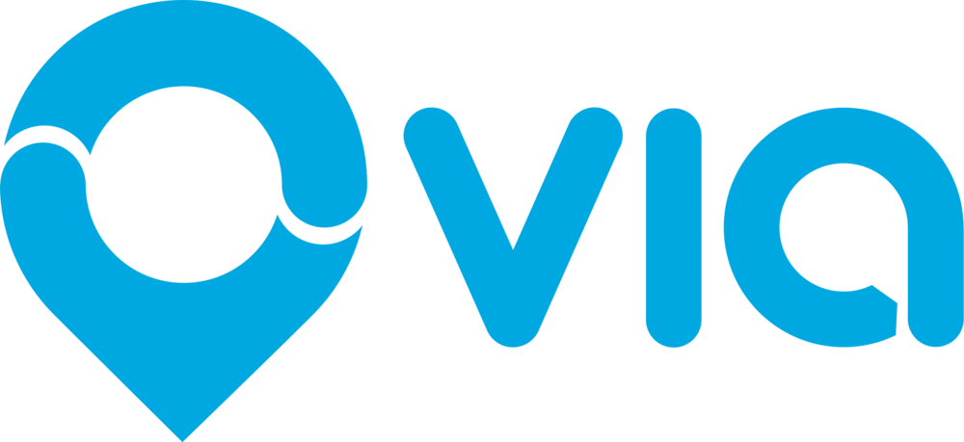

Competitive Landscape: Signalling is a closed oligopoly, while North American bus ITS is consolidating around Modaxo and Hitachi, leaving a private long-tail opportunity
COMPETITIVE LANDSCAPE
PLAYER GROUPS
COMPETITIVE SUMMARY: PUBLIC ITS PLAYER GROUPS AND IMPLICATIONS FOR A NEW ENTRANT
SIGNALLING MAJORS
BUS ITS CONSOLIDATORS
LISTED PURE PLAYS
MID-MARKET PRIVATES
SAAS / AI CHALLENGERS
MARKET POSITION
Together hold most of world signalling, with years of booked orders
Modaxo owns the largest North American installed base, and Hitachi is number two after buying Clever
INIT is the largest listed bus ITS pure play, while IVU is smaller
A fragmented long tail of privately held specialists
Newer firms selling cloud apps and AI cameras that agencies add on top of their existing systems
KEY STRENGTHS
Safety-certified systems, locked in by long maintenance and supply contracts
Largest installed bases, each kept for a system generation. Modaxo buys and never sells
Full stack (e.g., dispatch, location tracking, scheduling, fare) plus long-term service contracts
Sticky agency relationships. Avail and Passio lead real-time feeds at smaller US agencies
Easy to buy: short subscriptions, and the old system stays. Ticket fines pay for the AI cameras
KEY WEAKNESSES
Slow, publicly funded ETCS rollout and execution risk
Aging architecture, with legacy installs exposed at rebid
Hardware and project mix squeezes margins
Mostly sub-scale, with some still founder-led (GIRO, ETA), creating succession opportunity
Via and Optibus still lose money. Federal grants favor equipment over subscriptions
IMPLICATION FOR A NEW ENTRANT
Signalling is closed, so compete only in nearby niches (monitoring, cyber, connectivity). The consolidators bid against an entrant for targets, and Hitachi may buy at exit while Modaxo sets the floor
Where to focus: buy a mid-market private, add SaaS / AI, and exit at a software multiple
EXIT BENCHMARK
INIT and IVU show that recurring revenue lifts the price
ACQUISITION TARGETS
Buy one as the platform, then bolt on others
PARTNERS OR RIVALS
Partner with them, or buy a small one. Big ones are priced too high
Larger, more entrenched
Smaller, newer to the market
Sources: company reports and statutory filings, GTFS-Realtime feed census, Berg Insight, deal announcements, agency board records, trading data as of 6 Nov 2026

Slide 6




Risks and Barriers: Agencies keep systems for over a decade, so the way in is to own an installed base. The near-term risks are US funding and ETCS delays
RISKS AND BARRIERS TO ENTRY
IMPACT ON A NEW ENTRANT
BARRIERS AND RISKS
LIKELY IMPACT ON A NEW ENTRANT
Agencies rarely switch vendors
Systems last well over a decade, and most renewals skip a competitive bid
HIGH
Only a few contracts open up each year
But when one does, the challenger usually wins
Public buying is slow
Years from award to go-live, plus bid protests and Buy America rules for hardware
HIGH
Agencies trust vendors that already run systems elsewhere
Shared purchasing contracts let agencies skip a full tender
Signalling is an oligopoly
Safety certification and long contracts protect the few big suppliers
HIGH
Signalling itself is off-limits to new entrants
Nearby niches stay open, like monitoring and cybersecurity
US funding reset and ETCS delays
Federal transit funding may fall in FY2027, and Europe's ETCS rollout is behind schedule
MID
Some states may delay purchases
Money for system upgrades is the safest federal funding
Debt-heavy hardware deals
Cubic's debt-funded buyout is in distress, and Alstom and INIT cut profit forecasts
MID
Lumpy project revenue can't carry much debt
Buy recurring revenue, and leave hardware to partners
Sources: agency board records (LA Metro, TfL, CTA, MARTA, Miami-Dade), 2016-26 ITS award dataset, FTA notices, H.R. 8870, FY2027 President's Budget, European Commission ERTMS Work Plan (2026), company reports

Slide 7



Investment Thesis: The most attractive entry is North American bus ITS software, but returns need a software exit multiple (~2.6x revenue), well above Clever's ~1.6x
INVESTMENT THESIS
NEW ENTRANT
INVESTMENT THESIS FOR A NEW ENTRANT
WHERE TO PLAY
North American bus software and services (~$0.6B), the most practical place to start
Add-ons beside incumbents: cloud apps, AI cameras and electric-bus software
OUR RECOMMENDATION
The most attractive entry is a private North American mid-market bus ITS vendor below a software multiple. Cloud, AI cameras and electric-bus software then make recurring revenue most of its sales.
WHY NORTH AMERICA FIRST
Refresh wave: major agencies decide by 2031 on aging dispatch and tracking systems
Mid-size customers and targets: mid-size agencies run over half the US fleet
Europe is larger but split: national buying rules limit scale across borders
Avoid: signalling itself, and debt-heavy buyouts of hardware firms
HOW TO WIN
Coexist, then replace: sell add-ons first, then use those customers to win rebids
Sell through existing channels: shared purchasing contracts and hardware partners, with subscriptions shaped to qualify for federal grants
RETURN MULTIPLE EXAMPLES, 5-YEAR HOLD
If sold at Clever's multiple (1.6x revenue)
1.2x
RETURNS AND EXIT
If sold at Clever's multiple, the deal barely returns its capital. Likely exit buyers are Hitachi, Siemens and Via, while Modaxo sets the floor price
With mostly recurring revenue, like IVU, the money invested roughly doubles, so check recurring revenue first
If sold at IVU's multiple (2.6x revenue)
2.0x
Note: Illustrative returns only, before fees, with entry between the INIT and IVU multiples.
Sources: Hitachi Q1 FY2026 results, IVU Q3 2026 report, trading data as of 6 Nov 2026, FTA NTD RY2025, 2016-26 ITS award dataset, analysis

