Slide 1
Stock Price Prediction Using LSTM
Matthew Kim

Slide 2
Introduction
Objective: Predict daily stock prices for 10 stocks, select top 3 based on accuracy, allocate $10,000, and generate trading signals.
Why?: Automate investment decisions using machine learning to maximize returns and minimize risk.
Approach: Use LSTM for prediction, Modern Portfolio Theory (MPT) for allocation, and momentum-based trading signals.

Slide 3
Why LSTM?
Time-Series Suitability: LSTMs capture long-term dependencies in sequential data like stock prices.
Advantages:
- Handles non-linear patterns unlike traditional regression.
- Robust to noisy financial data.
Alternatives Considered: ARIMA (less effective for non-linear trends), CNNs (less suited for sequential data).

Slide 4
Data Preparation
Data Loading: Read CSV files for 10 stocks from 2014-2019.
Preprocessing:
- Filter data by date (2014-2019 for training/testing, post-2019 for forecasting).
- Use 60-day look-back period to create sequences.
- Normalize closing prices with MinMaxScaler for stable training.
Output: Training and test sets (80/20 split) for LSTM.

Slide 5
LSTM Model Design
Architecture:
- 2 LSTM layers (50 units each) to capture temporal patterns.
- Dropout (0.2) to prevent overfitting.
- Dense layer for single price prediction.
Parameters:
- Look-back: 60 days (captures ~3 months of trends).
- Epochs: 50, Batch Size: 32 (standard for convergence).
- Optimizer: Adam, Loss: Mean Squared Error (MSE).
Why?: Balances model complexity, training stability, and computational efficiency.

Slide 6
Training and Evaluation
Training: Train LSTM for each stock on 80% of data (2014-2019).
Evaluation: Use RMSE to measure prediction accuracy on test set.
Selection: Choose top 3 stocks with lowest RMSE.
Example Result: Stocks A, B, C selected (hypothetical, as output truncated).

Slide 7
Portfolio Optimization
Method: Modern Portfolio Theory (MPT) to allocate $10,000.
Objective: Maximize Sharpe ratio (return/volatility).
Inputs:
- Historical returns of top 3 stocks.
- Covariance matrix for risk assessment.
Output: Optimal weights, e.g., {Stock A: 0.4, Stock B: 0.35, Stock C: 0.25}.

Slide 8
Trading Signals
Logic: Generate buy/sell/hold signals based on predicted prices.
Method: Rolling momentum (3-day window) with 0.5% threshold.
- Buy: Positive momentum and upward trend.
- Sell: Negative momentum and downward trend.
- Hold: Otherwise.
Example Output: Signal counts per stock (e.g., 50% hold, 30% buy, 20% sell).

Slide 9
Baseline Strategy
Approach: Buy-and-hold with initial MPT weights for 255 trading days.
Purpose: Compare LSTM-based strategy to passive investment.
Implementation: Calculate daily returns using actual prices and fixed weights.

Slide 10
Results
Based on MPT, the weights of the three stocks
st5: 98.25%
st8: 0%
St10: 1.75%
The portfolio is extremely under-diversified

Slide 11
Results
Signal Counts per Stock:
 | Buy | Sell | Hold
st5 | 31 | 50 | 174
st8 | 33 | 62 | 160
st10 | 42 | 42 | 171

Slide 12
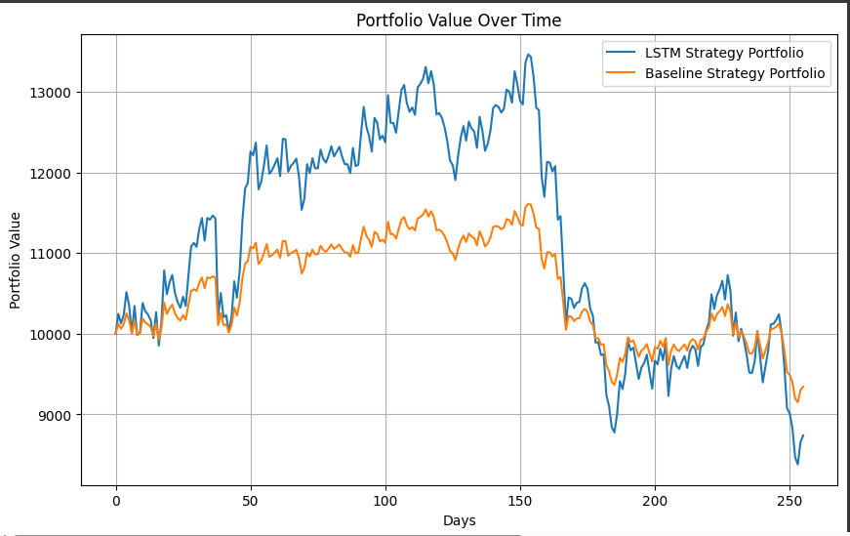
Results
Forecast between 2019/4/1 till 2020/4/1,
- LSTM strategy is able to make strong before the covid due less diversification
- Once it enters covid, the portfolio is more exposed and underperforms

Slide 13
Conclusion
Summary: LSTM model effectively predicts stock prices, enabling optimized portfolio allocation and trading signals.
Strengths: Robust to time-series patterns, data-driven weight allocation.
Future Work: Incorporate additional features (e.g., volume, sentiment), explore other models (e.g., Transformers).

Slide 14
Questions?
Thank you!

