Slide 1

US Agriculture
Indigo Data Analyst Case Study
Matthew Lim

Slide 2
Contents
Background
Data Preparation and Cleaning
Interactive Data Visualization
Questions

Slide 3
Background
Raw Data
Can appear messy
Need To Learn How Fields Connect
Cleaning
Transform And Aggregate Information Into a Digestible Format
Visual
Use the data to create visuals
Draw insights from once messy data

Slide 4
Data Preparation and Cleaning
The raw dataset provided by NASS USDA provides a rich amount of information.
It also includes various miscellaneous pieces of information not intended to work together.
We need to parse out the information that we do want before we can make use of the data for insights.
Notes:
Consider talking about:
Different viewpoints
Ethics

Slide 5
End Goal: Interactive Data Visualization
Use the data to understand trends and draw insights.
Visualizations can take advantage of all the work from data preparation by highlighting and drawing attention to specific important details.
E.g. Wheat acreage planted and harvested declines over time while corn and soybeans have increased
Notes:
Consider talking about:
Nutrients
Soil
Land
Energy
Water

Slide 6

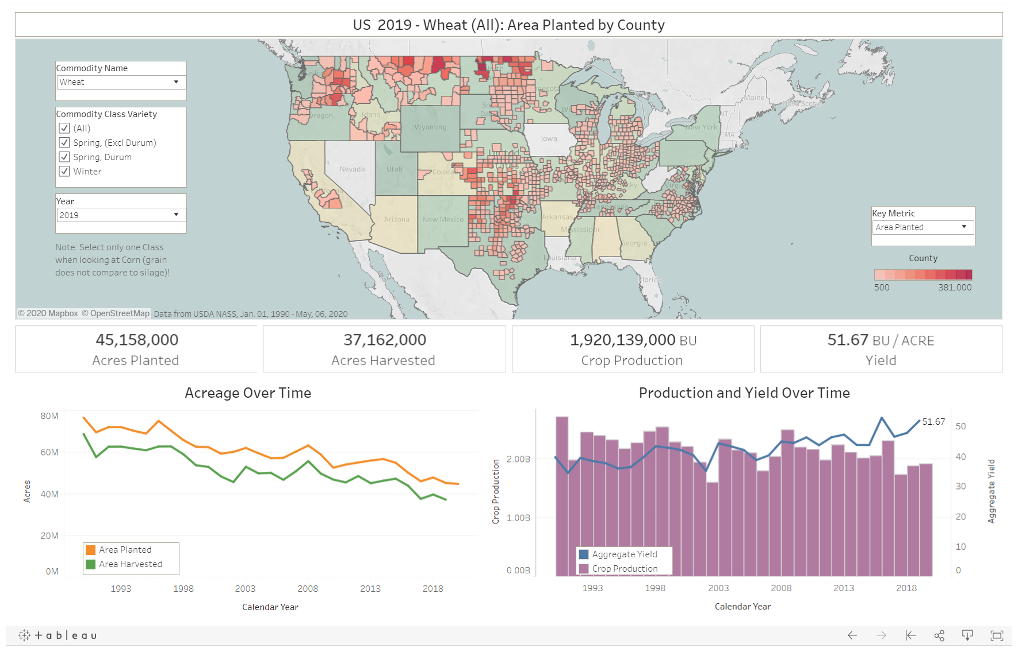
End Goal: Interactive Data Visualization
Use the data to understand trends and draw insights.
Visualizations can take advantage of all the work from data preparation by highlighting and drawing attention to specific important details.
E.g. Wheat acreage planted and harvested declines over time while corn and soybeans have increased
Notes:
Consider talking about:
Intensification
Water
Soil and nutrients
Pests and weeds
Plants
Traditional agriculture
Alternative agriculture

Slide 7
Questions?

