Slide 2
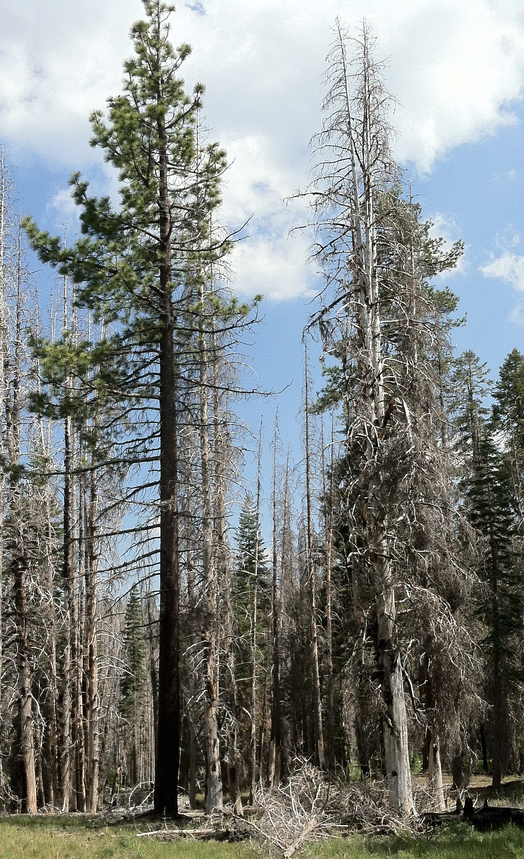
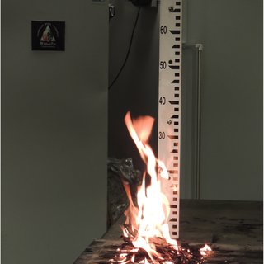
a
b

Slide 3
Caption:
Examples of contrasting traits of different conifer species. (a): Jeffrey pine (left) and lodgepole pine (right) following the 2012 Reading Fire, Lassen National Park. The two species experienced similar fuel environments (fairly open-grown), with the Jeffrey pine surviving and the lodgepole pine dying. (b): example of litter flammability test (maybe Jeffrey and lodgepole if we have picture?) (c,d): other examples would be great if you have them.

