Slide 1

Detecting Alzheimer’s disease
APS360 – FINAL PROJECT MATTHEW LEE
JOHN XIE, ROHAN RAMDOSS
Through MRI ANALYSIS USING CNNS

Slide 2
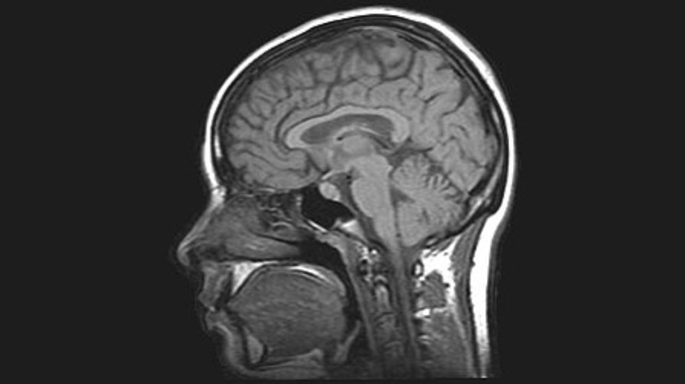
Background & PROBLEM
Alzheimer’s Disease & Medical imaging

Slide 3

Can we reliably detect and diagnose Alzheimer’s Disease through MRI scans?

Slide 4
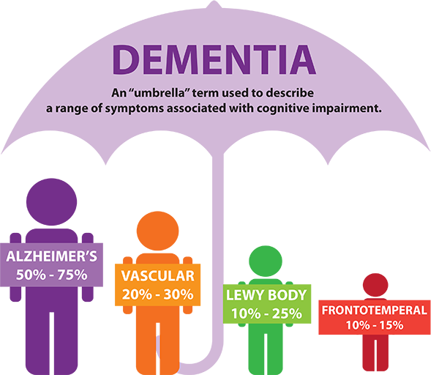
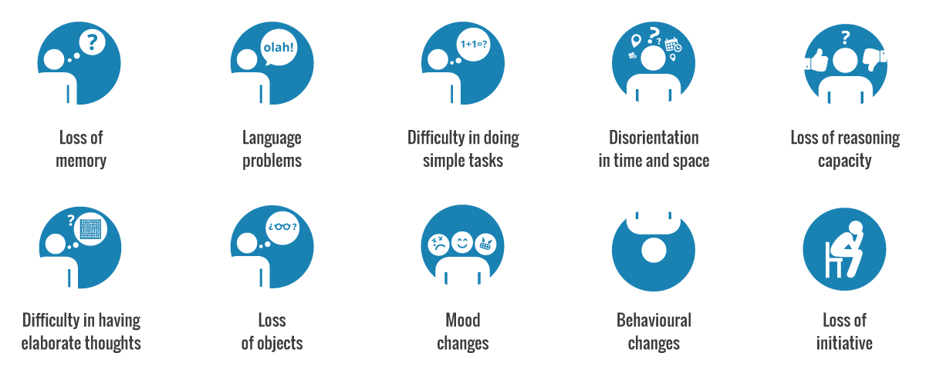
Alzheimer’s Disease
50 million have dementia worldwide (WHO)
Severe cognitive impairment and behavior issues
Previous ML approaches used manually extracted features and numbered data
Approach from 3D Image pesrpective
Problem important because
Do not require specialized practitioners for diagnosis
Better understanding of symptoms
Notes:
One of the most Common neurodegenerative disease

Slide 5
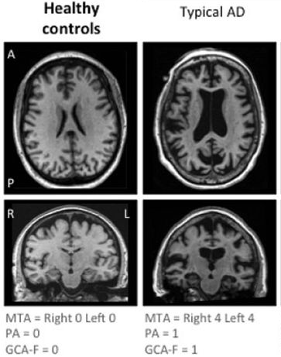
Imaging diagnosis
Magnetic Resonance Imaging
T1 weighted detects fat
Brains structure and metabolic rate change due to AD
MRI captures structural data
Shrinkage of the hippocampi is the best MRI biomarker for AD (Jack et al., 2011a)
Healthy vs AD MRI
Notes:
Metabolic changes can be monitored through PET—could have also included these image points

Slide 6

DATA & PROCESSING
OASIS3 - T1 MRI Longitudinal Axial Scans

Slide 7


Dataset
 | Cognitively Normal | Alzheimer’s Disease | Total
Subjects |  |  | 1098
MR T1 Sessions | 2375 | 397 | 2772
Longitudinal raw MR and PET images
1098 subjects, 2117 MR T1w sessions
Each session can have multiple runs
Scanning methods were mostly the same (4 different scanners)
Standardized MRI procedure, still differences in depth
Also includes CN patients that developed AD later in the study
 | Female | Male | Total
Number | 611 | 487 | 1098
Age | 67.68 (43.2-95.6) | 70.17 (42.5-91.7) | 68.84 (42.5-95.6)
Right Handed | 546 | 433 | 979
Notes:
Most data does not consider early onset AD (before 55) extremely uncommon

Slide 8

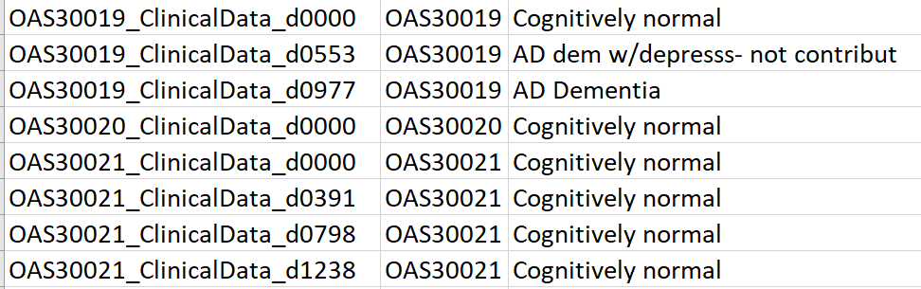
Data point
OAS30019_SES-D500
3D/2D Image
Label
Each scan is 256 (256 x 176) greyscale images
Parse subject ID (30019) and scan date (500)
Look for nearest diagnosis AFTER scan date in cognitive assessment .csv
Some diagnosis use past scans
Want model train on confident AD data
1 (AD)
2D [3, 256, 176]
Or
3D [1, 48, 96, 96]

Slide 9
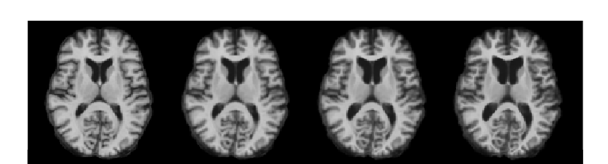
Challenges & LIMITATIONS
Heavy imbalance in data
~86% CN vs 14% AD
Different models = different dimensions
2D image with 3 channels
3D images with 1 channel
Varying sizes
Depths of brain scans weren’t consistent
Large dataset (37 GB)
Smaller batching
Slower computation
Data directory organization and specialized files
Inconsistent assessments
Normal Brain Aging

Slide 10

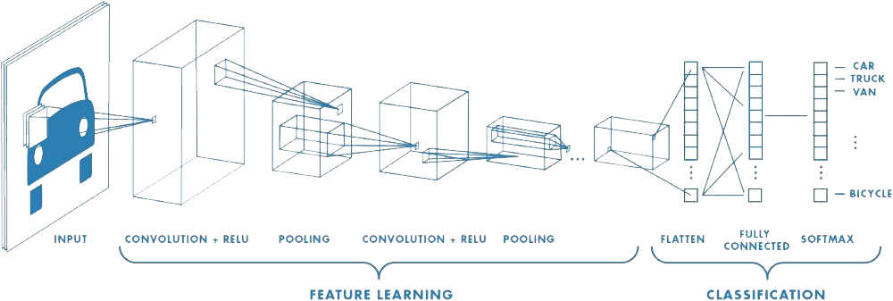
MODELS
2D baseline, 3dcnn, 2d+3d CNN

Slide 11
Baseline model
2D images, 3 “Channels”
Data Processing
3D base image cropped in Z-dimension (discard first 100 and last 57 images)
99 remaining images divided into 3 chunks
Each channel is average of each chunk (33 images)
Average to not throw out any imaging biomarkers existent on only few images
Copy and append AD data 4 times (to balance classes)
CE Loss, SGD (lr=1e-3) , batch size = 8
VGG 11 architecture, NO pretrained weights + one fully-connected classifier layer
Test Accuracy | Test True Positive Rate (AD) | Validation Accuracy | Validation True Positive Rate
71.62% | 65.62% | 76.80% | 77.94%

Slide 12
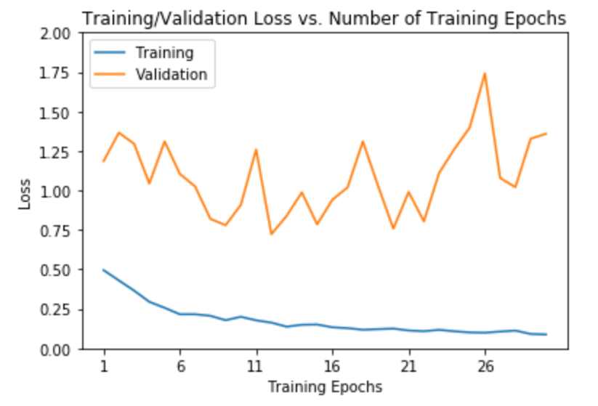
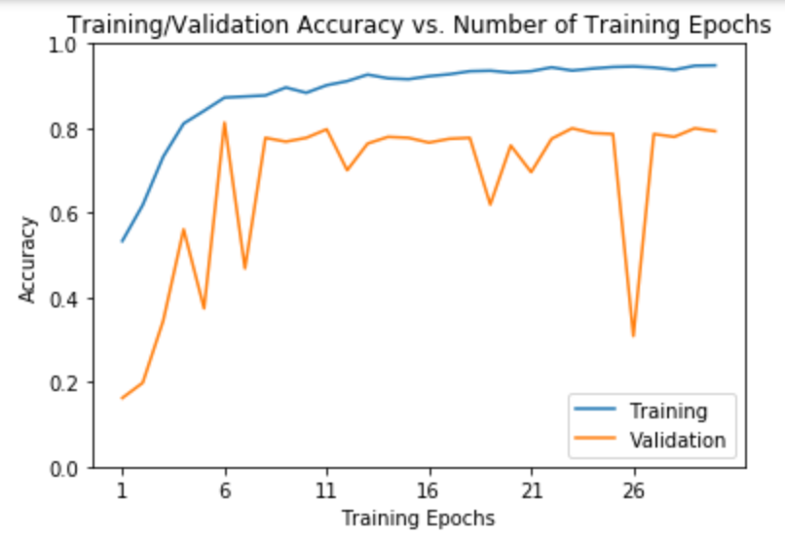
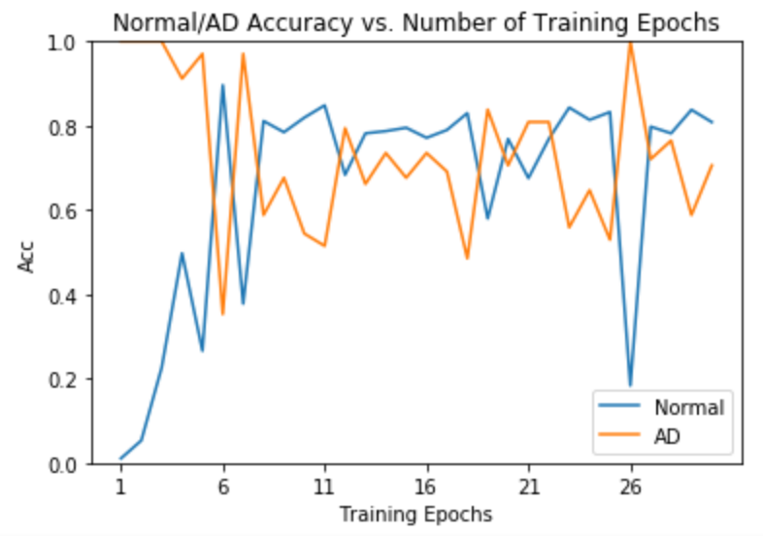
ENHANCED 2D cnn
Same data processing, model, loss, and optimizer
Data augmentation on copied AD data
Noise, rotate, flip horizontally
Class-weighted Loss
Penalize losses for AD data points more
Test Accuracy | Test True Positive Rate (AD) | Validation Accuracy | Validation True Positive Rate (AD)
76.80% | 78% | 78.15% | 73.53%
Notes:
Explore hyperparameters with 2D before 3D

Slide 13
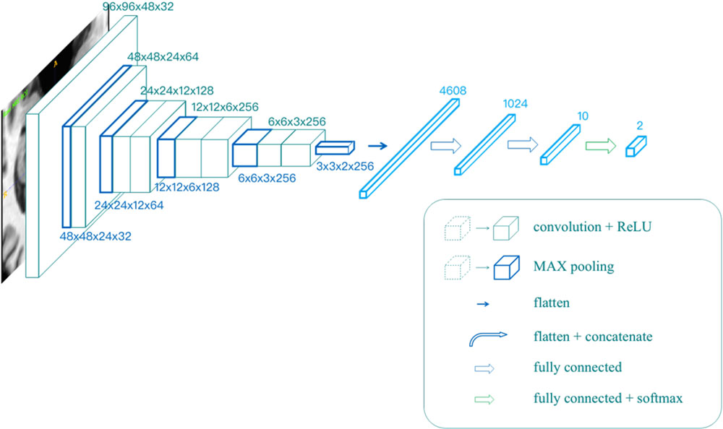
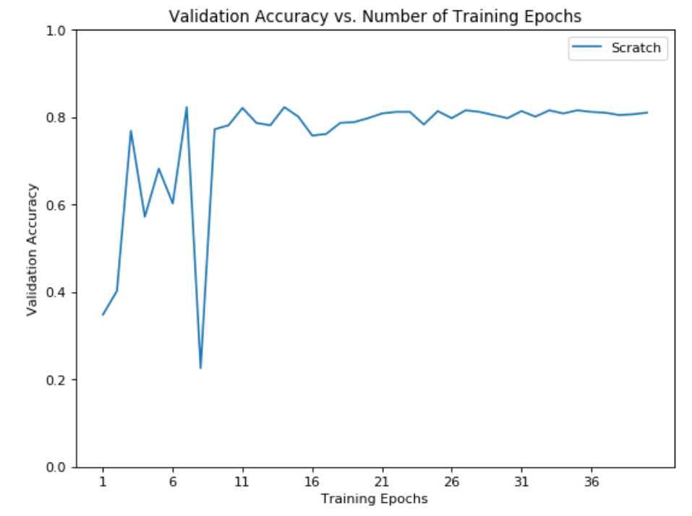
3D CNN model
Based on related study and respective 2D architectures
All passed in 1 x 48 x 96 x 96 3D images
Cropped extremities of each dimension and scale accordingly
VGG-Based
Architecture | Test Accuracy | Test True Positive Rate (AD)
VGG-Based | 76.9% | 75.31%
ResNet152-Based | 72.38% | 60.49%
ResNet101-Based | 69.13% | 64.2%
Test Accuracy | Test True Positive Rate (AD) | Validation Accuracy | Validation True Positive Rate
76.9% | 75.31% | 78.7% | 72.83%

Slide 14
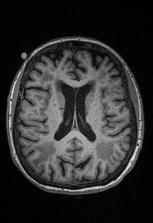
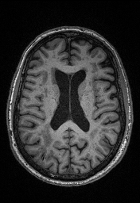
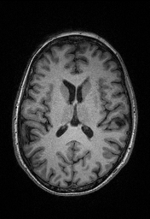
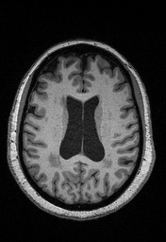
RESULTS
Subject 30019 Day 376
Subject 30019 Day 2394
Actual: AD
Prediction: Healthy
Actual: AD
Prediction: AD
Subject 30038 Day 3376
Subject 30050 Day 110
Actual: Healthy
Prediction: Healthy
Actual: Healthy
Prediction: AD
Notes:
SUBJECT 30019 ACTUALLY was initially healthy, scan was in between healthy and AD assesments

Slide 15
Learning challenges
Hardware limitations
Training takes long time
Hard to experiment with parameters/hyper-parameters
Cannot have large batch sizes
Overfit very easily due to:
parameters >>> data points
Small data set amplified by many more parameters
Not many pre-trained 3D models
The existing ones focus on video inputs
2D fails to account for spatial features in the Z dimension
Has no method of knowing the channels are spatially related

Slide 16
FUTURE IMPROVEMENTS
Further data augmentation
Zoom, translate
Z dimension
Support Vector Machines
Better suited for problems with low number of data points
Pre-diagnosis?

Slide 17
Detecting Alzheimer’s disease
APS360 – FINAL PROJECT MATTHEW LEE
JOHN XIE, ROHAN RAMDOSS
Through MRI ANALYSIS USING CNNS

