Slide 1

Seeing Inside Out with Computer Vision
Matthew Le
The Association for Computing Machinery

Slide 2

How can you tell if someone is happy?

Slide 3
How can a computer tell if someone is happy?

Slide 4
How do computer see?

Slide 5
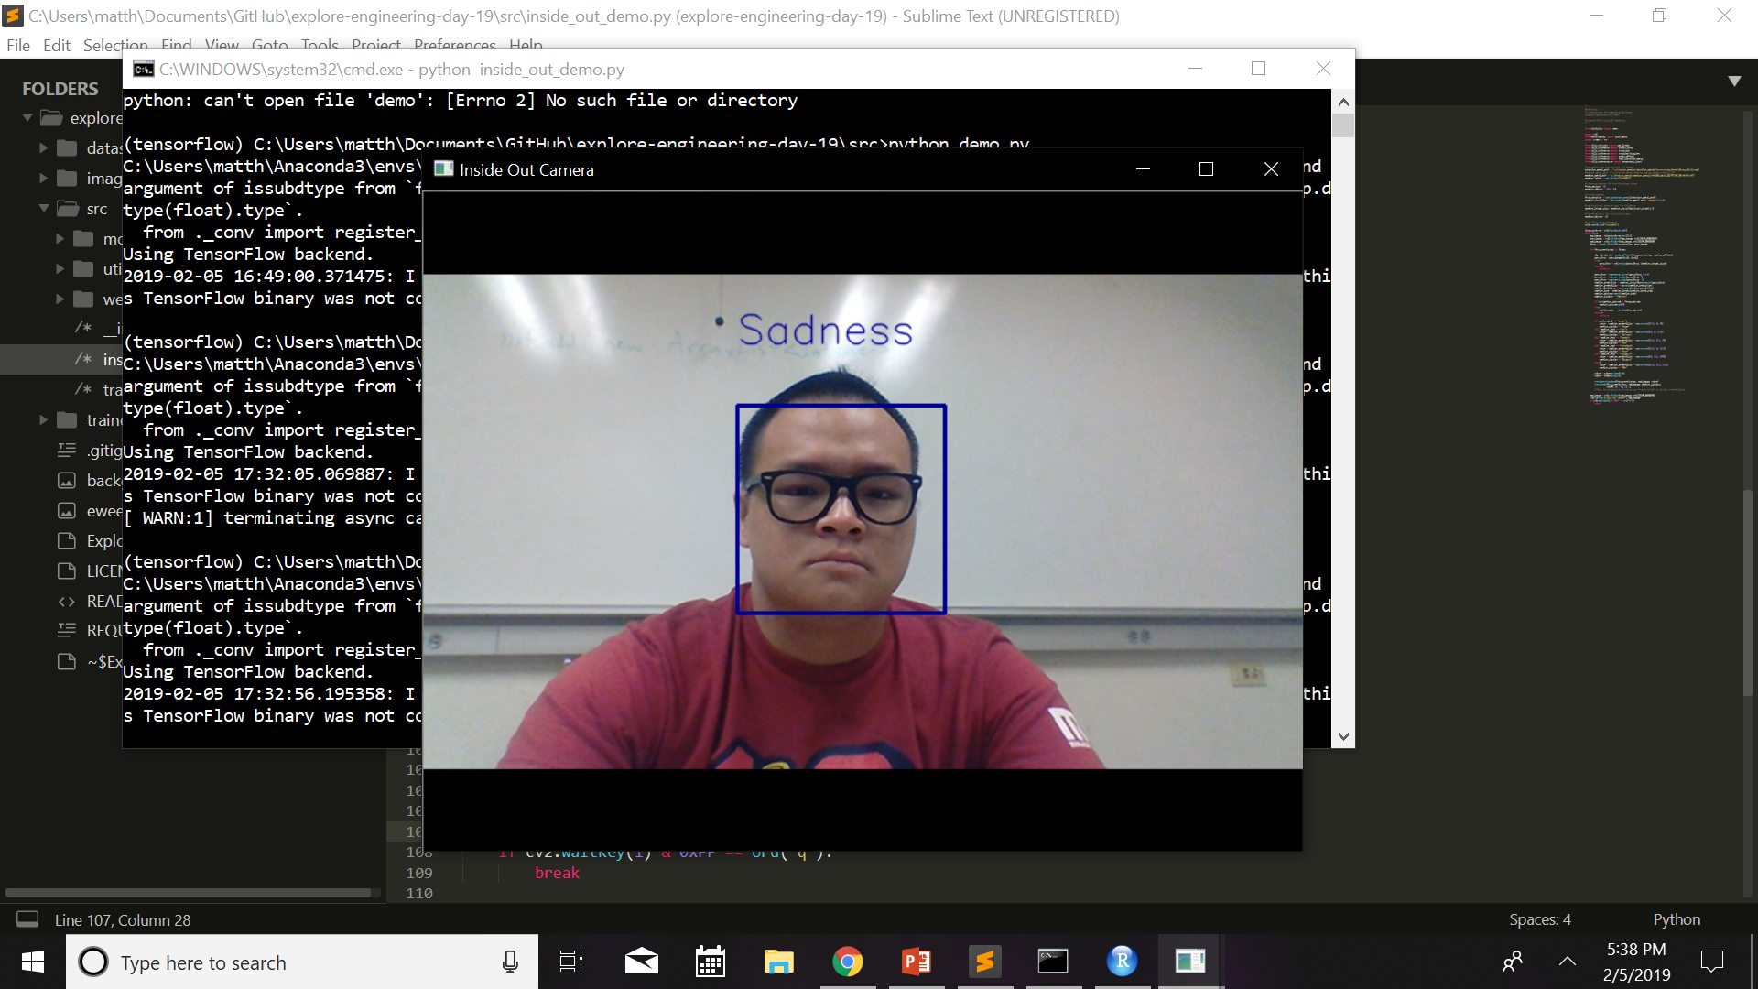
Demonstration

