Slide 1
A Comparison of SQL and NoSQL Databases
Slides from: Keith W. Hare
Metadata Open Forum
More reading: http://martinfowler.com/articles/nosqlKeyPoints.html

Slide 2
Abstract
NoSQL databases (either no-SQL or Not Only SQL) are currently a hot topic in some parts of computing. In fact, one website lists over a hundred different NoSQL databases.
This presentation reviews the features common to the NoSQL databases and compares those features to the features and capabilities of SQL databases.
BIG DATA!

Slide 3
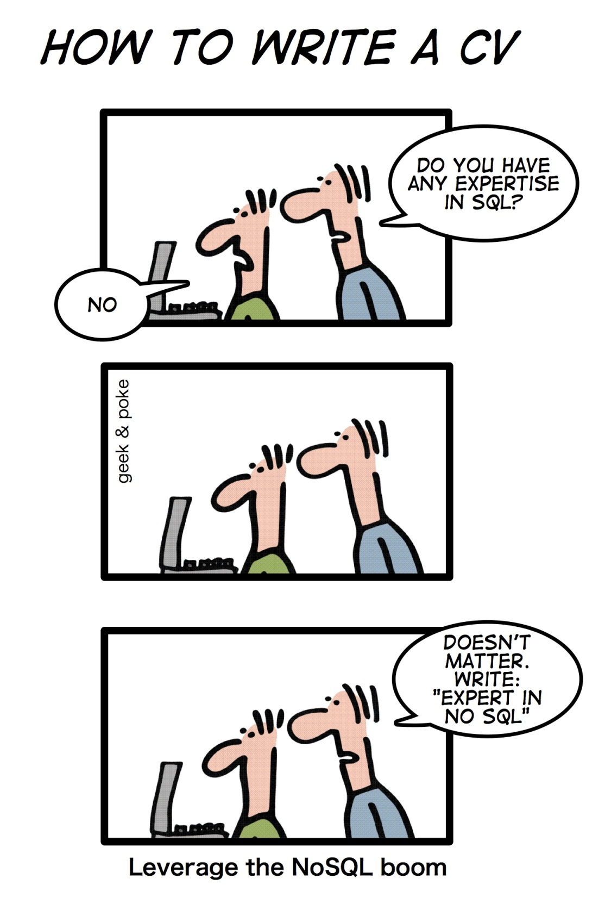

Slide 4
SQL Characteristics
Data stored in rows, columns and tables
Relationships represented by data
Data Manipulation Language
Data Definition Language
Transactions
Abstraction from physical layer

Slide 5
SQL Physical Layer Abstraction
Applications specify what, not how
Query optimization engine
Physical layer can change without modifying applications
Create indexes to support queries
In Memory databases

Slide 6
Data Manipulation Language (DML)
Data manipulated with Select, Insert, Update, & Delete statements
Select T1.Column1, T2.Column2 … From Table1, Table2 … Where T1.Column1 = T2.Column1 …
Data Aggregation
Compound statements
Functions and Procedures
Explicit transaction control

Slide 7
Data Definition Language
Schema defined at the start
Create Table (Column1 Datatype1, Column2 Datatype 2, …)
Constraints to define and enforce relationships
Primary Key
Foreign Key
Etc.
Triggers to respond to Insert, Update , & Delete
Stored Modules
Alter …
Drop …
Security and Access Control

Slide 8
Transactions – ACID Properties
Atomic – All of the work in a transaction completes (commit) or none of it completes
Consistent – A transaction transforms the database from one consistent state to another consistent state. Consistency is defined in terms of constraints.
Isolated – The results of any changes made during a transaction are not visible until the transaction has committed.
Durable – The results of a committed transaction survive failures

Slide 9
NewSQL: real-time analytics
) SQL as the primary mechanism for application interaction
2) ACID support for transactions
3) A non-locking concurrency control mechanism so real-time reads will not conflict with writes, and thereby cause them to stall.
4) An architecture providing much higher per-node performance than available from the traditional "elephants”
5) A scale-out, shared-nothing architecture, capable of running on a large number of nodes without bottlenecking
Notes:
This is the panacea
NewSQL is a class of modern relational database management systems that seek to provide the same scalable performance of NoSQL systems for online transaction processing (OLTP) read-write workloads while still maintaining the ACID guarantees of a traditional database system.

Slide 10
NoSQL Definition
From www.nosql-database.org:
Next Generation Databases mostly addressing some of the points: being non-relational, distributed, open-source and horizontal scalable. The original intention has been modern web-scale databases. The movement began early 2009 and is growing rapidly. Often more characteristics apply as: schema-free, easy replication support, simple API, eventually consistent / BASE (not ACID), a huge data amount, and more.

Slide 11
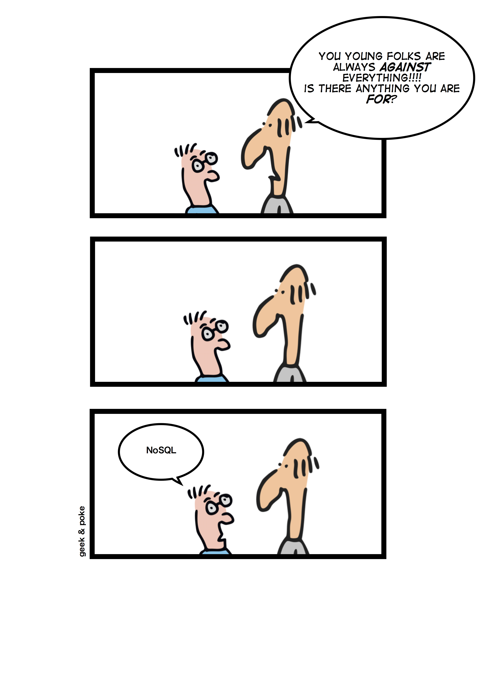
NoSQL Products/Projects
http://www.nosql-database.org/ lists > 225 NoSQL Databases
Cassandra
CouchDB
Hadoop & Hbase
MongoDB
StupidDB
Etc.

Slide 12
NoSQL Distinguishing Characteristics
Large data volumes
Google’s “big data”
Scalable replication and distribution
Potentially thousands of machines
Potentially distributed around the world
Queries need to return answers quickly
Mostly query, few updates
Asynchronous Inserts & Updates
Schema-less
ACID transaction properties are not needed – BASE
CAP Theorem
Open source development

Slide 13
BASE Transactions
Acronym contrived to be the opposite of ACID
Basically Available,
Soft state,
Eventually Consistent
Characteristics
Weak consistency – stale data OK
Availability first
Best effort
Approximate answers OK
Aggressive (optimistic)
Simpler and faster

Slide 14
Brewer’s CAP Theorem
A distributed system can support only two of the following characteristics:
Consistency
Availability
Partition tolerance
Notes:
n theoretical computer science, the CAP theorem, also known as Brewer's theorem, states that it is impossible for a distributed computer system to simultaneously provide all three of the following guarantees:^{[1][2][3]}
Consistency (all nodes see the same data at the same time) – not the same as consistency in ACID
Availability (a guarantee that every request receives a response about whether it was successful or failed)
Partition tolerance (the system continues to operate despite arbitrary message loss or failure of part of the system)

Slide 15
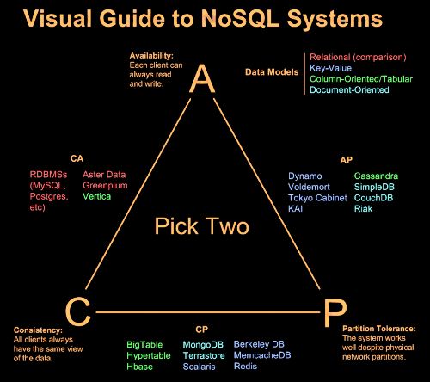

Slide 16
NoSQL Database Types
Discussing NoSQL databases is complicated because there are a variety of types:
Column Store – Each storage block contains data from only one column
Document Store – stores documents made up of tagged elements
Key-Value Store – Hash table of keys

Slide 17
NoSQL Example: Column Store
Each storage block contains data from only one column
Example: Hadoop/Hbase
http://hadoop.apache.org/
Yahoo, Facebook
Example: Ingres VectorWise
Column Store integrated with an SQL database
http://www.ingres.com/products/vectorwise

Slide 18
Column Store Comments
More efficient than row (or document) store if:
Multiple row/record/documents are inserted at the same time so updates of column blocks can be aggregated
Retrievals access only some of the columns in a row/record/document

Slide 19
Other Non-SQL Databases
XML Databases
Graph Databases
Codasyl Databases
Object Oriented Databases
Etc…
Will not address these today

Slide 20
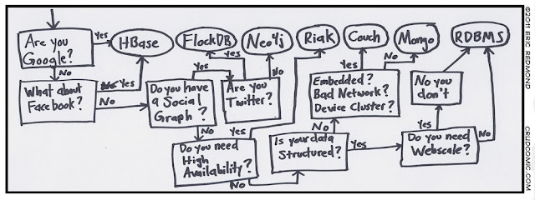

Slide 21
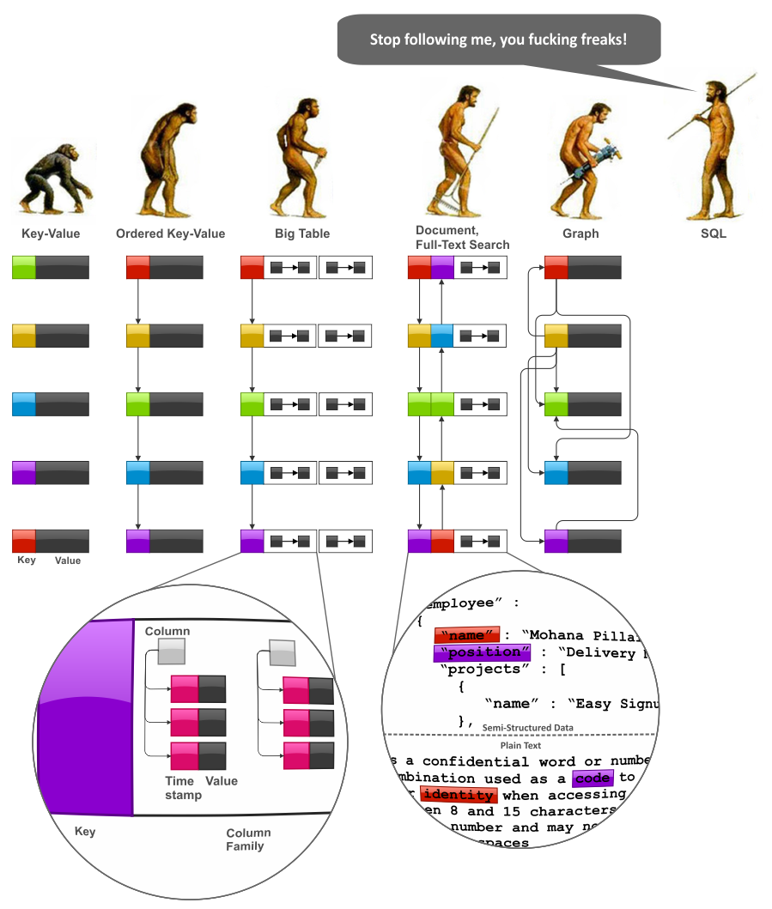
Notes:
BigTable: On the clustered systems the database was designed and it uses a simple data model that has been described by Google as a persistent, sparse, distributed, multi-dimensional sorted map.

Slide 22
Storing and Modifying Data
Syntax varies
HTML
Java Script
Etc.
Asynchronous – Inserts and updates do not wait for confirmation
Versioned
Optimistic Concurrency

Slide 23
Retrieving Data
Syntax Varies
No set-based query language
Procedural program languages such as Java, C, etc.
Application specifies retrieval path
No query optimizer
Quick answer is important
May not be a single “right” answer

Slide 24
Open Source
Small upfront software costs
Suitable for large scale distribution on commodity hardware

Slide 25
NoSQL Summary
NoSQL databases reject:
Overhead of ACID transactions
“Complexity” of SQL
Burden of up-front schema design
Declarative query expression
Yesterday’s technology
Programmer responsible for
Step-by-step procedural language
Navigating access path

Slide 26
Summary
SQL Databases
Predefined Schema
Standard definition and interface language
Tight consistency
Well defined semantics
NoSQL Database
No predefined Schema
Per-product definition and interface language
Getting an answer quickly is more important than getting a correct answer

Slide 27
Web References
“NoSQL -- Your Ultimate Guide to the Non - Relational Universe!” http://nosql-database.org/links.html
“NoSQL (RDBMS)” http://en.wikipedia.org/wiki/NoSQL
PODC Keynote, July 19, 2000. Towards Robust. Distributed Systems. Dr. Eric A. Brewer. Professor, UC Berkeley. Co-Founder & Chief Scientist, Inktomi . www.eecs.berkeley.edu/~brewer/cs262b-2004/PODC-keynote.pdf
“Brewer's CAP Theorem” posted by Julian Browne, January 11, 2009. http://www.julianbrowne.com/article/viewer/brewers-cap-theorem
“How to write a CV” Geek & Poke Cartoon http://geekandpoke.typepad.com/geekandpoke/2011/01/nosql.html

Slide 28
Web References
“Exploring CouchDB: A document-oriented database for Web applications”, Joe Lennon, Software developer, Core International. http://www.ibm.com/developerworks/opensource/library/os-couchdb/index.html
“Graph Databases, NOSQL and Neo4j” Posted by Peter Neubauer on May 12, 2010 at: http://www.infoq.com/articles/graph-nosql-neo4j
“Cassandra vs MongoDB vs CouchDB vs Redis vs Riak vs HBase comparison”, Kristóf Kovács. http://kkovacs.eu/cassandra-vs-mongodb-vs-couchdb-vs-redis
“Distinguishing Two Major Types of Column-Stores” Posted by Daniel Abadi onMarch 29, 2010 http://dbmsmusings.blogspot.com/2010/03/distinguishing-two-major-types-of_29.html

Slide 29
Web References
“MapReduce: Simplified Data Processing on Large Clusters”, Jeffrey Dean and Sanjay Ghemawat, December 2004. http://labs.google.com/papers/mapreduce.html
“Scalable SQL”, ACM Queue, Michael Rys, April 19, 2011 http://queue.acm.org/detail.cfm?id=1971597
“a practical guide to noSQL”, Posted by Denise Miura on March 17, 2011 at http://blogs.marklogic.com/2011/03/17/a-practical-guide-to-nosql/

