Slide 1
Caregiver Module Analysis
By: Matthew Leffler, Nairui Liu, Keerthika Loganathan, and Justin Aboud

Slide 2
Business Problem
Approximately 18% of the population of the United States (43.5 million people) care for a family member or friend over 50 years of age (National Alliance for Caregiving & AARP, 2009)
Increases in resources directly correlate to a reduction in burden and higher perceived health; however, in practice, there is currently a negative relationship between caregiving situations and resources (Harrington & Hong, 2016)
That is, more stressful caregiving situations are not correlated with an increase of incoming resources
Link to CDC Data Caretaker Survey Summary:
https://drive.google.com/file/d/1YW35yvSMdcIOhp87z108duUgy1buJetC/view?usp=sharing

Slide 3
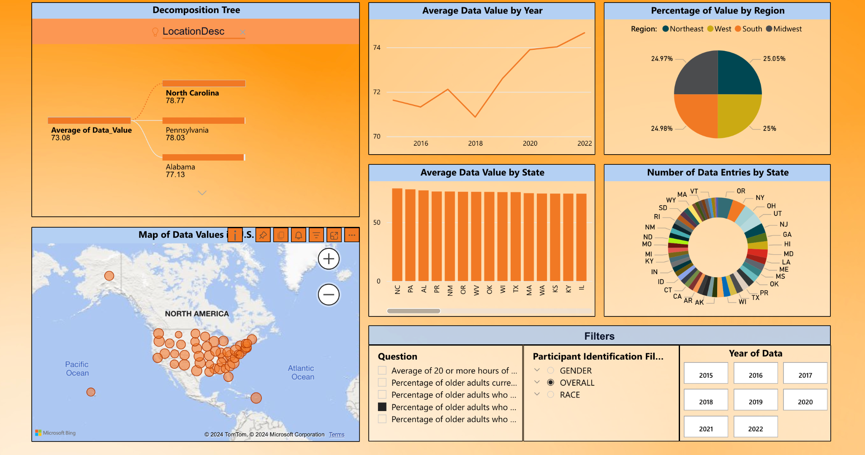
Percentage of Older Adults Providing Care for 6+ Months

Slide 4
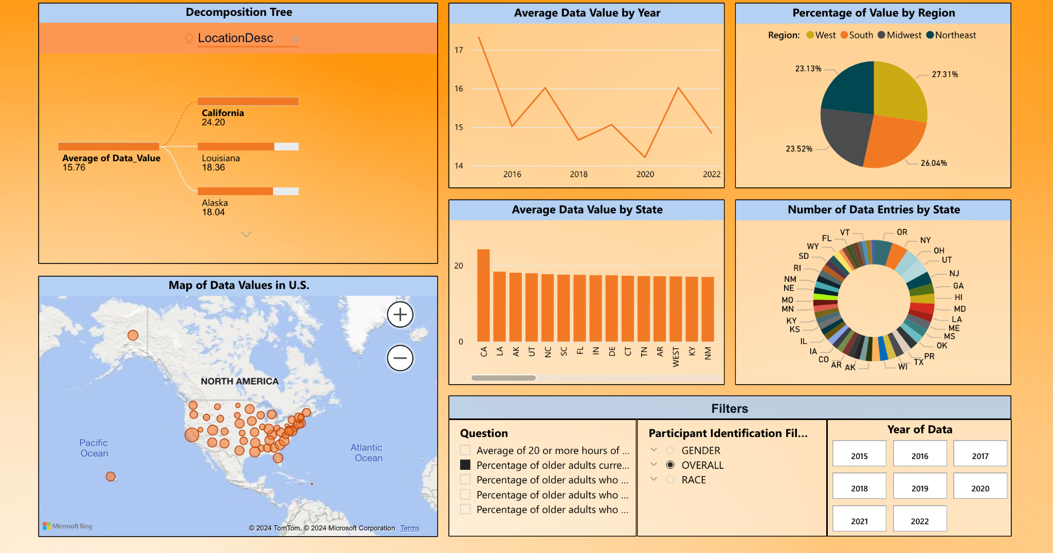
Percentage of Older Adults Expecting to Provide Care

Slide 5
Business Question
With health concerns being at the forefront of news over the past decade, how has this affected caretakers throughout the US?
What type of issues are caretakers facing in their day-to-day lives, and where should resources be allocated to improve the wellbeing of them and their patients?

Slide 6
Dataset Description
Developed by CDC to collect data on caretakers to make decisions on policies affecting caretakers (Centers for Disease Control and Prevention)
Provides insights about
Patients
Diseases
Number of inactive days
Cognitive disorders
Etc.
Caretakers
Race
Gender
Location
Number of hours working, percentage of older adults (65+) providing care, etc.

Slide 7
EDA
Question:
With 39 different questions offered in the dataset, how do we focus on which responses to focus on?
Approach:
Find the questions with the most drastic changes in values during the duration of the study.

Slide 8
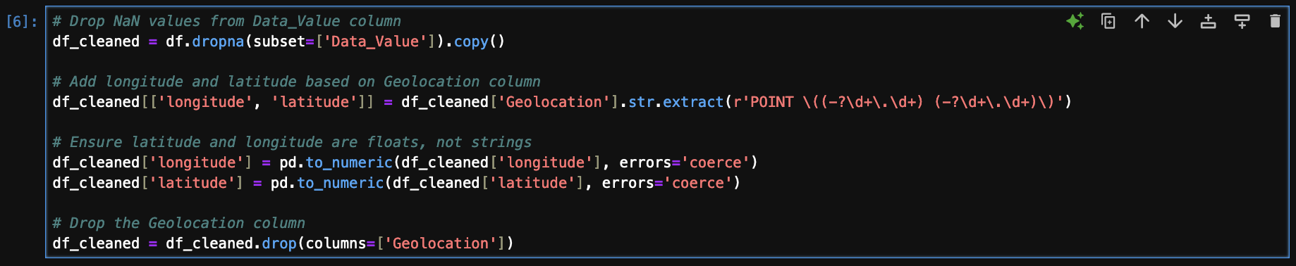
EDA Cont. (Data Munging)
Remove rows with NaN values in
Separate latitude and longitude in Geolocation column
Done for plotting on Tableau/Power BI Maps
Drop Geolocation column
Split data based on whether row contains percentages or averages

Slide 9
EDA Cont. (Data Filtering)
With data cleaned, want to extract data with largest changes for duration of study.
Process:
Group data by question and year
Order matters
Perform aggregation on result to find minimum and maximum value in column based on question
Calculate difference between minimum and maximum values
Extract questions with a 10% increase in data

Slide 10
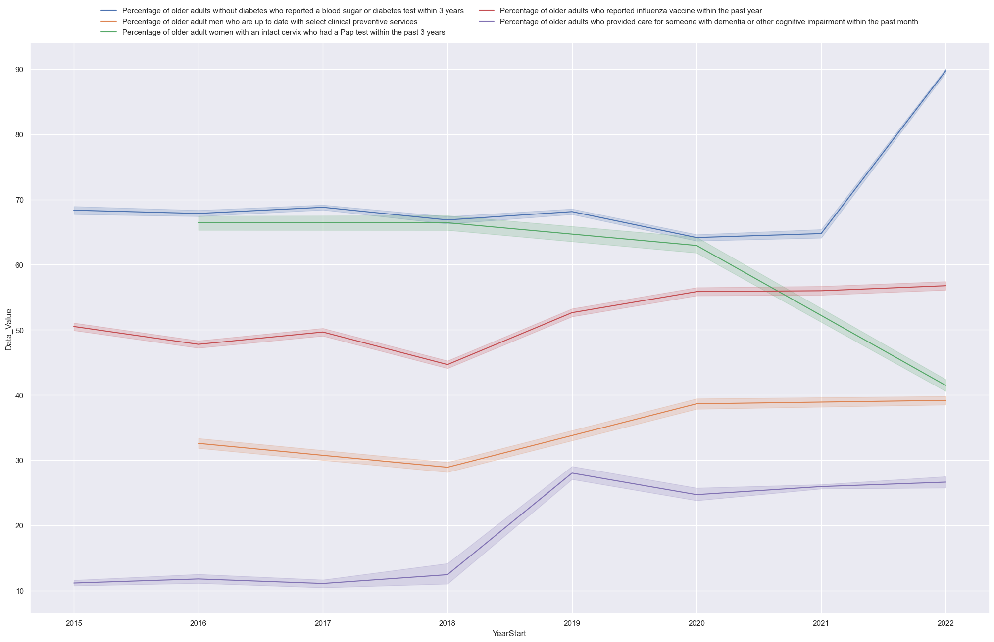
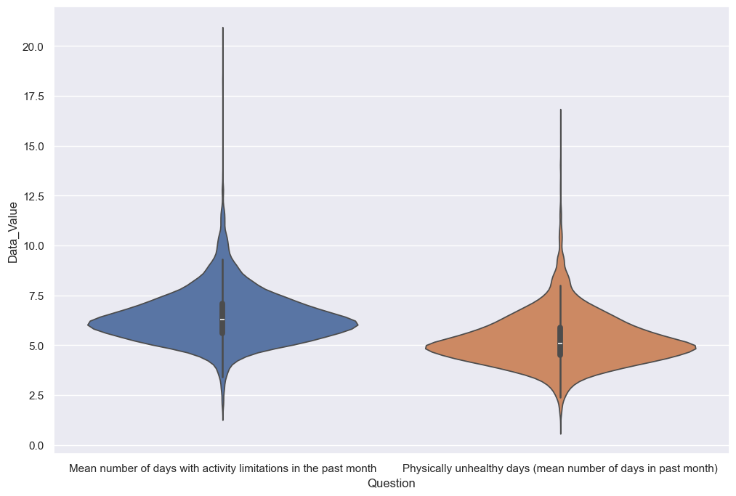
EDA Cont. (Data Visualization)

Slide 11
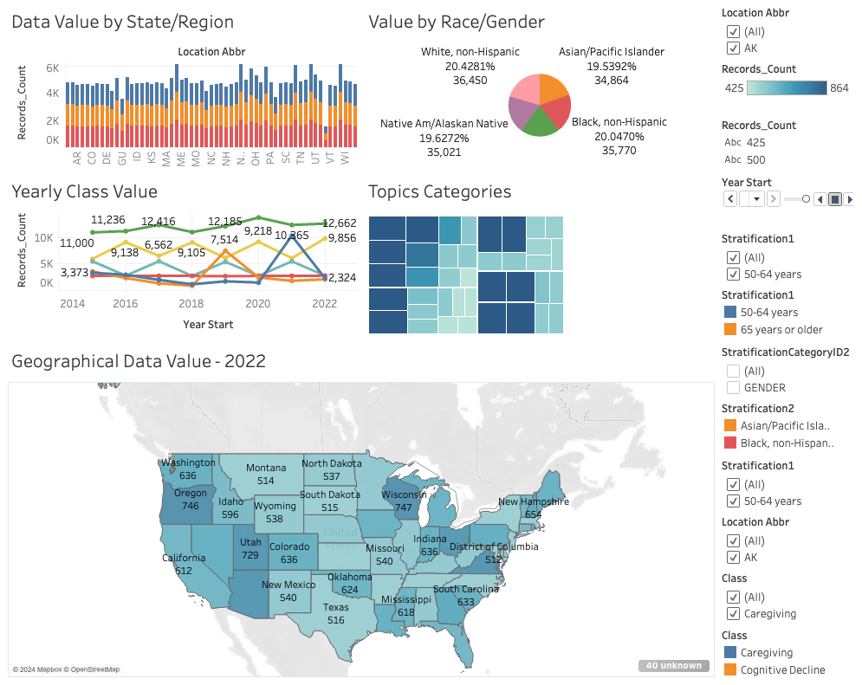
Dashboard Screenshots

Slide 12
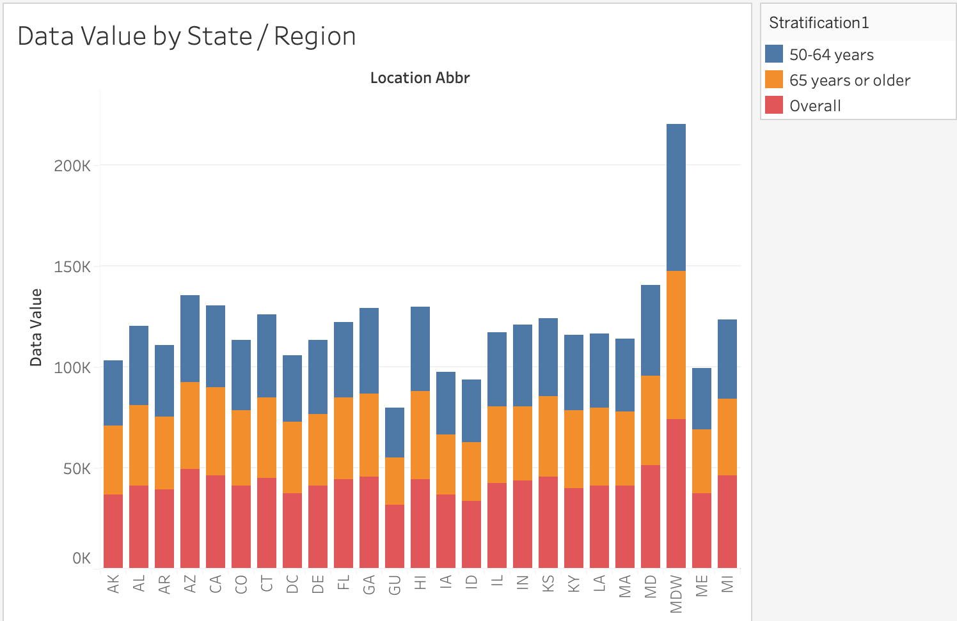
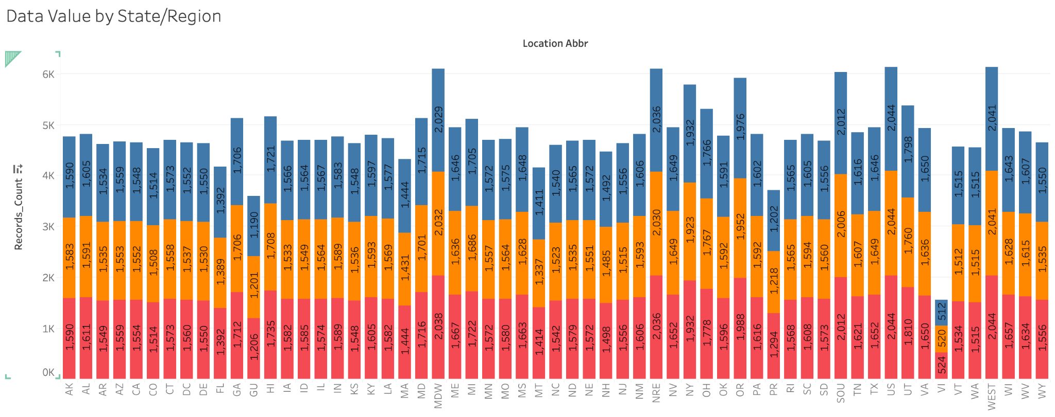
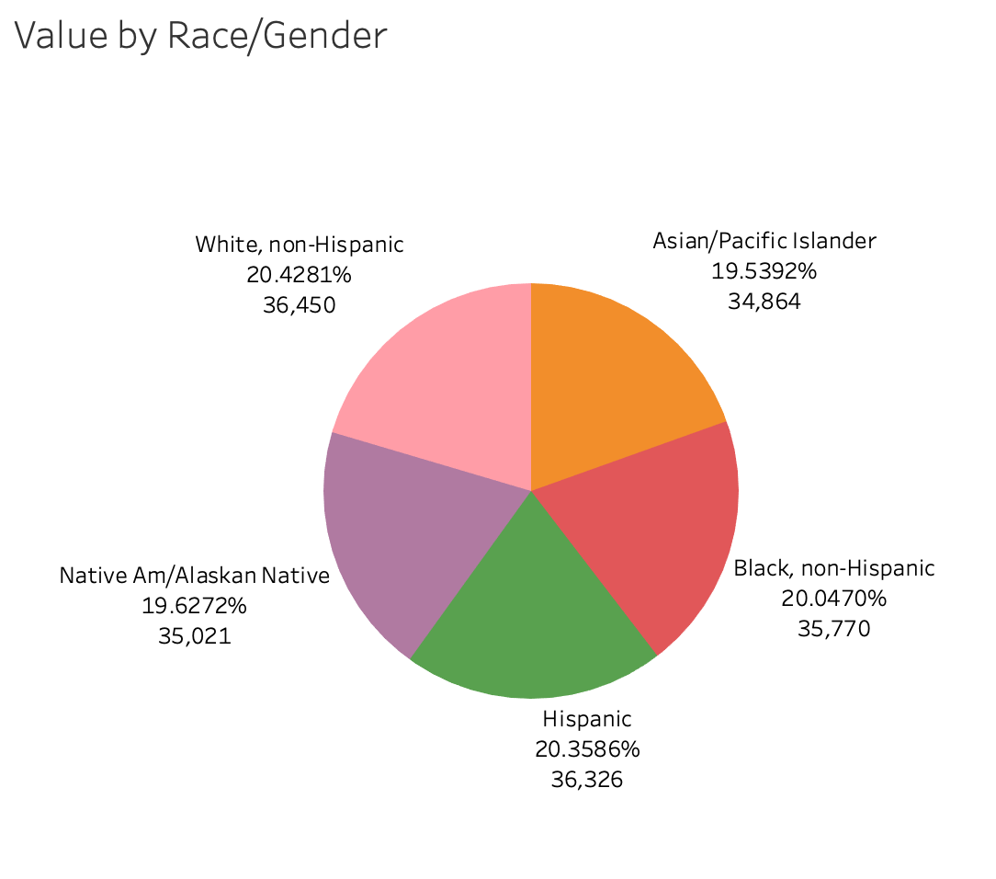
Dashboard Screenshots

Slide 13
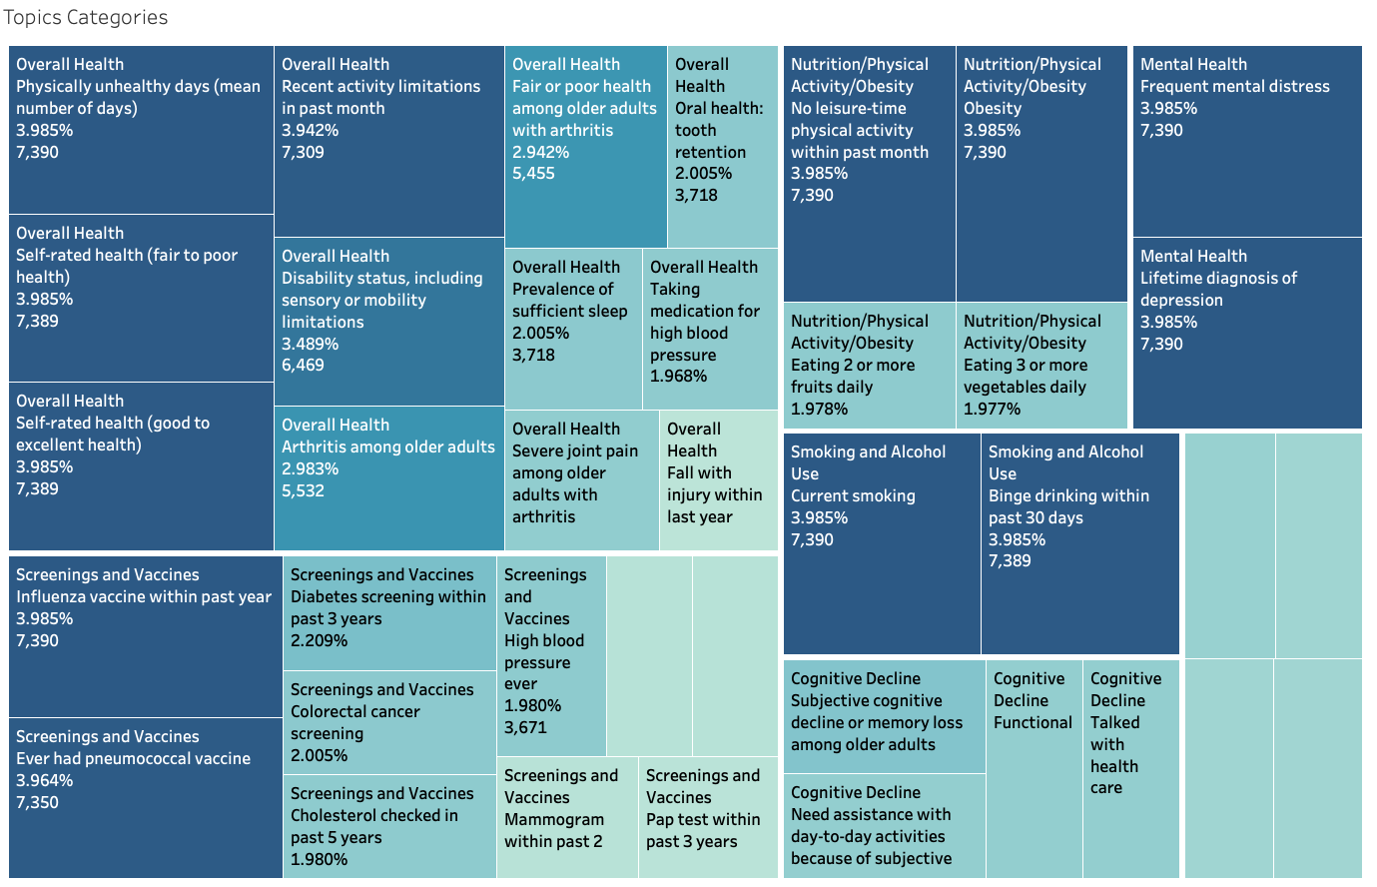
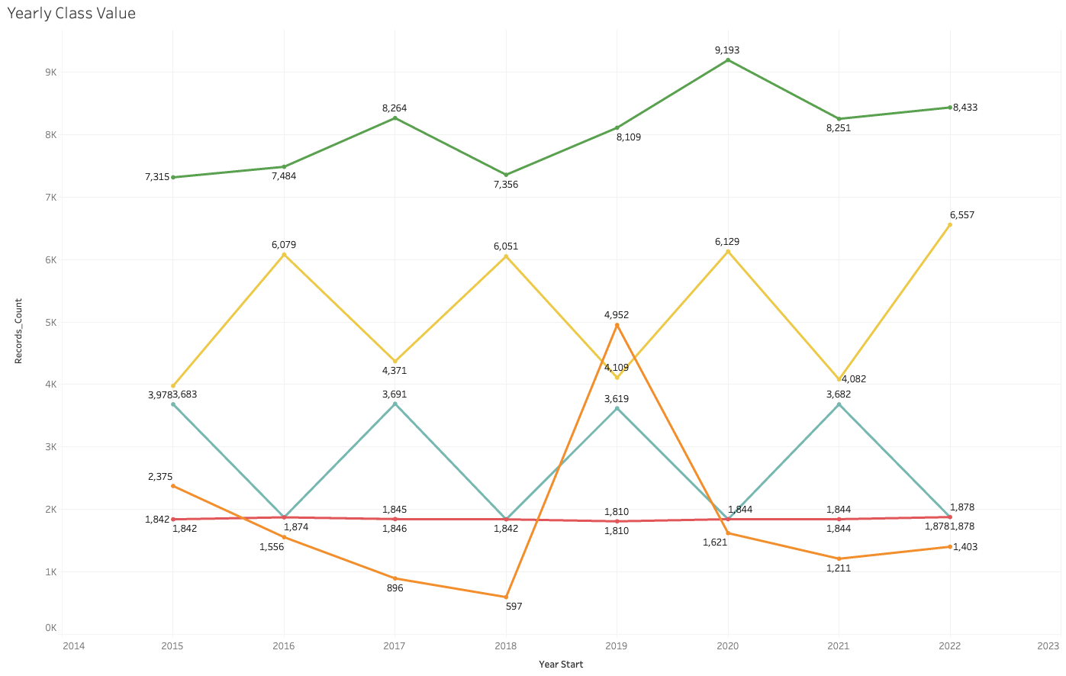
Dashboard Screenshots

Slide 14
Advanced Features
1. Interactive Dashboards
Build dashboards using tools like Tableau, Power BI to enable dynamic exploration of life expectancy and caregiving trends.
2. Geospatial Analysis
Visualize the data on a map to study geographic disparities in life expectancy or caregiving.
Analyze the impact of regional healthcare policies on life expectancy using geographic clustering methods.
Regional insights, policy implications and correlation exploration.

Slide 15

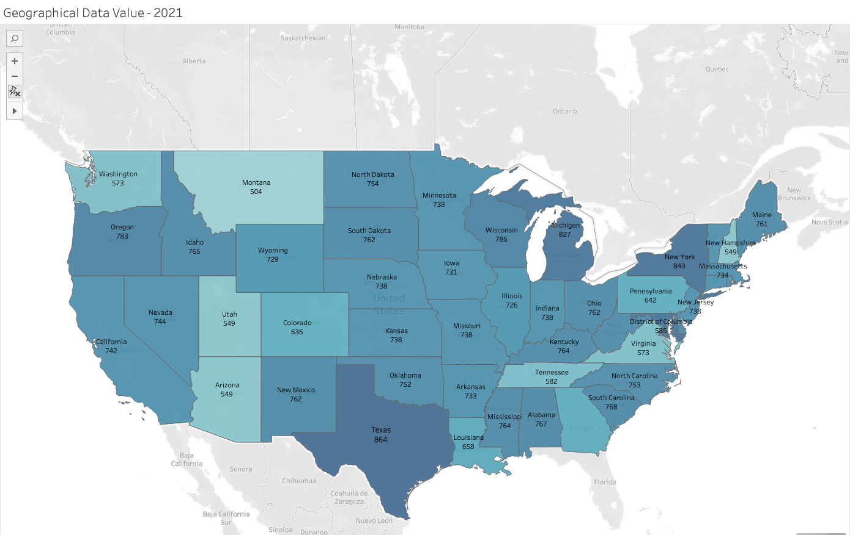
Dashboard Screenshots

Slide 16
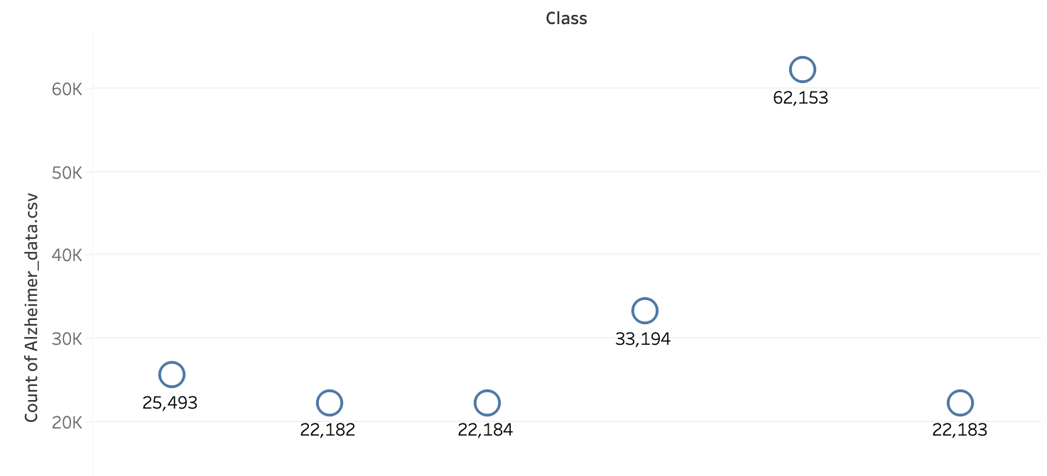
Conclusion
Caretakers have to deal with not only the mental and physical strain of taking care of individuals with health concerns but they also have to deal with the financial implications that come with it as well
Resources should be allocated to struggling regions and states
In order to improve wellbeing across the board, the major issues should be at the forefront of the attack for resources
Prioritized resources can not only help patients directly but can also help their caretakers as well by lessening their load and freeing up their time

Slide 17
Next Steps
Understand the connection within the data
Narrow our scope of research and isolate the dependent and independent variables
Dissect the data in different ways (creating new graphs and more diverse dashboards)
Understand when to simplify our research and when to add complexity
Identify any outliers (if we encounter any) throughout our research

Slide 18
References
Centers for Disease Control and Prevention. (n.d.-a). Alzheimer’s disease and healthy aging data: Explore by location. Centers for Disease Control and Prevention. https://nccd.cdc.gov/aging_data/rdPage.aspx?rdReport=DPH_HAP.ExploreByLocation&rdRequestForwarding=Form
Centers for Disease Control and Prevention. (n.d.-b). Behavioral risk factor surveillance system (BRFSS) caregiver module. Centers for Disease Control and Prevention. https://www.cdc.gov/healthy-aging-data/brfss/caregiver.html
Harrington D, Hong M. The Effects of Caregiving Resources on Perceived Health among Caregivers. Health Soc Work. 2016 Aug 1;41(3):155-163. doi: 10.1093/hsw/hlw025. PMID: 29206951; PMCID: PMC4985882.
National Alliance for Caregiving & AARP. (2009). Caregiving in the U.S 2009: A focused look at those caring for the 50+. Retrieved from http://assets.aarp.org/rgcenter/il/caregiving_09.pdf [Google Scholar]

