Slide 1
SOFT20091: Software Design & Imp (SDI)
Week 2
Dr Vishal Thakor

Slide 2
Class and Objects

Slide 3
Classes & Objects
C++ Program Structure
Class definition : Data members
Class definition : Member Functions
Class definition : Access Control
Class definition : Member Functions
Declaration of Objects

Slide 4
C++ Program Structure
General C++ program structure
class class_name
{
private:
... //data member
... //data member
public:
... //members function
... //members function
};
main()
{
class_name obj1;
class_name obj2;
...
...
}
Typical C++ Programs consist of:
A main function
One or more classes
Each class contains
data members
member functions

Slide 5
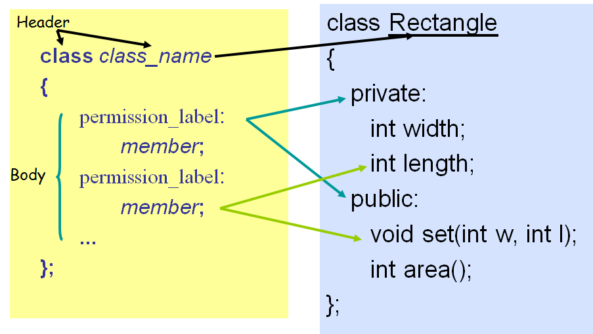
Define a Class Type
Defining a Class

Slide 6
Class definition : Data members
Class data members
non-static data member
Each class object has its own copy
static data member
Acts as a global variable
One copy per class type, e.g. count
class Rectangle
{
private:
int width;
int length;
static int count;
public:
void set(int w, int l);
int area();
}
Objects: Instances of the Class
Rectangle r1;
Rectangle r2;
Rectangle r3;
count
r1
r2
width
length
width
length
width
length
r3

Slide 7
Class member functions
class Rectangle
{
private:
int width, length;
public:
void set (int w, int l);
int area() {return width*length;}
};
Member functions are used to
access the values of the data members (accessor)
perform operations on the data members (implementer)
Are declared inside the class body
Their definition can be placed inside the class body, or outside the class body
Can access both public and private members of the class
Can be referred to using dot or arrow member access operator
class name
member function name
inline
void Rectangle :: set (int w, int l)
{
width = w;
length = l;
}
r1.set(5,8);
r2->set(8,10);
Referral
scope operator
Notes:
foo->bar() is the same as (*foo).bar().
The parenthesizes above are necessary because of the binding strength of the * and . operators.
*foo.bar() wouldn't work because Dot (.) operator is evaluated first (see operator precedence)
The Dot (.) operator can't be overloaded, arrow (->) operator can be overloaded.
The Dot (.) operator can't be applied to pointers.

Slide 8
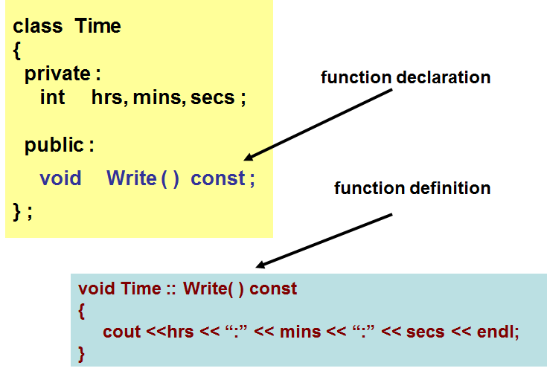
Class member functions
const member function
declaration
return_type func_name (para_list) const;
definition
return_type func_name (para_list) const ← inline
{
…
…
…
}
return_type class_name :: func_name (para_list) const
{
…
…
…
}
Makes no modification to the data members (safe function)
Notes:
To make Write() a const member function, we simply append the const keyword to the function prototype, after the parameter list, but before the function body:
Now Write() has been made a const member function, which means we can call it on any const objects.

Slide 9
Class definition: Access Control
class Rectangle
{ public: // Public access specifier int w; // Public data member private: // Private access specifier int l; // Private data member }; int main()
{ Rectangle r1; r1.w = 20; // Allowed (public)
r1.l = 10; // Not allowed (private) return 0; }
Information hiding
To prevent direct access to data members and member functions from outside the class
Access Specifiers
public
Accessible from anywhere within a program
private
Accessible only by the member functions, and friends of this class
protected
acts as public for derived classes
private for the rest of the program
Accessibility | Public members | Protected members | Private members
Base Class | √ | √ | √
Derived Class | √ | √ | ×

Slide 10
What is an object?
OBJECT
set of methods
(member functions)
internal state
(values of private data members)
Operations
Data

Slide 11
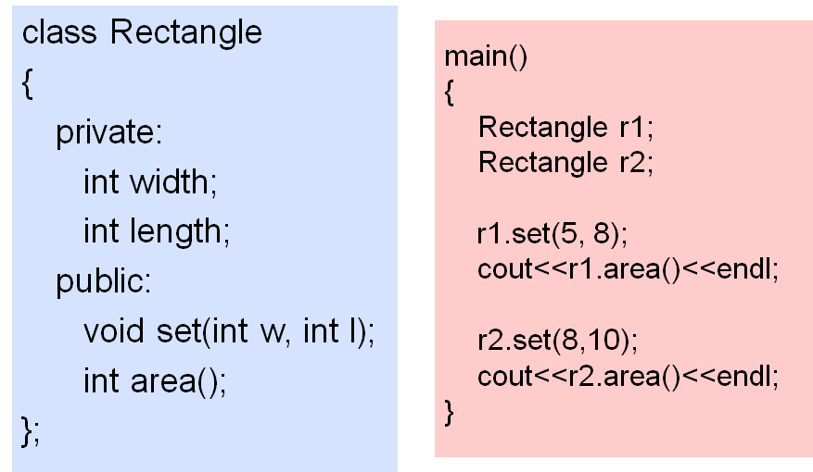
Declaration of Object(s)

Slide 12
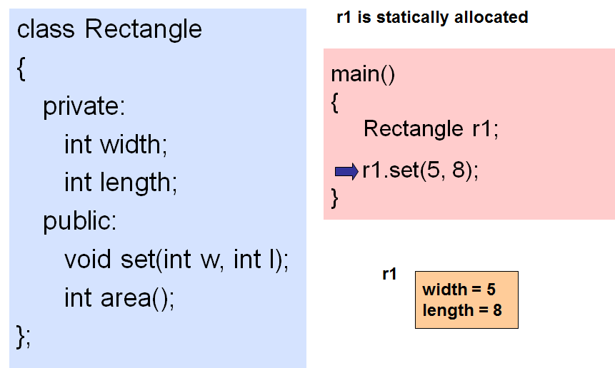
Declaration of Object(s)

Slide 13
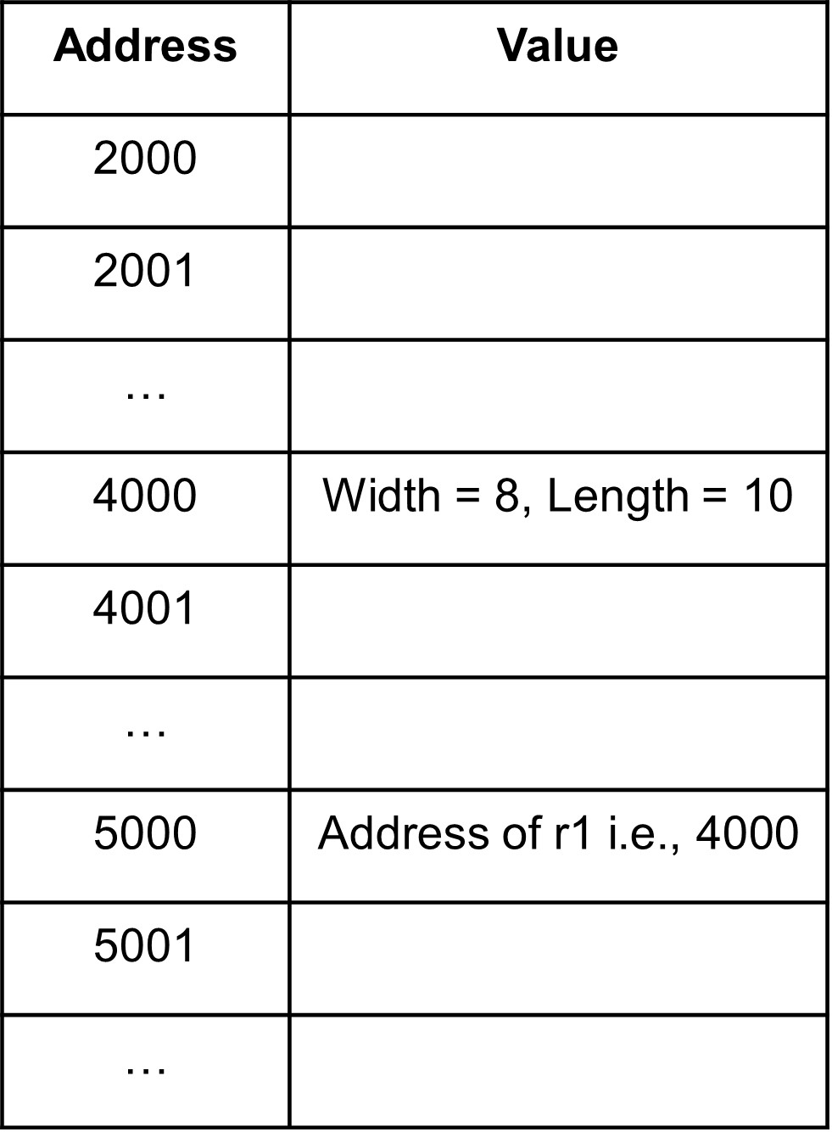
Declaration of Object(s)
Pointer and memory
class Rectangle
{
private:
int width;
int length;
public:
void set(int w, int l);
int area();
};
r2 is a pointer to a Rectangle object
Address | Value
2000
2001
…
4000 | Width = 5, Length = 8
4001
…
5000
5001
…
main()
{
Rectangle r1;
r1.set(5, 8);
Rectangle *r2;
r2 = &r1;
r2->set(8,10);
}
//dot notation
r1
r1
//arrow notation
r2
4000
4000
r2
r1
r1
5000
width = 8
length = 10
5000
width = 5
length = 8
4000
???
Referral

Slide 14

Declaration of Object(s)
#include <iostream.h>
class circle
{
public:
double radius;
};
1. By Assignment
Only work for public data
members
No control over the operations
on data members
int main()
{
circle c1; // Declare an instance of the class circle
c1.radius = 5; // Initialize by assignment
}

Slide 15
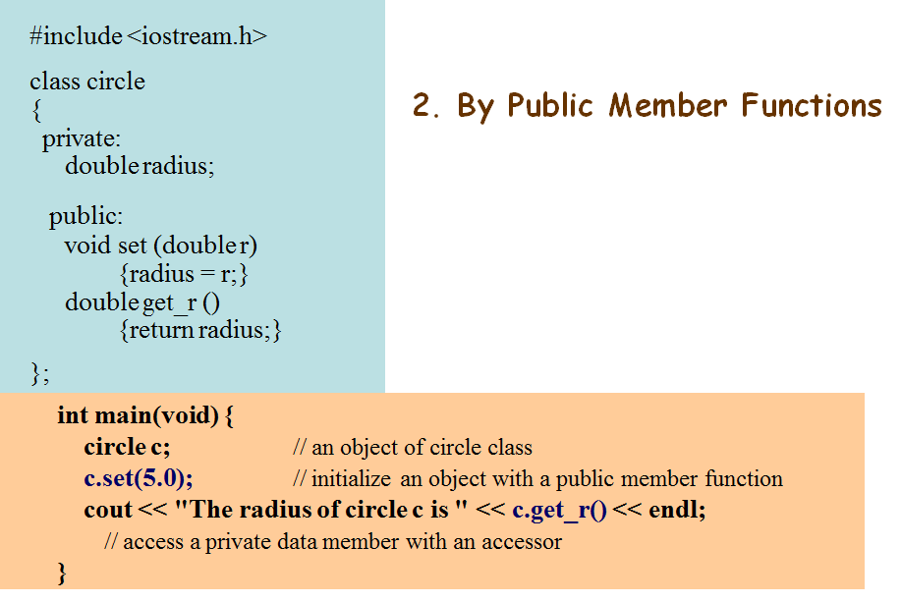

Declaration of Object(s)

Slide 16

Constructor - Automatically initialize the class data members
#include <iostream>
#include <string>
using namespace std;
class student
{
private:
int s_id;
string s_name;
public:
student() //Default constructor
{
cout << "Default Constructor" << endl;
s_id = 0;
s_name = "abc";
}
student(int id, string name) //Parameterised constructor
{
cout << "Parameterised Constructor" << endl;
s_id = id;
s_name = name;
}
void display()
{
cout << "Student id: " << s_id <<", "<<"name: " << s_name << endl;
}
};
int main()
{
student s1;
student s2(5, "xyz");
s1.display();
s2.display();
}
Output:

Slide 17
Destructor - Cleanup of an Object
#include <iostream>
#include <string>
using namespace std;
class student
{
private:
int s_id;
string s_name;
public:
student(); //Default constructor
student(int id, string name); //Parameterised constructor
void display();
~student(); //Destructor
};
student :: ~student()
{
cout << "Destructor called, resources freed!!!" << endl;
}
int main()
{
student s1;
student s2(5, "xyz");
s1.display();
s2.display();
}
Destructor
student :: ~student()
{
cout << "Destructor called, resources freed!!!" << endl;
}
Its name is the same as that of the class name preceded by a ~ (tilde)
It has no argument
It is used to release dynamically allocated memory and to perform other "cleanup" activities
It is executed automatically when the object goes out of scope

Slide 18
Interfacing objects

Slide 19
Separate compilation and linking of files
specification file
main program
time.h
implementation file
main.cpp
time.cpp
#include “time.h”
Compiler
Compiler
main.o
time.o
Linker
mainExec

Slide 20
Objects in Software Engineering

Slide 21
Software Modules versus Objects
Modules are loose groupings of subprograms and data
“Promiscuous” access to data often results in misuse
Subprograms
(behaviors)
Data
(state)
Software Module 1
Software Module 2
Software Module 3
Objects encapsulate data
Example: Object of an Animal
Attributes: name, colour, #legs, #hands, etc
Functions: eat, walk, etc.
Attributes/data
(state)
Methods
(behaviors)
Software Object 1
Software Object 2
Software Object 3

Slide 22
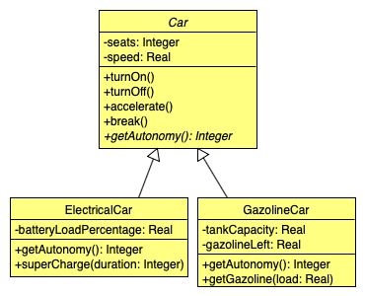
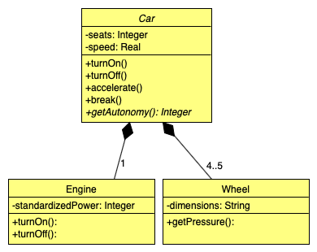
Object Relationships
Inheritance: Inheriting common properties through class extension
Composition: using instance variables that are references to other objects
Inheritance
Composition

Slide 23
Object Relationships (continue…)
Both inheritance and composition extend the base functionality provided by another object
INHERITANCE: Change in the “base” class propagates to the derived class and its client classes
BUT, any code change has a risk of unintentionally introducing bugs.
COMPOSITION: More adaptive to change, because change in the “base” class is easily “contained” and hidden from the clients of the front-end class
Electric Car
Is a
Engine
Car
Has a
Transmission
Inheritance
Composition

Slide 24
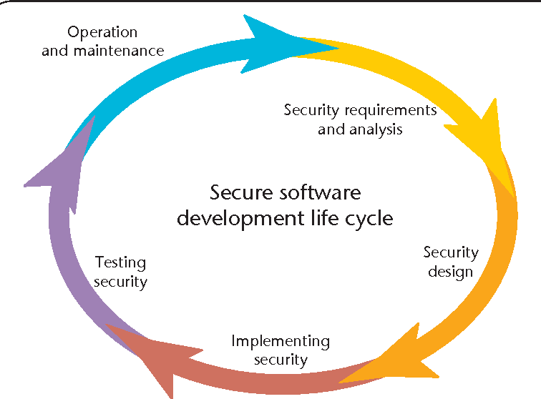
How To Design Well OO Systems?
Traceability:
Testing:
Test-Driven Development (TDD)
Every step in the development process must start with a plan of how to verify that the result meets a goal
The developer should not create a software artefact (a system requirement, a UML diagram, or source code) unless they know how it will be tested
It should be possible to trace the evolution of the system, step-by-step, from individual requirements, through design objects, to code blocks.
Measurement:
We need tools to monitor the product quality
And tools to monitor the developers’ productivity
Security

