Slide 1
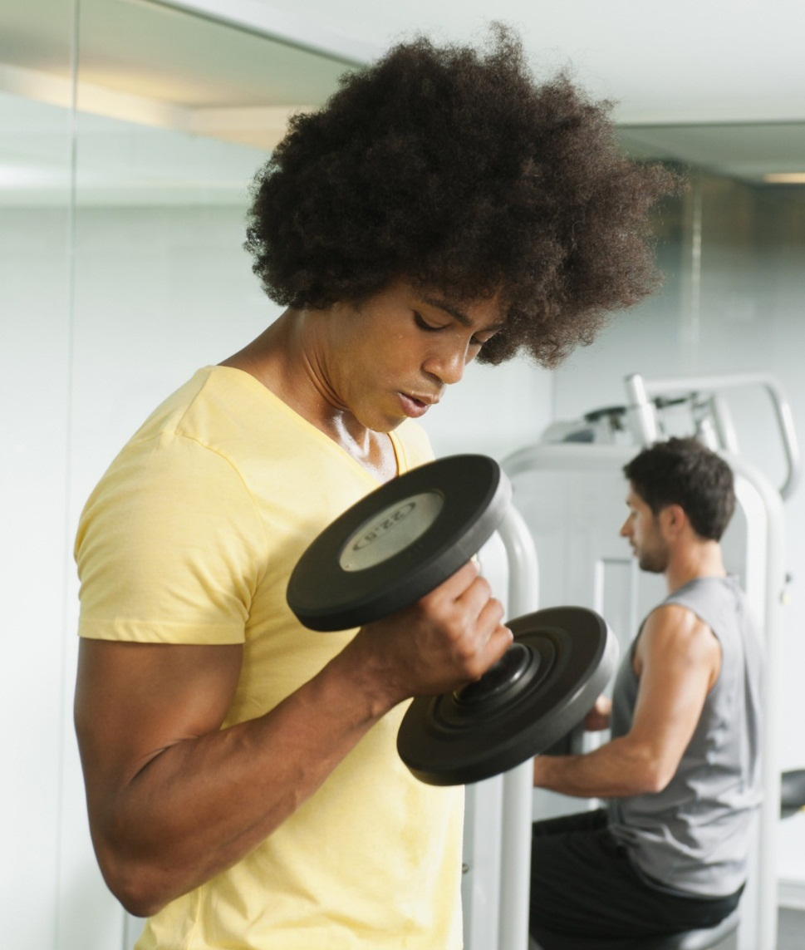
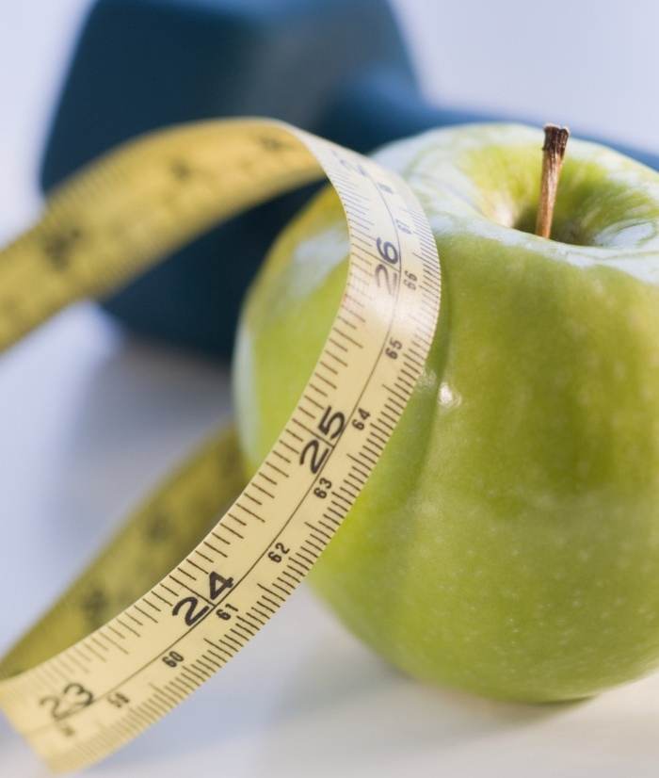
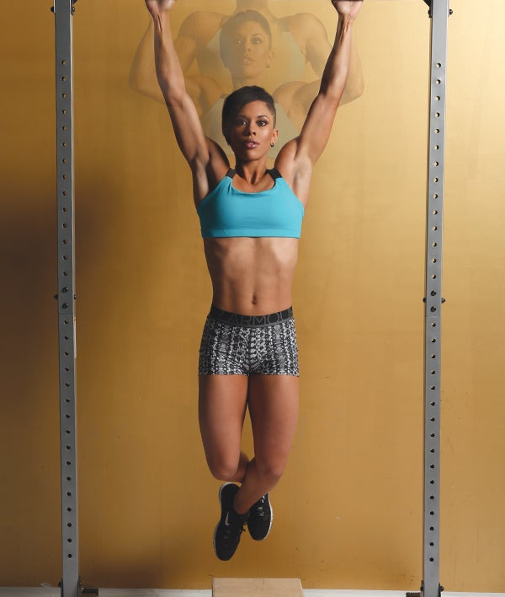
Subreddit classification r/gainit & r/bodyweightfitness
Project 3: Web API & nlp
By: Matthew lio

Slide 2
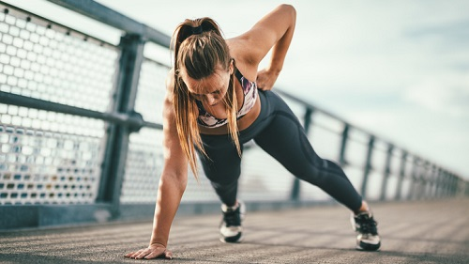
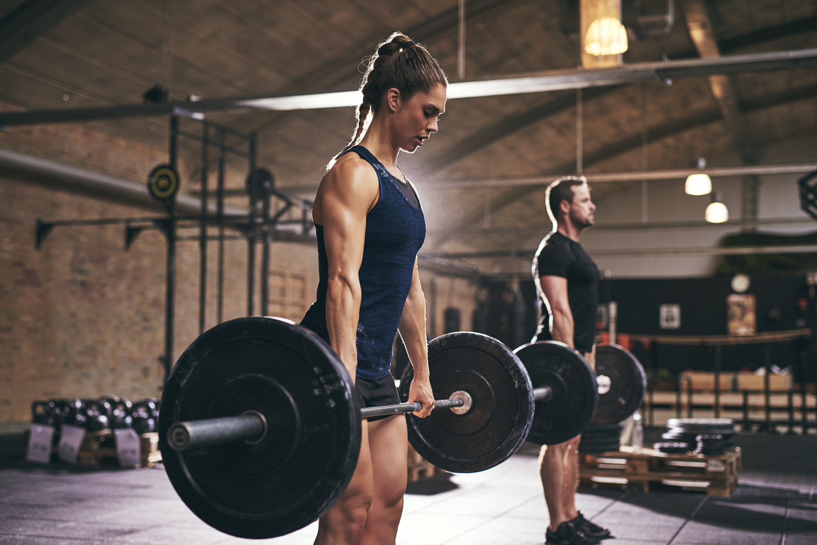
subreddits
r/gainit
Weightlifting
VS
r/bodyweightfitness
Bodyweight

Slide 3

Contents
Introduction
Problem Statement
Cleaning & Pre-processing
Modeling
Performance Summary
Conclusion & Model Limitations
fitnis
&

Slide 4
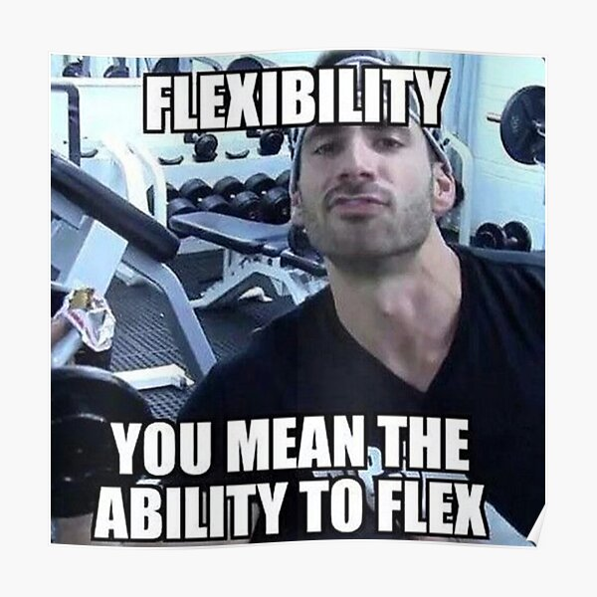
Introduction
Fitness suffers from misinformation online
Diet craze
Wellness trends
Fitness fads
Broscience

Slide 5
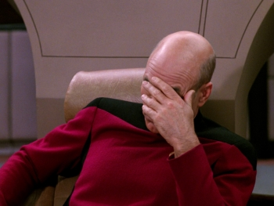
Problem statement
To classify fitness and health related questions or posts into the correct subreddit
  right experts can give proper advice and answers to these posts
INEFFICIENT
TRAINING/
DIET
WRONG
EXPERT
INCORRECT
ADVICE
EVEN
INJURY
=
=
=

Slide 6
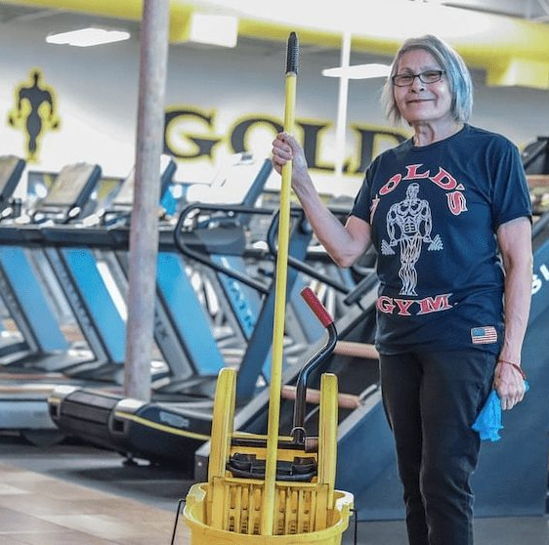
Cleaning & pre-processing
Moderator and Discussion Posts
Common Posts
Spams
Duplicates
Links
Special Characters
Tokenizing & Lemmatizing

Slide 7
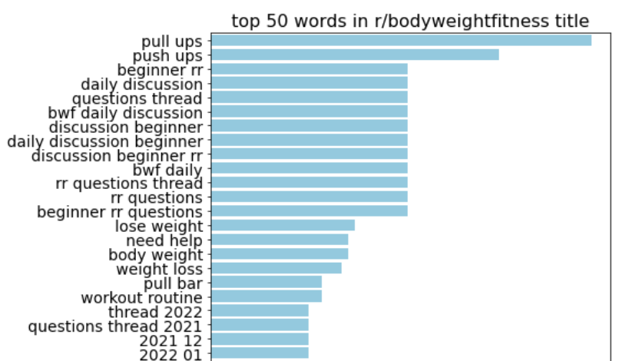
Cleaning & pre-processing
Moderator and Discussion Posts

Slide 8
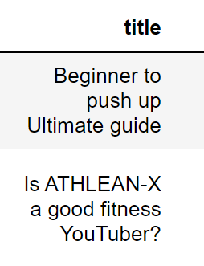
Cleaning & pre-processing
Moderator and Discussion Posts
Common Posts

Slide 9
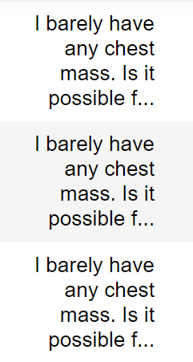
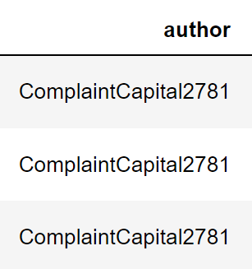
Cleaning & pre-processing
Moderator and Discussion Posts
Common Posts
Spams
Duplicates

Slide 10
Cleaning & pre-processing
Moderator and Discussion Posts
Common Posts
Spams
Duplicates
Links
[Recommended Routine](https://www.reddit.com/r/bodyweightfitness/wiki/kb/recommended_routine)

Slide 11
Cleaning & pre-processing
Moderator and Discussion Posts
Common Posts
Spams
Duplicates
Links
Special Characters
REGEX

Slide 12
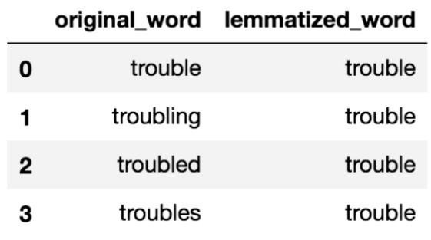
Cleaning & pre-processing
Moderator and Discussion Posts
Common Posts
Spams
Duplicates
Links
Special Characters
Tokenizing & Lemmatizing

Slide 13
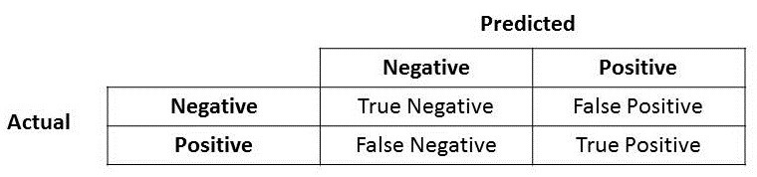
modeling
If wrongly classified, wrong experts would be answering the questions
Incorrect advice -> inefficiency and even injuries
Need to decrease False Positives and False Negatives!
Increase PPV and NPV scores!
DECREASE FP
INCREASE PPV
DECREASE FN
INCREASE NPV
r/gainit
r/bodyweightfitness

Slide 14
modeling
Accuracy
PPV (Positive Predictive Value/Precision)
NPV (Negative Predictive Value)
DECREASE FP
INCREASE PPV
DECREASE FN
INCREASE NPV
r/gainit
r/bodyweightfitness

Slide 15
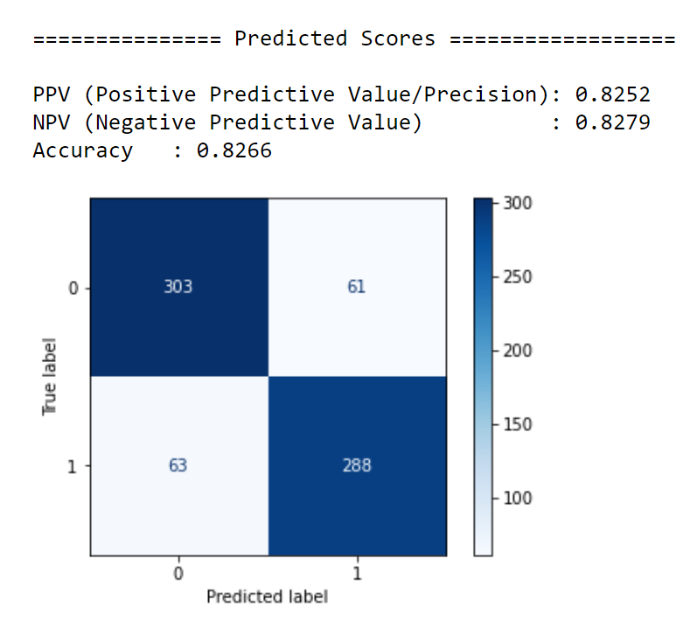
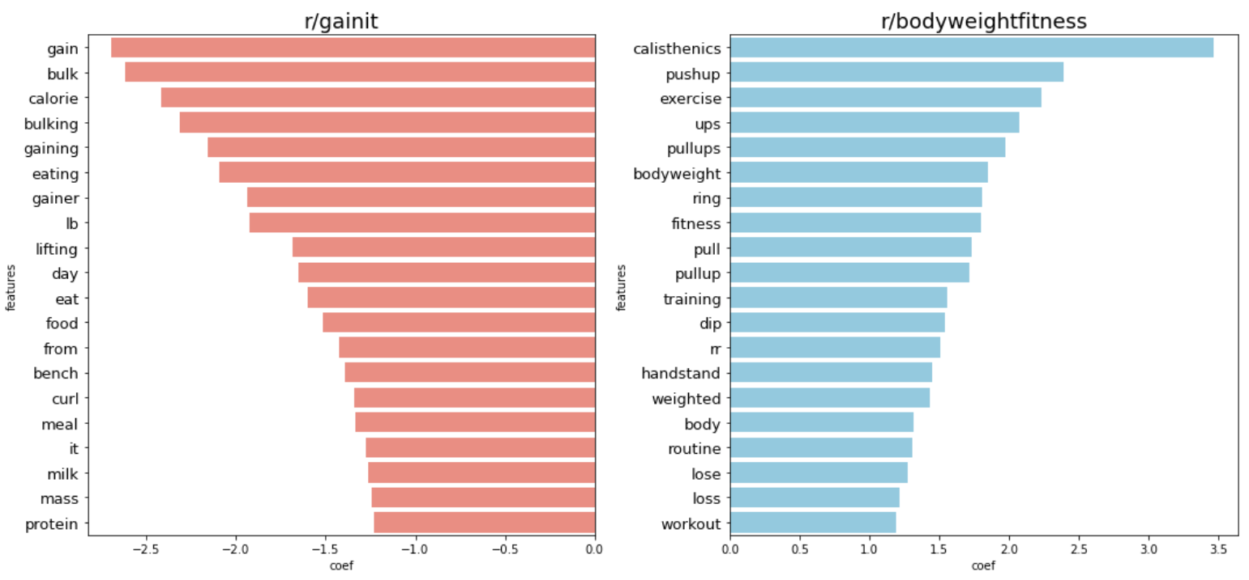
Modeling: Logistic regression w tvec
Primary words for each subreddit!
Mix bag
Mix bag
gain, calorie, lifting, protein
calisthenics, ring, handstand

Slide 16
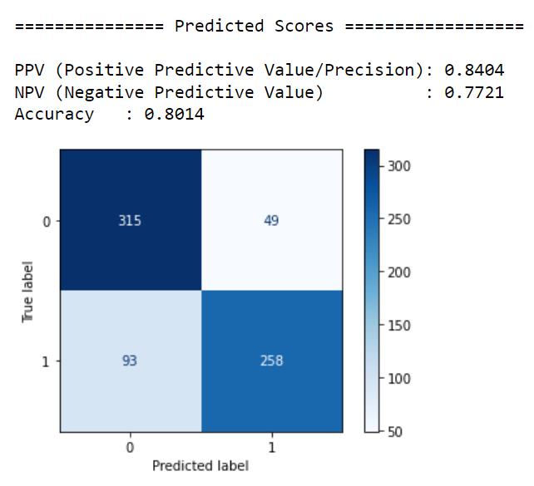
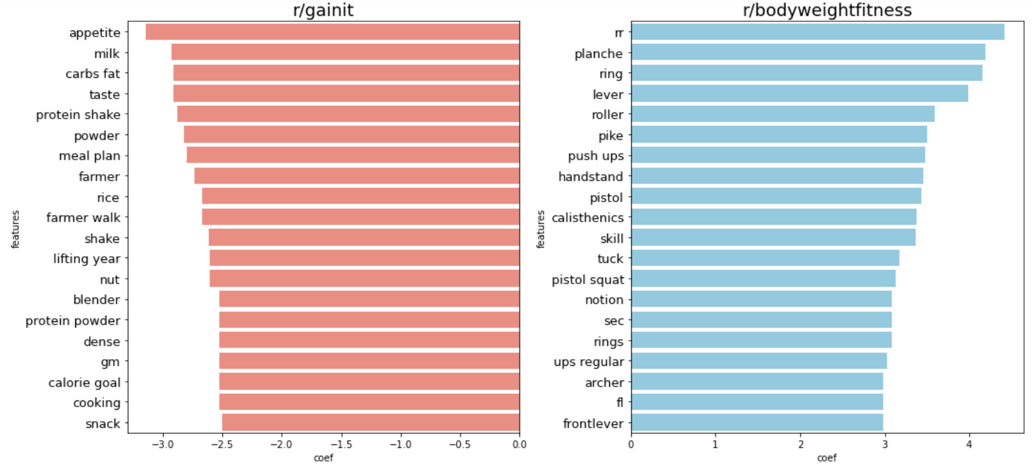
Modeling: naïve bayes w cvec
Primary words for each subreddit!
Diet & nutrition
Advance techniques
Appetite, protein, meal plan
rr, planche, lever, pistol squat

Slide 17
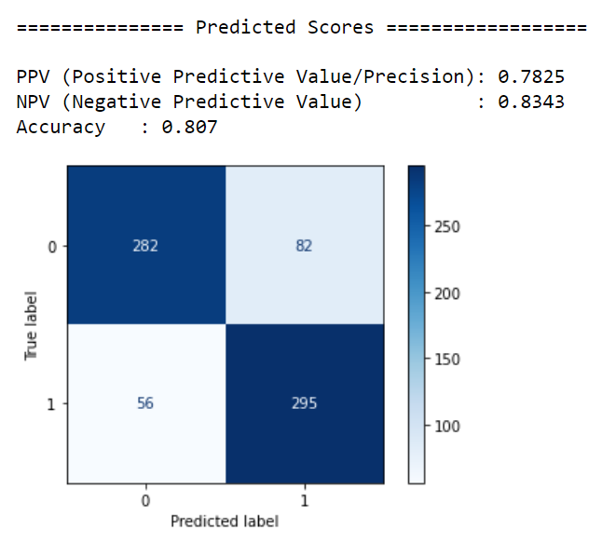
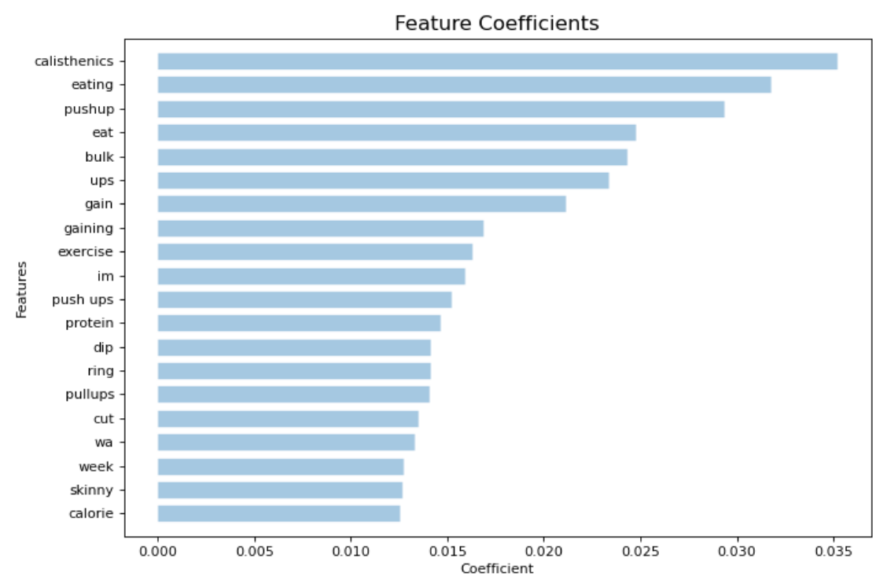
Modeling: random forest w tvec

Slide 18
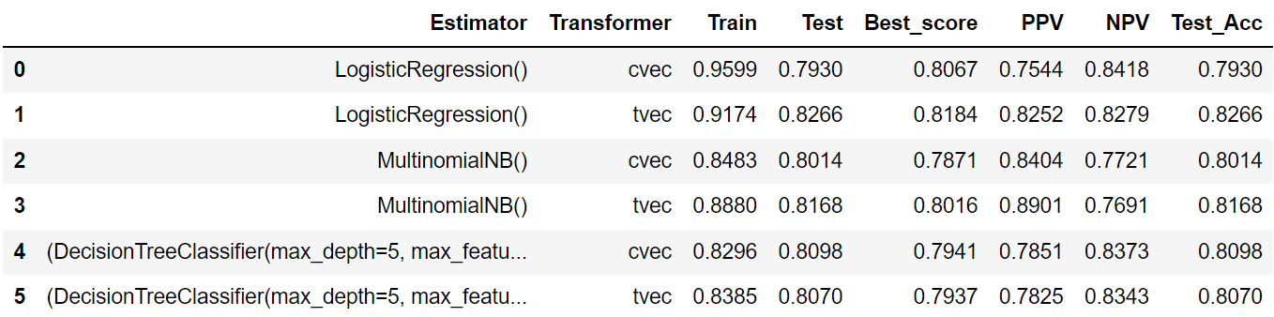
Performance summary
DECREASE FP
INCREASE PPV
DECREASE FN
INCREASE NPV
r/gainit
r/bodyweightfitness

Slide 19

conclusion
Production model: Logistic Regression with TF-IDF Vectorizer
Accuracy, PPV, NPV scores above 0.8
Some posts could belong to either subreddits
Model limitations
Fine-tune further on production model, avoid overfitting
Explore other complex estimators that might have the potential to be more accurate

Slide 20
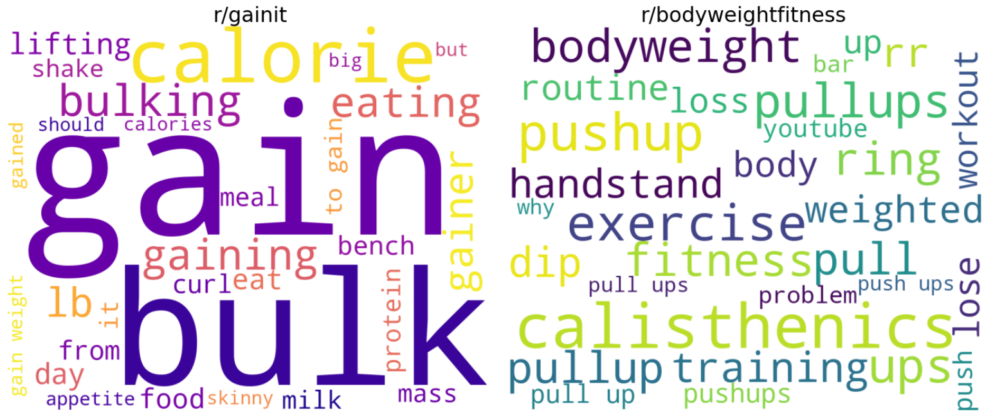
THANK YOU

